Slide 1
PRESENTATION
Swati Dinakar Ghatage
Assistant Professor(CHB)
Department of Chemistry
PDVP College, Tasgaon

Slide 2
"It has become appallingly obvious that our technology has exceeded our humanity."
-Albert Einstein
"There's Plenty of Room at the Bottom"
-Richard Feynman

Slide 3
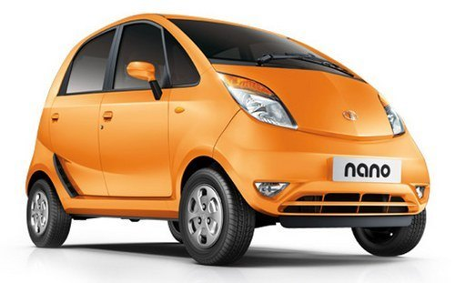
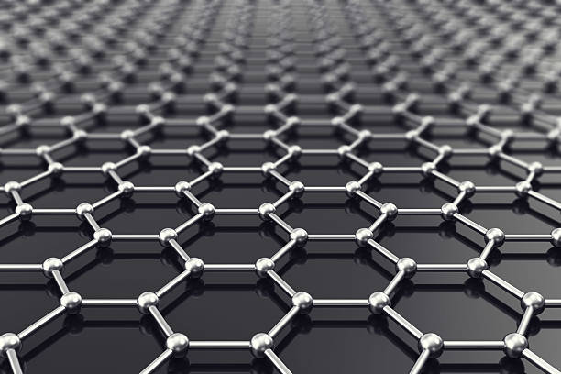
NANOTECHNOLOGY

Slide 4
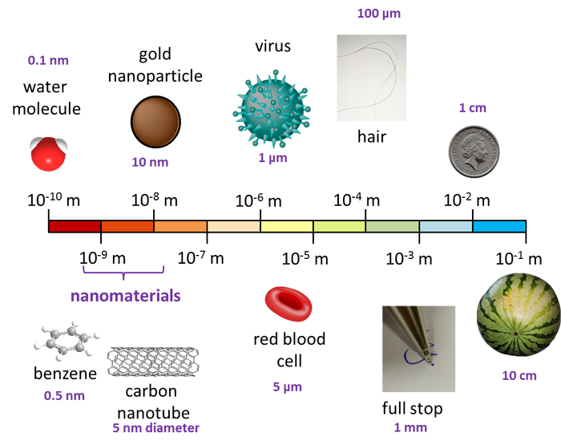
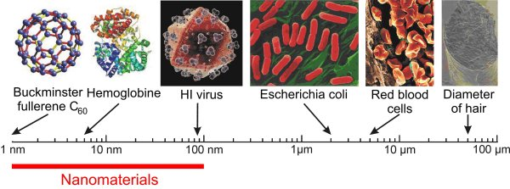
Going down on the Scale:
One nanometre is the length of just seven carbon atoms in a row; 100,000 nm span the thickness of a human hair.

Slide 5
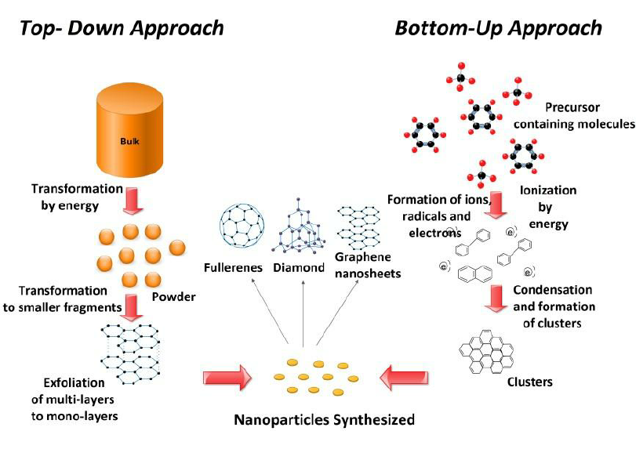
Synthesis and Characterization of Nanomaterials

Slide 7
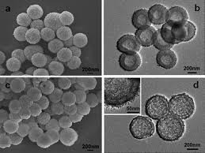
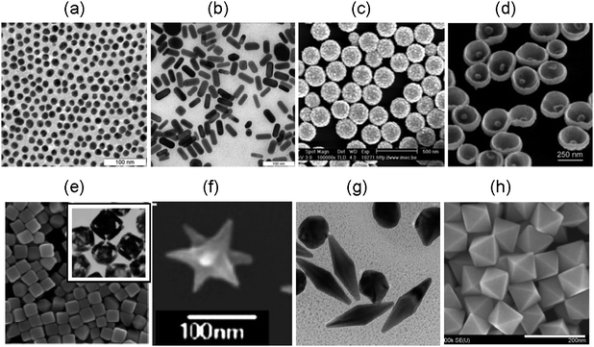
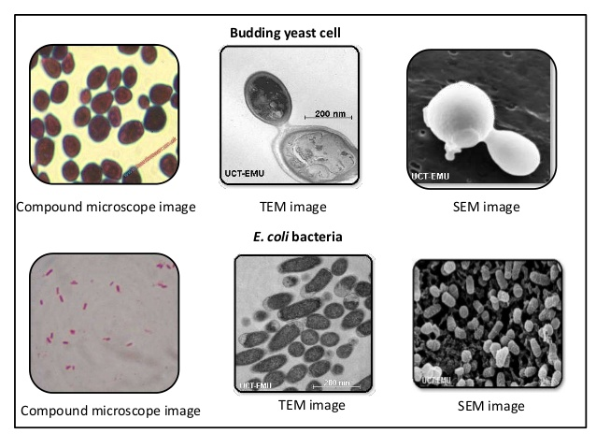
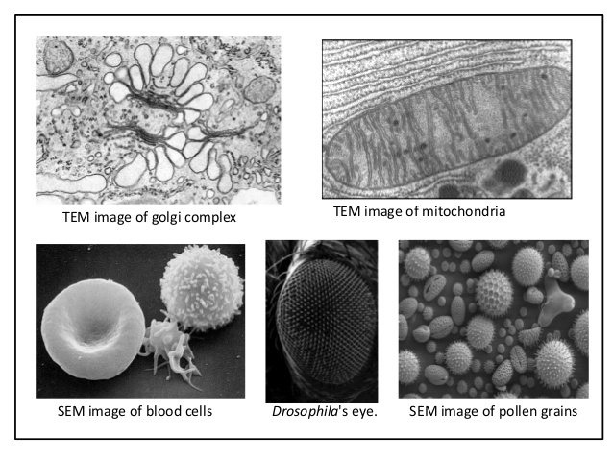
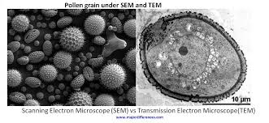
SEM & TEM Images

Slide 8
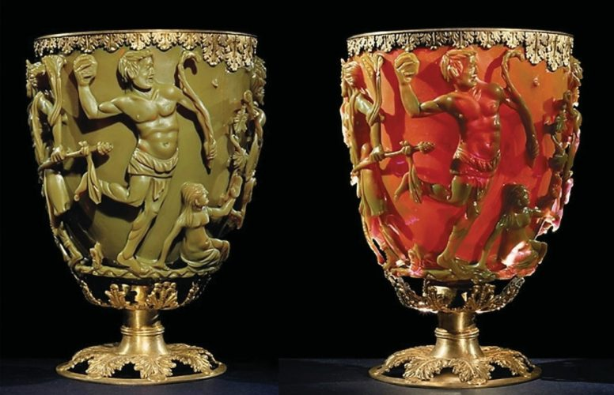
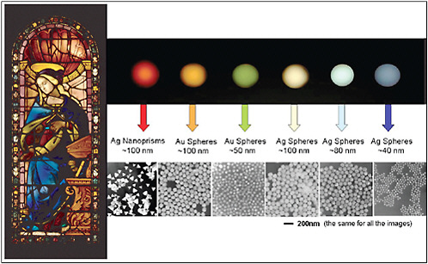
The Ancient Romans. Thousands of years ago, they used metal nanoparticles to create eye-catching colours and other optical effects in stained glass artefacts.
The Lycurgus Cup
In 1990 scientists Barber and Freestone, from the University of Essex and the British Museum Research Laboratory respectively, studied a sample of the cup under a transmission electron microscope (TEM) and discovered the presence of metal nanoparticles with diameters ranging from 50-100 nm. Further X-ray analysis revealed that the composition of these nanoparticles was approximately 70% gold and 30% silver.
Ancient Coloured Glasses

Slide 9
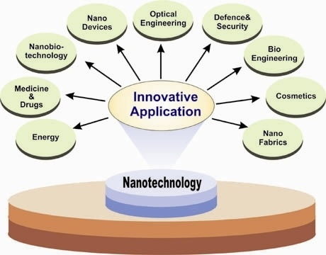
APPLICATIONS

Slide 10
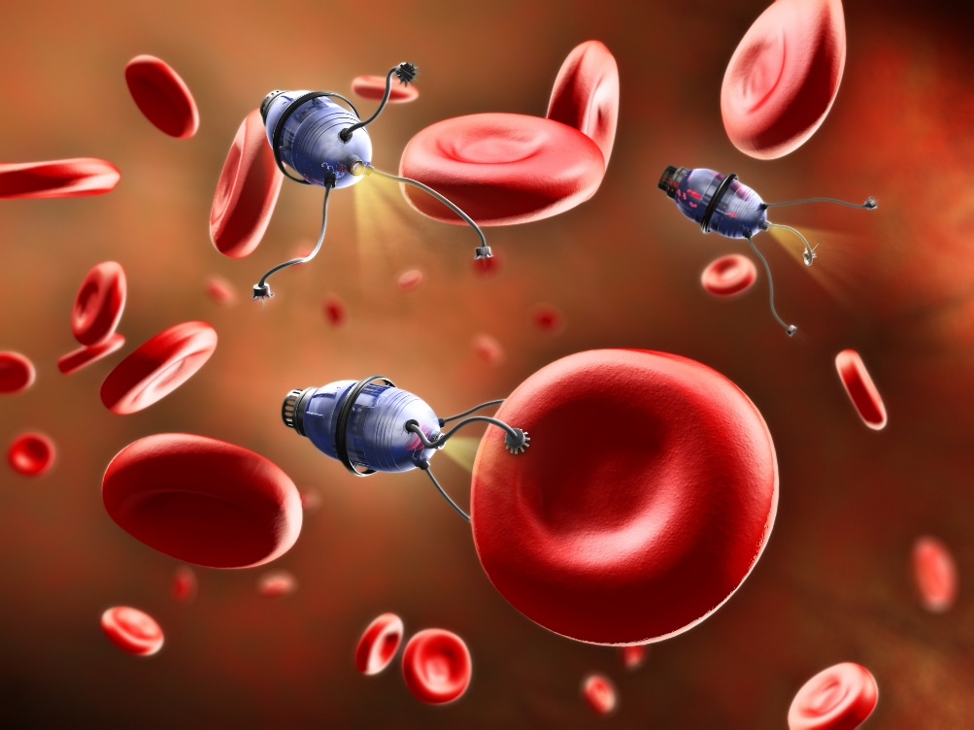
Nanotechnology in food and medicines:
Nanotechnology isn’t just protecting your food – it’s in your food. Scientists are manufacturing nano-sized vitamins that are easier for our bodies to absorb. In the future they hope to create ‘interactive’ food – food and drink that could change colour, flavour or nutrients on demand.

Slide 11
Cancer Treatment
The use of nanotechnology in cancer treatment offers some exciting possibilities, including the possibility of destroying cancer tumors with minimal damage to healthy tissue and organs, as well as the detection and elimination of cancer cells before they form tumors.
Most efforts to improve cancer treatment through nanotechnology are at the research or development stage. However the effort to make these treatments a reality is highly focused

Slide 13
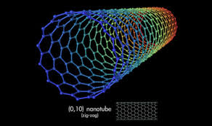
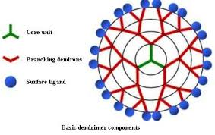
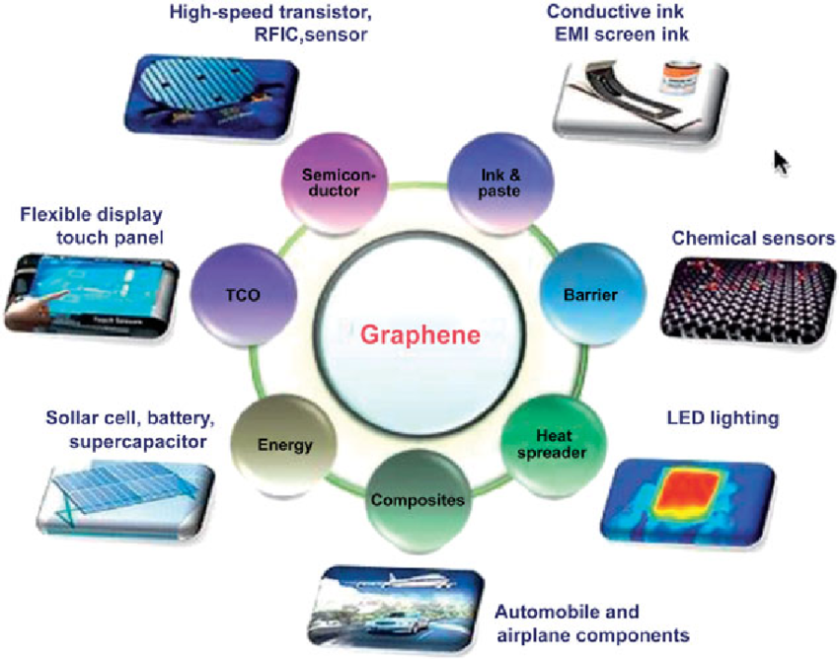
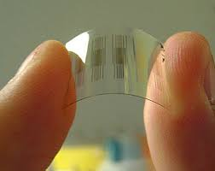
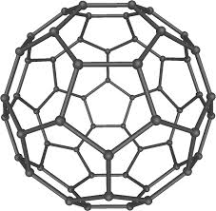
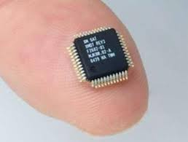
Carbon Nanotubes
Dendrimers
Tools of Nanotech
Nano Sensor
NanoChips
Fullerenes

Slide 14
Nano Modified Fabric:
Making composite fabric with nano-sized particles or fibers allows improvement of fabric properties without a significant increase in weight, thickness, or stiffness as might have been the case with previously-used techniques. For example incorporating nano-whiskers into fabric used to make pants produces a lightweight water and stain repellent material.

Slide 15
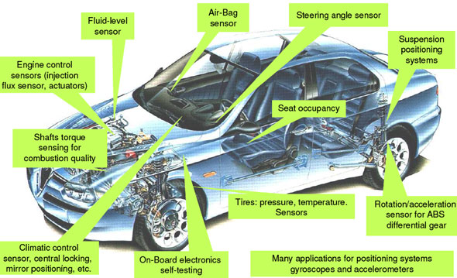
Nanotechnology for cars
The basic trends that nanotechnology enables for the automobile are
lighter but stronger materials (for better fuel consumption and increased safety) improved engine efficiency and fuel consumption for gasoline-powered cars (catalysts; fuel additives; lubricants) reduced environmental impact from hydrogen and fuel cell-powered cars improved and miniaturized electronic systems better economies (longer service life; lower component failure rate; smart materials for self-repair)

Slide 16
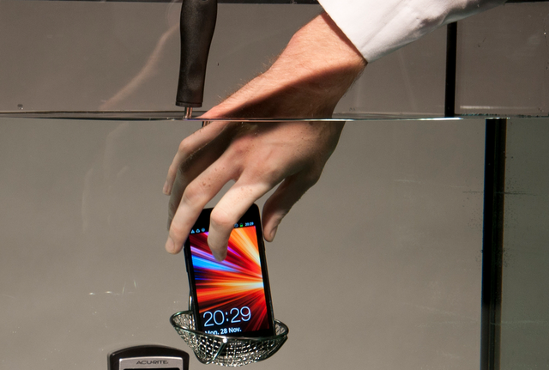
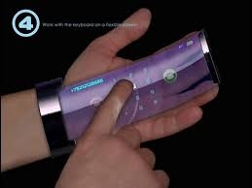
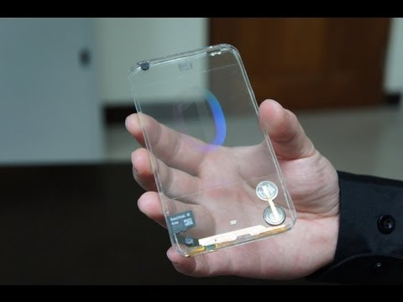
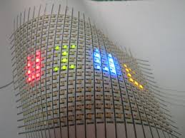
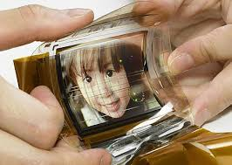
Nano Enriched Electronics & Mobiles

Slide 17
Building made by using self-cleaning concrete ‘‘Dives in Misericordia”, Church, Rome, Italy

Slide 18
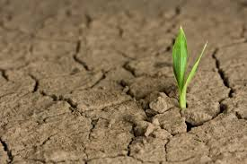
Disadvantages
The potential dangers to humans and the environment
Loss of manufacturing and agricultural jobs
Economic market crashes related to a potential lower value of oil due to more efficient energy sources and gold or diamonds, materials that can be reproduced with molecular manipulation
Accessibility of weapons of mass destruction
Improved atomic weaponry
The cost of research and products made from nanoparticles
…..everything comes with a price the only thing you have to do is be willing to pay that price………….

Slide 19
Reference
The data has been collected from Wikipedia and various Nanotechnology related websites.

Slide 20
Thank You….

