Slide 1
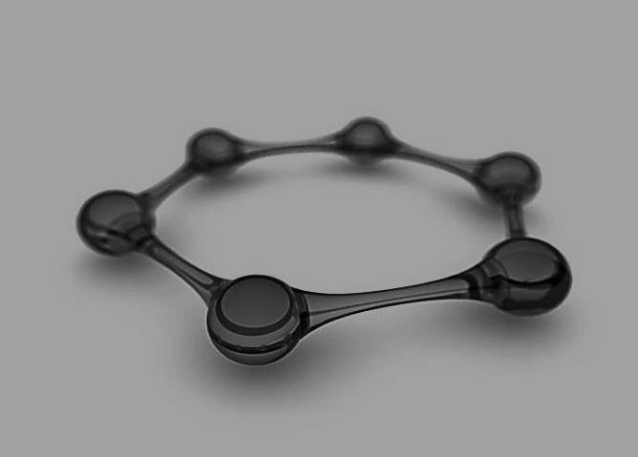
AROMATICITY
By
Mr. Ashutosh A. Jagdale
Assistant Professor
PDVP Mahavidyalaya, Tasgaon,
Dist-Sangli 416312.

Slide 2
Subject Index
♣Aromatic compounds
♣Hϋckel’s law
♣Delocalization
♣NMR characteristics

Slide 3
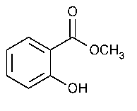
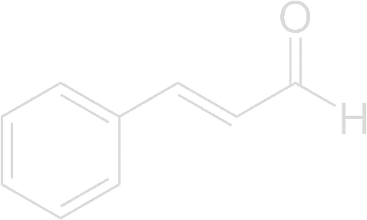
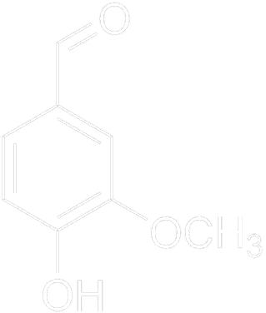
What are aromatic compounds ?
♣Distinctive odour.
Eg. Wintergreen oil Cinnamon Vanilla

Slide 4
Benzene and benzene derivatives are known as aromatic compounds.

Slide 5
Hϋckel’s Law
If the compound is cyclic,planar, fully conjugated & posses (4n +2) π electrons, then it is an aromatic compound.
If the compound is cyclic, planar, fully conjugated & posses 4n π electrons, then it is an anti-aromatic compound.
where n is any integer like 1,2,3,……..

Slide 6

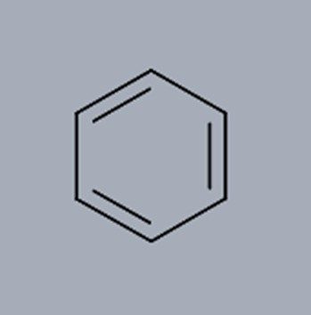
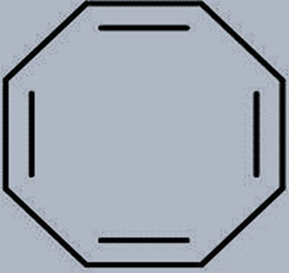
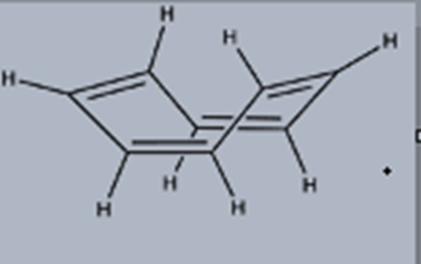
Anti-aromatic
Aromatic
Anti-aromatic
Non-aromatic

Slide 7
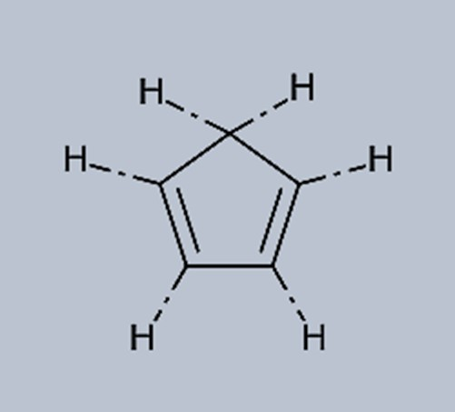
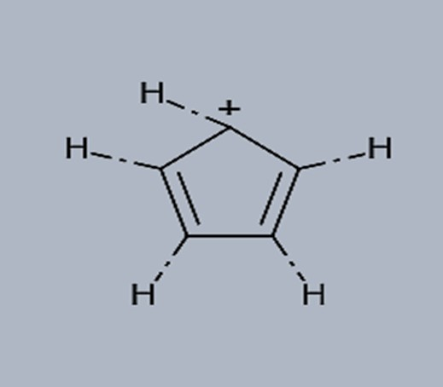
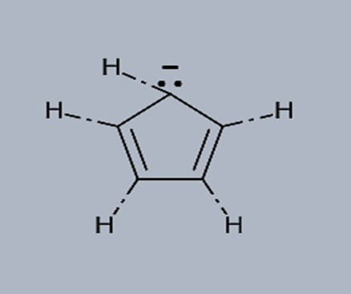
Cyclopentadienyl cation
Cyclopentadiene
Non-aromatic
Anti-aromatic
Cyclopentadienyl anion
Aromatic

Slide 8
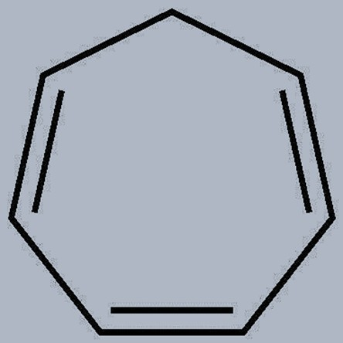
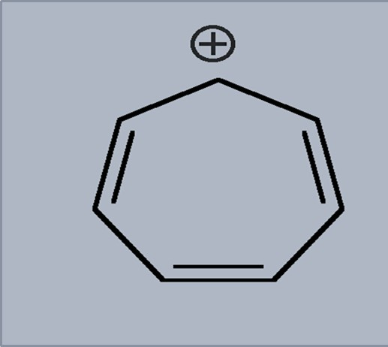
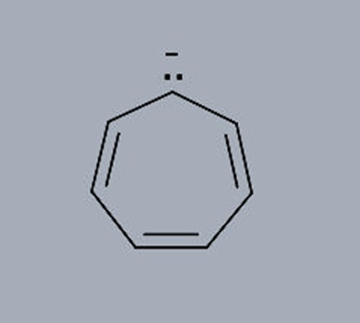
Cycloheptatriene
Cycloheptatrienyl cation
Cycloheptatrienyl anion
Non-aromatic
Aromatic
Anti-aromatic

Slide 9
Aromaticity
♣The term aromaticity is used to describe aromatic compounds properties:
Highly stable.
Undergoes substitution reaction rather than addition reaction.
The C-C bond length (1.39Å), intermediate between single (1.47Å)& double (1.34Å) bonds.

Slide 10
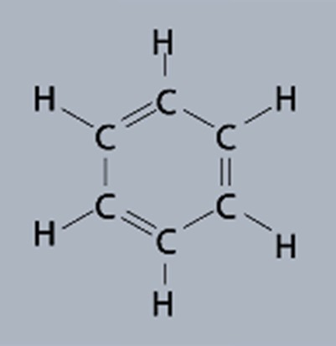
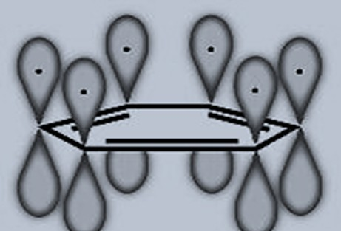
Delocalization:
All C atoms are sp² hybridized

Slide 11
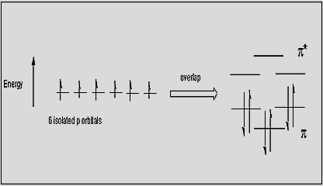
Molecular orbital diagram

Slide 12
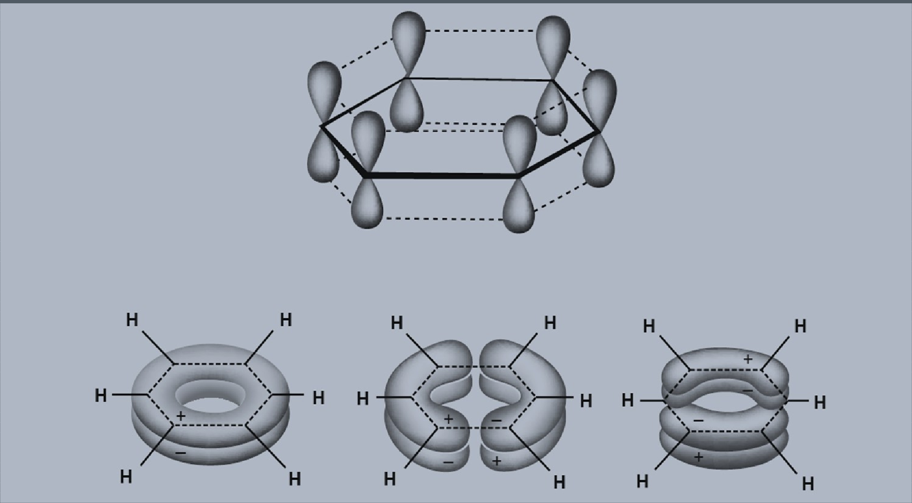
Bonding orbitals

Slide 13
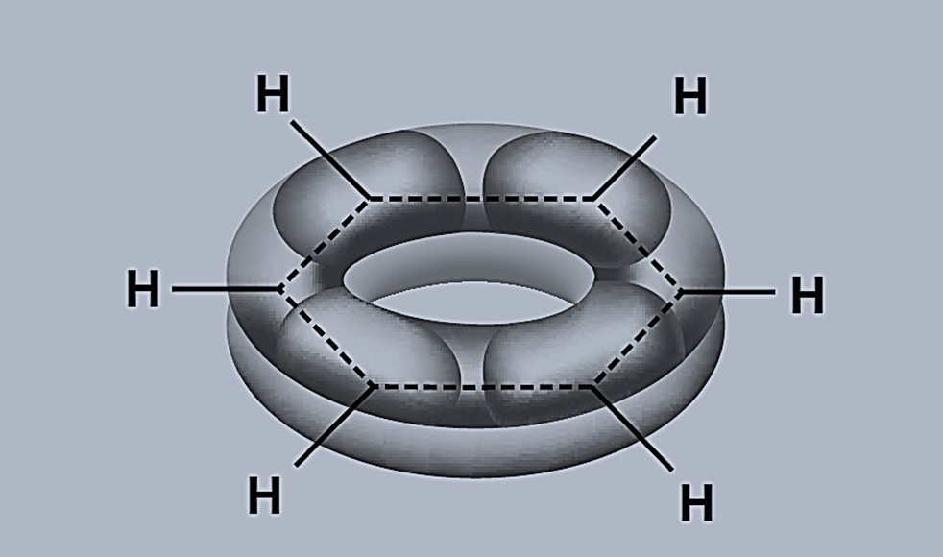
Doughnut shaped structure

Slide 14
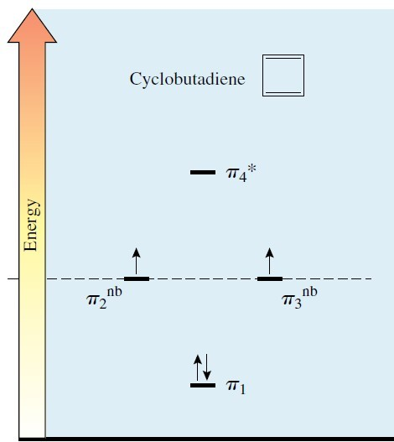
MOD of cyclobutadiene

Slide 15
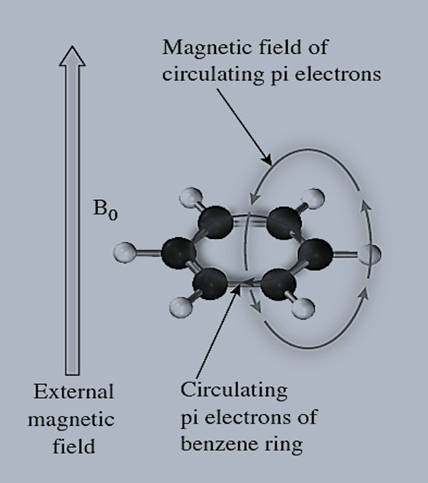
NMR characteristics
Aromatic compounds are called diatropic. It can sustain a induced ring current.
Protons on the ring are deshielded while protons above & below the plain of molecule are shielded.
Protons of benzene are located at 7-8ʆ.

Slide 16
NMR characteristics of anti-
aromatic compounds
Anti aromatic compounds show paramagnetic ring current.
Protons on the ring are shielded while protons above & below the plan of molecule are deshielded.

Slide 17
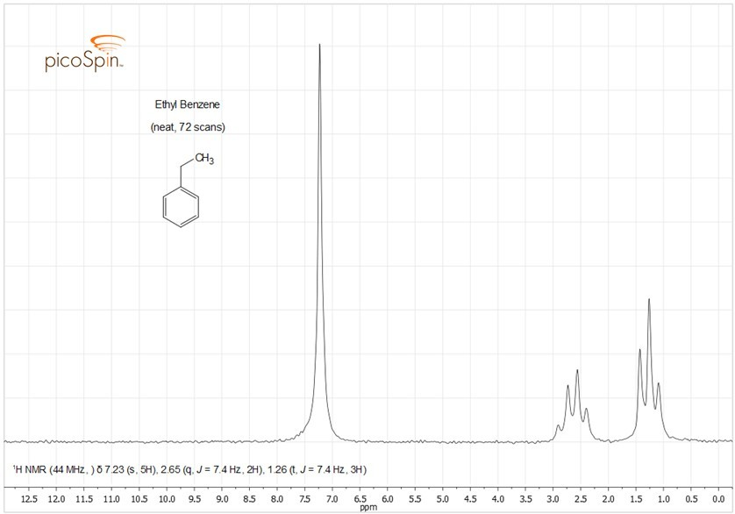

Slide 18
Questions ???????

Slide 19

Bibliography
March’s Advanced organic chemistry.
Advanced Organic Chemistry Part A - Structure and Mechanisms, 5th ed (2007) - Carey & Sundberg
www.picospin.com
www.wikipedia.com
www.wikictionary.com

Slide 20


