Slide 1
CHROMATOGRAPHY
B.Sc. III
Dr. Ajay N. Ambhore

Slide 2
INTRODUCTIO
It is an extremely valuable technique for the separation, isolation, purification and identification of compound of a mixture and also to check the purity of compound.
separation
chemical properties
physical properties
Purification
Fractional crystallization
Fractional distillation

Slide 3
First developed by MICHAEL TSWETT (1906)
Separation of plant pigment on CaCO₃ column by running
petroleum ether
Numerous modifications are done on the original technique
and today we use the chromatography technique for the
separation of coloured, colourless, simple and complex
mixture

Slide 4
Advantages
Separate mixture which are chemically similar and
physically resemble
Separation at R.T. or even below it
Method is sensitive
Method is simple and rapid
Most of the equipments are simple and inexpensive
Thus chromatography may be regarded as an
analytical technique employed for the purification and
separation of organic and inorganic compounds

Slide 5
GENERAL PRINCIPLE
Chromatography technique consist of two phases
Stationary (fixed) Phase:-
May be solid or liq.
Called SORBENT
If sorbent is liq. It is supported by a solid called MATRIX
Mobile phase:-
Called SOLVENT / DEVELOPER
(The component of the mixture to be separated is called
SOLUTE)

Slide 6
The mobile phase percolates continuously over the surface
of stationary phase.
Mobile phase (solvent action) exert a driving force on the
solute of mix.
Stationary phase (adsorption action ) tend to retain the solute
in the position held by them.
Solute of mix. Subjected to two opposing forces by
stationary and mobile phase.

Slide 7
The extent of these force is different on different component
of the mix.
The distribution of solute between the two phases occurs
rapidly to establish an equilibrium.
But due to the continuously flow of the fresh mobile phase
this equilibrium is not achieve

Slide 8
This situation is expressed by following equation
Greater the K value of a given solute, greater is the retarding
force on it
Less the K value of a given solute, greater is the driving
force on it
For different type of chromatography only the nature of
operating force involved is different but the basic principle
remain same

Slide 9
CLASSIFICATION OF CHROMATOGRAPHY
Based on force operating on separation
Five main class of chromatography based on the force
operating in separation
Sr. No. | Type of Chromatography | Force operating
1 | Absorption | Surface active force
2 | Partition | Distribution force
3 | Ion exchange | Ion exchange force
4 | Affinity | Ligand attractive force
5 | Permeation | Molecular sieving

Slide 10
Classification based on nature of mobile and stationary phase
CHROMATOGARPHY
GAS
GSC
GLC
LIQUID
COLUMN
PLANER
LSC
TLC
PAPER
IEC
EC
LLC
BPC
HPLC
GPC
GFC

Slide 11
PAPER CHROMATOGRAPHY
First introduced by Schonbein (1961) and A.J.P. Martin
(1964)
Liquid - Liquid type chromatography
Stationary phase:- liquid Mobile phase:- liquid
Paper _ mechanical support for liquid stationary i.e.
MATRIX
Stationary phase – aq. Phase – adsorb strongly in between
the cellulose fibers
Mobile phase – non aq. /org. phase

Slide 12
Component of the mixture distributed in these two phase
in a ratio characteristic of their distribution coefficient
Only those component which are differ in their K value
under the given condition are separated

Slide 13
Important aspects
Filter Paper :-
Choice of filter paper :- depends upon natural of material
and purpose of separation
Cellulose is the basic material of the paper used in paper
chromatography
Verity of paper eg. Slow, medium, fast
Strongly hold aq. Solvent

Slide 14
In some special case like separation of fatty acids, lipids etc.
an org. phase is used as stationary phase while aq. phase as
mobile phase
Usually whatmann filter paper No. 1 is used – uniform flow
rate, grain size and texture
Remove the impurities by washing the paper with acid

Slide 15
Solvent system :-
Depends upon the nature of substance to be separated
Solvent must be in combination with stationary and mobile phase i.e.
org. and aq. solvent
Use acetic acid, formic acid, hydrochloric acid, ammonia, pyridine etc
for more incorporation of water in org. solvent
Ex. :-
Amino acid – Butanol : Pyridine : Water ­ - - - - Ninhydrine
33 : 33 : 33
Carbohydrates – Butanol : Acetic acid : Water ---Ammoniacal AgNO₃
Carotenoids - Chloroform : HCl ------ Rubanic acid,Ammonia

Slide 16
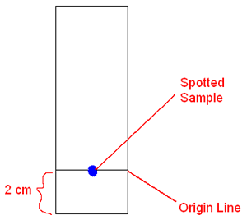
Preparation of sampling :
Solid dissolve in suitable solvent
Animal or plant extract also dissolve in suitable solvent
Applied with the help of capillary
Sample loading:
Reference line 2cm from the bottom
Loading as a spot or as a line
Repeat twice or thrice after drying each time

Slide 17
Developing:
Hanged in chromatographic chamber or jar containing
solvent
Spotted side edge just dip in the solvent
after some time paper taken out and dried
use spraying agent

Slide 18
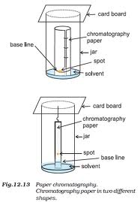
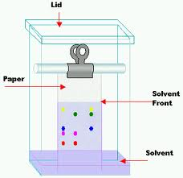
Types of paper chromatography
1) Ascending Chromatography

Slide 19
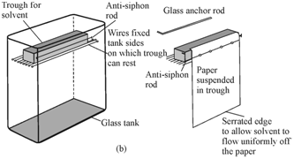
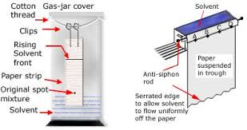
2) Descending Chromatography

Slide 20
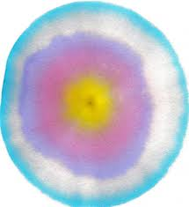
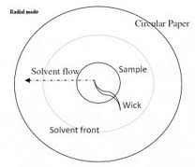
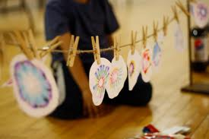
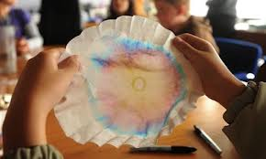
3) Radial or Circular Chromatography

Slide 21
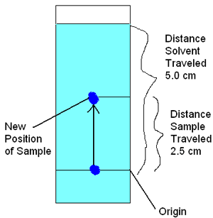
Rf value (Rate of flow)
It is the ratio of the distance moved by the
solute to the distance moved by the solvent
Rf value is Constance for any substance
relative to solvent
It is function of the partition coefficient

Slide 22
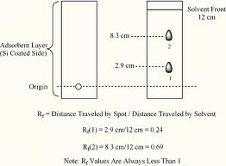
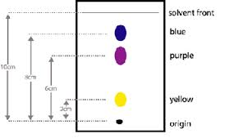

Slide 23
Rf value is depends upon :-
Nature of substance to be separate
Solvent system used
Quality and size of paper used
Temperature
Size of developing chamber

Slide 24
Application of paper chromatography
Used in separation and purification process
Rapid analysis of certain organic mixture
Used for the analysis of mix. of amino acids,
polypeptides, etc
Used for analysis of sugar mix.
Also used in blood and urine diagnosis test
Used for separation of alkaloids, lipids, plant and
animal extract etc.

Slide 25
COLUMN CHROMATOGRAPHY
Developed by an American petroleum chemist D.T. Day
(1900)
Stationary phase use in the form of column
Also known as adsorption chromatography
Solid –Liquid type chromatography
Stationary phase – solid : Mobile phase – liquid

Slide 26
Basic principle of separation is selective adsorption o the
surface of adsorbent
Adsorption is a surface phenomenon hence degree of
separation is depend upon surface area
Adsorption caused by electrostatic attraction, hydrogen
bonding, complexation, Van der Wall’s forces etc.
For good separation adsorbent must be of uniform particle
size and high surface area

Slide 27
Mixture dissolves in a suitable solvent
Pass through the column containing adsorbent
Component of the mix. having breather adsorption power
is adsorbed in the upper part and those having lower
adsorption power adsorbed in lower part of the column
By this method selective adsorption takes place in the from
of bands
The various bands of adsorbent is called chromatogram

Slide 28
Experimental technique:-
Apparatus:-
Column:
Standard ration of length to diameter is 40:1
For best separation long thin column is best
Wide column is use for large quantity of mixture
Installation of column is depending upon the
temperature condition

Slide 29
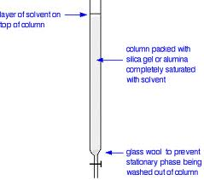
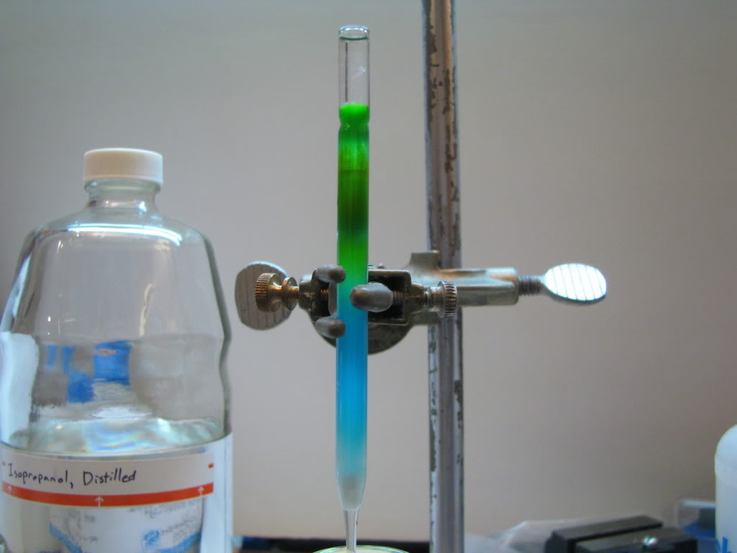
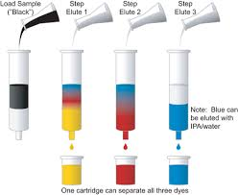

Slide 30
Adsorbent:
For good column adsorbent must have following characteristics
Particles of adsorbent are spherical in shape and in uniform size
Must be stable
Chemically inert
Catalytically inactive and neutral surface
Should be colourless

Slide 31
Ex. : commonly used :-
Activated Al₂O_{3,}
Silica gel,
activated charcoal,
magnesium oxide,
magnesium carbonate,
calcium sulphate etc.

Slide 32
Preparation of column:
First wool or cotton plug is used for the column
Preparation of column by dry adsorbent and uniform
pressing after addition of each lot to get uniform column
Preparation by using slurry of the adsorbent in a suitable
solvent (pet ether, chloroform, benzene etc.)

Slide 33
Eluent : (Solvent/ mobile phase)
Depends upon nature of solute and solubility of the mixture
Must possess B.P. between 40⁰c to 85⁰c
Avoid too fast and too slow eluent
Commonly used solvent are:
Pet ether, C₆H_{12,} CCl_{4,} C₆H₆, CHCl₃, Ab. Alcohol, Ethyl
acetate, Pyridine, Acetone, Methanol, water, formaldehyde,
etc.

Slide 34
Experimental procedure:
Column packing
Application of sample
Development
Detection: optical detector, flame ionization detector,
conductivity detector etc. For colourless component

Slide 35
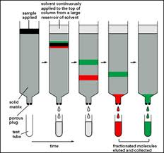
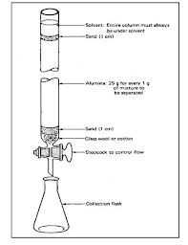
Extrusion method Elusion method

Slide 36
Application of column chromatography
Separation of 17- ketosteroids
Separation of geometrical isomers
Separation of diastereomers, tautomers
For remove small impurities
Purification of solvent use in spectroscopic studies
Identification of component by comparing the band with
known component

Slide 37
THIN LAYER CHROMATOGRAPHY
First introduced by IZMAILOV and SHRAIBER (1938)
The chromatography using thin layer of adsorbent held on
glass plate is known as Thin Layer Chromatography
Similar to paper chromatography
Separation takes place on a layer of finely divided adsorbent

Slide 38
Adsorbent or coating material
Variety of adsorbent are use which depends upon component
of separation
Commonly used coating materials are:
Calcium phosphate, Magnesium trisilicates, silica gel,
alumina, cellulose, etc.
Use of binding material with the adsorbent to adhere to the
glass plate
Ex. : Gypsum, starch, hydrated silicon oxide, etc.
Coating takes place by different method like Spreading, Spraying,
Dipping method
Most common method for uniform coating is Spreading technique

Slide 39
Solvent system
Chose of solvent depends upon
Nature of substance to be separate
Adsorbent on which the separation to be carried out
Almost all those solvent which are used in paper and
column chromatography
But the combination of two or more solvent gives better
result
A typical solvent system used in TLC is n-hexane-diethyl
ether- acetic acid in 90:10:01 ratio

Slide 40
Experimental technique
Preparation of TLC plate:
Adsorbent apply in the form of slurry to get uniform layer
Applying by using applicator or spreader for thin layer
Sample application
By micropipette or microsyringe or fine capillary

Slide 41
Development
Same development tank used in paper chromatography
Plate placed at an angle of 45⁰
Take out when solvent reaches to required height
Detection or location of component
For colourless use of UV light or visualizing
reagent(chromic acid, sulphuric acid, iodine, etc.)
Calculation Rf value

Slide 42
Application of TLC
For qualitative and quantitative analysis
Separation of amino acids, vitamins, alkaloids, alcohol,
sugar, etc.
Preparative method by using thick layer
Separation of organic mixture

Slide 43
Advantages over paper and column chromatography
Required less amount of substance
Required less time for development
Separated spots are concentrated and sharp
Strong acid can be use for spraying
Use in high temperature
Corrosive component are also use for separation

Slide 44
GAS CHROMATOGRAPHY
Similar to column chromatography
Gas is used as a mobile phase instead of liquid
Two types of gas chromatography
GSC :
Based on selective adsorption on solid
First developed by G.D. Kholer and K. Thiele (1943)
GLC:
Based on partition between gas and liquid
First developed by A.J.P. Martin (1951)

Slide 45
Gas chromatography is used to separate the mixture of
volatile component by partition between stationary solid/
liquid phase and mobile gaseous phase
Major factors are the speed, resolving power and sensitivity
of the technique
Separation of ten isomers of heptanes in less than ten second

Slide 46
Carrier gas:
Chemically inert and available in low coast
Ex.:
Hydrogen gas : more advantages than other gas but dangerous due to its explosive nature
Nitrogen gas : it gives reduced sensitivity
Helium gas: generally used because of its excellent thermal conductivity, inertness, low density and great flow rate (expensive)

Slide 47
Sample injector:
Solid by dissolving in suitable solvent
Liquid by syringe
Gas by special gas sampling valve
Temperature must not be so high that it will not decompose
sample

Slide 48
Column:
Made up of glass or metal tubing and has 4.8 mm in
diameter
May be in the form of coil, bent or straight
Packed column:
Made by glass or metal tubing
For GSC column packed by size graded adsorbent or porous
polymer
For GLC coating of liquid over size graded solid support

Slide 49
Open tabular column:
Mainly use for GLC
Also known as capillary column
Made by long capillary tubing (30 – 90 meter) having
uniform and narrow internal diameter (0.025-0.075 cm)
Made by stainless steel, copper, nylon or glass
Liquid coating in the form of thin layer
Flow of gas with least resistance

Slide 50
Support coated open tabular column:
Made by micron sized porous layer of support material on
the inner wall of capillary and then coating with thin film of
liquid phase
More sample capacity
Adsorbents in column:
For GSC : polymer of styrene, divinely benzene, carbon,
calcium zeolite, etc.
For GLC : solvent use in column chromatography

Slide 51
Detector :
Carrier gas coming out form the column passes into the
detector and gives the electrical signal
Signal response is proportional to the concentration of the
substance present in the carrier gas
Use different detector like conductivity detector, flame
ionization detector, electron capture detector

Slide 52
Applications
Separation of hundred of hydrocarbons in peteroleum
industries by GLC
Separation of benzene and cyclohexane by GLC
Automobile exhaust gas pollution hazards
Human blood, urine
Aromas and flavors of flowers and food by GLC
Purity of sample
Study of reaction mechanism

Slide 53
THANK YOU

