Slide 1

Organometallic Compounds
Presented by
Mr. Ashutosh A. Jagdale
Assistant Professor
PDVP Mahavidyalaya, Tasgaon,
Dist-Sangli 416312.

Slide 2
Organometallic Compounds
Chemistry of compounds containing metal-carbon bonds.
In many complexes, both σ- and π-bonding exist between the metal atom and carbon.
Types
Sandwich complexes, cluster compounds, and carbide clusters (to name a few).

Slide 3
Organometallic Compounds
The 1st – Ziese’s compound/salt (Sec. 13-1).
The organic molecule is attached to the metal via the π electrons of the ethylene ligand.
Compounds with CO
Ni(CO)₄ – Mond (purification of Ni).
The Big Boom in Organometallic Chemistry
Synthesis of ferrocene (Sec. 13-1).
Began the era of modern organometallic chemistry.

Slide 4
Organic Ligands and
Nomenclature
A number of ligands may bond through different number of atoms.
The number is indicated by η (eta) followed by a superscript.
Ferrocene – contains the pentahaptocyclopentadienyl ligand.
hapto means to fasten
Do a few others.

Slide 5
The 18-Electron Rule
Total of 18 valence electrons on the central atom (there are many exceptions). Table 13-1 (Sec. 13-3-1).
Cr(CO)₆
(η⁵-C₅H₅)Fe(CO)₂Cl
(CO)₅Mn-Mn(CO)₅
(η³-C₅H₅)(η⁵-C₅H₅)Fe(CO)
In general, hydrocarbon ligands come before the metal.
HM(CO)₅ The metal is in the 1st row.

Slide 6
The 18-Electron Rule
18 electrons represent a filled valence shell for atransition metal.
Why do many complexes (if not most) violate the 18- electron rule?
The 18-electron rule does not consider the type of bonding and interactions. The interactions between the ligands and the metal need to be identified to determine if the complex will obey or violate the 18-electron rule. This treatment will also identify why in many cases.

Slide 7
Interactions between the
Ligands and the Metal
Examine the MO diagram for Cr(CO)₆.
This includes interactions between the d-orbitals and the σ-donor/π- acceptor orbitals of the six ligands.
Understand this diagram in terms and strengths of the different types of interactions.
18-electron is the most stable for this type of complex.
Assuming the d-orbitals to be at similar energy levels, which complex would you predict to be the most stable?
Complexes that possess ligands that are both strong σ donors and π acceptors should be the most likely to obey the 18-electron rule.

Slide 8
Interactions between the
Ligands and the Metal
How about ligands that have different donor and acceptor characteristics?
Ethylenediamine is a σ donor, but not as strong as CO. Why affects does this have on the diagram studied previously?
The [Zn(en)₃]²⁺ complex is stable. How many electrons?

Slide 9
Interactions between the
Ligands and the Metal
How about TiCl₆²⁻? It has 12 electrons. Can you justify this with an interaction diagram?

Slide 10
Interactions between the
Ligands and the Metal
Square-planar complexes (16-electron).
Examine Figure 13-11 (Section 13-3-3).
The ligand is a good σ donor and π acceptor.
Understand the interactions and influences on stabilization of the complex.
The 16-electron square-planar complexes are mostly encountered for d⁸ metals.
Oxidations states of +2 are common.

Slide 11
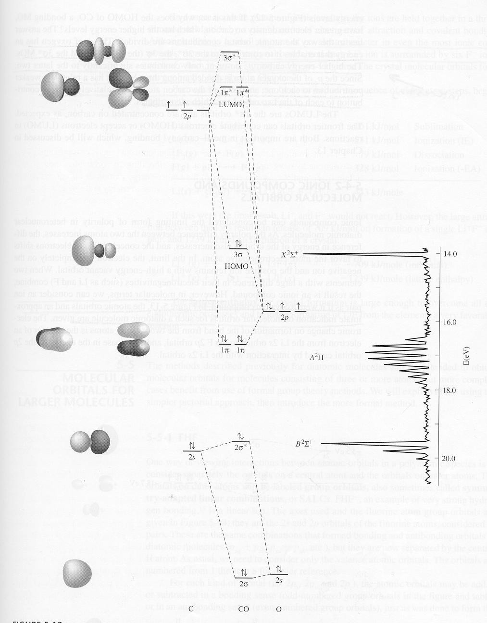
Ligands in Organometallic
Chemistry – Carbonyl Complexes
Examine the frontier orbitals (HOMO and LUMO)
Synergistic effect
σ donor/π acceptor
Spectroscopic evidence?
Bond lengths are vibrational frequencies.
Figure 5-14

Slide 12
Ligands in Organometallic
Chemistry – Carbonyl Complexes
How will the interaction diagram appear for a binary octahedral compound?
HOMO – These will have the same symmetry characteristics as a p_{y} orbital (previously).
Γ_{red}(HOMO) – A_{1g} + E_{g} + T_{1u}
LUMO – These will have the same symmetry characteristics as the p_{x} and p_{y} orbitals (previously considered).
Γ_{red}(LUMO) – T_{1g} + T_{2g} + T_{1u} + T_{2u}

Slide 13
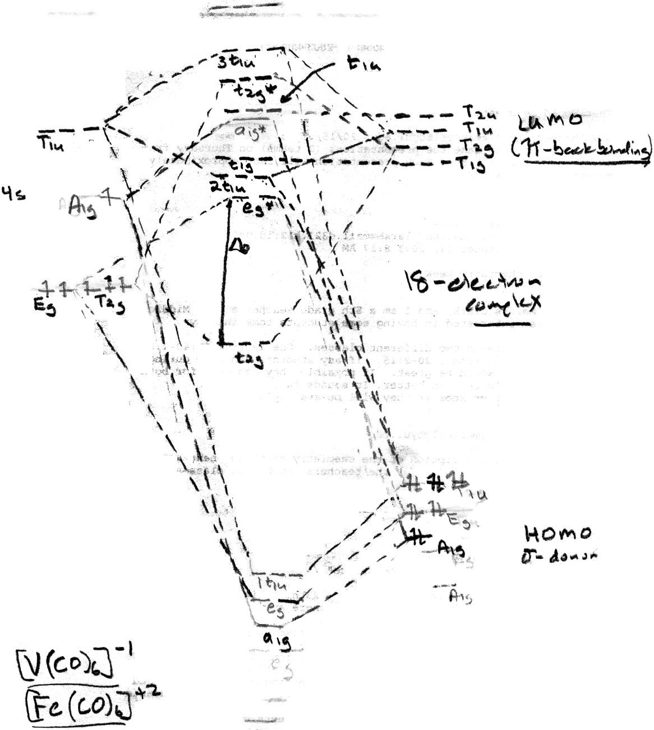

Slide 14
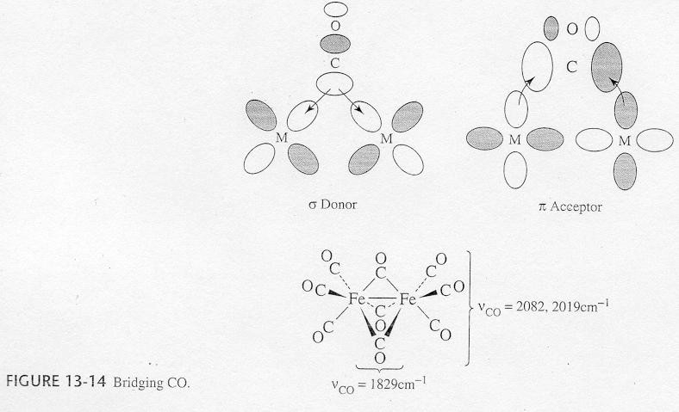
Bridging Modes of CO
CO can also form bridges between two or more metals.
Position of C-O stretching mode. Why is there a general decrease in frequency with increasing metal centers?

Slide 15
Ligands in Organometallic
Chemistry – Carbonyl Complexes
Most binary carbonyl complexes obey the 18-electron rule.
Why?
Why doesn’t V(CO)₆ form a dimer to obey the 18-electron rule?
The tendency of CO to bridge transition metals decreases going down the periodic table. Why?
No synthesis discussion.

Slide 16
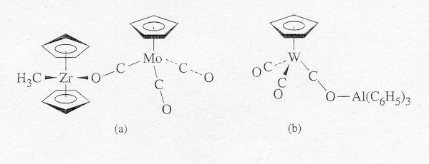
Ligands in Organometallic
Chemistry – Carbonyl Complexes
Oxygen-bonded carbonyls
Occasionally, CO bonds through the oxygen atom in addition to the carbon atom.
Attachment of a Lewis acid to the oxygen weakens the CO bond.

Slide 17
Ligands Similar to CO
CS, CSe, CN⁻, and N₂
CN⁻ is able to bond readily to metals having higher oxidation states.
CN⁻ is a good σ donor, but a weaker acceptor (cannot stabilize metals of low oxidation state).
No NO complexes.

Slide 18
Hydride and Dihydrogen
Complexes
Hydride complexes (e.g. [ReH₉]²⁻)
Only a 1s orbital of suitable energy for bonding
Must be a σ interaction (minimal basis set)
Co₂(CO)₈ + H₂ → 2HCo(CO)₄
Dihydrogen complexes
Ziese’s salt
What are the types of possible interactions? What happens to the H-H bond? Extreme case?

Slide 19
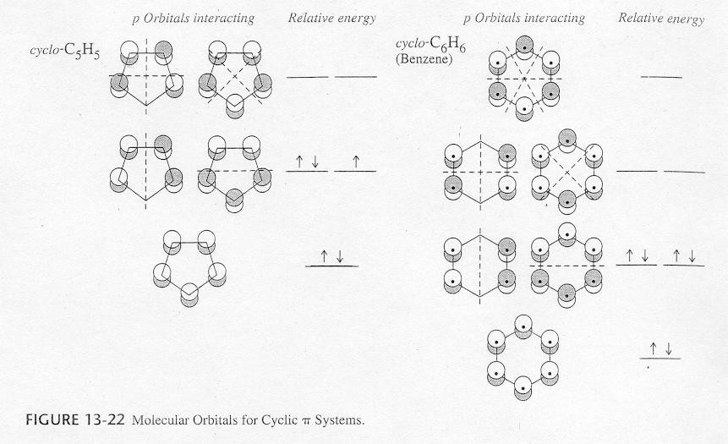
Ligands Having Extended π
Systems
Linear π systems
Ethylene, allyl, and 1,3- butadiene
Cyclic π systems
C₃H₃, C₄H₄, and Figure 13- 22.

Slide 20
Bonding Involving π Systems
Bonding between ethylene and a metal.
σ donation/π acceptance
If orbitals of appropriate symmetry are present (isolobal), an interaction may occur (Fig. 13-23).
Construct an MO diagram.
π-allyl systems (trihapto ligand)
Examine Fig. 13-25, could construct MO interaction diagram.
[Mn(CO)₅]⁻ + C₃H₅Cl → (η¹-C₃H₅)Mn(CO)₅ → (η³- C₃H₅)Mn(CO)₄ + CO

Slide 21
Cyclic π Systems
C₅H₅ (η¹, η³, or η⁵ bonding modes (η⁴ can also be observed)).
Ferrocene (η⁵-C₅H₅)₂Fe
Orbitals on the ligands and metal can interact if they have the same symmetry.
Strongest interaction is between orbitals of similar energies.
What is the point group?
Let’s give it the treatment!!

Slide 22
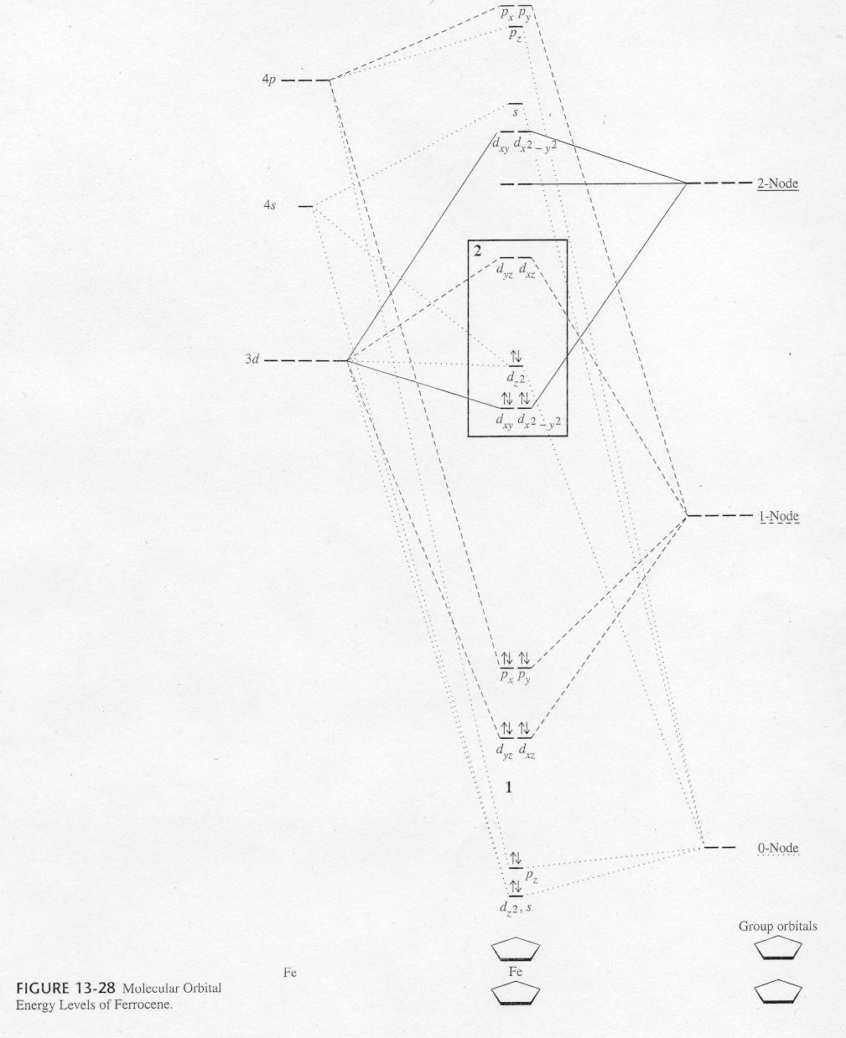

Slide 23
Fullerene Complexes (an
immense π system)
Adducts to the oxygens of oxmium tetroxide
C₆₀(OsO₄)(4-t-butylpyridine)₂
Complexes in which the fullerene itself behaves as a ligand
Fe(CO)₄(η²-C₆₀), Mo(η⁵-C₅H₅)₂(η²-C₆₀)
Compounds containing encapsulated metals
UC₆₀, Sc₃C₈₂

Slide 24
Fullerenes as Ligands
C₆₀ behaves primarily as an electron deficient alkene. Bonds to metals in a dihapto fashion through a C-C bond at the fusion of two 6-membered rings (Fig. 13-35).
[(C₆H₅)₃P]₂Pt(η²-C₂H₄)+C₆₀→[(C₆H₅)₃P]₂Pt(η²-C₆₀)
What affect does this have on the two carbon atoms?

Slide 25
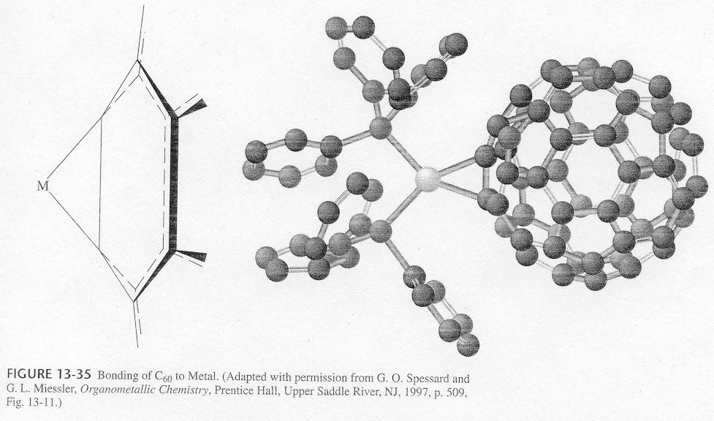

Slide 26
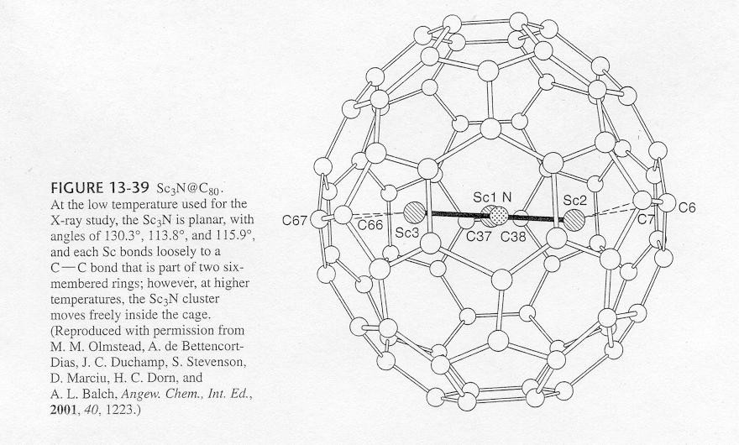
Fullerenes Containing
Encapsulated Metals
Cage organometallic compounds
U@C₆₀ and Sc₃@C₈₂

Slide 27
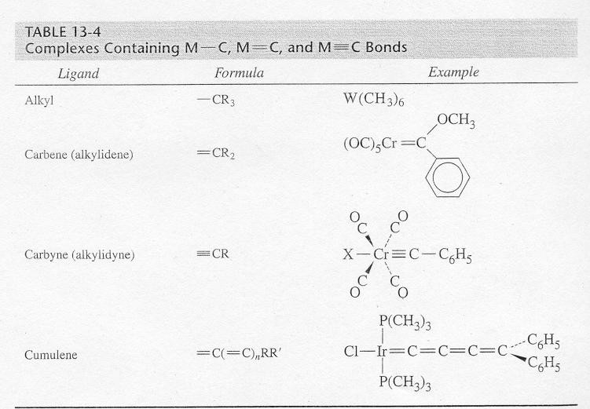
Complexes Containing M-C, M=C,
and M≡C Bonds

Slide 28
Alkyl Complexes (M-C)
Grignard reagents (Mg-alkyl bonds) and methyl lithium.
Grignard reagents can be used to synthesize organometallic compounds containing an alkyl group
The interaction is largely through σ donation.
Metals containing only alkyl ligands are rare and usually unstable.

Slide 29
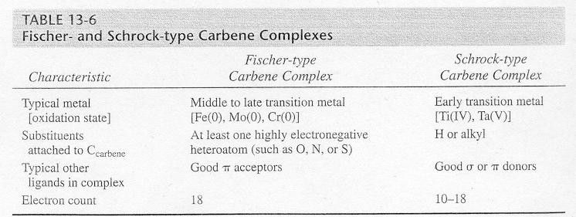
Carbene Complexes ( M=C)
Fisher-type and Schrock-type complexes.
What are the differences between the two different type of carbene complexes (Table 13-6).

Slide 30
Carbene Complexes ( M=C)
Bonding in Fisher carbene complexes.
σ donation and π back bonding (illustrate).
Complex is generally more stable if the carbene atom is attached to a highly electronegative atom. The electronegative atom participates in the π bonding.
Similar to a π-allyl system (illustrate, Fig. 13-41).
Can be represented as a hybrid structure.
What type of spectroscopic evidence would show the existence of M=C?

Slide 31
Carbene Complexes ( M=C)
Discuss the proton NMR of Cr(CO)₅[C(OCH₃)C₆H₅].
At high temperatures there is one signal from the methyl protons and at low temperatures there is one signal. Why?

Slide 32
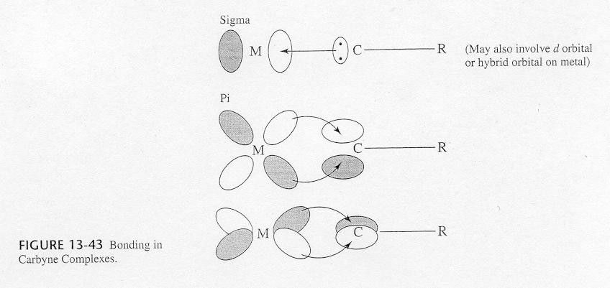
Carbyne (alkylidyne) Complexes
(M≡C)
Illustrate a compound.
Type of bonding
σ bond, plus two π bonds.
Neutral 3-electron donor.

Slide 33
Spectra Analysis and
Characterization of Organometallic Compounds
X-ray crystallography
Infrared spectroscopy
NMR spectroscopy
Mass spectrometry
Elemental analysis
Others

Slide 34
Infrared (IR) Spectra
The number of IR bands depends on the molecular symmetry (IR active modes).
Monocarbonyl complexes
Dicarbonyl complexes
Linear and bent
Three or more carbonyl on the complex (Table 13-7).
We will assume that all the IR active modes are visible and distinguishable.
Exercise caution when using this table.

Slide 35
Positions of IR Bands
Terminal > doubly bridging > triply bridging
Why?
As π-acceptor ability increases, the C-O stretch decreases.
What may affect the ability to accept electron density into the π- acceptor orbitals?

Slide 36
NMR Spectra
Chemical shifts, splitting patterns, and coupling constants are useful in characterizing environments of atoms.
¹³C NMR
Table 13-9 (unique carbon environments)
¹H NMR
Protons bonded to metals are strongly shielded (chemical shifts)
Table 3-10
Ring whizzing
Using spectroscopy for identification.

Slide 37
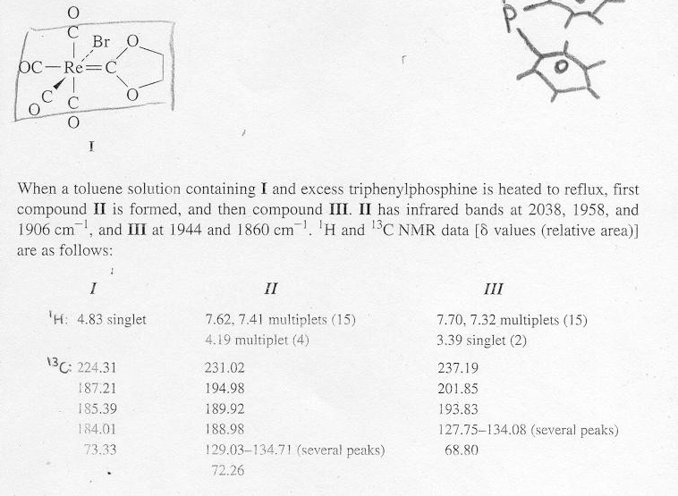
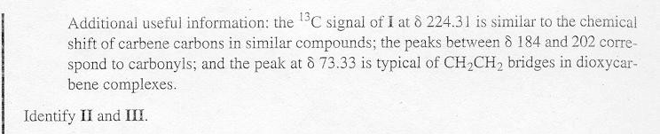

Slide 38
References
Organometallic Chemistry and Catalysis, Didier Astruc
Organometallic Chemistry, R.C. Mehrotra
Inorganic Chemistry: Principles of Structure and Reactivity, James
E. Huheey, Ellen A. Keiter, Richard L. Keiter, Okhil K. Medhi
Reaction Mechanisms of Inorganic and Organometallic Systems,
Robert B. Jordan; Professor of Chemistry, University of Alberta
http://www.chem.iitb.ac.in/~rmv/ch102/ic6.pdf
-Thank
You

