Slide 1
Nucleophilic Substitution by
Mr. Ashutosh A. Jagdale
Assistant Professor
PDVP Mahavidyalaya, Tasgaon, Dist-Sangli 416312.

Slide 2


Nucleophilic Substitution
+
+
Y
R X R Y
X
R = aliphatic as well as aromatic
Nucleophile + Substrate
Product + Leaving group

Slide 3


Nucleophilic Substitution
S_{N}1
S: Substitution N: Nucleophilic 1: unimolecular
S_{N}2
S: Substitution N: Nucleophilic 2: Bimolecular
leaving group goes first and nucleophile comes later
Y
+
C X
C+
C Y
+ X
nucleophile attacks and leaving group goes simultaneously
Y C X C Y
X
+
+

Slide 4
^{ν} reaction and mechanism
S_{N}2
kinetics
stereochemistry
substrate structure
nucleophiles
leaving groups
solvents

Slide 5
S_{N}2 reaction and mechanism

Slide 6
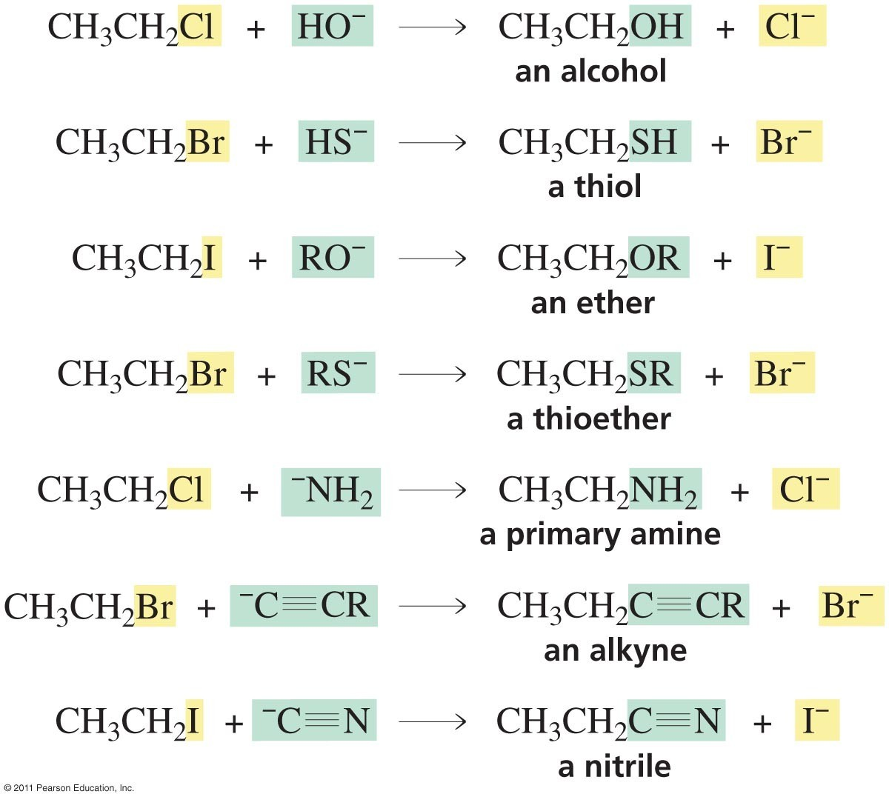
Synthetic Utility of the S_{N}2 Reaction
A variety of functional groups can be prepared employing a good nucleophile and an electrophile with a good leaving group:

Slide 7


Slide 8
S_{N}2 reaction : Kinetics

Slide 9
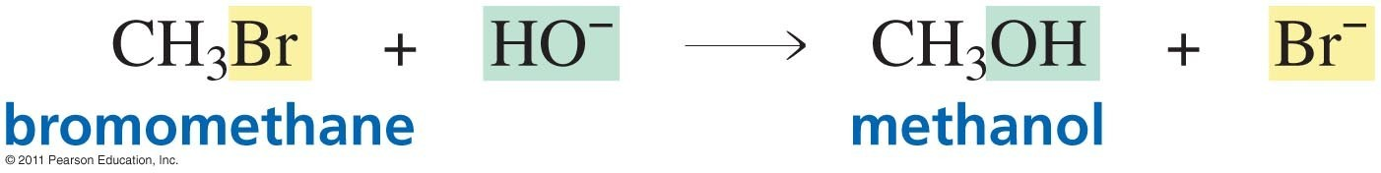
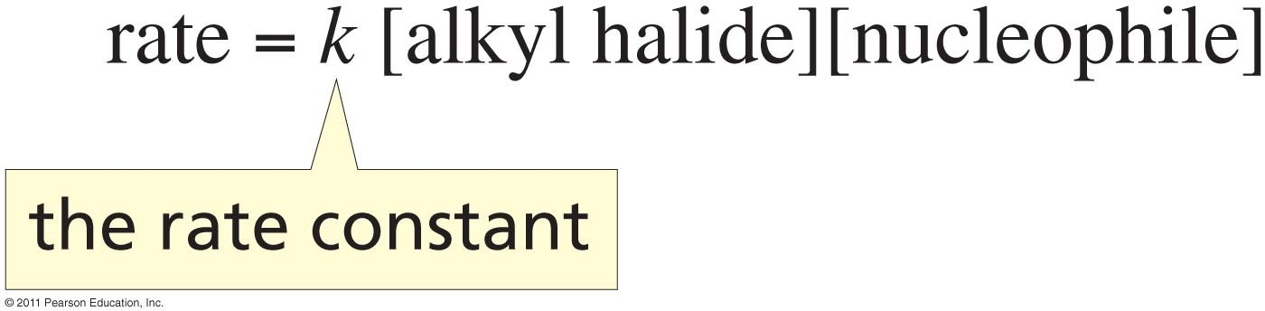
Obtained experimentally:
Rate law includes both the alkyl halide and the nucleophile, a second- order process

Slide 10
S_{N}2 reaction : Stereochemistry

Slide 11
S_{N}2 MECHANISM
nucleophilic attack
R
(R)-config
.. ^{O}..:
CH₃
H
..
: :
C
B..r
R
H
attacks back lobe
..
H O.. :
(S)-config
C
CH₃
H
INVERSION

Slide 12
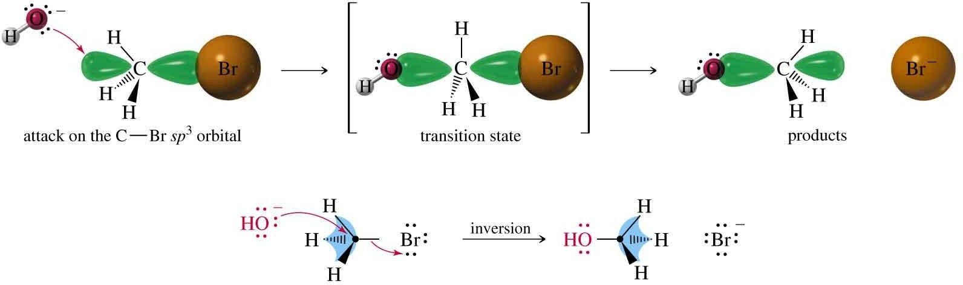
Stereochemistry of S_{N}2
Walden inversion

Slide 13
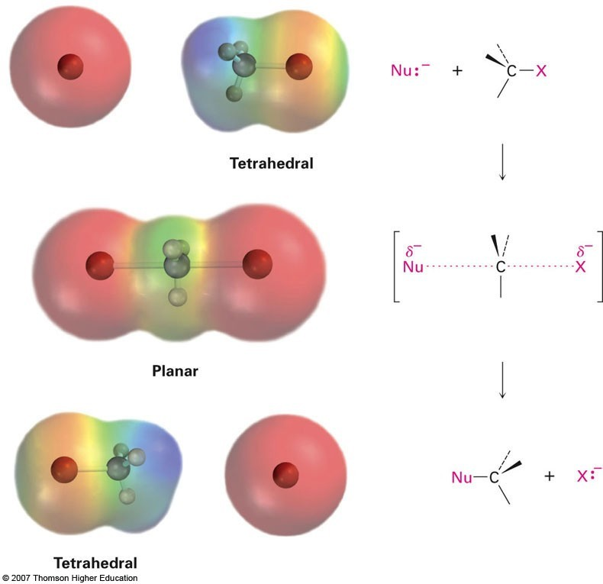

Slide 14
THE INVERSION PROCESS
R 2p
sp²
HO C B
partial bonding
HO
C
Br
activated complex
is trigonal planar (sp² )
CH_{3 H}
..
R
sp³
configuration
H O..:
is inverted
R
sp³
C : Br
HO : C
Ea
CH₃
H
CH₃
H
(R)-configuration
(S)-configuration

Slide 15
S_{N}2 reaction : substrate structure

Slide 16
^{ν}Less bulky
^{ν}Should stabilize the transition state

Slide 17
S_{N}2 Reaction: substrate structure
KI in Acetone at 25°
^{k}rel
CH₃ Br
150
CH₃ CH₂ Br
1
CH₃ CH Br
CH₃
0.008
CH₃
CH₃ C Br
unreactive!
CH₃

Slide 18
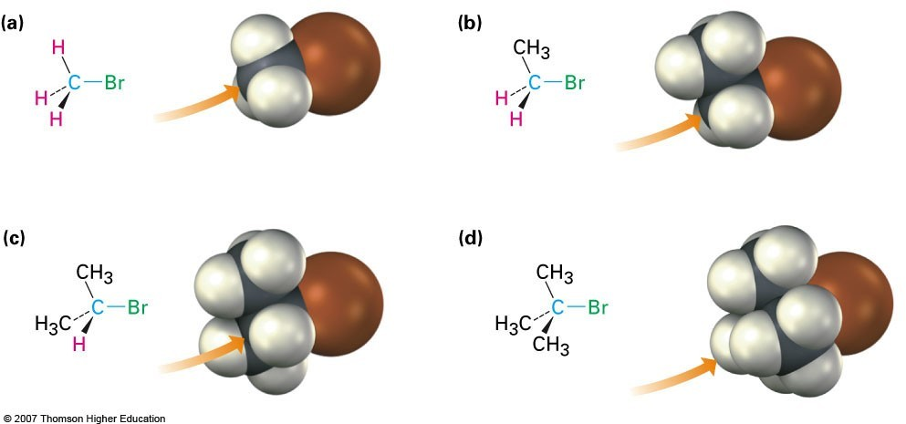

Slide 19
Relative rates of S_{N}2 reactions of alkyl chlorides with the iodide ion
The rates are given with respect to
n-BuCl
Alkyl chloride
Me Cl
relative rate
200
0.02
Cl
Me
920
O
Cl
O
Cl
1,00,000

Slide 20
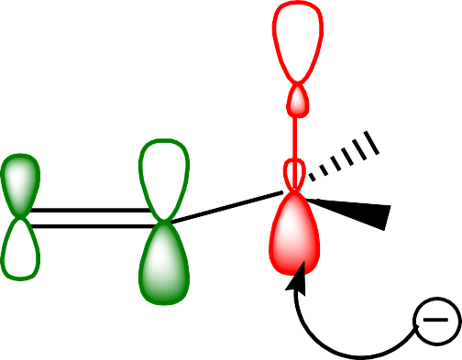

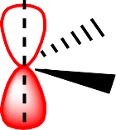
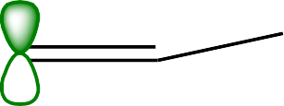
O
R
O
R
Nu⁻
only S_{N}2, no S_{N}1
Hal
Nu
R = alkyl, aryl, OR'
Relative rates of S_{N}2 reactions with iodide ion
O
Cl
1:500
Me Cl
C=O group stabilizes the T.S. by Overlap of its π* orbital with full
P-orbital of the C-atom under attack
σ * of of the C-Cl
H
+
π* of the C=O
Cl
π* of the C=O
Cl
H H
H
Nu
Nu

Slide 21
S_{N}2 reaction : Effect of Nucleophile

Slide 22
^{ν} The nucleophilicity may be
correlated with the availability of
the electron pairs and the ease with which it is donated

Slide 23
Trends in Nuc. Strength
Increases down Periodic Table, as size and polarizability increase:
I⁻ > Br⁻ > Cl⁻ >F⁻
Of a conjugate acid-base pair, the base is stronger:
OH⁻ > H₂O, NH ⁻ > NH
2 2 3

Slide 24
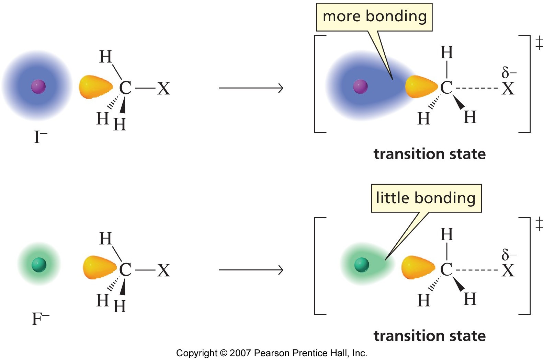
Polarizability and nucleophilicity - increased polarizability makes for a better nucleophile
I- > Br- > Cl- >F-

Slide 25






Effect of Nucleophile :
The nucleophilicity may be correlated to its basicity as both involve the availability of the electron pairs and the ease with which it is donated
rapid
CH₃O
+
H₃C I
CH₃OCH₃
+
I
very
+
CH₃OCH₃
+
HI
CH₃OH
H₃C
I
slow
>
A negatively charged nucleophile is always stronger than its conjugate acid.
N u cle op hi lic it y of
CH O
CH OH
3
3
Stronger base better nucleophile
weaker base poorer nucleophile
>
>
>
HO
H₂O
CH₃OH NH₃
CH₃O
H₂N
The direct relationship between basicity and nucleophilicity is maintained if the reaction occurs in the gas phase

Slide 26
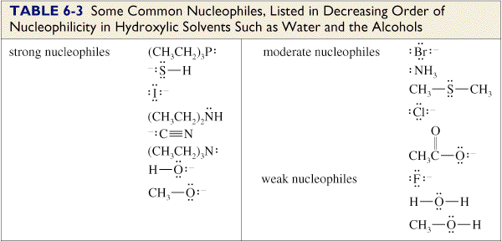
S_{N}2: Nucleophilic Strength
Stronger nucleophiles react faster.
Strong bases are strong nucleophiles, but not all strong nucleophiles are basic.

Slide 27
SN2 reaction : Effect of leaving group

Slide 28
A good leaving group needs to be a Stable anions that are weak bases which can delocalize charge

Slide 29
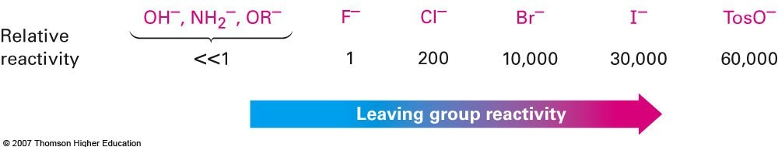
The Leaving Group

Slide 30
Sulfonate Leaving Groups
O
R O S CH₃
O
R OTs
para-Toluenesulfonate
O
R O S
Tosylate
Br
R OBs
O
para-Bromobenzenesulfonate
Brosylate

Slide 31
S_{N}2 reaction : Effect of Solvent

Slide 32
Solvent
ν
Polar Solvent
nonpolar Solvent
Polar protic
Solvent
Polar aprotic Solvent
SN2 reaction prefers polar aprotic solvent

Slide 33
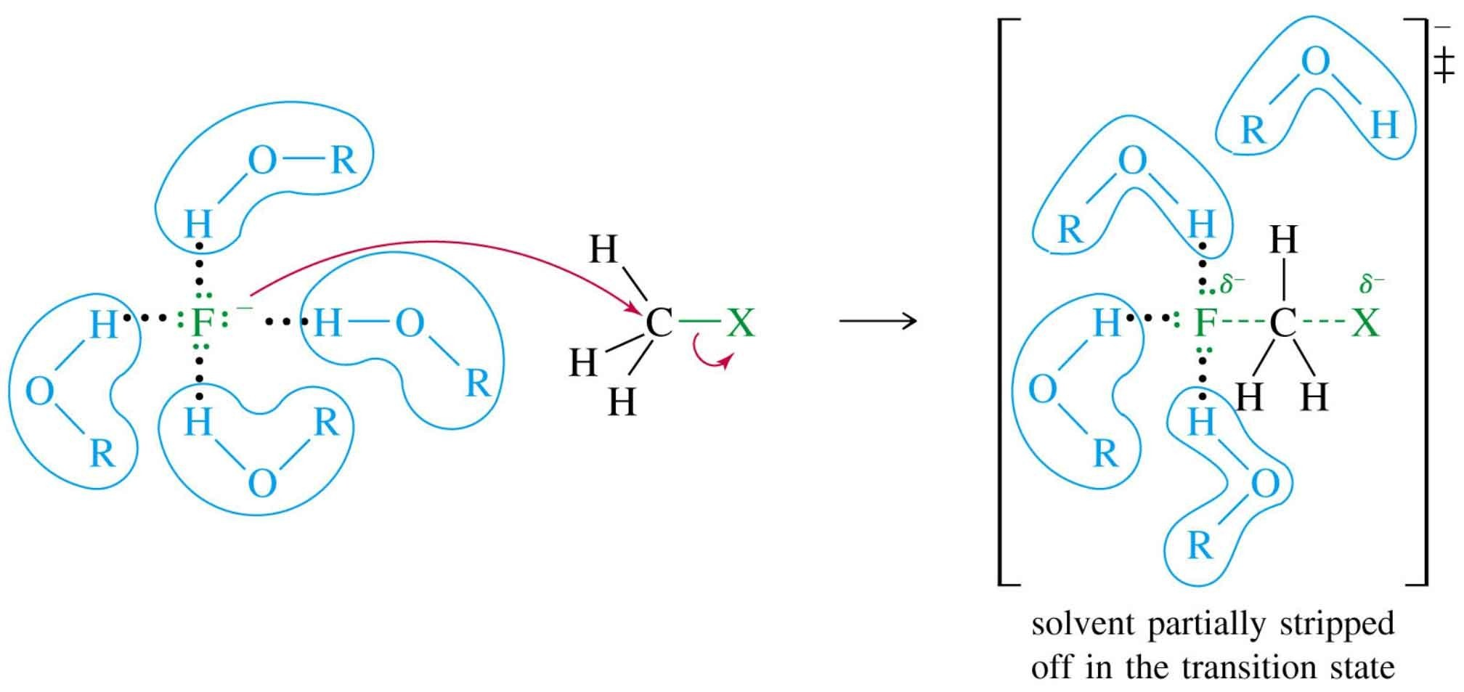
Solvent Effects (1)
Polar protic solvents (O-H or N-H) reduce the strength of the nucleophile.
Hydrogen bonds must be broken before nucleophile can attack the carbon.

Slide 34
Solvent Effects (2)
Polar aprotic solvents (no O-H or N-H) do not form hydrogen bonds with nucleophile
Examples:
O C
O C
CH₃ C N
acetonitrile
CH₃
CH₃
H N
H₃C CH₃
dimethylformamide (DMF)
acetone

Slide 35
Marked effect on the rate of S _{N}2 reaction, when that t ransferred from polar protic solvent to polar aprotic solvent.
Me
I +
N₃⁻Na⁺
solvent
Me N₃
+ NaI
Rate in MeOH (ε = 33) 1
DMF (ε = 37) 4.5X10⁴
DMF: HCONMe₂
DMSO (ε = 46)
1X10⁹
DMSO: Me₂SO
In MeOH both Na ⁺ and N ₃⁻ are solvated.
In DMF only Na ⁺ is solvated, but not N ₃ ^{-.}
So, unsolvated N ₃ ⁻ is a much more powerful nucleophile

Slide 36
^{ν} reaction and mechanism
S_{N}1
kinetics
stereochemistry
substrate structure
nucleophiles
leaving groups
solvents

Slide 37
S_{N}1: reaction and mechanism

Slide 38

Solvolysis of tert-Butyl Bromide
CH₃
CH₃
acetone
CH C CH
+ H O
CH C CH
+
H Br
3
3
2
3
3
Br
OH
+ other products

Slide 39
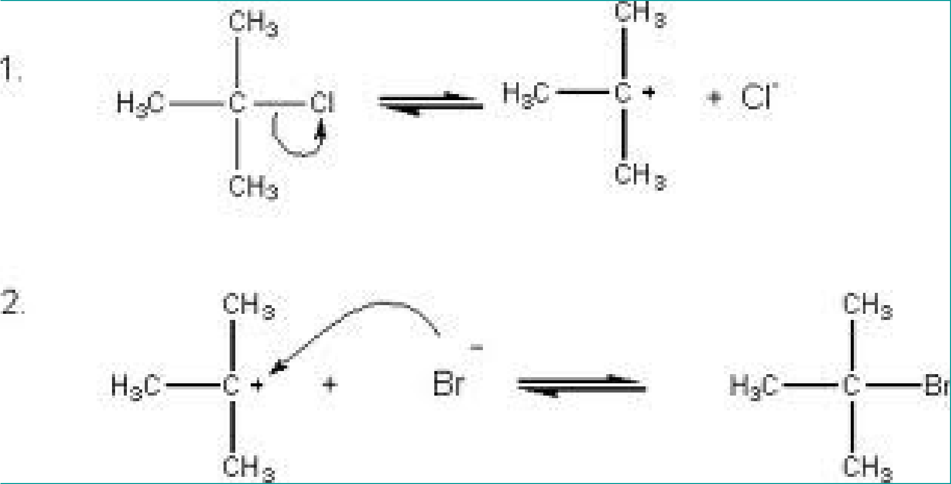
S_{N}1: Mechanism
1935: Hughes & Ingold

Slide 40
S_{N}1 reaction : Kinetics

Slide 41
S_{N}1 Reaction: kinetics
The reactions follows first order (unimolecular) kinetics
Rate = k [R-Br]¹

Slide 42



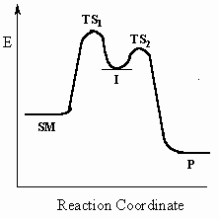
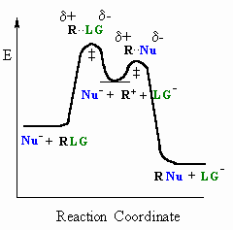
Reaction profile for S_{N}1 reaction
_{LG} slow
fast
R
LG +
R
R Nu
Nu
Rate = K[R-LG]

Slide 43
S_{N}1 reaction : Stereochemistry

Slide 44
S_{N}1: Hydrolysis of t- butyl chloride by base pr oceed according to
Rate = k ₁[t- BuC l] or independent of [OH ⁻]
Me
HO
fast
OH
fast
⁻OH
Me Me
Me Me
Me
Me
-
slow
+
Me
Cl
Me
sp²
Me
Me
Me
OH
sp³
Halide undergoes slow ionization to yield the ion pair R ⁺ and Cl⁻
followed by first attack by – OH or solvent or nuleophile.
The energy necessary to effect the initial ionization is largely recovered from the energy evolved through solvation of the resultant ion-pair.

Slide 45
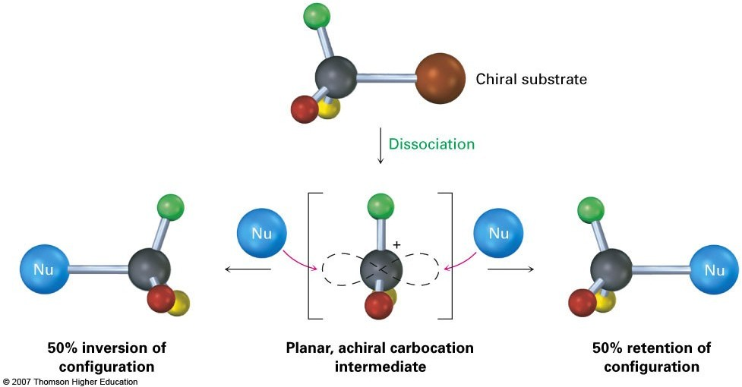

Slide 46
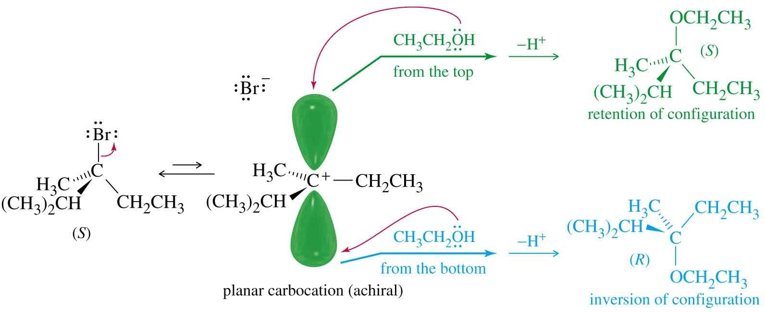

Slide 47
S_{N}1 reaction : substrate structure

Slide 48
^{ν}Stability of carbocation

Slide 49
CH₃
CH₃
C
Br >
CH₃ CH Br
CH₃
>
CH₃-CH₂-Br
>
CH₃-Br
CH
3
tertiary
secondary
primary
CH₃
C +
+
CH₃ CH
+
CH₃ CH ₂
+
CH₃
CH
3
CH₃
CH₃
tertiary carbocation (very stable)
secondary carbocation
primary carbocation (unstable)
very unstable carbocation
three methyl groups
two methyl groups
one methyl group
no methyl groups

Slide 50
S_{N}1 Reaction: substrate structure
^{k}rel
CH₃ Br no reaction
CH₃ CH₂ Br
1.00
CH₃ CH Br
11.6
CH₃
CH₃
6
1.2 x 10
CH₃ C Br
CH₃
Solvolysis in water at 50°C

Slide 51
S_{N}1 reaction : Effect of Nucleophile

Slide 52
Nucleophiles in S_{N}1
^{ν} Since nucleophilic addition occurs after formation of carbocation, reaction rate is not normally affected by nature or concentration of nucleophile (weak nucleophile)

Slide 53
A protic solvent acts as both a solvent and nucleophile in S _{N}1
reactions - solvolysis:
Water
O
H H
abbreviations
HOMe
Methanol
H ^{O} CH
3
Ethanol
CH₃
HOEt
H ^{O} CH
2
Acetic acid
HOAc
H ^{O} C
O
CH₃
Formic acid
H ^{O} C ^{H}
O

Slide 54
S_{N}1 reaction : Effect of leaving group

Slide 55
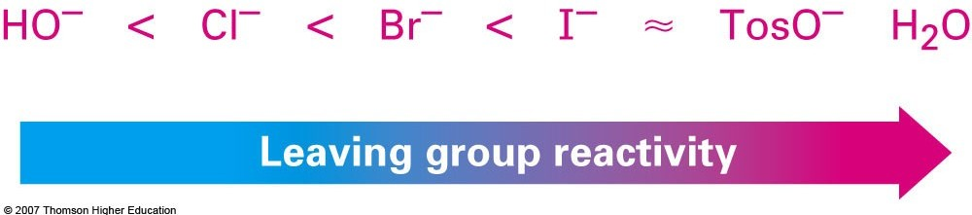
Leaving groups
^{ν} Leaving groups are the same as in S_{N}2 reactions:

Slide 56
S_{N}1 reaction : Effect of Solvent

Slide 57
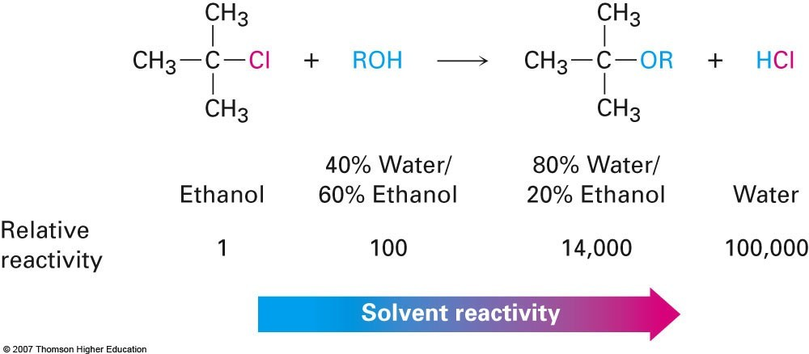
Solvent effect
Increase in dielectr ic constant and/or ion- solvating ability result in a marked increase in reaction rate
Dielectric constant (ε, at 25 C): H₂O 79
EtOH 25

Slide 58
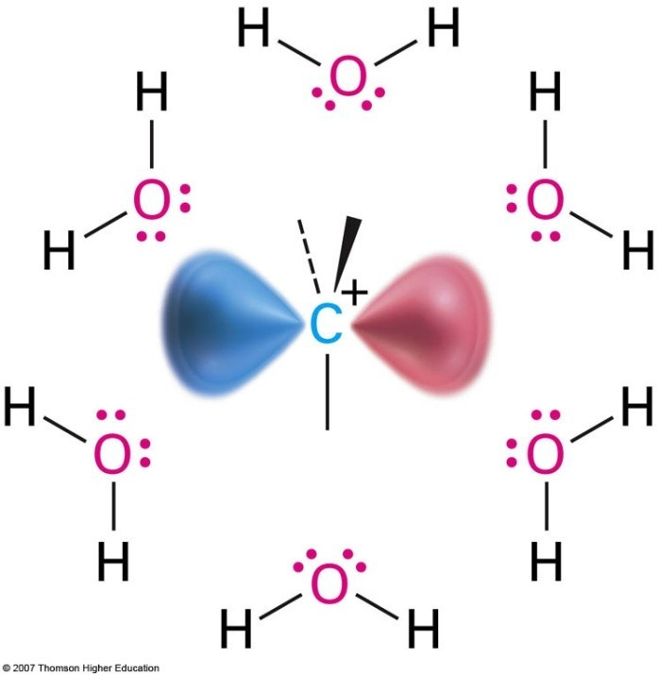
ν
Polar protic solvents favoring the S_{N}1 reaction since it stabilizes carbocation of the transition state
Protic solvents disfavor the S_{N}2 reaction by stabilizing the ground state
ν
Transfer from polar, protic to polar, aprotic solvents can change the reaction mode from SN1 ◊ SN2

Slide 59
Things to remember

Slide 60
S_{N}2 or S_{N}1?
Primary or methyl
Strong nucleophile
Polar aprotic solvent
Tertiary
Weak nucleophile (may also be solvent)
Polar protic solvent, silver salts
Rate = k [halide]
^{ν} Rate = k [halide]
[Nuc]
^{ν} Inversion
^{ν} Racemization
^{ν} No rearrangements ^{ν} Rearranged products
=>

Slide 61
^{ν} Competition reaction in S_{N}1

Slide 62
Rearrangements
Carbocations can rearrange to form a more stable carbocation.
Hydride shift: H⁻ on adjacent carbon bonds with C⁺.
^{ν} Methyl shift: CH₃⁻ moves from adjacent
3
carbon if no H’s are available.
=>

Slide 63






Hydride Shift
Br H
H
CH₃ C C CH₃
H CH₃
CH₃ C C CH₃
H CH₃
H
CH₃ C C CH₃
H CH₃
H
CH₃ C C CH₃
H CH₃
H
CH₃ C C CH₃
H CH₃
H Nuc CH₃ C C CH₃
H CH₃
Nuc

Slide 64






Methyl Shift
Br CH₃
CH₃
CH₃ C C CH₃
H CH₃
CH₃
CH₃ C C CH₃
H CH₃
CH₃
CH₃ C C CH₃
H CH₃
CH₃ C C CH₃
H CH₃
CH₃
Nuc CH₃ C C CH₃
H CH₃
CH₃
CH₃ C C CH₃
H CH₃
Nuc

Slide 65
Important substrates……..

Slide 66
Allylic and Benzylic compounds

Slide 67
Allylic and Benzylic compounds
Allylic and benzylic compounds are especially reactive in S_{N}1 reactions.
Even though they are primary substrates, they are more reactive most other halides! They form resonance stabilized carbocations.
CH₂-Br
CH₂=CH-CH₂-Br
benzyl bromide
allyl bromide

Slide 68



+
+
CH₂
CH₂
etc
+
+
CH₂
CH₂
etc

Slide 69
Allylic and Benzylic compounds
Allylic and benzylic compounds are especially reactive in S_{N}2 reactions.
They are more reactive than typical primary compounds!
CH₂-Br
CH₂=CH-CH₂-Br
benzyl bromide
allyl bromide

Slide 70
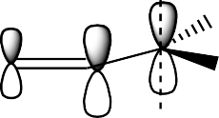
For S _{N}2: stabilisation of TS by conjugation with allylic π - bond
δ(-)
+
Br
δ(-)
+
Nu
Nu
H H
_{Nu}δ(-)
Br
H
H
Nu
_{Br}δ(-)
T.S.
T.S.

Slide 71
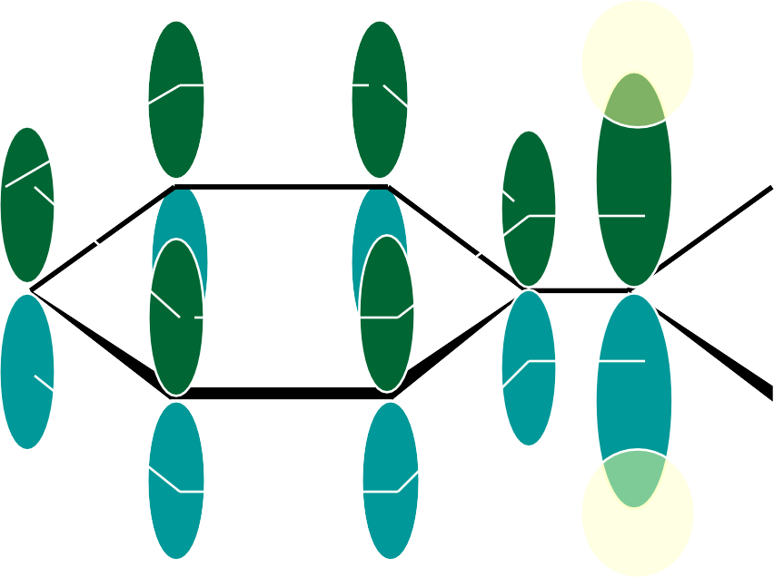
BENZYL ( GOOD FOR S_{N}1 )
IS ALSO A GOOD S_{N}2 SUBSTRATE
primary, but faster than other primary
CH₂ Br + NaI
CH₂ I NaBr
+
I
overlap in the activated complex lowers the activation energy
Br
critical overlap

Slide 72
Vinyl and aryl halides

Slide 73
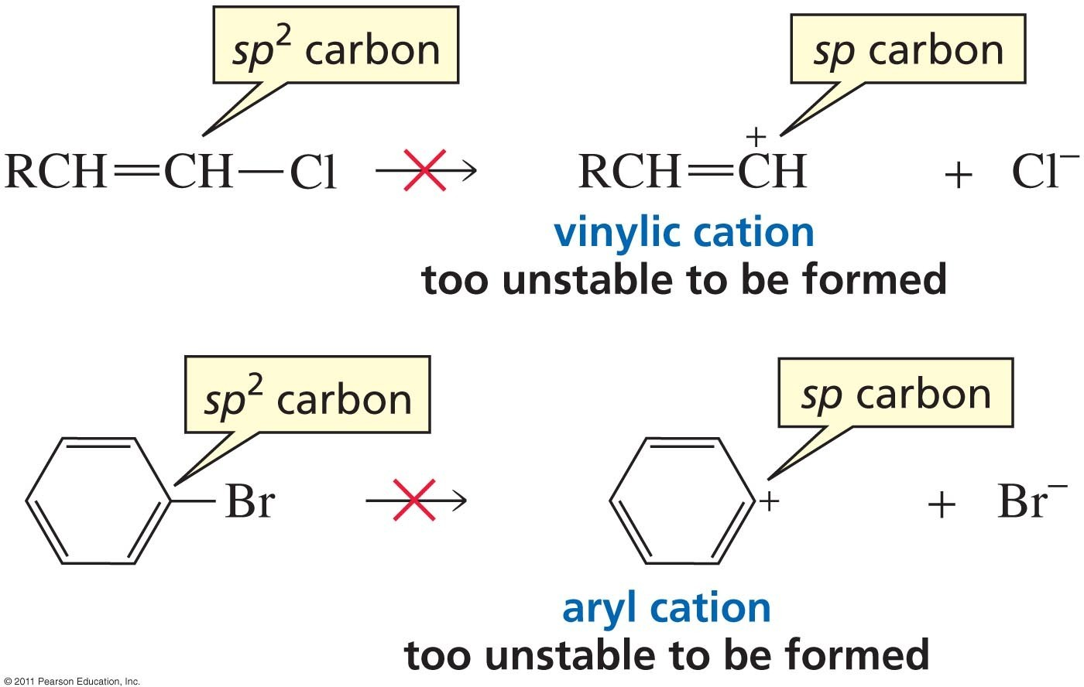
Vinyl and aryl halides do not undergo S_{N}1 because:

Slide 74
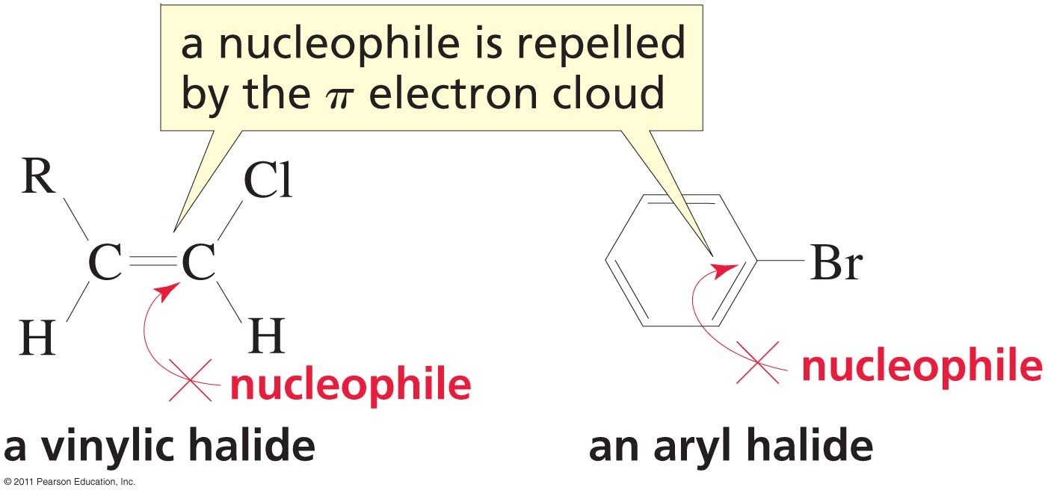
Vinyl and aryl halides do not undergo S_{N}2 because:

Slide 75
Cyclic systems

Slide 76
rigid bicyclic molecule.
You can’t have p orbitals on a bridgehead position
-- You cannot form a carbocation
at a bridgehead position.
X
+
Br
+
“steric rigidity”
+

Slide 77
Problems :
1) S _{N}2 reaction by Et O ⁻ in Et OH:
CH₃CH₂ Br
1
CH₃CH₂CH₂ Br
2.8X10⁻¹
Me₂HCCH₂ Br
3.0X10⁻²
Me₃CCH₂ Br
24.2X10⁻⁶
Expl ain ?
relative rate
2) Rate of solvolysis in EtOH :
Br
Br
Explain?
cc at bridge head, less stable, difficult to attain planarity due to rigidity
A)
Br
1
₁₀-6
₁₀-14
Br
Br
B)
Expl ain ?
Rigid structure, cation empty p-orbitals are at right angles to π orbitals of Ph
1
₁₀-23
1-bromotriptycene

