Slide 1
WEL - COME

Slide 2
TOPIC’S NAME
SOME BASIC CONCEPTS
OF PHYSICS

Slide 3
SOME BASIC CONCEPTS OF PHYSICS
prof. S.S. Patil
Asst. Prof.
Dept. Of Physics
P. D. V. P. College Tasgaon

Slide 4
INTRODUCTION
In this chapter we will be introduced to different concepts of Physics. It includes definitions, formulae, diagrams, units of
Physics concepts.

Slide 5
Meaning of Physics –
The science of matter & energy and their properties and interaction in fields including mechanics, acoustics, optics, heat, electricity, radiation & atomic nuclear science.
Physics is the science of How things work.
Velocity –
It is a ratio of change of displacement with respect to time.
V = ds / dt
Velocity
Acceleration
Unit : meter/ sec
Deceleration
Time

Slide 6
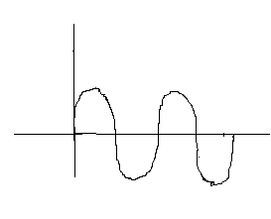
Wavelength –
Wavelength is a distance between two successive peaces denoted as.
A Pearson's idea & way of thinking espeasialy as it affects their ability to communicate with other, that is a Wavelength.
‹- λ -›
Amplitude –
The maximum displacement of partical from mean position is called as Amplitude.

Slide 7
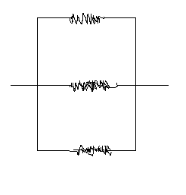
Resistance – R
It is defined as voltage divided by current
ie : R = V/I.
Voltage increase the current increase.
Unit – Ω
Series Resistance :-
When Resistance is serial's then total Resistance is
Rs = R1+R2+R3+ ------
R1
R2
2) Parallel Resistance:-
when resistance is parallel the total resistance is
Rp = 1R1+1/R2+1/R3+------
R1
R2
R3

Slide 8
Period
Period is time taken for a complete one of the work.
the period such as –hour,day,sec,year etc.
e.g. Earth around the sun having period is 365 day’s.
Surface Tension
Surface tension is defined as force per unit length .
T = F/L
Surface tension is elastic tendency of liquid unit is N/M. Dyne/Cm

Slide 9
scalar
1) A scalar quantity is one of has only magnitude only
e.g. Mass, time, speed, work, energy, density etc.
2) Vectors
A vector quantity is one which has both magnitude & directions.
e.g. Displacements, velocity, force, momentum etc.

Slide 10
THANK YOU.

