Slide 1
B.S.Harale Asso.Prof. Dept.of Physics P.D.V.P.College, Tasgaon Pin -416312 Maharashtra
B.Sc. III
Physics Paper No.IX
Mathematical Physics
Orthogonal Curvilinear Co-ordinates

Slide 2
Gradient of Scalar field in Orthogonal curvilinear co-ordinates is,

Slide 3
Vector differential operator in Orthogonal curvilinear co-ordinates is,

Slide 4
Divergence of vector field in Orthogonal curvilinear co-ordinates is, $\vec{∇.}\vec{A}=\frac{1}{h1h2h3}$ $\{\frac{∂(A1h2h3)}{{∂u}_{1}}$+$\frac{∂(A2h3h1)}{{∂u}_{2}}$+$\frac{∂(A3h1h2)}{{∂u}_{3}}\}$

Slide 5
Laplace operator in Orthogonal curvilinear co-ordinates is, $∇^{2}=\frac{1}{h1h2h3}$ $\{\frac{∂}{{∂u}_{1}}$($\frac{h2h3}{h1}\frac{∂}{{∂u}_{1}}$)+$\frac{∂}{{∂u}_{2}}$($\frac{h3h1}{h2}\frac{∂}{{∂u}_{2}}$)+$\frac{∂}{{∂u}_{3}}(\frac{h1h2}{h3}\frac{∂}{{∂u}_{3}}$)}

Slide 6
Curl of vector field in orthogonal curvilinear coordinates. $\vec{∇}×\vec{A}$= $\frac{1}{h_{1}h_{2}h_{3}}$ $\left|\begin{matrix}h_{1}{\hat{u}}_{1} & h_{2}{\hat{u}}_{2} & h_{3}{\hat{u}}_{3} \\ \frac{∂}{∂u_{1}} & \frac{∂}{∂u_{2}} & \frac{∂}{∂u_{3}} \\ h_{1}A_{1} & h_{2}A_{2} & h_{3}A_{3}\end{matrix}\right|$

Slide 7
Gradient of scalar field in Cartesian co-ordinates $\vec{∇}$ f =($\hat{i}$ $\frac{∂f}{∂x}$ +$\hat{j}$ $\frac{∂f}{∂y}$+$\hat{k}$ $\frac{∂f}{∂z}$)

Slide 8
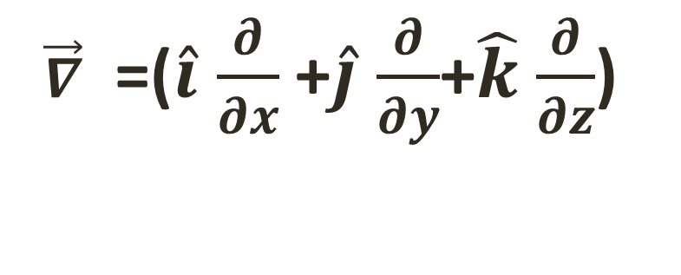
Vector differential operator in Cartesian co-ordinates
$\vec{∇}$ =($\hat{i}$ $\frac{∂}{∂x}$ +$\hat{j}$ $\frac{∂}{∂y}$+$\hat{k}$ $\frac{∂}{∂z}$)

Slide 9
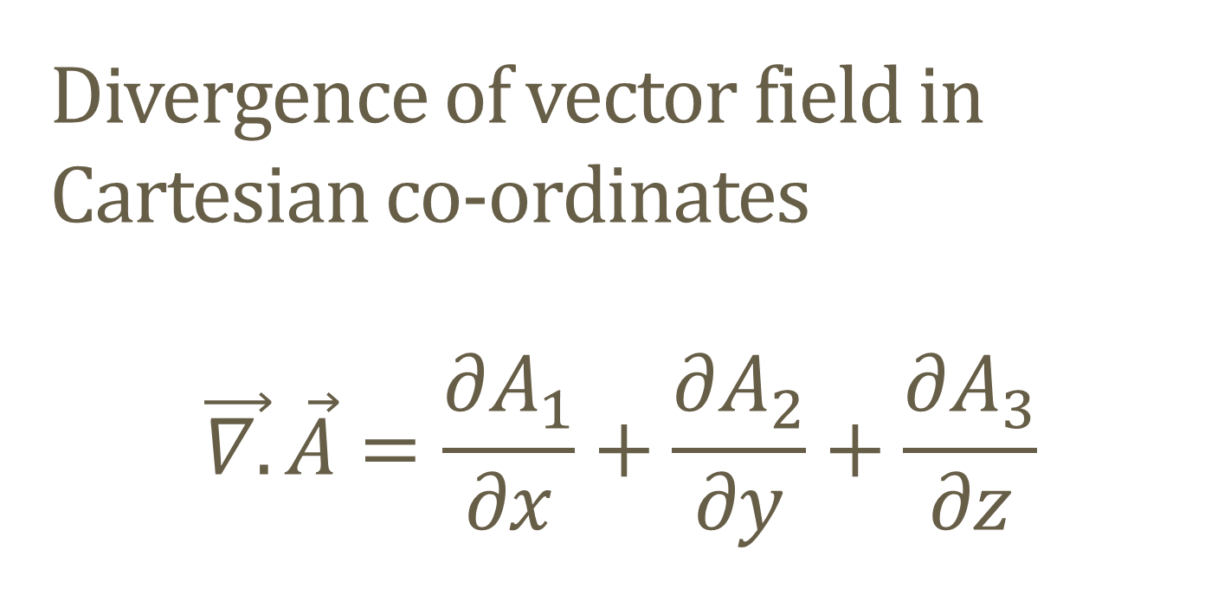
Divergence of vector field in Cartesian co-ordinates $$\vec{∇.}\vec{A}=\frac{∂A_{1}}{∂x}+\frac{∂A_{2}}{∂y}+\frac{∂A_{3}}{∂z}$$

Slide 10
Laplace operator in Cartesian co-ordinates $∇^{2}$=$\frac{∂^{2}}{{∂x}^{2}}+\frac{∂^{2}}{{∂y}^{2}}+\frac{∂^{2}}{{∂z}^{2}}$

Slide 11
Curl of vector field in Cartesian coordinates $\vec{∇}×\vec{A}$ =$\left|\begin{matrix}\hat{i} & \hat{j} & \hat{k} \\ \frac{∂}{∂x} & \frac{∂}{∂y} & \frac{∂}{∂z} \\ A_{1} & A_{2} & A_{3}\end{matrix}\right|$

