Slide 1
Adventure Tourism
सा ह सी प र्य ट न
By Ranjeet Kumbhar.....

Slide 2
Concept:-
According to the U.S.-based Adventure Travel Trade Association, Adventure Tourism may be any tourist activity that includes physical activity, a cultural exchange, and connection with nature.

Slide 6
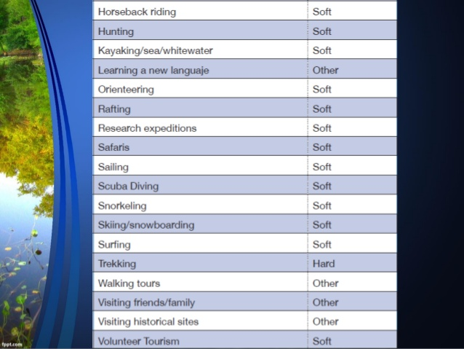

Slide 10
Types of Adventure Tourism
1) Mountaineering. (पर्वतारोहन)

Slide 11
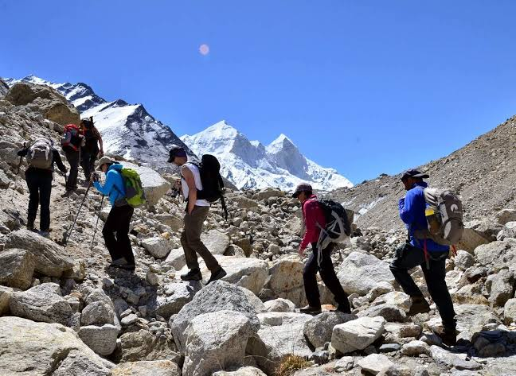
2) Trekking

Slide 12
3) Bungee Jumping

Slide 13
4)Mountain Biking

Slide 14
5) Cycling
Ex.-
◆Tour de France
◆The American Tour

Slide 15
Sailing

Slide 17
6) Canoeing 7)Rafting 8) Kayaking

Slide 18
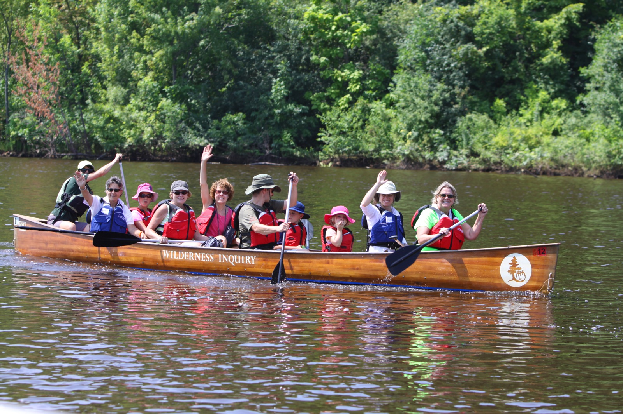
6) Canoeing

Slide 19
7) Rafting

Slide 21
8) Kayaking

Slide 22
9) Scuba Diving

Slide 23
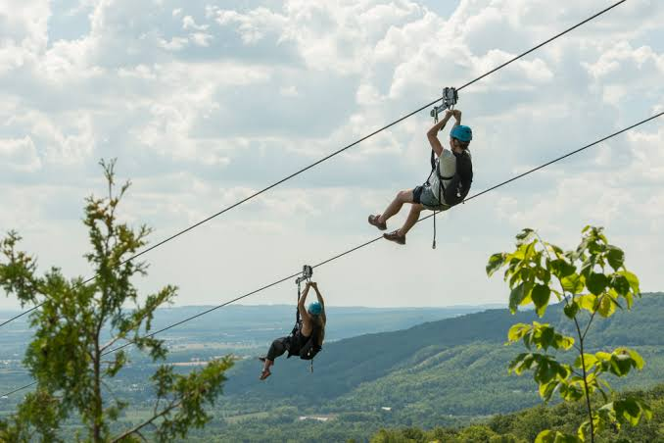
10) Zip-Lining

Slide 24
12) Para gliding

Slide 25
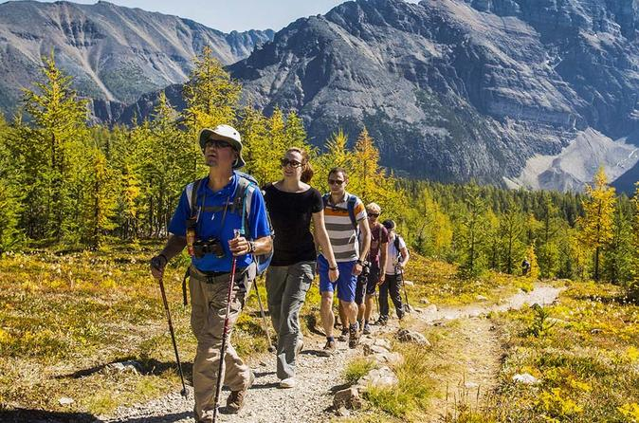
13) Hiking
walk for a long distance, especially across country or in the woods.

Slide 26
14) Exploring
travel in or through (an unfamiliar country or area) in order to learn about or familiarize oneself with it.

Slide 28
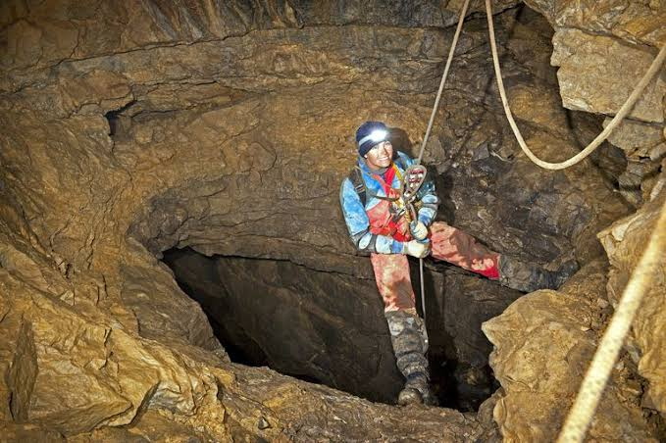
16) Caving

Slide 29
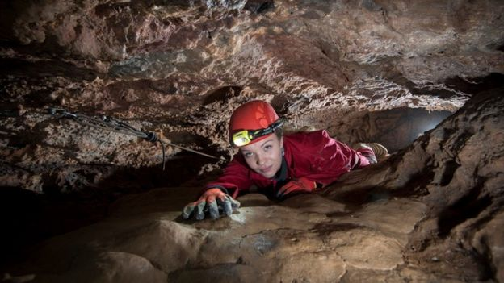
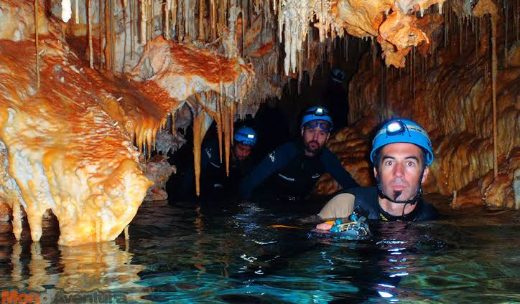
Speleology:-. To study or exploration of caves.

Slide 30
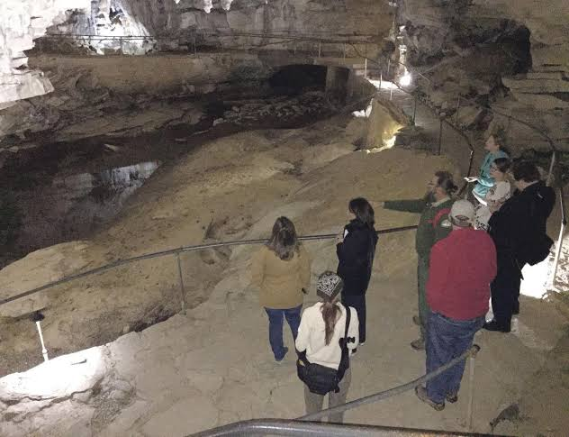
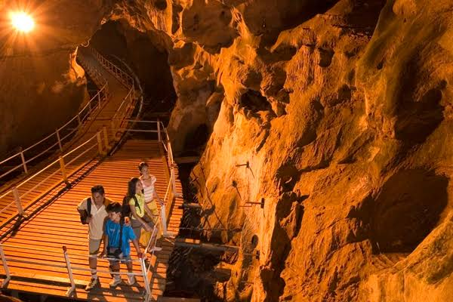
Cave Tourism

Slide 31
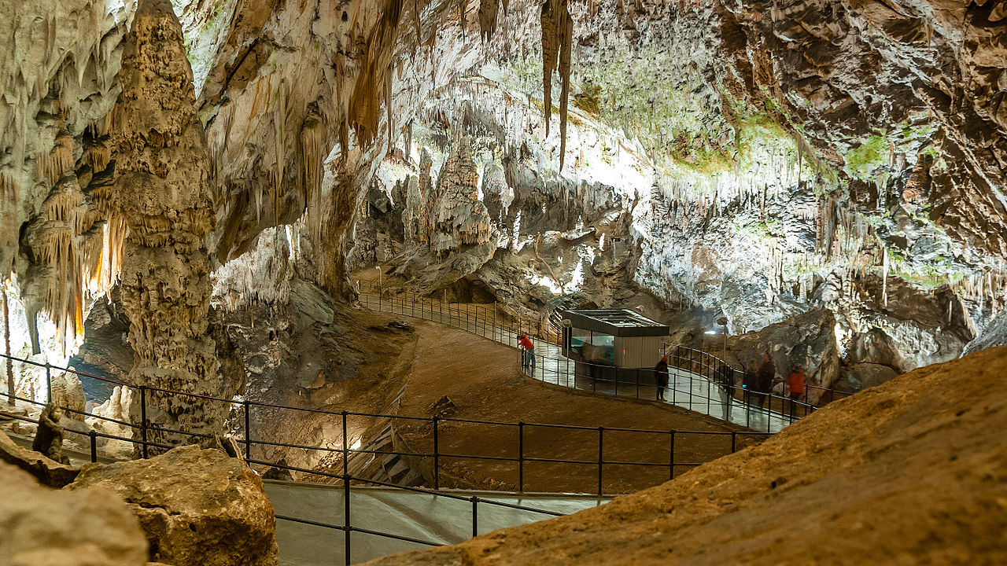
Infrastructure

Slide 32
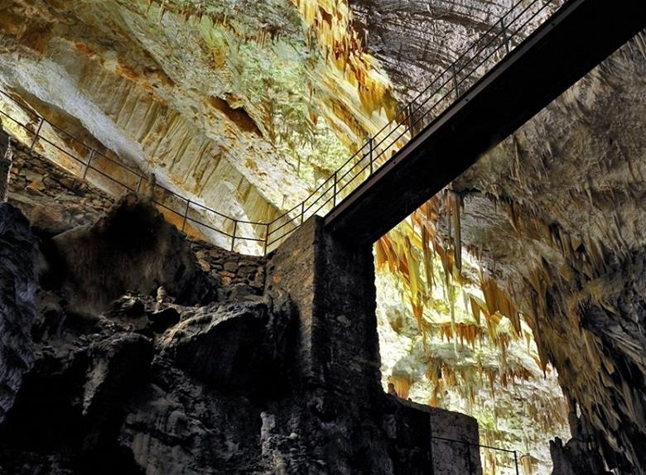

Slide 33
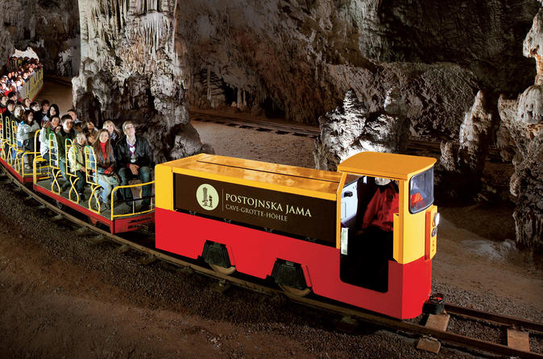

Slide 34
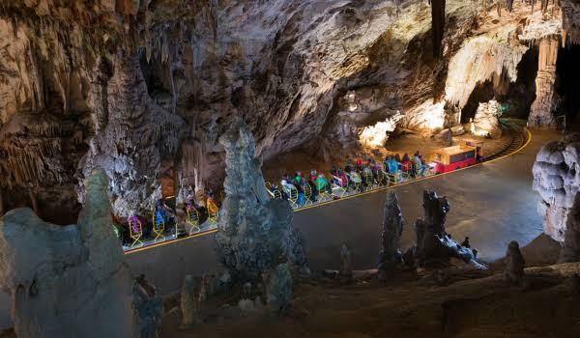

Slide 36
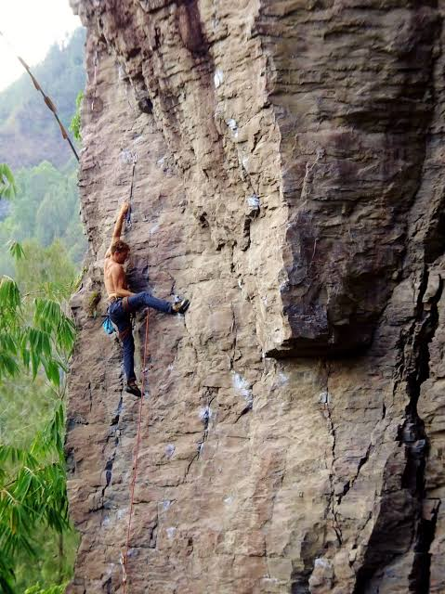
17) Rock Climbing

Slide 37
18) Sea surfing. 19) Ice skating 20) sandbording

Slide 38
18) Sea surfing

Slide 39
19) ICE skating

Slide 40
20) Sand Boarding

Slide 44
Stey Hungry .....
Stey Fullish......
- Steve Jobs

Slide 45
Thank
You.....

