Slide 1
“Dissemination of Education for Knowledge, Science and Culture”
-Shikshanmaharshi Dr. Bapuji Salunkhe
Shri Swami Vivekanand Shikshan Sanstha, Kolhapur Sanchlit
Padmabhushan Dr.Vasantraodada Patil Mahavidyalaya, Tasgaon
DEPARTMENT OF HISTORY
T.Y. B.A.
8th July 2019
Paper No. VIII
Political History of Medieval India
By
Dr. H.D. Nadaf
Head,
Department of History
2019-2020

Slide 2
Alauddin Khilji:
Alauddin Khilji, who was the nephew and son-in-law of Jalal-ud-din was one of the most ambitious and powerful sultans of Khilji dynasty. He wanted to conquer the world (to become second Alexander).
Alauddin Khilji, when became sultan, gave presents (of gold) to the citizens. At the same time, he also contended that he was a strong and powerful ruler and hence, he would deal severely with anyone who showed signs of disloyalty.
Alauddin Khilji raised the land taxes on the wealthier people of the Doab (the fertile area between the Ganga and Yamuna rivers). Further, he strictly monitored the revenue, which the nobles got from their land and hence, did not allow them to keep anything, which was not their due. The prices of goods were also closely controlled so that everyone could afford to pay the price demanded as well as no one could make a large profit.

Slide 3
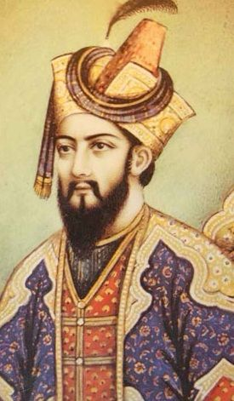

Slide 4
Alauddin Khilji made a new policy i.e. he ordered a new assessment of the cultivated land and the revenue. First, the land under cultivation (of his kingdom) was measured. And the revenue of these lands was assessed on the basis of the measurement.
Alauddin Khilji campaigned against the kingdoms of Gujarat and Malwa. He tried to establish his control over Rajasthan by capturing the famous forts of Ranthambhor and Chittor.
Under the command of Malik Kafur, Ala-ud-din sent a large army towards the south with the intention to conquer the peninsula as well as obtain money and wealth.
Malik Kafur plundered in all directions and collected a large amount of gold from the various kingdoms of the south, including the Yadavas (of Devagiri), the Kakatiyas (of Warangal), and the Hoyasalas (of Dvarasamudra).

Slide 5
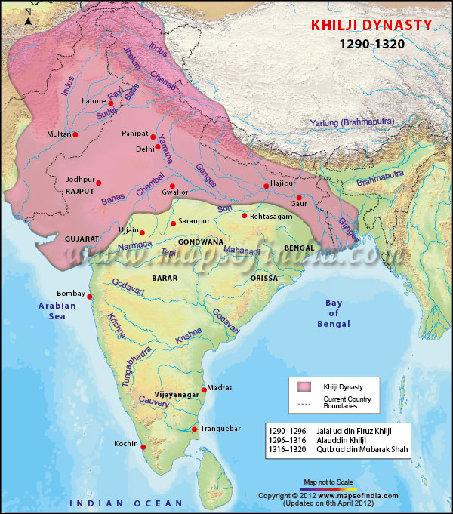

Slide 6
The defeated rulers were allowed to keep their throne provided they paid a tribute. Malik Kafur also conquered the city of Madurai. By the time, no north Indian ruler attempted to penetrate so far in the south India.
In 1,315, Aladdin Khilji died. After his death, there was a chaotic situation for the succession. Ambitious Malik Kafur made himself as sultan, but lacked support from Muslim amirs and hence, he was killed only after few months.
By 1,320, three more Khilji successors assumed power, but no one sustained rather killed brutally. Likewise, a new dynasty namely Tughlaq was founded. Medieval Indian History 20 Tughlaq dynasty came after the Khilji dynasty and ruled from A.D. 1320 to 1413.

Slide 7
Thank You

