Slide 1
B.Sc II Semester III
Physics Paper No.V Thermal Physics and statistical mechanics- I

Slide 2
Topic Name:Laws of Thermodynamics
Carnot Cycle and IdealHeat Engine B.S.HARALE Asso.Prof. Dept.of Physics P.D.V.P.Mahavidyalaya, Tasgaon, Dist.Sangli, Maharashtra

Slide 3
Carnot cycle and Carnot heat engine:
• A carnot cycle is hypothetical cycle consist of
four process
– Two reversible isothermal process and
– Two reversible adiabatic process.
• Heat is caused to flow in working fluid by
application of high temperature energy source
during expansion, and flow out of fluid by the
application of lower temperature energy sink
during compression

Slide 4
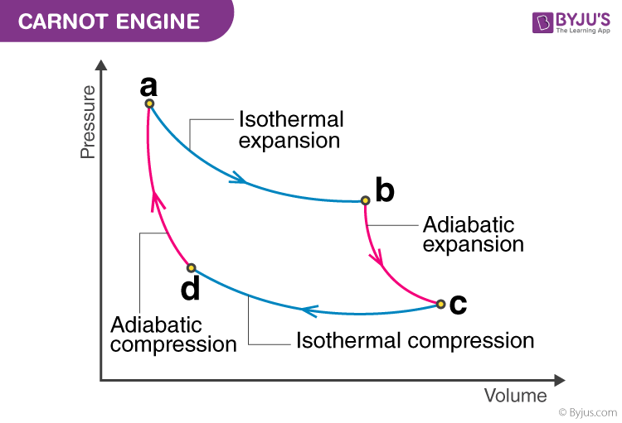

Slide 5
Assumptions made in Carnot Cycle:
I. Piston moving in the cylinder does not produce any
friction.
II. The cylinder head is arranged in such a way that it
can be perfect heat conductor or heat insulator.
III. The walls of cylinder and piston are consider as
perfect insulator of heat.
IV. Heat transfer does not affect temperature source or
sink.
V. Compression and expansion are reversible.
VI. Working is perfect gas and has constant specific heat

Slide 6
Carnot’s theorem:
“It is impossible to construct an engine
operating between two constant
temperature reservoir can be more efficient
then reversible engine operating between
the same reservoir”

Slide 7
Corollary of Carnot Theorem:
1) “All reversible engine operating between
the two constant temperature thermal
reservoir have the same efficiency.”
2) “The efficiency of any reversible heat engine
operating between two thermal reservoir
does not depend on nature of working fluid
and depends only on the temperature of the
reservoir.”

Slide 8
THANK YOU

