Slide 1
B.Sc. Part – III
Year: 2020-21
Classical Mechanics & Classical Electrodynamics
(Paper: XI)
Miss. Ankita S. Yadav
Department of Physics
P.D.V.P. College, Tasgaon

Slide 2
Shivaji University, Kolhapur: CBCS Syllabus Chemistry
B.Sc. Part –III Semester (V and VI)
Nature of Syllabus
Semester V
Paper – XI : Mathematical Physics
Paper – X : Quantum Mechanics
Paper – XI : Classical Mechanics & Classical Electrodynamics
Paper – XII : Digital and Analog circuits and Instrumentation
Semester VI
Paper – XIII : Nuclear and Particle Physics
Paper – XIV : Solid State Physics
Paper – XV : Atomic and Molecular Physics and Astrophysics
Paper – XVI : Energy Studies and Materials Science
Theory: 200(50+50+50+50 =200 marks for each semester)
Practical : 200

Slide 3
Unit I Chapter - 1 Lagrangian Formulation
Introduction
Constraints
Degrees of Freedom
Generalised Coordinates
Principle of virtual work
D’Alembert’s Principle
Application of Lagrange’s Equation
Solved Problems
Questions; Problems

Slide 4
Chapter – 2 Techniques of calculus of Variation
Introduction
Hamilton’s Principle
Deduction of Hamilton's Principle from D’Alembert’s Principle
Deduction of Lagrange’s Equation from Hamilton’s Principle
Applications of the Techniques of the Calculus of variation
Solved problems
Question
problems for practice

Slide 5
Unit II Chapter -1 Special Theory of Relativity
Introduction
Inertial Frame of reference
Non-inertial frame of Reference
Galilean Morley experiments
Postulates of special theory of Relativity
Lorentz Transformation Equations
Length Contraction
Time Dilation
Relativistic Addition of Velocities
Variation of Mass with Velocity
Mass energy Equivalence Relation
Solved Problems ;
Questions
Problems for practice

Slide 6
Chapter – 2 Charged particles Dynamics
Introduction
Poisson’s and Laplace’s Equation
Laplace’s Equation in one dimension and its solution
Motion of charged particle in Uniform Electric Field
Motion of charged particle in Uniform Magnetic Field
Motion of charged particle in crossed Uniform and Constant Electric and Magnetic fields
Solved Problems;
Questions
Problems for practice

Slide 7
PHYSICS
Classical Mechanics
Quantum Mechanics
Mechanics
Thermodynamics
Electrodynamics
Optics
Atomic and Nuclear Physics

Slide 8
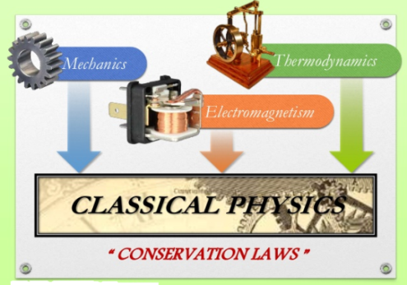
CLASSICAL MECHANICS
Definition : It is study of motion of body (macroscopic) under influence of forces
Motions can be –
Translational
Rotational
Oscillating
Circular

Slide 9
Basics of Classical Mechanics
Atomic & Sub-atomic
Lagrange’s (L)
Mechanics
CLASSICAL MECHANICS
Rigid Body
Coupled Oscillations
Electricity and magnetism
Hamilton’s (H)
D’Almbert’s

Slide 11
Constraints
The limitations or geometrical restrictions on the motion of particle or system of particles are known as constraints.
The Constraints may be classified in the ways given below :
First stage:
Scleronomic
Rheonomic
Second stage:
Holonomic
Non- Holonomic
Third stage:
Conservative
Dissipative

Slide 12
The force of i^{th} particle is,
According to Newton’s second law of i^{th} particle,

Slide 13
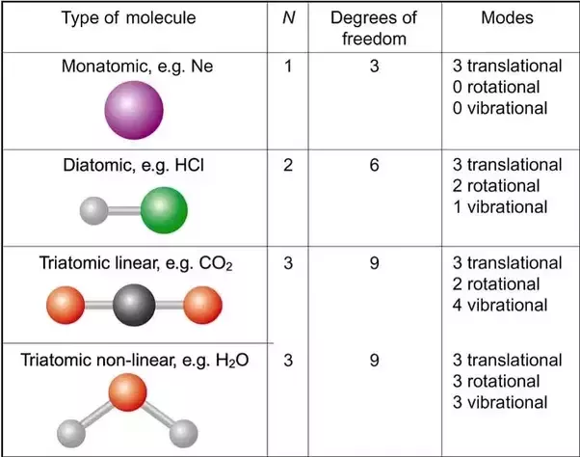
Degrees of Freedom

Slide 14
Generalised Coordinates

Slide 17
Thank You...

