Slide 1
B.Sc. Part – III
Year: 2020-21
B. Sc. III Physics Paper-XVI
Energy Studies and Materials Science
Miss. Ankita S. Yadav
Department of Physics
P.D.V.P. College, Tasgaon

Slide 2
Shivaji University, Kolhapur: CBCS Syllabus Chemistry
B.Sc. Part –III Semester (V and VI)
Nature of Syllabus
Semester V
Paper – XI : Mathematical Physics
Paper – X : Quantum Mechanics
Paper – XI : Classical Mechanics & Classical Electrodynamics
Paper – XII : Digital and Analog circuits and Instrumentation
Semester VI
Paper – XIII : Nuclear and Particle Physics
Paper – XIV : Solid State Physics
Paper – XV : Atomic and Molecular Physics and Astrophysics
Paper – XVI : Energy Studies and Materials Science
Theory: 200(50+50+50+50 =200 marks for each semester)
Practical : 200

Slide 3
Unit I Chapter - 1
Energy and Wind Energy
Energy, Forms of energy, Man and environment,
Energy chains, Classification of energy resources, Energy demands, Age of renewable and alternatives ,
Wind energy, Wind energy chains, Wind energy quantum, Planning of wind farm, Wind power density, Efficiency factor of wind turbine (P-H graph),
Power of wind turbine for a given incoming wind velocity, Types of a wind turbine generator unit,
Horizontal axis propeller type wind turbine generator unit.

Slide 4
Chapter – 2
Solar Energy
Solar energy, Solar energy spectrum (UV, Visible and IR),
Utilization of solar energy-thermal route, photovoltaic route, Essential subsystems in solar energy plant, Solar constant,
Clarity index, Solar insolation, Solar energy from satellite station through microwave to earth station, Solar photovoltaic systems,
Merits and limitations of solar PV systems, Prospects of solar PV systems, Power of a solar cell and solar PV panel.

Slide 5
Chapter – 3
Biomass Energy
Origin of biomass,
Biomass energy resources (biomass from cultivated crops, biomass from waste organic matter),
Biomass conversion process (biochemical conversion-anaerobic digestion and fermentation)

Slide 6
Unit- II Chapter – 1
Superconductivity
Idea of superconductivity,
Critical temperature,
Critical magnetic field, Meissner effect, Type-I
and Type-II superconductors,
London equation and penetration depth,
Isotope effect,
Application (magnetic levitation)

Slide 7
Chapter – 2
Nanotechnology
Introduction to nanoscience and nanotechnology,
Length scales relevant to nanoscience,
Nanostructures: 1D, 2D and 3D nanostructures,
Size effects in nanosystems, Quantum confinement, Synthesis of nanostructured materials(Top down and bottom up approach),
Photolithography,
Ball milling,
Nucleation and growth,
Applications of nanotechnology ( Spintronics, Molecular electronics, Nanobiotechnology )

Slide 8
Basics of Classical Mechanics
Solar Energy
Wind Energy
Biomass energy
Energy
Thermal Energy
Chemical Energy
Sound Energy
Nuclear Energy
Mechanical Energy

Slide 9
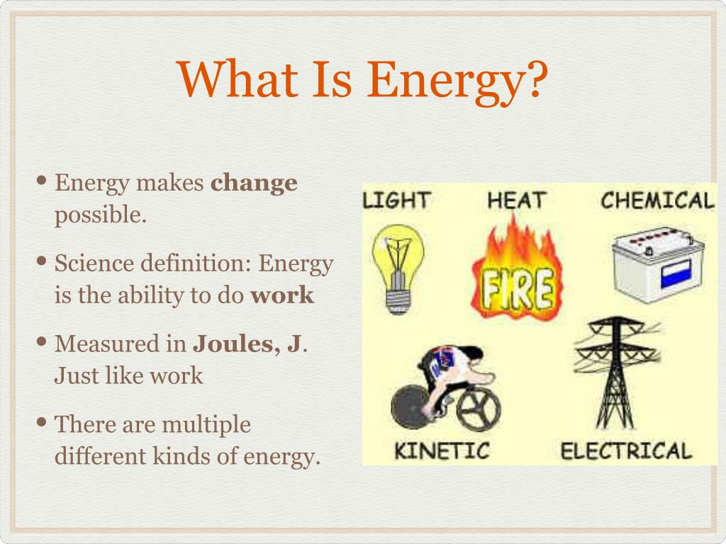
Energy
Energy is defined as the capacity of a physical system to perform work.
( E.g - Chemical Energy, Potential Energy, Kinetic Energy, Sound Energy etc.)

Slide 10
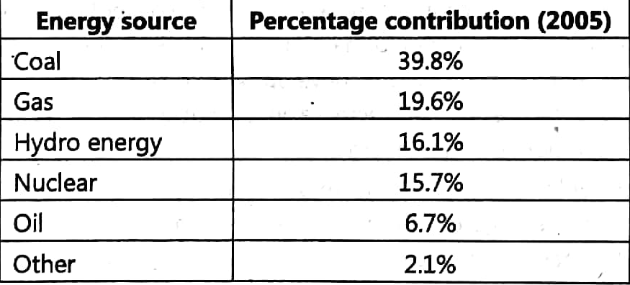
Energy

Slide 11
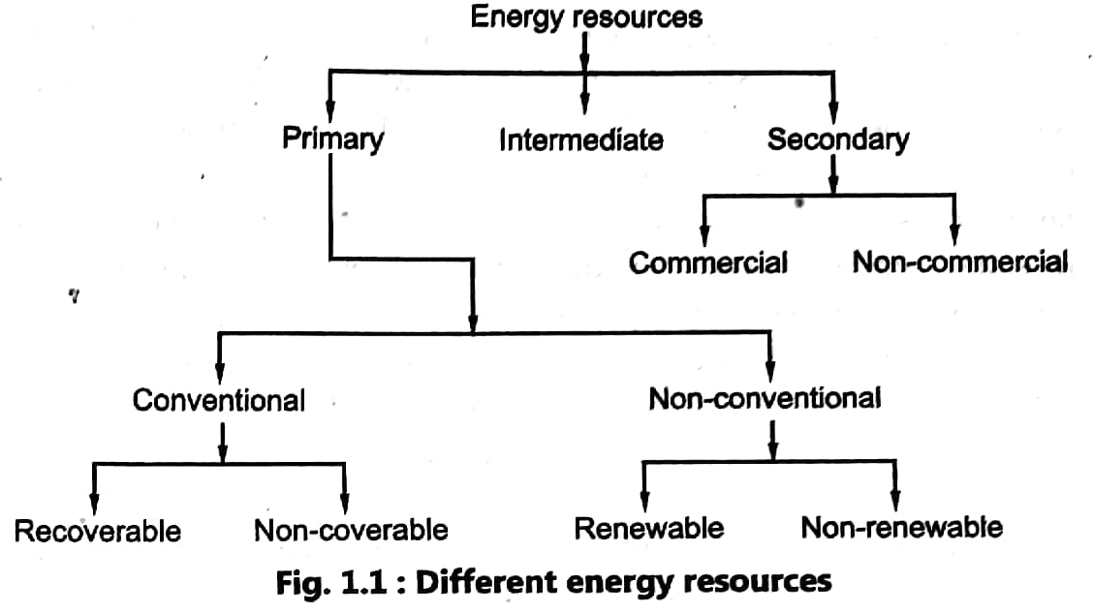
Classification of energy resources

Slide 12
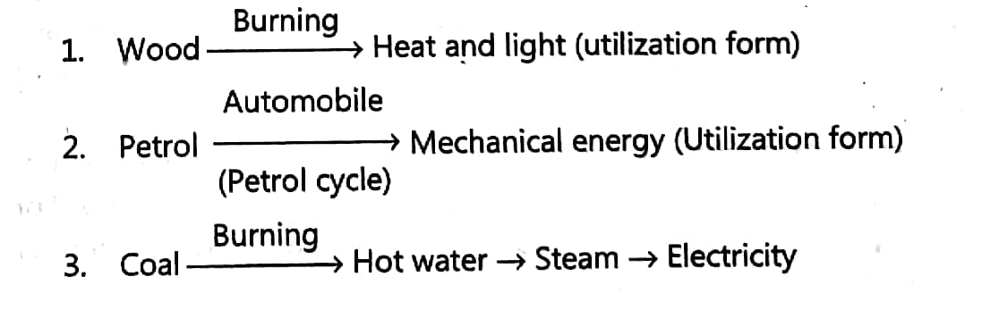

Slide 13
Age of renewable and alternatives
Solar energy :
Wind energy:
Geothermal energy:
Ocean thermal energy:
Ocean Wave energy:
Ocean tide energy:
Waste incineration:
Bio fuels:
Fuel-cell:
Nuclear energy:
Magneto-Hydro Dynamics (MHD):

Slide 14
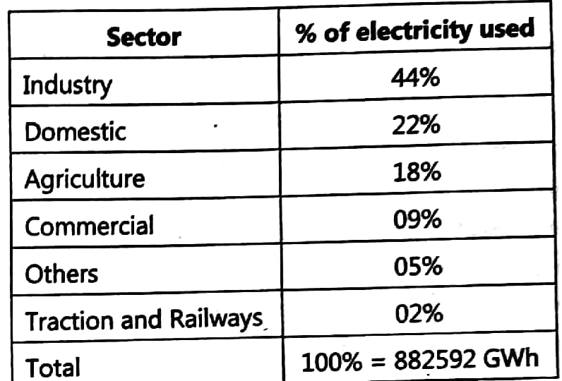
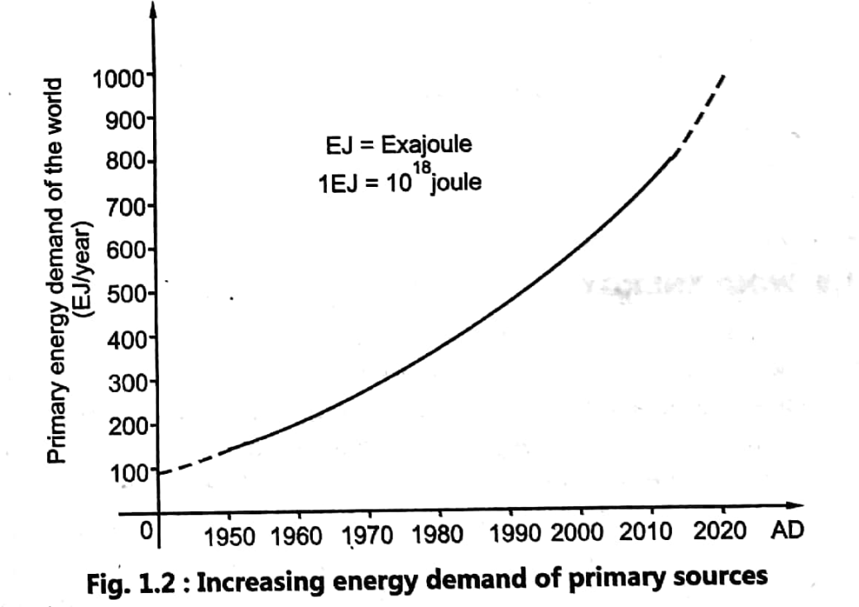
Energy demands

Slide 15

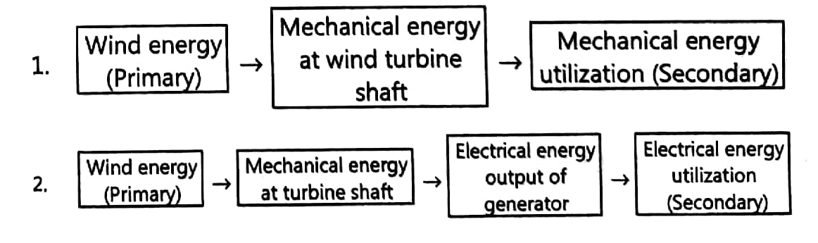
Wind Energy
Wind Energy Chain

Slide 16

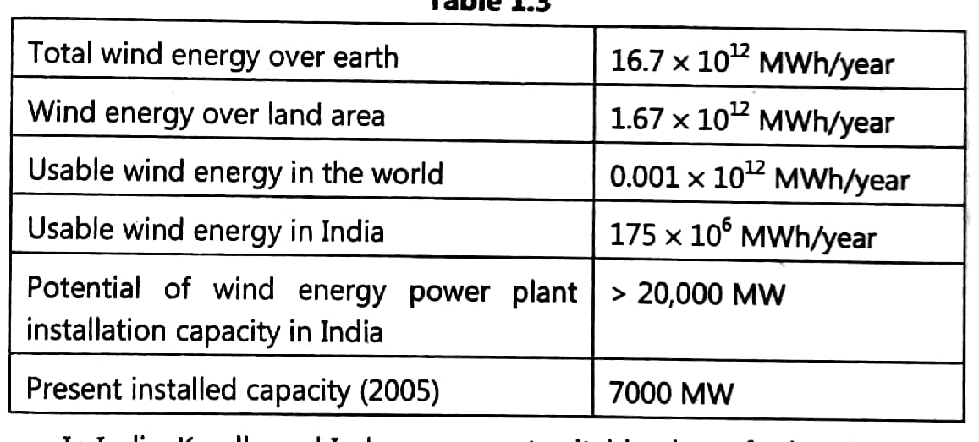
Wind energy quantum

Slide 17


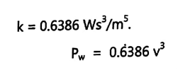

Wind Power Density

Slide 18

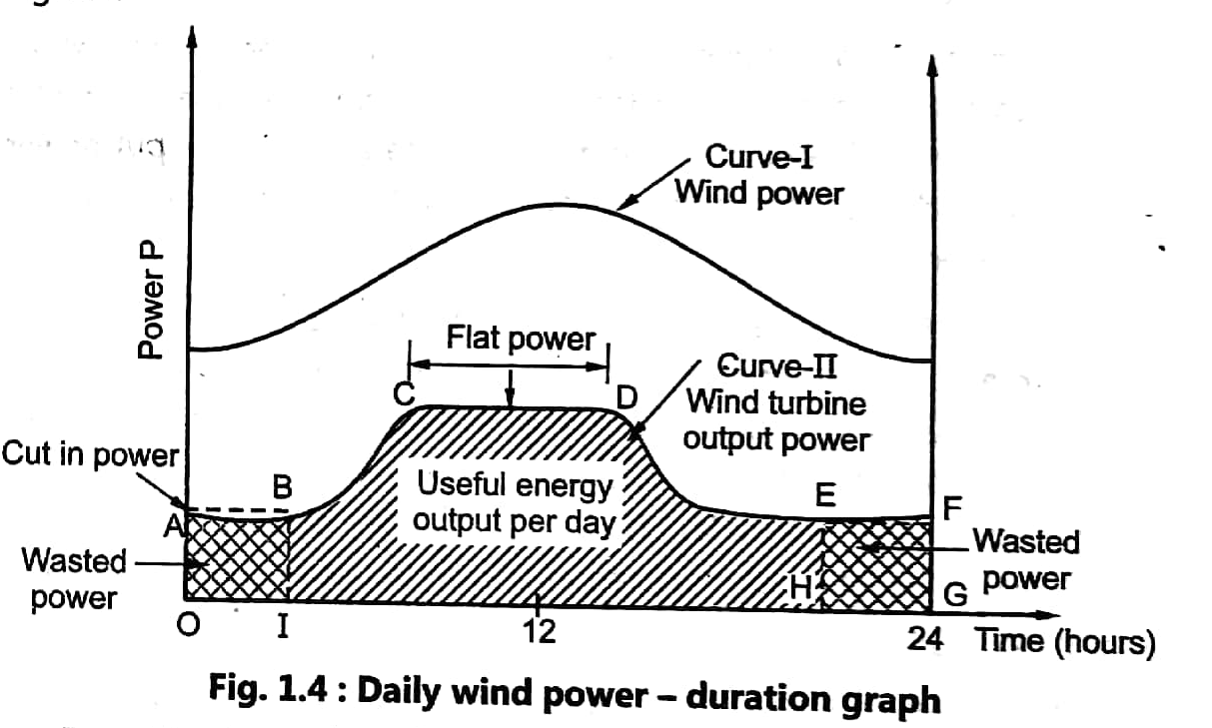
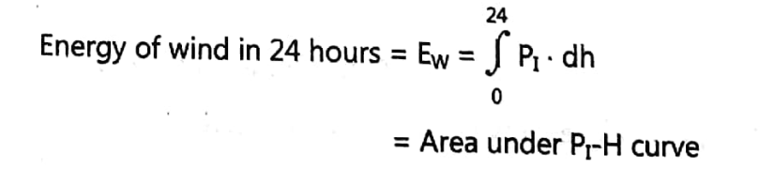
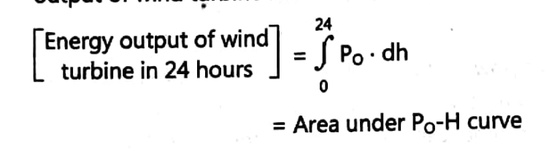
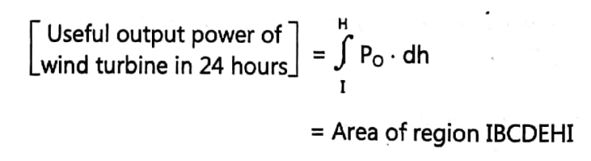
Efficiency factor of wind turbine (P-H graph)

Slide 19
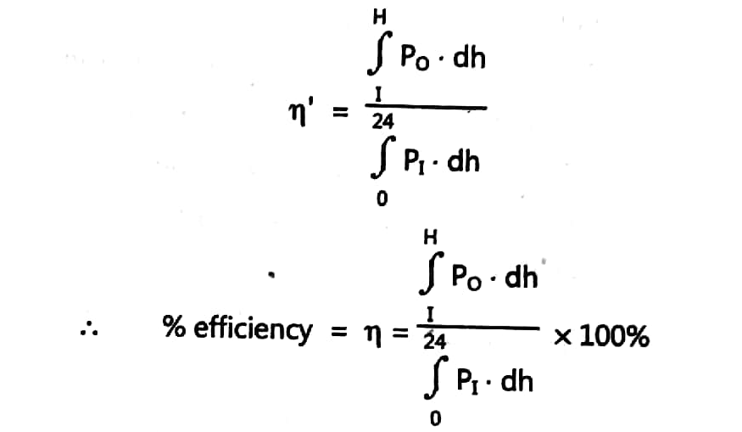


Slide 20
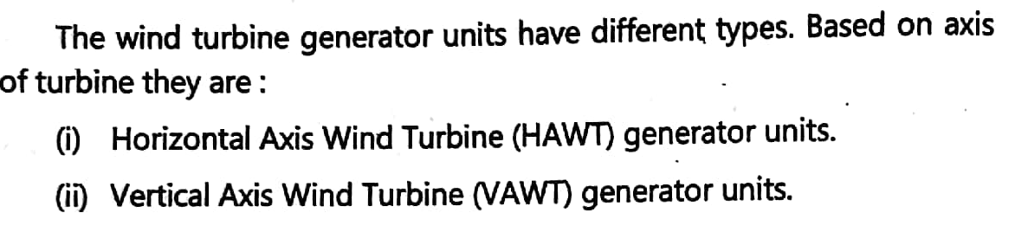
Types of a wind turbine generator unit
Propeller type horizontal axis :
Space frame rotor mansforth design:
Wind mill type multi-blade design:
Bicycle wheel multiblade design

Slide 21
VAWT
Darrius wind turbine with 𝜙 configuration:
VAWT with H- Configuration:
1. Monoblade HAWT:
2. Two – Blade HAWT:
3. Three- Blade HAWT:

Slide 22
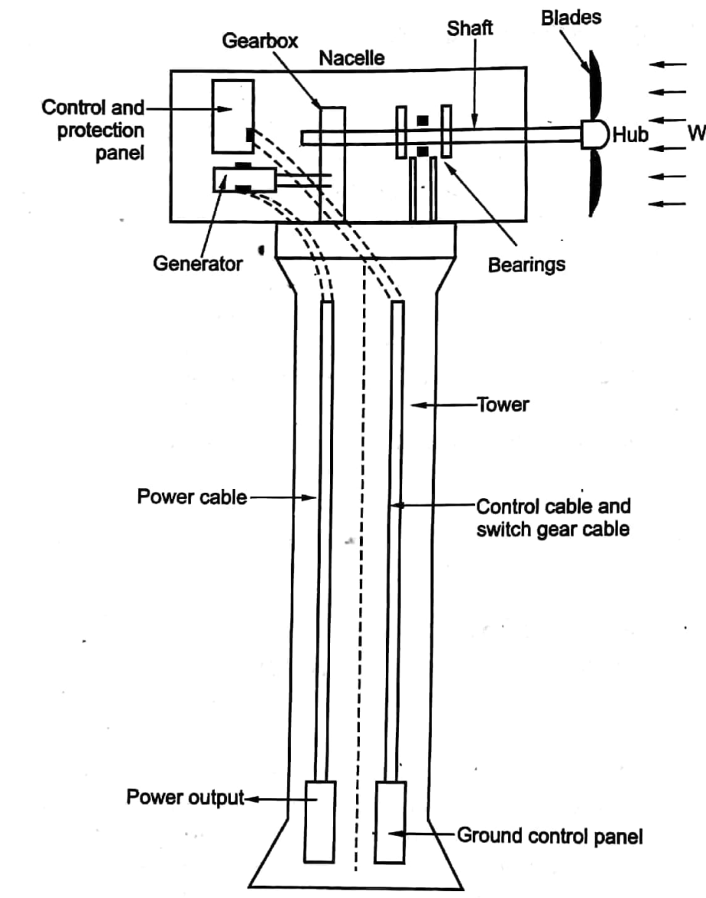
Horizontal axis propeller type wind turbine generator unit.
Hub
Propeller :
Nacelle:

Slide 23
Thank You!

