Slide 1
B.Sc II Semester iii
Physics Paper No.v
thermal Physics and statistical mechanics i

Slide 2
Topic Name:Laws of Thermodynamics
Thermodynamic Systems B.S.HARALE Asso.Prof. Dept.of Physics P.D.V.P.Mahavidyalaya, Tasgaon. Dist.Sangli, Maharashtra

Slide 3
THERMODYNAMICS
Introduction
The word is come from Greek Thermo – Heat Dynamics - power

Slide 4
Thermodynamic systems
1. System
2. Boundary,
3. Surroundings

Slide 5
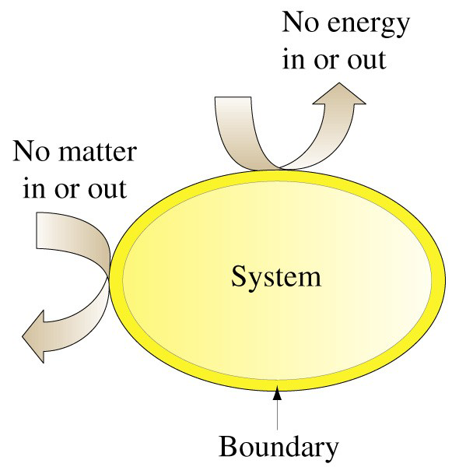

Slide 6
DEfination
System –
A thermodynamics system is defined a
definite space or area on which the study
of Energy Transfer and Energy conversions
is made

Slide 7
DEfination
Boundary –
The system and surrounding are
separated by boundary. It may be fixed
or movable or imaginary.It will not
occupy any volume or mass in space

Slide 8
DEfination
Surroundings -
Anything outside the system which
affects the behaviour of the system is
known as surroundings

Slide 9
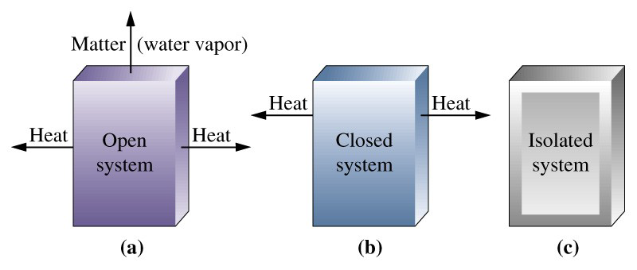
Open,Closed,Isolated Systems

Slide 10
Classification of thermodynamics systems
open, closed, Isolated systems
Open system - One in which Both Energy and
mass cross the boundaries of the
system.
Closed system - One in which mass does not
cross boundaries of the
system, though energy may
do so.
Isolated system - one in which neither mass nor
energy crosses the boundaries
of the system.

Slide 11
THANK YOU

