Slide 1
PADMABHUSHAN DR. VASANTRAODADA PATIL MAHAVIDYALAYA TASGAON DEPARTMENT OF PHYSICS B.Sc III

Slide 2
B.Sc. III Paper-XII Digital & Analog circuits & Instrumentation Topic Name:- Logic gate
Prof. Mr. B.S.Harale
Asso.Prof Department of Physics,
PDVP College Tasgaon.

Slide 3
Introduction: Boolean functions may be practically implemented by using electronic gates. The following points are important to understand. * Electronic gates require a power supply. * Gate INPUTS are driven by voltages having two nominal values, e.g. 0V and 5V representing logic 0 and logic 1 respectively. * The OUTPUT of a gate provides two nominal values of voltage only, e.g. 0V and 5V representing logic 0 and logic 1 respectively. * In general, there is only one output to a logic gate except in some special cases. * There is always a time delay between an input being applied and the output responding.

Slide 4
Logic gate 1) Basic gate :- OR,AND,NOT 2) gate:- NAND, NOR, Ex-OR, Ex-NOR

Slide 5
NOT gate *A NOT gate produces an output that is the complement of the input. It has only one input signal. *It produces a 1 output when the input is 0. and *It produces a 0 output when the input is 1. *The NOT gate is a single input single output gate. *This gate is also known as Inverter because it performs the inversion of the applied binary signal, i.e., it converts 0 into 1 or I into 0. *In other words, the gate which has high input signal only when their input signal is low such type of gate is known as the not gate.

Slide 6
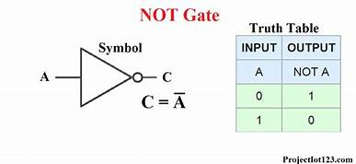
Symbolls:- The symbol of the not gate is a triangle with a bubble on its end. This bubble is known as the inversion bubble. It gives the complement of the input signal. It is also known as the decision making devices because it has only one input.

Slide 7
NAND gate
*The Logic NAND Gate is a combination of a digital logic AND gate and a NOT gate connected together in series.
*The logic or Boolean expression given for a logic NAND gate is that for Logical Addition, which is the opposite to the AND gate, and which it performs on the complements of the inputs.
*A NAND gate presents an AND gate followed by an inverter. It has 2 or more input signals.
*It produces a 0 output only when all the inputs are 1.
*It produces a 1 output when any of the inputs is 0.
*De Mergon’s second theorem says that the NAND gate is equivalent to a negative (bubbled) OR gate.

Slide 8
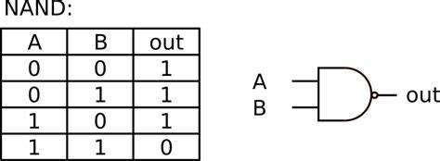
Symbolls:- *The NAND gate has the property of functional completeness. The function completeness means any types of gates can be implemented by using the NAND gate. *It performs the function of OR, NOR and AND gate. *The logic symbol for the gate is shown below.

