Slide 1
PADMABHUSHAN DR. VASANTRAODADA PATIL MAHAVIDYALAYA TASGAON DEPARTMENT OF PHYSICS B.Sc-III

Slide 2
B.Sc. III Paper-XII Digital & Analog circuits & Instrumentation Topic Name:- Logic gate
Prof. Mr. B.S.Harale
Asso.Prof Department of Physics,
PDVP College Tasgaon.

Slide 3
Introduction: Boolean functions may be practically implemented by using electronic gates. The following points are important to understand. * Electronic gates require a power supply. * Gate INPUTS are driven by voltages having two nominal values, e.g. 0V and 5V representing logic 0 and logic 1 respectively. * The OUTPUT of a gate provides two nominal values of voltage only, e.g. 0V and 5V representing logic 0 and logic 1 respectively. * In general, there is only one output to a logic gate except in some special cases. * There is always a time delay between an input being applied and the output responding.

Slide 4
Logic gate 1) Basic gate :- OR,AND,NOT 2) gate:- NAND, NOR, Ex-OR, Ex-NOR

Slide 5
Ex-NOR gate
*The XNOR gateis a digital logic gate whose function is the logical complement of the exclusive OR (XOR) gate.
*The two-input version implements logical equality, behaving according to the truth table to the right, and hence the gate is sometimes called an "equivalence gate".
*A high output (1) results if both of the inputs to the gate are the same. If one but not both inputs are high (1), a low output (0) results.
*An exclusive-NOR (X-NOR) gate is a coincidence gate. It produces a 1 output only when even number of 1 is present at the input.
*A 2-input X-NOR gate is an equality detector.
*It produces a 1 output only when its two inputs are equal i.e when both inputs are 1 or 0. An X-NOR gate can be used as a controlled inverter by connecting one input terminal to logic 0 and feeding the signal to be inverted to the other terminal.

Slide 6
*An exclusive-NOR (X-NOR) gate is a coincidence gate. It produces a 1 output only when even number of 1 is present at the input. *A 2-input X-NOR gate is an equality detector. *It produces a 1 output only when its two inputs are equal i.e when both inputs are 1 or 0. An X-NOR gate can be used as a controlled inverter by connecting one input terminal to logic 0 and feeding the signal to be inverted to the other terminal.

Slide 7
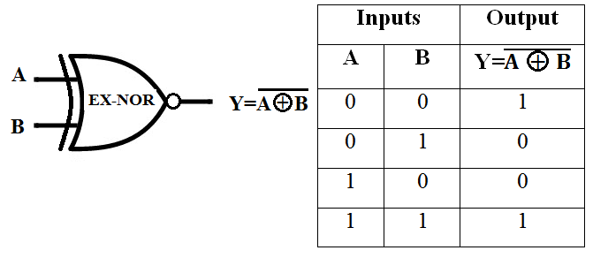
Symboll

