Slide 1
MOVING CO-ORDINATE SYSTEM
BY: MISS. M. C. SADAKALE
PADMBHUSHAN DR. VASANTDADA PATIL MAHAVIDYALAYA TASGAON.
DEPARTMENT OF PHYSICS
2019-2020

Slide 2
OUTLINE
Moving co-ordinate system (Translational motion)
Rotating co-ordinate system (Rotational motion)
Pseudo force (eg. Coriolis force)
y
y’
S
P
S’
r
r’
x
R
O
O’
x’
z
z’

Slide 3
Moving co-ordinate system(Translational motion)
Consider two co-ordinate systems or two reference frames S and S’
S’ is fixed with origin O’ having axes x’, y’ and z’
S is moving with velocity v having origin O with axes x’, y’ and z’
P be the point in space such that,
r is radius vector from O
r’ is radius vector from O’
R is radius vector from O’ to O
y
y’
S
P
S’
r
r’
x
R
O
O’
x’
z
z’

Slide 4
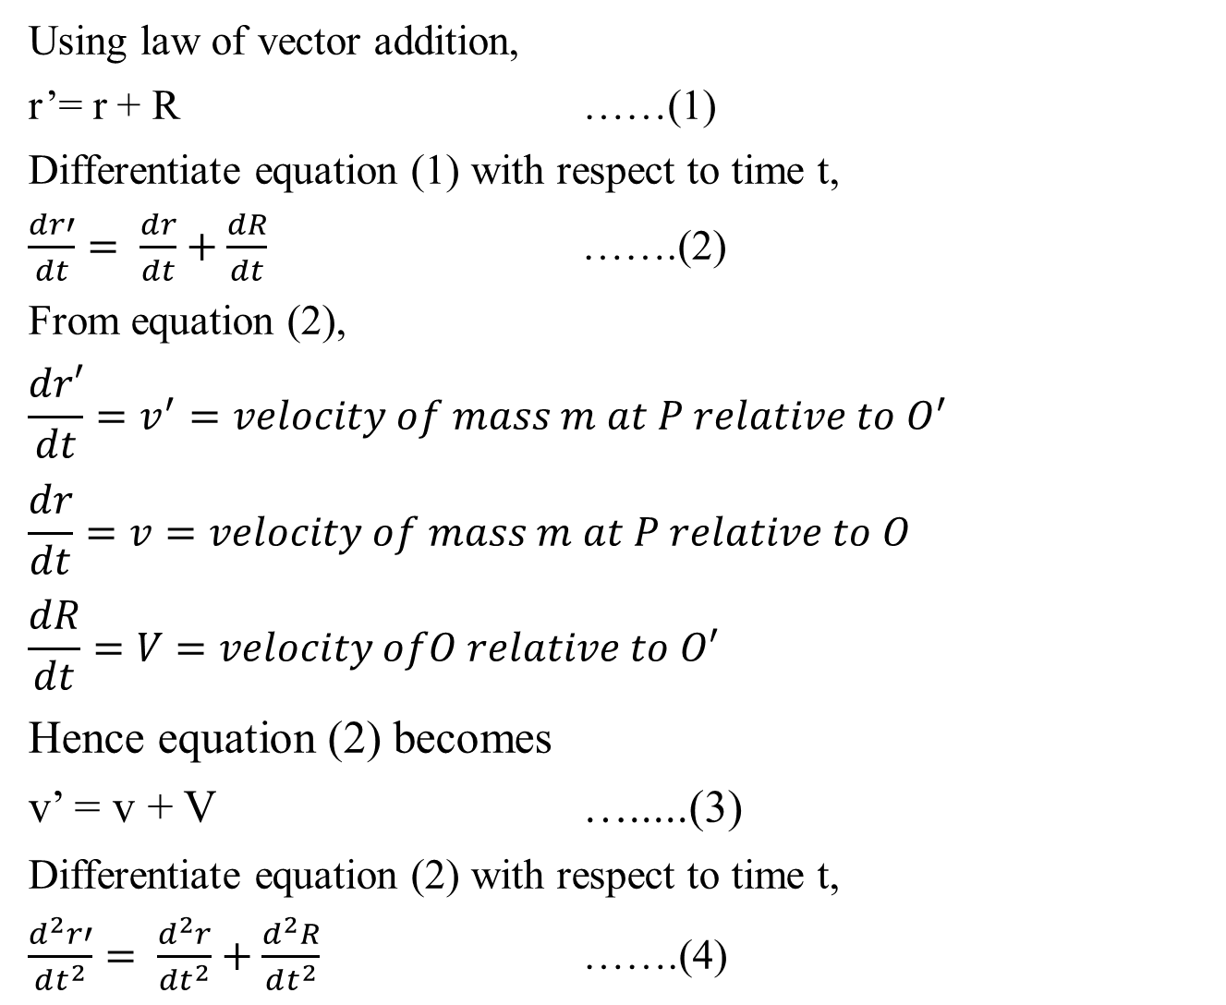
Using law of vector addition,
r’= r + R ……(1)
Differentiate equation (1) with respect to time t,
$\frac{dr′}{dt}= \frac{dr}{dt}+\frac{dR}{dt}$ …….(2)
From equation (2),
$$\frac{dr′}{dt}=v^{′}=velocity of mass m at P relative to O^{′}$$
$$\frac{dr}{dt}=v=velocity of mass m at P relative to O$$
$$\frac{dR}{dt}=V=velocity ofO relative to O′$$
Hence equation (2) becomes
v’ = v + V ….....(3)
Differentiate equation (2) with respect to time t,
$\frac{d^{2}r′}{dt^{2}}= \frac{d^{2}r}{dt^{2}}+\frac{d^{2}R}{dt^{2}}$ …….(4)

Slide 5
$\ddot{r^{′}}=\ddot{r }+ \ddot{R}$ …….(5)
From equation (2) operator equation becomes,
$\frac{d^{′}…}{dt}= \frac{d…}{dt}+\frac{d…}{dt}$ …….(6)
Also from equation (3) operator equation becomes,
$\frac{{d^{2}}^{′}…}{dt^{2}}= \frac{d^{2}…}{dt^{2}}+\frac{d^{2}…}{dt^{2}}$ …….(7)
multiply equation (7) by mass m of body at point P,
$$\ddot{{mr}^{′}}=m\ddot{r }+m\ddot{R}$$
From above equation we have following conclusions,
Force acting on the mass in fixed frame S’ is higher than that acting on the same mass relative to moving frame S by factor $m\ddot{R}$
When system S and S’ are moving with uniform relative velocity then V = $\dot{R }=constant$,then second term on RHS becomes zero. In this case S and S’ are called inertial frames of reference.
The second term on RHS gives rise to pseudo force i.e. pseudo force = $m\ddot{R}$

Slide 6
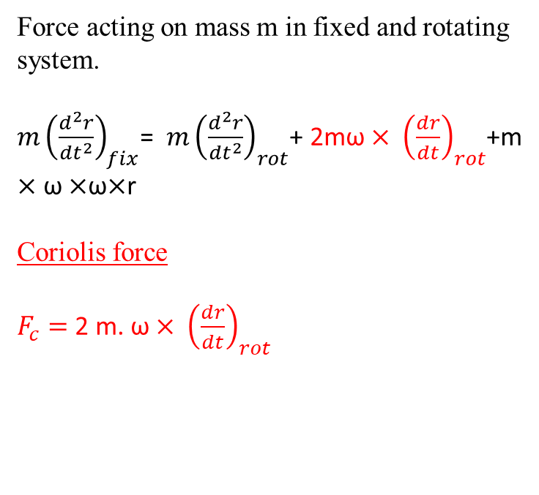
ω
y’
Rotating Co-ordinate System
y
S’
P
Force acting on mass m in fixed and rotating system.
$m{\left(\frac{d^{2}r}{dt^{2}}\right)}_{fix}$= $m{\left(\frac{d^{2}r}{dt^{2}}\right)}_{rot}$+ 2mω$× {\left(\frac{dr}{dt}\right)}_{rot}$+m$×$ ω$×$ω$×$r
Coriolis force
$F_{c}=$2 m. ω$× {\left(\frac{dr}{dt}\right)}_{rot}$
S
x
r
j
j’
i
x’
O’
i’
O
k’
k
z’
z

Slide 7
Effect of Coriolis force on nature
Flight of missile
The range and time of flight of missile projected form the surface of the earth is affected by the Coriolis force. In Northern hemisphere, when missile travels towards the north then it is deflected to the east through an angle α.
$$α= ωt sinθ$$
At poles defection is maximum and at equator there is no deflection.
b) Formation of cyclones
Cyclones formed in northern hemisphere are anticlockwise while those in southern hemisphere are clockwise. This is because of Coriolis force.

Slide 8
THANK YOU

