Slide 1
B.Sc. Part – II (Sem- III)
Year: 2020-21
Waves and Optics- I
(Paper: VI)
Miss. Ankita S. Yadav
Department of Physics
P.D.V.P. College, Tasgaon

Slide 2
Shivaji University, Kolhapur: CBCS Syllabus Chemistry
B.Sc. Part –II Semester (III and IV)
To be implemented from June -2018
Nature of Syllabus
Semester III
Paper – V : Thermal Physics and Statistics Physics - I
Paper – VI : Waves and Optics- I
Semester IV
Paper – VII : Thermal Physics and Statistics Physics - II
Paper – VIII : Waves and Optics- II
Theory: 200 (50+50+50+50 =200 marks for each semester)
Practical : 100 [Annual(Last Semester)]
Total : 500

Slide 3
CONTENTS
Unit – I
Superposition of Harmonic Oscillations
Coupled Oscillations
Wave Motion and Ultrasonic Waves
Unit - II
Sound and Acoustics of Buildings
Viscosity
Physics of low pressure

Slide 4
Unit I Chapter – 1 Superposition of Harmonic Oscillations
Linearity and superposition principle.
Superposition of two collinear harmonic oscillations for oscillations having equal frequencies.
Superposition of two collinear harmonic Oscillations having different frequencies (beats).
Superposition of two perpendicular harmonic oscillations having equal frequencies.
Superposition of two SHM’s at right angles to each other and having frequencies in the ratio 2:1
Uses of Lissajous figures.

Slide 5
Chapter - 2 Coupled Oscillations
Frequencies of coupled oscillatory systems
Normal modes and normal co-ordinates
Energy of coupled oscillations
Energy transfer in coupled oscillatory system.
Chapter -3 Waves Motion and Ultrasonic waves
Transverse waves on a string
Travelling and standing waves on a string
Normal modes of a string
Group velocity and Phase velocity
Plane waves and Spherical waves
Piezo-electric effect
Production of ultrasonic waves by Piezo-electric generator
Detection of ultrasonic waves
Properties ultrasonic waves
Applications of Ultrasonic waves

Slide 6
Unit II Chapter – 1 Sound and Acoustics of buildings
Transducers and their characteristics
Pressure microphone
Moving coil loudspeaker
Intensity and loudness of sound,
Decibels, Intensity levels, musical notes and musical scale.
Reverberation and time of reverberation
Absorption Coefficient
Sabine’s formula for measurement of reverberation time(T)
Acoustic aspects of halls and Auditoria.

Slide 7
Chapter- 2 Viscosity
Rate flow of liquid in a capillary tube - Poiseuille’s formula
Experimental determination of coefficient of viscosity of a liquid by Poiseuille’s apparatus method
Variations of viscosity of a liquid with temperature
Lubrication

Slide 8
Chapter – 3 Physics of low pressure
Introduction : Production and Measurement of low pressure
Some Characteristics of a vacuum pump
Rotary oil pump
Diffusion pump
Molecular pump
Knudsen Absolute Gauge
Pirani Gauge
Detection of Leakage

Slide 9
Production and Measurement of low pressure
Pump
A hydrodynamic pump machine is a device for converting the energy held by mechanical energy into fluid.
Single stage pump
Multistage/ Double stage pump

Slide 10
Some Characteristics of a Vacuum Pump
Speed of a pump
Gaede’s equation for pumping speed as,

Slide 11
b) Influence of connecting tubes:
Flow of gases through tubes at low pressures, greatly influences the vacuum obtainable.
c) Degree of vacuum attainable:
This is the lower limit of pressure obtained in the vessel to be evacuated by using a vacuum pump.

Slide 12
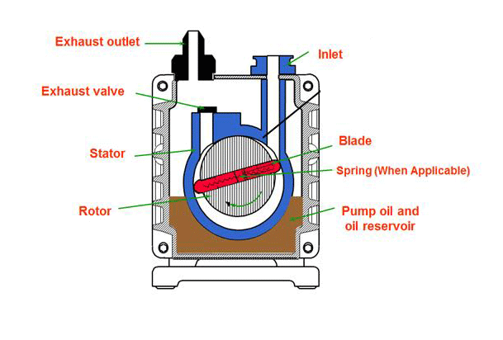
Rotary Oil Pump
Rotary Oil Pump
There are two types of rotary pumps
Rotary vane type
Stationary vane type
Principle :
Rotor
Stators

Slide 13
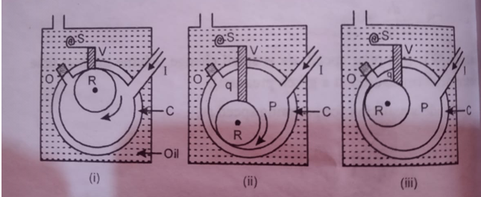
Construction:
Working:
First stage:
Second stage:
Third stage:

Slide 14
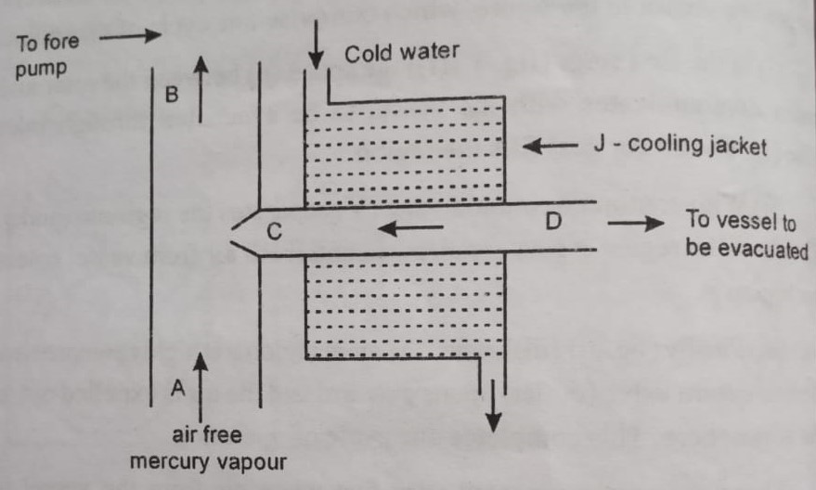
Diffusion pump
Principle : It is produce low pressure upto 10⁻⁶ mm
Construction :
Working :

Slide 15
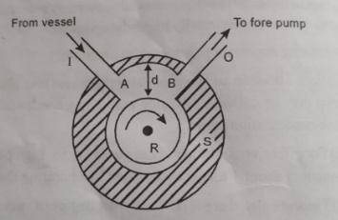
Molecular pump
Principle:
Construction:

Slide 16
Working:
According to kinetic theory of gases the pressure different created is given by,
Gaede showed that the pressure ratio is given by the relation,

Slide 17
Detection of leakage
Sizes of the leaks:
Physical verification :
This Techniques is used if even roughing vacuum (~ 10⁻¹ torr) can’t be reached.

Slide 18
2. Pirani gauge and Solvent Method :
This method is used for small leakages in this case the vacuum climbs above the roughing stage.
3. Helium leak detector :
Helium being very light gas, the He⁴ molecules are very small in size.
General rules for leak testing :
Test all components before assembly.
Connect the part to the vacuum system and test it for leak.

Slide 19
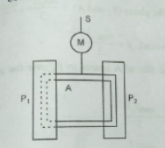
Knudsen Absolute Gauge
Principle:
It can measure pressure in the range from 10⁻³ torr to 10⁻⁷ torr.
Construction:

Slide 20
Working :
…………… (eq^{n} 1)
i.e.
… (eq^{n} 2)
Total pressure between the plates,
Pressure inside the vessel,

Slide 21
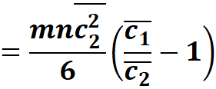
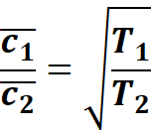
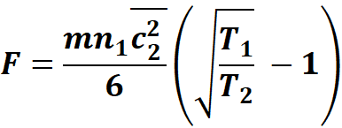
………… (From eq^{n} 2)
…….. (eq^{n} 3 )
……. ( Eq^{n}4)

Slide 22
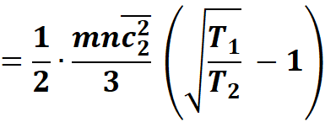
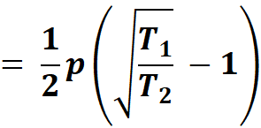
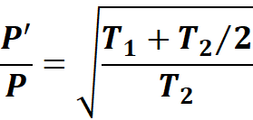
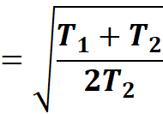
……… ( Eq^{n}5)
So, if p´ is the pressure between the plates (P₁ and A), then

Slide 23
……… ( Eq^{n}6)

Slide 24
……… ( Eq^{n}7)
From ( Eq^{n}6) and ( Eq^{n}7) , we get,
……… ( Eq^{n}8)

Slide 25
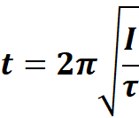
If t is the time period of vibration of the frame (A) whose moment of inertia is (I), then,
Substituting for τ in (eq^{n} 8) , we get,
…….. (Eq^{n}9)

Slide 26
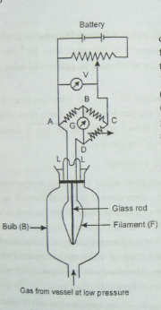
Pirani Gauge
Principle: It can measure pressure in the range from 10⁻² torr to 10⁻⁴ torr.
Construction:
working:

