Slide 1
Padmabhushan Dr. Vasantraodada Patil Mahavidyalaya, Tasgaon.
Department of Sociology
Dr. Vinodkumar D. Kumbhar
Assistant Professor,
Department of Sociology

Slide 2
B.A.PART –II. SOCIOLOGY
SEMESTER-IV : Paper No. V
SOCIAL CHANGE IN INDIA

Slide 3
SOCIAL CHANGE IN INDIA
SEMESTER- . IV
Paper No. V
SOCIAL CHANGE IN INDIA
UNIT-I- Social Change :
A) Tribal Social Change :
B) Rural Social Change:
C) Urban Social Change :

Slide 4
UNIT-I- Social Change :
Introduction
Change Is Law of Nature,
Change means modification in established patterns of inter-human relationship.
Change means observable differences in any social phenomena.
Change means as a new fashions or mode.
Change means new ideas or thoughts.

Slide 5
UNIT-I- Social Change :
Definitions
1. Jons : “Social change is a term used to describe variations in or modifications of any aspect of social processes, social patterns, social interactions or social organization.”
2. Ginsberg : “Social change means change in social structure.”
3. Davis : “Social change means change in social structure and social functions of society .”
4. MacIver and Page : “Social change means change in social relationships.”

Slide 6
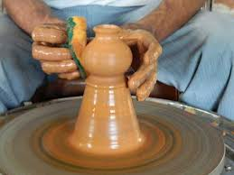
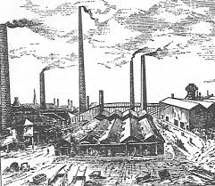
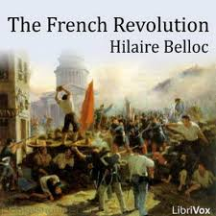
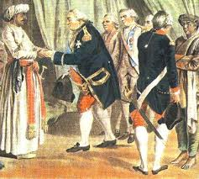
SOCIAL CNGE IN INDIA
Jons :

Slide 7
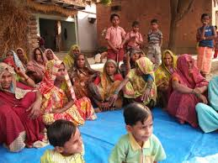
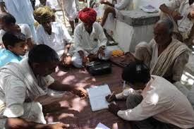
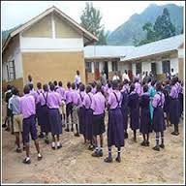
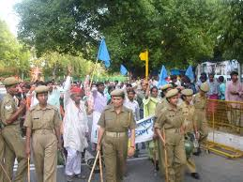
TRIBAL SOCIAL CHANGE IN INDIA

Slide 8
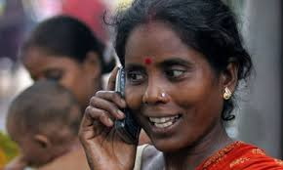
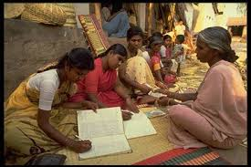
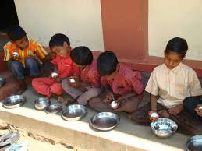
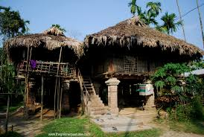
TRIBAL SOCIAL CHANGE IN INDIA
yauvaaga`haMcaa áhasa

Slide 9
TRIBAL SOCIAL CHANGE IN INDIA
1. Tribal Social Change :
2. Tribal Economic Change :
3. Tribal Cultural Change :
4. Tribal Religious & Magic Change:
5. Tribal Political Change :
6. Tribal Health Change :
UNIT-I- Social Problems:

Slide 10
TRIBAL SOCIAL CHANGE IN INDIA
1. Tribal Social Change :
A. Change In Family.
B. Change In Marriage.
C. Change In Clan, Totem & Totemism.
D. Change In Youth House.
E. Change In Social Relationship.
F. Change In Social Status & Rights.
G. Change In Traditions.

Slide 11
TRIBAL SOCIAL CHANGE IN INDIA
2. Tribal Economic Change :
A. Economic Actions.
B. Agriculture Changes.
C. New Occupations.
D. Effect On Money & Market.
E. Effect On N.G.O.S.
Notes:
AGRITUATRAL

Slide 12
TRIBAL SOCIAL CHANGE IN INDIA
3. Tribal Cultural Change :
A. Change In Life Style.
B. Change In Agencies Of Entertainment.
C. Change In Language.
D. Change In Food-stuff.
E. Change In Art.
F. Change In Play.

Slide 13
4. Tribal Religious & Magic Change: (Beliefs – Prayer – Sacrifice- Tabbo) 5. Tribal Political Change : (King Method - Jat Panchyat - Old People - Organization) 6. Tribal Health Change : New Health Problems - Kuposhan (Malnutrition)
TRIBAL SOCIAL CHANGE IN INDIA

Slide 14
TRIBAL SOCIAL CHANGE IN INDIA
Summary
There Are So Many Changes In Tribal Community.
Change In Education.
Change In Thought Process.
Manly Causes
British Rule – Law Of Forest- New Technology – Democracy System – Developmental Process – Natural Incidents .

Slide 15
THANK YOU

