Slide 1
B. Sc. – Part I Zoology Practical [DSC-15A DSC-16A]
Miss Gavali C.S.
Department of Zoology

Slide 2
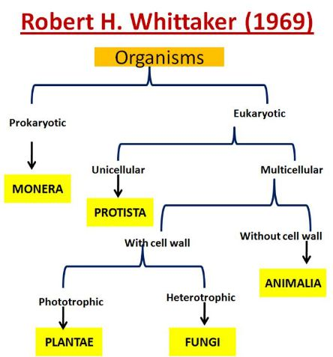
FIVE KINGDOM CLASSIFICATION
It is the most common system of classification in use today.
It is based on certain characters like the structure of the cell, mode of nutrition, the source of nutrition, interrelationship, body organization, and reproduction.
According to this system, there are five main kingdoms.
Kingdom Monera
Kingdom Protista
Kingdom Fungi
Kingdom Animalia
Kingdom Plantae
Kingdoms are divided into subgroups at various levels or the hierarchy of classification.
Kingdom → Phylum → Class → Order → Family → Genus → Species

Slide 3
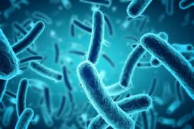
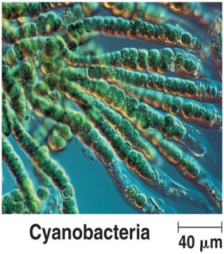
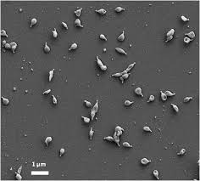
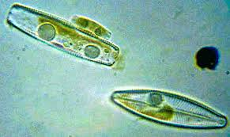
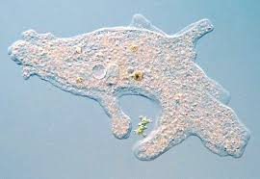
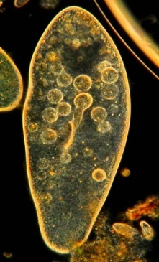
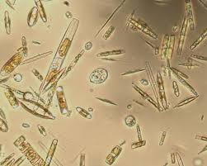
FIVE KINGDOM CLASSIFICATION
Kingdom: Monera
Prokaryotic and unicellular
Primitive nucleus
Nuclear membrane is absent
Lack cell organelles.
Some organisms show the cell wall
Autotrophic as well as heterotrophic.
Examples: Bacteria, Cyanobacteria, Mycoplasma.
Kingdom: Protista
Unicellular and eukaryotic organisms.
Well defined nucleus present
These are the simplest forms of eukaryotes
Autotrophic or heterotrophic mode of nutrition.
Appendages such as cilia, flagella or pseudopodia
Examples: Diatoms, Amoeba, Paramoecium

Slide 4
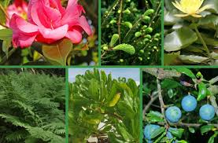
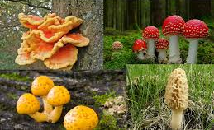
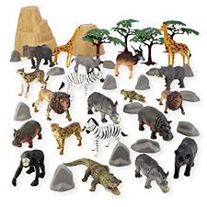
FIVE KINGDOM CLASSIFICATION
Kingdom: Plantae
Eukaryotic and Multicellular
Cell wall made up of cellulose.
They are Autotrophs
This kingdom includes all plants.
Kingdom: Fungi
Eukaryotic and Multicellular
Heterotrophic
Saprophytic mode of nutrition
Chitinous cell walls
Also form a symbiotic association with some blue-green algae.
Examples: Aspergillus, Mushroom,
Kingdom: Animalia
Eukaryotic and Multicellular
No cell wall.
Heterotrophic
Show Locomotion
Few are attached.
Examples – Hydra, Starfish, Earthworms, Birds, Monkeys etc.

Slide 5
KINGDOM PROTISTA
Classification
Kingdom Protista are categorized into two Sub-Kingdoms:
Protozoans - animal-like single-celled
Algae - plant-like single or multi-celled
Protozoans are classified depending upon locomotion into four Classes:
Sacordina - Pseudopod.
Mastigophora - Flagella.
Ciliophora - Cilia.
Sporozoa - No locomotion, Spore forming
Protista
Algae
Protozoa
Plasmoderma
Ciliophora
Ciliata
Sarcodina
Mastigophora
Sporozoa
Kingdom
Sub-Kingdom
Phylum
Class
Example:
Amoeba Euglena Plasmodium Paramoecium

Slide 6
KINGDOM PROTISTA
General Characters
Unicellular Eukaryotic
Solitary or colonial
some are multicellular like algae.
Live in water, in moist soil or Endoparasites.
They have mitochondria for cellular respiration
Some have chloroplasts for photosynthesis.
Contain multiple DNA strands,
Number of nucleotides less than complex eukaryotes.
Locomotion by Pseudopodia, flagella or cilia.
Respiration - aerobic, but some living in mud below ponds or parasitic are anaerobes.
Nutrition: Both autotrophic or hetreotrophic.
Reproduction - Asexual as well as Sexual
Some protists are pathogenic. Example: Plasmodium falciparum
Protists are major component of plankton.
Multicellular protists are not a plant, animal or fungus.

Slide 7
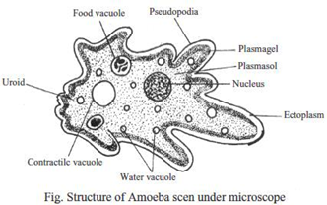
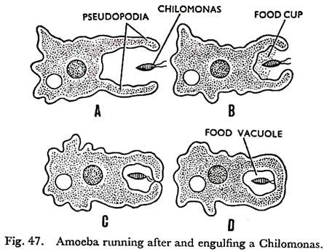
KINGDOM PROTISTA
Amoeba
Amoeba is found in mud, fresh water ponds, streams and ditches in which bacteria and decaying vegetation are rich.
Shape of body is irregular.
Body is covered by very thin and semi-permeable membrane called plasmalemma.
Protoplasm is divisible into an outer ectoplasm and an inner endoplasm.
The endoplasm is having single nucleus, a large single contractile vacuole and many food vacuoles.
Nutrition is holozoic.
Reproduction is by binary fission.
In Amoeba locomotion is called amoeboid movement and is performed by pseudopodia.

Slide 8
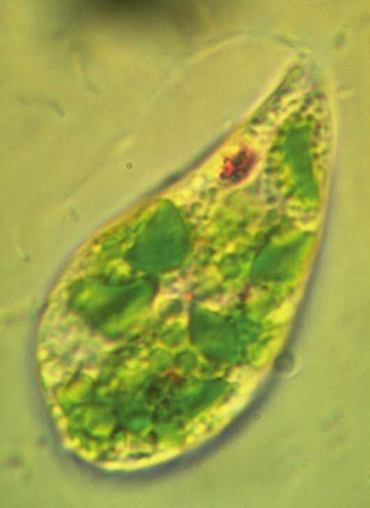
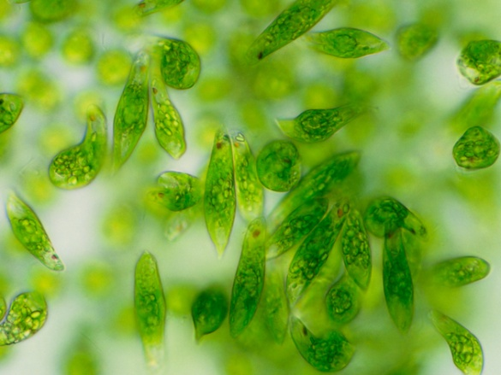
KINGDOM PROTISTA
Euglena
It is fresh water flagellate, found in ponds, ditches, pools and slow running streams.
The body is spindle shaped, green and measuring about 50-100 microns length.
Body covering is called pellicle which is marked by spiral striations.
The cytoplasm divisible into an outer ectoplasm and an inner endoplasm.
The endoplasm contains nucleus, chloroplast, paramylum and pyrenoids.
The anterior end contains flask shaped cytopharynx or gullet.
Nutrition is halophytic or saprophytic.
Stigmata or eye spot lie above the contractile vacuole which serves as photosensitive organ. It is a mass of red hematochrome granules.
A long flagellum originating from centroblepharoplast projects through the cell gullet.
Locomotion is due to the lashing movements of the flagellum, i.e. Euglenoid movement.
Reproduction usually by the binary fission.

Slide 9
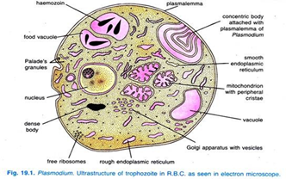
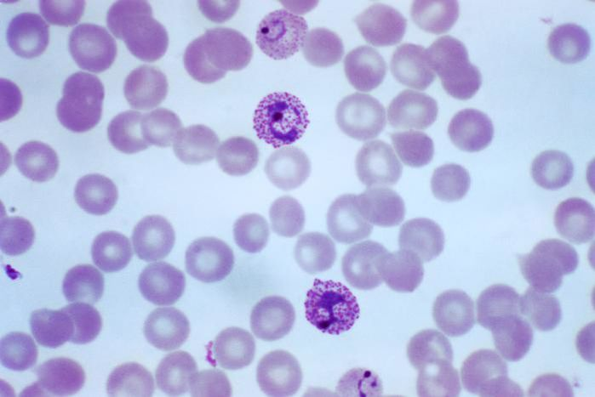
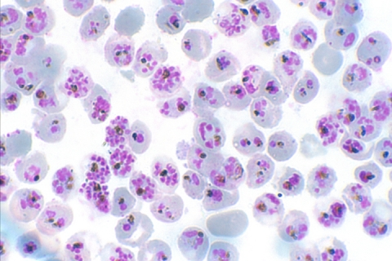
KINGDOM PROTISTA
Plasmodium
Plasmodium is a malaria parasite.
Life cycle of plasmodium is complicated and is completed in two hosts, man and female Anopheles mosquito.
Asexual cycle is passed in man in two phases. First phase in liver schizogony and second phase is completed in red blood cells and is known as erythrocytic schizogony.
After liver schizogony a stage called micro-metacryptomerozoite invades the red blood cells and becomes rounded to form a young trophozoite.
As the trophozoite grows in size, a central vacuole is developed.
As a result of this the nucleus is pushed to one side into peripheral cytoplasm and forms a Signet ring stage. It is a part of the erythrocytic schizogony.
This stage is clinically referred to as signet – ring stage.
In Sporozoa like Plasmodium locomotion is gliding or metaboly by myonemes
The common species of Anopheles which transmit malaria parasite in India are, A. maculates, A. stephensis, A. fluvialitis and A. culicifiacies.

Slide 10
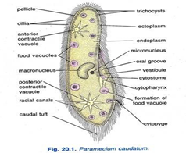
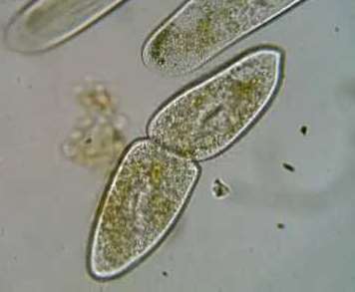
KINGDOM PROTISTA
Paramoecium
Paramecium is found in the mud, fresh water ponds, ditches in which organic matter and decaying vegetation is rich.
It is commonly known as slipper animalcule.
Body is slipper-shaped covered by the pellicle and cilia.
The cilia are arranged uniformly throughout the body, while at the posterior end of the body they are longer.
Protoplasm is divisible into an outer ectoplasm and an inner endoplasm.
The ectoplasm lies under the pellicle which contains trichocysts.
The endoplasm contains two nuclei, i.e. Macronucleus and micronucleus, two contractile vacuoles, i.e. anterior and posterior contractile vacuoles and many food vacuoles.
The oral groove runs backwards and ends into the mouth or cytostome.
Cytostome leads into a narrow cytopharynx, at the base of which food vacuoles are developed.
Cilia are the locomotory organs and the locomotion is called Ciliary locomotion.
Nutrition is holozoic.
Asexual reproduction is by binary fission and sexual reproduction is by conjugation, endomixis, autogamy and hemixis.

Slide 11
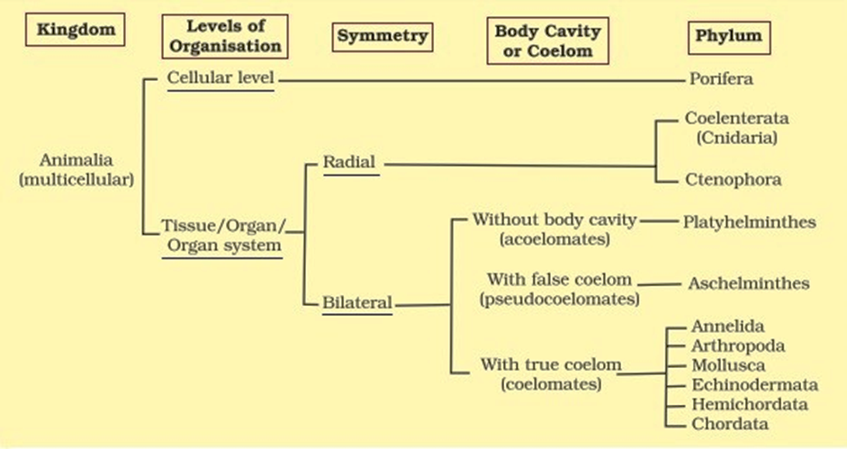
KINGDOM ANIMALIA
Characteristics of Classification
Body symmetry,
Nature of coelom,
Patterns of digestive, circulatory and reproductive systems,
Arrangement of cells in germ layers,
Segmentation,
Notochord.
Cellular Level - Sponges.
Tissue Level - Coelenterates.
Organ Level - Platyhelminthes.
Organ system Level – Annelids to Chordates.

Slide 12
PHYLUM PORIFERA
General Characters
Habitat: Aquatic, mostly marine, few are terrestrial
Habit: They are solitary or colonial.
Grade of organization: cellular grade of body
Shape: Body shape is variable, mostly cylinder shaped
Symmetry: Asymmetrical or radially symmetrical.
Germ layer: Diploblastic animals. In ecodermis and endodermis, there is a gelatinous and non-cellular mesoglea containing numerous free amoeboid cells.
Coelom: Absent; acoelomate but spongocoel is present
Surface of the body has numerous perforation called ostia (for the entry of water) and a large pore at the apex called osculum (for the exit of water).
Water canal system present
Endoskeleton: Either calcareous spicules (calcium carbonate) or siliceous spicules (silica) or sponging fibres (protein).
Nutrition: holozoic
Digestion: Intracellular
Nervous system: absent
Circulatory system: absent
Reproduction:
Asexual: by budding or gemmule or regeneration
Sexual: gamatic fusion
Fertilization: Internal

Slide 13
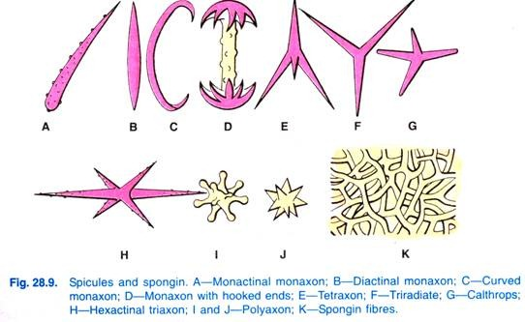
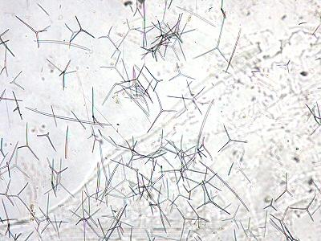
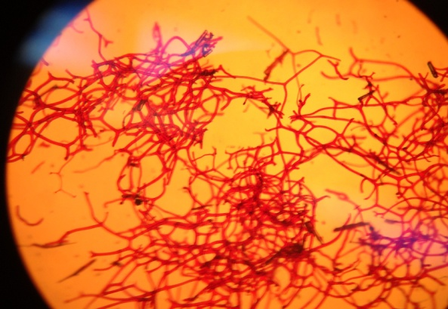
PHYLUM PORIFERA
Classification
Class: Calcarea:
They all are marine, shallow and coastal water species.
Body is vase shaped
Radially symmetrical body.
Skeleton consists of calcareous spicules
Spicules may be monoaxon, triaxon, tetraxon.
Canal system is Ascon or Sycon
e.g. Sycon, Grantia, Leucosolenia.
Class: Demospongia
They may be fresh water or marine.
Their body is massive and asymmetrical.
Canal system is Leucon type.
Skeleton consists of Spongin fibers, siliceous spicules which are monoaxon and triaxon.
e.g. Euspongia, Spongilla
Class: Hexactinellida
They all are marine and deep sea species.
Body is vase shaped or cylindrical.
They are radially symmetrical.
Skeleton consists of siliceous spicules which are triaxons with six rays.
Canal system may be Sycon or Leucon
e.g. Hyalonema, Euplectella

Slide 14
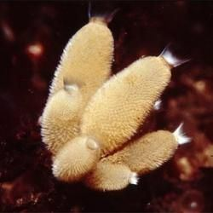
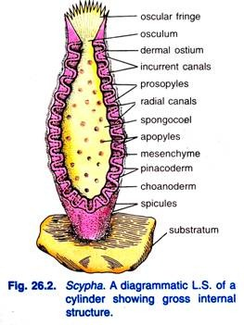
PHYLUM PORIFERA
Scypha
Sycon is a solitary colonial sponge, found attached to the rocks and other substratum in shallow sea water.
The body is slender vase-like or cylindrical.
The surface of the body is perforated by numerous pores called ostia.
Each cylinder is attached to the substratum by base and opens to the exterior by an opening called osculum.
Osculum is fringed by monaxon spicules.
The body wall is made up of the dermal epithelium.
Skeleton mainly consists of the calcareous spicules, which project out from the epithelium.
Each cylinder has a central large cavity called the spongocoel.
The spongocoel opens outside through the osculum.
Nutrition, respiration and excretion are performed by canal system.
Reproduction by both asexual and sexual mode.

Slide 15
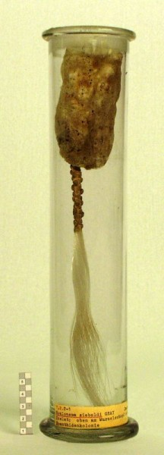
PHYLUM PORIFERA
Hylonema
It is exclusively marine in habitat found at the depths of 100-150 meters.
Body shape is variable, usually rounded or oval.
The body looks like a structure of glass wool with projecting tufts of glass spicules.
Body is supported by spicules of six rays and small amphidiscs.
Body is raised from the substratum by a stalk like root tuft which is twisted like a rope.
Root tuft is made up of a bundle of very long anchoring root spicules.
Root tuft also traverses the body as an axis or columella and usually project above as gastral cone.

Slide 16
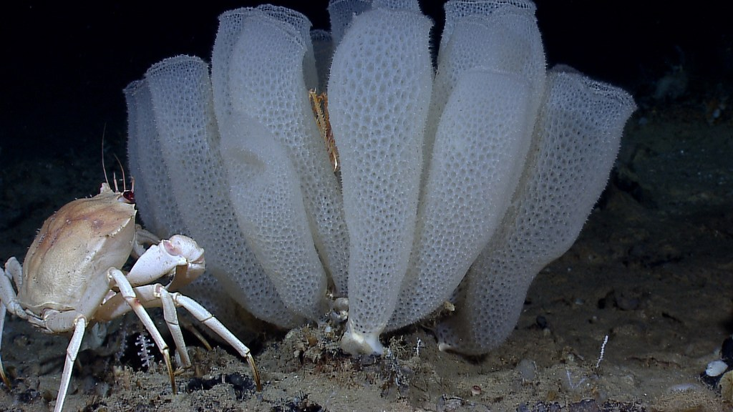
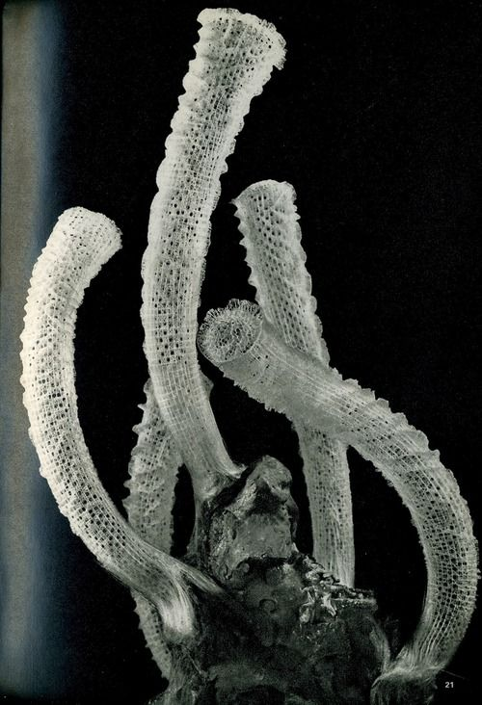
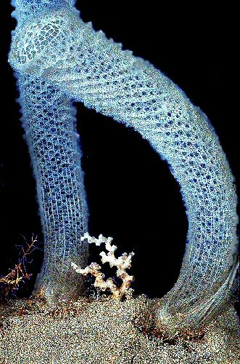
PHYLUM PORIFERA
Euplectella
It is commonly called as Venus flower basket due to its beautiful elegant glassy shape.
The animal measures 15-30 cm. in diameter.
The body is long, rigidly curved and cylindrical.
Body is composed of 4 and 6 rayed spicules forming 3 dimensional networks with parietal gaps.
The spicules are joined together forming a network.
It has knitted basket shaped body, ostia and oscular sieve plate hence it is Euplectella.

Slide 17
PHYLUM COELENTERATA
General Characters
Aquatic, mostly marine and some are fresh water forms (e.g. Hydra).
May be solitary (e.g. Hydra) or colonial (Obelia).
Many are sedentary (Corals). A few are active swimming or free-floating (e.g. Aurelia).
Body is cylindrical, cup-shaped or flat.
Bilaterally symmetrical (Sea anemone) or radially symmetrical (mostly) with central gastro-vascular cavity.
Multicellular with tissue grade of body organization.
Body wall is diploblastic i.e. outer-ectoderm (epidermis) and inner layer-endoderm (gastrodermis). Between them, there is a gelatinous non cellular layer called mesoglea is present.
They are acoelomate animals.
Body possess an internal hollow cavity, called coelenteron, which performs the function of intestine.
Nutrition is holozoic.

Slide 18
PHYLUM COELENTERATA
General Characters
Mouth is encircled with tentacles, having nematocysts. Mouth opens to gastrovascular cavity but anus is absent.
Tentacles helps in food capturing, its ingestion and also for defense. Tentacles bear nematocyst which are the organ of defense, adhesion and food capturing.
Digestion is intracellular or extracellular.
They do not possess skeletal structures but coral polyps secrete calcareous skeleton.
Locomotion takes place by smooth muscle fibers and tentacles. Some like coral and sea anemone remain fixed on substratum.
Respiratory, excretory and circulatory organs are absent. Respiration and Excretion takes place through general body surface.
They are ammonotelic since their excretory material is ammonia.

Slide 19
Classification
PHYLUM COELENTERATA
Hydrozoa
Habitat: mostly marine, few are fresh water
Habit: some are solitary and some are colonial
Asexual Polyps is dominant form
Medusa possess true velum
Mesogloea is simple and acellular
Examples: Hydra, Obelia, Physalia
Scyphozoa
Habitat: exclusively marine
Habit: solitary, freely swimming
Medusa is dominant and it is Large bell or umbrella shaped
Polyps is short lived or absent
Mesogloea is usually cellular
Examples: Aurelia (Jelly fishe)
Anthozoa
Habitat: exclusively marine
Habit: Solitary or colonial
Medusa stage is absent
Mesogloea contains fibrous connective tissue and amoeboid cells.
Examples: Metridium (sea anemone), Telesto, Tubipora, Xenia

Slide 20
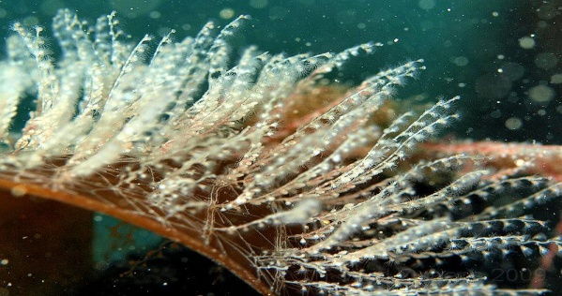
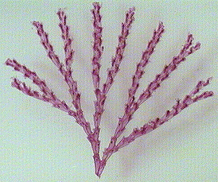
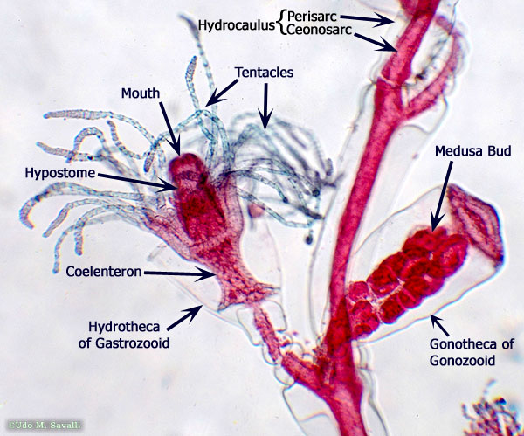
PHYLUM COELENTERATA
Obelia
Obelia is a colonial, marine, sedentary coelenterate, attached to seaweeds, shell and rocks.
The colony of Obelia is made up of the branches and zooids.
The colony is having as inner, tubular and living part the coenosarcs.
The coenosarcs is surrounded by tough and non living layer called the perisarc.
The coenosarc is continuous with the zooids.
The colony of the Obelia is dimorphic i.e. it shows two types of zooids.
The zooids are the polyps or hydranths and blastostyles.
The polyps or hydranths are nutritive in function and called as gastro zooids.
The blastostyles are reproductive in function, so called as gonozooids.
The perisarc is a yellowish or brown, tough, transparent layer.
The perisarc is a protective layer made up of the cuticle.

Slide 21
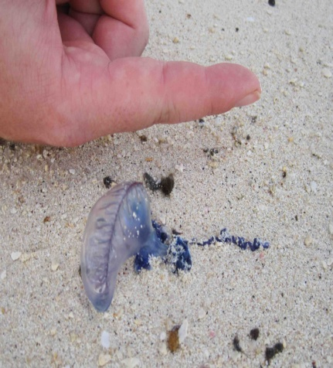
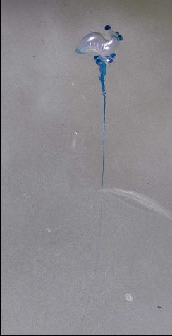
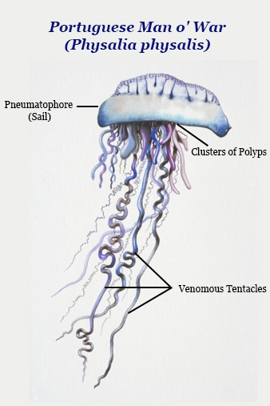
PHYLUM COELENTERATA
Physalia
The Portuguese man-of-war is a floating hydrozoan colony consisting of four types of polyps.
The pneumatophore functions as the float, dactylozooids function as tentacles, gastrozooids function as feeding zooids, and gonozooids produce gametes for reproduction.
The Portuguese man-of-war has two types of stinging cnidocyte cells used to obtain food with the help of the tentacles.
Food sources usually consist of fish fry and small adult fish as well as small crustaceans.
Sensory cells are numerous and located in the epidermis of the tentacles and the region around the mouth.
Movement of the Portuguese man-of-war is done passively with the aid of its gas-filled float.
The reproduction of the Portuguese man-of-war is based on the colony of unisexual organisms, with each individual having specific gonozooids.

Slide 22
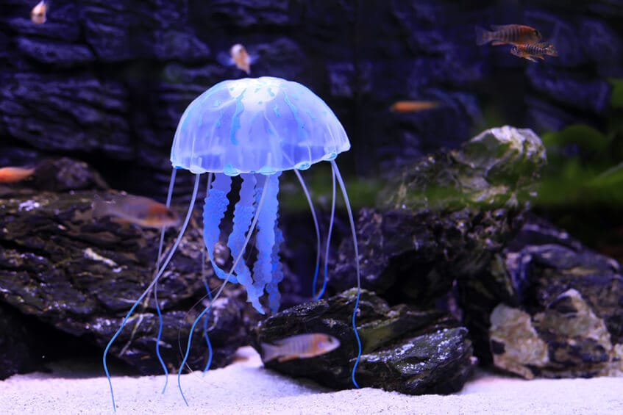
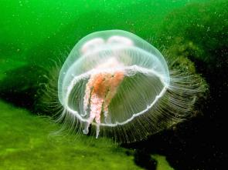
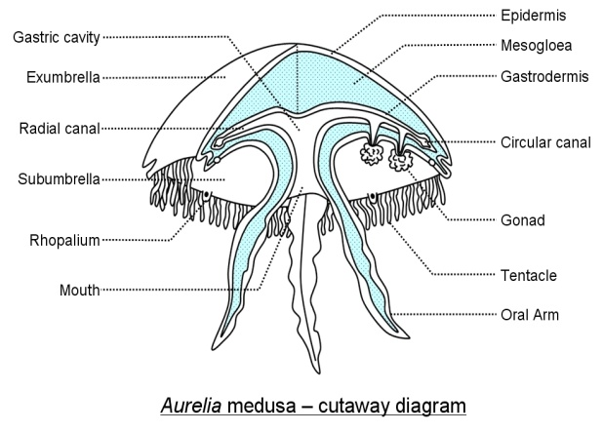
PHYLUM COELENTERATA
Aurelia
It is exclusively marine and commonly known as jelly fish.
Body is soft bell or umbrella-shaped, perfectly transparent and bluish in colour.
The reddish or pinkish horseshoe-shaped, gonads are clearly visible from the surface.
The circular body presents a concave oral or subumbrellar surface.
From the centre of sub – umbrellar surface hangs down a short manubrium.
At the free distal end of manubrium a squarish mouth is present.
From each corner of the mouth hangs down a long, tapering much – frilled delicate oral arm.
Each oral arm has ventral ciliated groove leading into mouth.
The edges of arms are beset with stinging cells called nematocysts.
The circular margin of umbrella is broken into 8 lobes by notches. In each notch is a sense organ called tentaculocyst.
The free edge of umbrella is base with closely set delicate hollow marginal tentacles.

Slide 23
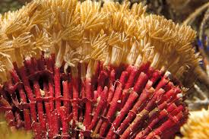
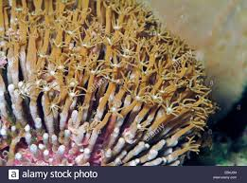
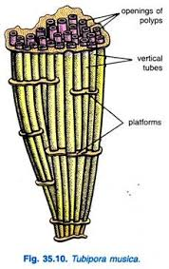
PHYLUM COELENTERATA
Tubipora
The organ pipe coral can be found in the shallow waters of the west Pacific to the south of Japan, west to Africa's east coast, and throughout the Red Sea. They prefer sheltered areas on reef slopes.
The organ pipe coral is unlike most corals due to the fact that it lacks colorful polyps, but has a dark red colored skeleton composed of thin tubes that look similar to a pipe organ.
Colonies of organ pipe coral polyps can form mounds of up to 50cm in diameter. They also form symbiotic relationships with zoochlorallae to obtain nutritional benefits.
In addition, the polyps of the organ pipe coral can use their tentacles to catch plankton and other small microorganisms that happen to float by.
The organ pipe coral is an important part of maintaining a balanced reef ecosystem that humans rely on for a number of reasons. It is currently considered near threatened on the IUCN Red List.

Slide 24
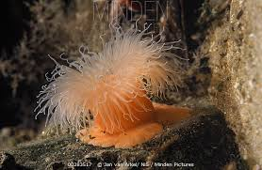
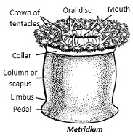
PHYLUM COELENTERATA
Metridium
Strictly marine, solitary or colonial and are fixed to substratum.
These are only polyps medusoid stage is absent.
Coelenteron is divided and mesoglea contains cells and fibers.
Body is short cylindrical and radially symmetrical. It is divided in to pedal disc, column and oral disc.
Pedal disc is attached to substratum firmly and the column forms major part of the body.
The column is divided in to an upper short thin walled capitulum and lower thick walled scapus.
The capitulum and the scapus are separated by a prominent fold called as collar.
Oral disc is expanded and crowned with several marginal tentacles around the mouth.
It is dioecious animal and asexual reproduction by budding and fragmentation

Slide 25
PHYLUM PLATYHELMINTHES
General Characters
Body is elongated, dorsoventrally flattened, soft leaf like or tape like.
Body is covered by ciliated epithelium or cuticle.
Mostly parasitic (ecto- or endo-), some are free-living.
Parasitic form have adhesive structures like spines, hooks, suckers and other devices for attachment with host.
Soft bodied. May be segmented or non-segmented.
Body wall is triploblastic i.e. made up of 3 layers; outer ectoderm, middle mesoderm and inner endoderm.
Bilaterally symmetrical with definite polarity of anterior (head) and posterior (tail) end.
They are acoelomate animals. Space between body wall and internal organs is filled up with parenchyma.
Nutrition is holozoic type.
Digestive system is incomplete without anus or absent in few parasitic form.
Respiratory and circulatory organ are absent. Respiration occurs through general body surface. Anaerobic respiration occurs in parasites and aerobic in free-living.
Excretory organs are flame cells or protonephridia or solenocytes.

Slide 26
PHYLUM PLATYHELMINTHES
General Characters
Nervous system is primitive and ladder like. It consists of a pair of anterior ganglia with longitudinal nerve cords connected by transverse nerves.
Sense organ are usually absent or reduced in parasitic forms. But sense cells are found in the body wall of turbellarians and are able to respond various stimuli.
They are hermaphrodite or bisexual or monoecious except Schistosoma.
Reproductive system is well developed. Reproduction occurs sexually but in few forms such as freshwater form asexual reproduction occurs by fission.
Fertilization is internal and may be cross or self.
Development may be direct or indirect. Usually indirect in endo-parasites with complicated life cycle involving many larval stages and hosts. Direct in free living forms.

Slide 27
PHYLUM PLATYHELMINTHES
Classification
Turbellaria
Mostly Free-living fresh water organism
Body: dorsoventrally flattened
Hooks and sucker usually absent
Examples: Planaria, Bipalium, Otoplana, Notoplana
Trematoda
Mostly parasitic
Body: dorso-ventrally flattened leaf like
Hooks and sucker are present
Examples; Fasciola hepatica (Liverfluke), Diplozoon,
Cestoda
Exclusive parasitic
Body: dorso-ventrally flattened tape like
Hooks and sucker are present
Digestive system-absent
Excretion: Protonephridia with flame cell
Examples: Taenia spp

Slide 28
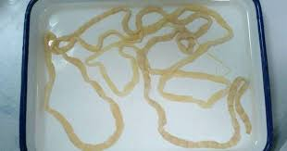
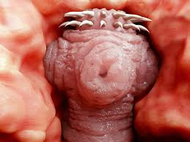
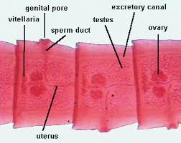
PHYLUM PLATYHELMINTHES
Tapeworm
It is an endoparasite in the intestine of man.
The body is ribbon like, differentiated in to scolex, neck and about 700-900 segments.
Scolex contains 4 suckers and a rounded rostellum.
Rostellum is crowned at its base by a double row of 28-32 hooks.
Below the scolex there is a area of segmentation called the neck.
Neck is followed by a large number of immature, mature and gravid proglottid or segments.
Mature segments contain fully developed hermaphroditic genital organs.
Male reproductive system consists of testes, vasa efferentia, vas deferens and cirrus.
Female system consists of a single bilobed ovary, oviduct, vitellaria and vagina.
Ingestion of improperly cooked pork beef leads to the infection.
It causes various diseases in man like anemia, eosinophilia, diarrhoea, haemorrhage, abdominal pain, nausea etc.

Slide 29
PHYLUM ASCHELMINTHES
General Characters
Habitat: They are marine or freshwater animal.
Habit: They are endoparasite.
Coelom: Pseudocoelomate which means they have a cavity called pseudocoel between the gut and body wall.
Symmetry: bilateral
Germ layer; triploblastic
Grade of organization: Organ system grade
They are non-segmented round worm.
Their body is covered with cuticle.
Digestive system: simple type
The mouth is provided with hooks and suckers
Respiratory system: Absent
Circulatory system: Absent
Nervous system: poorly developed
Excretory system: Protonephridia and canals
They are unisexual or dioecious animals
Reproduction: sexual by gamatic fusion
Fertilization: internal

Slide 30
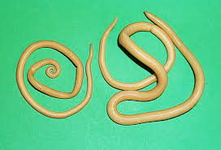
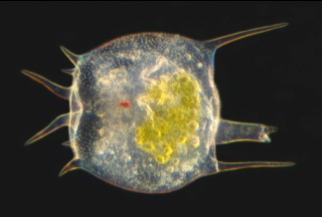
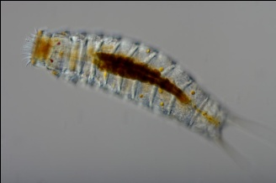
PHYLUM ASCHELMINTHES
Classification
Class 1 Nematoda
They are endoparasites
Body is Bilaterally symmetrical and vermiform.
Body covered in a complex cuticle.
Sexes are separate
Examples: Ascaris
Class 2 Rotifera
They are minute microscopic aquatic
Sexes are separate
Excretion: two protonephridia tubes
Examples: Brachionus, Colotheca, Philodina
Class 3 Gastrotricha
They are minute aquatic free living
Sexes are separated or united
Excretory organ: present or absent
Examples: Urodasys, macrodasys, Chaetonotus
Class 4 Kinorhyncha
Minute microscopic marine
Body is internally segmented
Sexes are separates
Development: indirect ( with larval form)
Examples: Echinoderes, Centroderes
Class 5 Nematomorpha
They are long slender un-segmented worm
Known as hair worm
Sexes are separate
Examples: Nectonema, Gordius

Slide 31
PHYLUM ASCHELMINTHES
Ascaris: Male - Female
Ascaris is a common endoparasite in the small intestine of man.
It is commonly known as round worm.
Body is elongated, cylindrical, pointed at both the ends.
Body is marked with mid –dorsal, mid-ventral and two lateral lines.
Mouth is situated at the anterior end.
Posterior end of the male is ventrally curved, having cloacal aperture.
Through the cloacal aperture two spicules project out, known as penial setae.
Posterior end of the female is bluntly pointed, having anus.
Excretory pore in male and female is situated at the anterior end just below the mouth.
Female genital aperture or gonopore lies about 1/3 of the length of the body from the anterior end.
Anus, in case of male opens into the cloacal aperture
Male is smaller than the female.

Slide 32
PHYLUM ANNELIDA
General Characters
Kingdom: Animalia
Habitat: mostly aquatic, some are terrestrial
Habit: free living
Symmetry: bilateral symmetry
Coelom: coelomate (Body cavity is a true coelom, often divided by internal septa)
Body is metamerically segmented
Grade of organization: organ system grade
Germ layer: triploblastic
Body possesses 3 separate sections, a prosomium, a trunk and a pygidium.
Digestive system: complete and developed
Respiration: by general body surface
Nervous system: nervous system with an anterior nerve ring, ganglia and a ventral nerve chord.
Circulatory system: Has a true closed circulatory system.
Excretion: by nephridia
Reproduction: Sexual and gonochoristic or hermaphoditic.
Fertilization: Internal or external
Development: direct with no larval stages

Slide 33
PHYLUM ANNELIDA
General Characters
Class 1 Polychaeta
Marine, terrestrial, and freshwater.
True coelomates
Bilaterally symmetry, segmented worms.
Complete digestive system.
Closed circulatory system.
Well-developed nervous system.
Excretory system: Both metanephridia and protonephridia.
Dioecious or hermaphroditic.
Fertilization: external
Examples: Nereis (sandworm), Syllis, Sabella
Class 2 Oligochaeta
Habitat: mostly terrestrial and few are freshwater
Body metamerically segmented
Clitellum present
Hermaphrodite but cross fertilization occur
Fertilization: external
Cocoon formation occur
Examples: Pheretima posthuma (Earthworm), Lumbricus, Stlaria, Tubifex
Class 3 Hirudinea
Habitat: primarily freshwater annelids but some are marine, terrestrial and parasitic
The body has definite number or segments.
The tentacles, parapodia and setae are totally absent.
They are hermaphrodite.
Fertilization: internal and a larval stage is absent.
Examples: .Hirudinaria (Leech)
Class 4 Archiannelida
Habitat: They are strictly marine.
The body is long and worm like.
The setae and parapodia normally absent.
They may be unisexual or hermaphrodite.
The development: indirect forming trochophore larva.
Examples: .Protodrillus. Dinophilus, Protodrilus

Slide 34
PHYLUM ANNELIDA
Aphrodite
Commonly known as Sea mouse
Habit and Habitat: marine and burrowing form.
Body is short and broad, oval, dorso-ventrally flattened.
Ventral surface is flat and segmented, consists of stiff setae and forms the creeping sole of the body.
Dorsal surface contains soft notopodial long setae forming a felt like covering on the surface. Dorsal cirri are modified into plate like structure called Elytra (15 pair).
Head is anterior having a median tentacle and a pair of lateral palps.
There are greatly modified parapodia in Aphrodite.
There are three types of setae present in notopodia.
Soft setae- forms the creeping sole of ventral surface.
Stiff setae- modified into the felt like dorsal surface.
Iridescent setae.
Anus-It is situated posteriorly on the dorsal surface.

Slide 35
PHYLUM ANNELIDA
Neiris
The Clamworm is a segmented annelid worm. Its segments are wider than they are long.
The prostomium has two antennae and a pair of palps differentiated into two units.
The pharynx is delineated into two parts with a pair of stout jaws and conical teeth.
There are usually a two pairs of eyes present in most species of Clamworms.
Coloration is greenish to greenish brown with slight blue tone. It can grow to a fairly large size at 30cm long and 1.2cm wide.
They usually eat algae and have large jaws with an eversible pharynx used to tear their food from hard surfaces.
Reproduction is done through the release of body parts called epitokes that make their way to the surface in mating swarms. After spawning, the male and female epitokes die.

Slide 36
PHYLUM ANNELIDA
Pheretima
It is found in moist soil.
Body is long cylindrical and brown in colour.
Anterior end is pointed, while the posterior end is more or less blunt.
Each segment of the body except the first and last segment provided with setae.
Mouth is situated antero- ventrally.
Clitellum is present in 14th, 15th and 16th segments.
Female genital pore is present midventral in the 14th segment.
A pair of male genital pores lies ventrally in the 18th segment.
Two pairs of genital papillae lie ventrolaterally on the 17th and 19th segment.
The anus is present in the last segment.
Sexual reproduction.

Slide 37
PHYLUM ANNELIDA
Hiridinaria
It is commonly called as Indian cattle leech found in ponds, marshes and streams.
It is ectoparasite.
Number of body segments 33. Each segment show superficial divisions called annuli.
Presence of suckers for locomotion and attachment.
Indistinct head with five pairs of eyes situated dorsally in the first five segments.
Animals are bisexual
The male genital pore is situated mid-ventrally in between the 10th segment.
The female genital pore lies mid-ventrally on the 11th segment.
The anus lies mid-dorsally on the 26th segment.
Only a well developed posterior sucker is present. The anterior sucker being reduced.

Slide 38
PHYLUM ARTHROPODA
General Characters
Cosmopolitan in distribution found in aquatic, terrestrial and aerial forms. Some are ectoparasitic and vectors of disease.
Body is triploblastic. Bilaterally symmetrical. Organ system level of organization.
Body have jointed appendages or legs There may be 3 pairs, 4 pairs, 5 pairs or Many pairs.
(Modified to different structures to perform different functions like jaws, gills, walking legs, paddle).
Body is divisible into head, thorax and abdomen. In some (crustacean and arachnida) body is divisible into cephalothorax (head and thorax is fused) and abdomen.
This is the first group to develop a true head, which contains sense organs and feeding organs specialized for their particular habitats. Head bears a pair of compound eyes and antenna.
Body is covered with chitinous exoskeleton.
They are haemocoelomate. Coelom i.e. body cavity is filled with blood or fluid.
Locomotion takes place by jointed appendages.

Slide 39
PHYLUM ARTHROPODA
General Characters
Digestive system is complete, straight and well developed. The mouth bears mouth parts for ingestion of foods. Mouths are modified for chewing, biting, sponging, piercing, siphoning.
Respiration takes place by general body surface or gills (in Crustaceans) or trachea ( in insects, diplopoda and chilopoda) or booklungs (Arachnida) and book gills (in king cobra).
Circulatory system is of open type
Do not have blood vessels and enters directly into the body chambers. The blood is colorless.
Excretion takes place through Malphigian tubules (in terrestrial form) or green glands or coxal glands (in aquatic forms). Aquatic forms are ammonotelic, terrestrial forms are uricotelic.
Nervous system is of annelidian type, which consists of brain and ventral nerve cord.
Unisexual i.e. sexes are separate. Fertilization is internal or external.
They are either oviparous or ovoviviparous. Development may be direct or indirect.
Sensory organ include antennae, sensory hairs for touch and chemoreceptor, simple and compound eyes, auditory organs (in insects) and statocysts (in crustacean).

Slide 40
PHYLUM ARTHROPODA
Classification
Character | Crustacean | Myriapoda | Arachnida | Insect | Onychophora
Habitat | Mainly aquatic, few live in moist place.Few are parasitic form | Terrestrial, found under logs of wood stones etc. | Terrestrial. Some are parasitic. | Terrestrial and rarely aquatic. Some are parasitic. | Terrestrial
Appendages/ walking legs | Five pairs | Many pairs | Four pairs | Three pairs. | Many Pairs, Unjointed
Division of body | Cephalothorax and abdomen. | Head, thorax and abdomen. | Cephalothorax (prosome) and abdomen (opisthosoma) | Head, thorax and abdomen. | Head and Trunk
Antenna | Two pairs | One pair | No antenna | One pair | One Pair
Respiration takes place by | Gills | Trachea | Trachea and book lungs | Trachea | Tachea
Eye | Compound eye | Compound eye | Distinct eye | Compound eye | Simple
Excretion | Coxal gland or Green gland or Antennary | Malpighian tubules | Green gland | Malpighian tubules | Nephredia
Examples | Prawn | Millipede | Spider, Scorpion | Butterfly, Moth | Peripatus

Slide 41
PHYLUM ARTHROPODA
Palaemon
Palaemon is the fresh-water prawn.
It remains at the bottom by day, and comes to the surface at night and feeds on algae, moss, small insects and debris.
Palaemon shows an elongated body which is spindle like and shows bilateral symmetry.
The entire body is covered by a strong, cuticular exoskeleton.
The body is divided into two parts Cephalothorax, and Abdomen.
The cephalothorax shows 13 segments. First five appendage bearing segments constitute the head. The remaining eight append­age bearing segments form the thorax.
The abdomen bears six pairs of appendages. These are known as the pleopods.

Slide 42
PHYLUM ARTHROPODA
Cancer
Commonly called rock crab, aquatic in habitat.
Body is oval and flattened dorsoventrally.
Eye stalked and antennules are in the sockets of carapace.
Five pairs of thoracic legs are well developed.
The first pair of leg modified in to chelate for offence and defense.
Abdomen is greatly reduced, folded ventral to thorax.
Eggs are carried by the female with the help of abdominal biramous pleopods.
Metamorphosis comprises zoea and megalopa larva

Slide 43
PHYLUM ARTHROPODA
Cancer
Marine animal and is nocturnal called horseshoe crab, king crab or limulus.
Body is divisible in to cephalothorax, abdomen and a caudal spine or telson.
Cephalothorax covered by horse shoe shaped carapace; it has a pair of median eyes and a pair of lateral eyes.
On the ventral side of the cephalothorax there is a mouth and seven pairs of appendages.
Mesosoma contains 6 pairs of movable spines.
It is the example of living fossil as they have not changed much in the last 350 to 400 million years.

Slide 44
PHYLUM ARTHROPODA
Palamnaeus
It is example of living fossil, nocturnal and strictly carnivorous.
Body is dorsoventrally flat, divisible in to prosoma or cephalothorax and opisthosoma or abdomen.
Opisthosoma is distinguished in to two parts
a) Mesosome or preabdomen
b) Metasoma or post abdomen.
Six pairs of appendages, 1- pair of chelicerae, 1- pair of pedipalps and 4- pairs of walking legs.
Poisonous, sting with poison gland present at the tip of last segment of metasoma (abdomen).
Respiration by 4- pairs of book lungs.
Sexes are separate and ovo-viviparous, shows ideal parental

Slide 45
PHYLUM ARTHROPODA
Scolopendra
Found under stones, gaps or in crevices.
Body is elongated and dorsoventrally flat, with numerous segments.
Each segment bears a pair of legs.
First pair of trunk appendage bears sharp paired claws connected to poison glands.
Carnivorous, feeds on insects, spiders, worms, slugs etc.
Sexes are separate

Slide 46
PHYLUM ARTHROPODA
Julus
Commonly called as wire worm, herbivorous.
Found in dumpy and dark places under stones or bellow decaying leaves.
When disturbed usually rolls up into tight coil.
Body Cylindrical, metamerically segmented and differentiated into head and trunk.
In each segment pair of legs such many pairs of legs.
Stink gland present along the sides of the body, secreting noxious substances for protection.
Respiration by mean of tracheae.

Slide 47
PHYLUM ARTHROPODA
Cockroach
It is nocturnal, hides during day time in crevices, gaps or in holes of kitchen, store rooms, sewage channels where warm, dumpy and plenty of food available.
Dorsally thorax shows two pairs of wings and ventrally three pairs of walking legs.
Head with pair of antennae, pair of compound eyes and mouth parts.
Body is dorso-ventrally flat, divided into head, thorax and abdomen.
Body is covered by chitinous cuticular plates. Dorsal tergal plates and ventral sternal plates, joined laterally by pleural membrane.
Thorax consists of three segments: Namely prothorasic, mesothorasic and metathorasic segments, while abdomen is ten segmented.
Sexes are separate, fertilization internal, oviparous shows complicated metamorphosis.

Slide 48
PHYLUM ARTHROPODA
Apis
Honey bees are social and live in colonies numbering in the thousands.
Three types of adult honey bees reside in one colony: the queen, male drones and infertile female workers.
The body of the honey bee is segmented: head, three segments of thorax and six visible segments of abdomen.
The head of the honey bee consists of the eyes, antennae and feeding structures.
The thorax of the bee consists of the wings, legs and the muscles that control their movement.
The abdomen is six segments include female reproductive organs in the queen, male reproductive organs in the drone and the stinger in both workers and queen.
Drones, or male bees, are the minority in a colony and serve only one purpose: to mate with virgin honey bee queens. Soon after mating, drones die

Slide 49
PHYLUM ARTHROPODA
Apis
Honey bees are social and live in colonies numbering in the thousands.
Three types of adult honey bees reside in one colony: the queen, male drones and infertile female workers.
The body of the honey bee is segmented: head, three segments of thorax and six visible segments of abdomen.
The head of the honey bee consists of the eyes, antennae and feeding structures.
The thorax of the bee consists of the wings, legs and the muscles that control their movement.
The abdomen is six segments include female reproductive organs in the queen, male reproductive organs in the drone and the stinger in both workers and queen.
Drones, or male bees, are the minority in a colony and serve only one purpose: to mate with virgin honey bee queens. Soon after mating, drones die

Slide 50
PHYLUM ARTHROPODA
Peripatus
1. It is a carnivores, predaceous and nocturnal arthropod found commonly in crevices of rocks, under stones and wood in damp tropical regions.
2. Body cylindrical, elongated and without true segmentation and exoskeleton.
3. Skin velvety and is thrown into numerous transverse grooves (wrinkles), which bear spiny papillae.
4. Distinct head is absent but anterior end bears a pair of segmented antennae, a pair of jaws, a pair of eyes and a pair of oral papillae having slime gland at their base.
5. Along the body, on lateral sides, are present about 14 pairs of un-segmented and stumpy appendages for movement.
6. Excretion through nephridia. Sexes are separate and they are mostly viviparous.

Slide 51
PHYLUM MOLLUSCA
General Characters
World wide distributed. Mostly aquatic (marine and few are fresh-water) and some are terrestrial living in damp soil.
Body is soft and unsegmented (except Neopilina).
Bilaterally symmetrical except gastropodas (asymmetrical) because the shell is coiled.
Schizocoel or Haemocoel cavity found as coelom.
Body is divisible into head (absence in pelecypoda and scaphopoda), dorsal visceral mass, ventral muscular foot and mantle.
Mantle- is a dorsal glandular fold of the body wall. It is thick and muscular and encloses a mantle cavity.
Head- anterior part of the body, which contains mouth, eyes and tentacles and other sense organs.
Foot-is ventral in position usually thick and muscular and generally forms the main locomotory organs.
Visceral mass contains digestive, circulatory and reproductive organ of the body and it forms a hump or dome.
Body is covered by a hard calcareous structure, made up of calcium carbonate, called shell. In some molluscus, it is internal or reduced or even absent (oplacophora).
Locomotion takes place by ventral muscular foot.

Slide 52
PHYLUM MOLLUSCA
General Characters
Digestive system is well developed with a hard chitinous structure, called radula.
Respiration takes place through one or more gills or ctenidia, lungs (pulmonary sac) or general body surface in the terrestrial forms.
Circulatory system is closed or open type.
Head consists tentacles and compound eyes.
Presence of one pair tentacles except octopus where tentacles are modified into arm.
Excretion takes place by paired metanephridia (kidney).
Nervous system consists of many paired ganglia, connectives and nerves.
Sense organs are eyes, tentacles, osphradium and statocyst.
Sexes are usually separate but some are monoecious.
Pila- sexual dimorphism.
Limax- hermaphrodite
Helix- hermaphrodite
Fertilization is external (in sessile group such as in oyster) or internal.
Development may be direct or indirect. Larva is trochopore or veliger or parasitic stage called glochidium larva.

Slide 53
PHYLUM MOLLUSCA
Classification
Monoplacophora
Habitat: exclusively marine
Head is present without eyes and tentacles
Gills are external
Excretion: by serially arranged nephridia
Examples: Neopilina
Amphineura
Habitat: mostly marine
Body is elongated
Eye and tentacles are absent
Radula is present
Examples; Chiton, Neomenia
Scaphopoda
Habitat: marine
Body is bilateral symmetry elongated and enclosed in tusk shell
Foot is reduced
Excretion: a pair of Kidney
Examples: Cadulus, Dentalium
Neopilina
Chiton
Dentalium

Slide 54
PHYLUM MOLLUSCA
Classification
Gastropoda
Habitat: These are either aquatic or terrestrial
They possess a spiral shell.
The foot is large and flat.
Head is well developed with tentacles and eyes.
Examples: Patella. Hilex (Snail), Limax (Slug), Pila (Apple snail)
Pelecypoda or Bivalvia
Habitat: mostly marine
They burrow in mud and sand.
Symmetry: bilateral and the body is laterally compressed.
No distinct head
Examples: Aplysia, Mytilus, Pearl Oyster

Slide 55
PHYLUM MOLLUSCA
Classification
Cephalopoda
Habitat: mostly marine.
They are adapted for swimming.
The foot is modified into eight to ten long tentacles in the head region.
The shell is either external, internal or absent.
Examples: Octopus, Loligo, Sepia, spirula, Nautilus
Loligo
Sepia
Octopus

Slide 56
PHYLUM ECHINODERMATA
General Characters
They are exclusively marine.
They are free living. Some are pelagic. Some are creeping on the sea bottom.
These are all triploblastic and co-elomate animals.
Adults show pentaradial symmetry and larval form show bilateral symmetry.
The size varies from moderate to considerable size.
Shape of the body is spherical or globular or elongated. It shows oral and aboral sides.
Exo and endo skeletons will be present.
Endo-skeletoh is mesodermal. It is made by hard polygonal plants.
Body walls include only Epidermis, dermis and peritonium.
Body cavity or coelome is large. It is an entero-coelome. It is lined by ciliated peritonium.
Respiration is carried on by a) Papullae -Star fish b) Peristomial gills - Sea urchin c) Genital bursae - Brittle star d) Respiratory trees - Holothurians
Excretory organs are absent.
Nervous system is primitive. Brain is absent.
Special sense organs are poorly developed. Eye spots and statocysts are present.
Reproduction is sexual. Sexes are separate. Sexual dimorphism is absent.
Fertilisation is external.
Eggs are homolethial. Cleavage is radial and indeterminate type.
Life history includes larval stage.
They can show autotomy and regeneration.

Slide 57
PHYLUM ECHINODERMATA
Classification
The classification followed here is based on Hyman's Classification.
Sub Phylum: Pelmatozoa
Sub Phylum: Eleutherozoa
SUB PHYLUM I: PELMATOZOA:
Mostly extinct echinoderms. Mouth and anal.aperture present on the oral surface. Tube feet are primarily food catching. They do not show suckers, pelmatozoa has only one living class.
Class: Crinoidia:
Extinct and living forms. Living members are with stalk. Oral surface is directed upwards.
Mouth is usually central. Anus is usually excentric. They are present on the oral surface.
Arms movable, simple mostly branched, usually five or ten in number.
Madreporite, spines and pedicellariae are present. Larva is doliolaria. Ex: Antedon, Metacrinus.
Antedon

Slide 58
PHYLUM ECHINODERMATA
Classification
SUB PHYLUM II: ELEUTHEROZOA:
Mostly living echinoderms. Stem or stalk is absent. They are living forms. Body structure is usually pentamerous. Oral surface has mouth. It is downwards. Anus usually on the aboral surface.
Class 1: Asteroidea :
Body is flat, pentagonal or star shaped. Oral and aboral surfaces are distinct. Sexes separate, gonads radially arranged. Develop­ment includes bipinnaria or brachiolaria larva. Ex. Sea Star
Clsss 2: Ophiuroidea:
Body is flattened with a pentamerous or rounded central disc. Oral and aboral surfaces are distinct. Arms usually five, rarely six or seven, are long and slender. Ambulacral grooves are absent. Madreporite is on the oral surface. Sexes areseparate. Ex. Brittle Star

Slide 59
PHYLUM ECHINODERMATA
Classification
SUB PHYLUM II: ELEUTHEROZOA:
Mostly living echinoderms. Stem or stalk is absent. They are living forms. Body structure is usually pentamerous. Oral surface has mouth. It is downwards. Anus usually on the aboral surface.
Class 3: Holothuroidea:
Body bilaterally symmetrical, usually elongated in the oral aboral axis having mouth at or near one end and anus or near the other end. Example – Cucumaria (Sea Cucumber)
Class 4: Echinodea:
Body is spherical, disc like, oval or heart shaped. Body is enclosed in an endoskeletal shell or test of closely fitted calcareous plates covered with movable spines. Ambulacral grooves are absent. Pedicellariae are stalked and three jawed. Sexes are separate. Larval form is echinopluteus larva. Example – Echinus (Sea Urchin)

Slide 60
STUDY OF FOLLOWINGS
1. Locomotion in Protista
Pseudopodial Locomotion:
It is slow creeping type of locomotion which is performed with the help of protoplasmic outgrowths called pseudopodia.
Pseudopodia are of four types:
Lobo-podia: These pseudopodia are lobe- like with broad and blunt ends. (Amoeba)
Filo-podia: These pseudopodia are fine, thread-like, tapering, and are composed of ecto­plasm. (Euglypha)
Axo-podia: These are long and stiff, with hard axial filament. (Actinophrys)
Reticulopodia: These are long and branching. The branches of adjacent pseudopodia may form network. (Globigerina)
Flagellar Locomotion:
Flagella show whip-like movement.
They usually beat independently.
This type of locomotion occurs in dinoflagellates (e.g., Gonyaulax), euglenoids (e.g., Euglena)and zoo-flagellates (e.g., Leishmania).

Slide 61
STUDY OF FOLLOWINGS
2. T. S. of Sycon
1. Body wall is diploblastic with an outer dermal layer and inner gastric layer.
2. The gastric layer is made up of mesenchyme with interspersed monoaxon and triaxon spicules and is lined internally with flat pinacocyte cells.
3. The dermal layer is also made by flat pinacocytes and is perforated by ostia.
4. The ostia leads into incurrent canals which, through prosopyles, lead into radial canals which are lined with choanocytes.
5. The radial canals lead into small ex-current canals and are lined by pinacocytes.
ADVERTISEMENTS:
6. The ex-current canals open into spongocoel.
7. The canal system is of syconoid type.

Slide 62
STUDY OF FOLLOWINGS
3. Life cycle and Parasitic Adaptations: 1. Tapeworm
Tapeworms live as internal parasites and they have to make several adjustments for the same. The following are few of the adaptations made by these tapeworms to make their life easy in their hosts.
Presence of enzymatic resistant covering
Absence of locomotory organelles
Osmotic pressure
Presence of hooks and suckers for attachment
Anaerobic type of respiration
Absence of digestive system
Protection of zygote
Presence of complex reproductive organs
Hermaphroditism and proglottization

Slide 63
STUDY OF FOLLOWINGS
3. Life cycle and Parasitic Adaptations: 2 Ascaris
Parasitic Adaptions
Body is long and round Cuticle covering the body protect the worm from digestion It also secretes antienzymes against digestive enzymes of the host. Papillae for anchoring to the villi in the intestine. Worm can ingest tissue of the host and suck the blood from the host. Absorption by the surface of the body directly from the host's intestine. Worm respires anaerobically in the host's intestine which is devoid of oxygen. Millions of eggs are produced ata time for the benefit of survival. Eggs hatch into juveniles which are present in the environment. Eggs can also be present in the environment. Infection is direct through contaminated food and water.

Slide 64
Physiological Experiments
1. Preparation of Hemin Crystals
Crystals are homogeneous solids, bounded by plane faces and having a geometric shape.
Preparation:
A small amount of dry blood is taken on a glass slide and crushed to a fine powder with the help of the fused end of a glass rod or with a needle. One crystal of common salt (NaCI) is added to it, which is also crushed to powder. The two are thoroughly mixed and two drops of glacial acetic acid added to it.
The mixture is covered with a cover slip and the slide heated over the flame of a spirit lamp. The reaction is complete with the beginning of boiling of the mixture and the slide is quickly removed from the flame.
The preparation is allowed to cool and examine under a microscope, initially under low magnification and then under high magni­fication.
Man: Rhomboidal plates and prisms, often arranged in star-shaped clusters with round edges.
Rat: Narrow plates with varying width to needles, blunt at both the ends.
Guinea pig: Triangular plates often arranged in the form of squares.

Slide 65
Physiological Experiments
2. Preparation of Haemochromogen Crystals
Haemochromogen test - It is also known as Takayama test . Takayama Crystals
Takayama reagent –
Saturated solution of glucose 3ml
Pyridine solution 3ml
10%NaoH (sodium hydroxide solution) 3ml
Glacial Acetic Acid 7ml
Reagent preparation-
Taken the 3ml of saturated solution of glucose,3ml of pyridine solutiona and 3ml of NaOH solution along with 7ml of Glacial acetic acid.
Procedure-
Place the material to be tested on a microscopic slide and cover with a cover slip. Add a drop of Takayama Reagent and allow to flow under the cover slip. Warm slide gently on a hot plate at 65°C for 10-20 seconds. Allow to cool and observe under microscope at 100X.
Observation-
The appearance of pink needle shaped crystals of pyridine Haemochromogen is positive reaction for haeme and confirms the presence of hemoglobin.

Slide 66
Physiological Experiments
3. Determination of Blood Group
Aim: To study the A- B- O blood groups in mammalian blood.
Requirements: Blood sample, sterilized cotton, antisera, pricking needle or lancet, slide, compound microscope, tooth picks / pins etc.
Principle: Blood groups are specified by the presence or absence of specific antigens on the membrane of RBC.
Procedure:
Draw the figure of slide on the paper and mark A, B and D as shown in the figure.
Place the slide on the paper and place three drops of antisera A, B and D to respective spot.
With the help of spirit or alcohol sterilize the tip of ring finger and prick using pricking needle/ lancet.
Place a drop of blood near the drop of each antiserum (do not touch the finger to antiserum drop). Mix well antiserum and blood at each spot with the help of separate pins / tooth picks.
Observe for the agglutination under microscope.

Slide 67
Physiological Experiments
3. Determination of Blood Group

Slide 68
CYTOLOGICAL PREPARATIONS
1. Temporary Stained Preparation of Mitochondria
MITOCHONDRIA
The mitochondria are double membrane-bound organelle found in all eukaryotic organisms. Some cells in some multicellular organisms may however lack them (e.g. mature mammalian red blood cells).
Procedure:
Take a smear of oral mucosa or a peel of onion or Hydrilla leaf base on a clean dry slide.
Stain the material with dilute Janus green B stains for five minutes.
Observe under microscope, initially under low power and then under high power.
Mitochondria appear as bluish green stained granules.
Nucleus
Mitochondria

Slide 69
CYTOLOGICAL PREPARATIONS
2. Temporary Stained Preparation of Mitochondria
Polytene Chromosome
Polytene chromosomes are oversized chromosomes which have developed from standard chromosomes and are commonly found in the salivary glands of Drosophila melanogaster. Specialized cells undergo repeated rounds of DNA replication without cell division (endomitosis), to increase cell volume, forming a giant polytene chromosome. Polytene chromosomes form when multiple rounds of replication produce many sister chromatids that remain fused together
Procedure:
On a slide, take a larva. Hold its body with one BB forceps and with other BB forceps pulls out its head. Due to this pulling, the alimentary canal, salivary glands etc also get pulled out with body wall. Locate the salivary glands from this mass. Stain the salivary glands with acetocarmine for about 10 minutes. Put a caver slip, blot excess stain and observe under microscope.

Slide 70
STUDY OF FOSSILS
1. FOSSIL FORMATION
Process of fossilization:
First requirement is burial of dead animal.
There should not be bacterial decay or oxidation
The dead body should consists hard body parts like, Bones, teeth, shell etc.
Material where the dead body is buried should consist preservatives.
Better chances of fossilization in aquatic animals than land animals.
Soft parts are destroyed by scavengers, insect larvae, bacteria etc.
Hard parts sink to bottom and covered by always dropping sediments.
Mining in bogs and quicksand with death and burial of animal is another form of fossilization.

Slide 71
STUDY OF FOSSILS
1. FOSSIL FORMATION

Slide 72
STUDY OF FOSSILS
2. TYPES OF FOSSILS
Fossils form the concrete evidences of the evolution and also provide the information about the followings;
Unaltered or Actual remains
Petrification
Moulds and Casts
Trails, Tracks and Footprints
Burrows, Borings and Tubes
Coprolites

Slide 73
STUDY OF FOSSILS
2. TYPES OF FOSSILS
Unaltered or Actual remains:
Preservation without change from the living state. (preservation in ice)
Preservation in amber (fossil resin from pines)
preservation in asphalt / salts (asphalt lakes and bogs)

Slide 74
STUDY OF FOSSILS
2. TYPES OF FOSSILS
Petrification: (conversion in to stone)
Replacement of organic matter of a dead animal or plant by mineral matter.
Retains morphological as well as cellular structure intact.
Important for histological details (histometabasis).
Minerals involved in Petrification are iron oxides, sulphur, malachite, silica or carbon.

Slide 75
STUDY OF FOSSILS
2. TYPES OF FOSSILS
Moulds and Casts:
Moulds:
Do not preserve the material while formed by hardening of surrounding material (sediment) in which the animal was buried. Only external appearance is reserved called external or natural mould
Casts:
Similar to the mould instead the cavity filled with other minerals. Differ from the Petrification that it preserve the form of animal not the internal details

Slide 76
STUDY OF FOSSILS
2. TYPES OF FOSSILS
Trails, Tracks and Footprints:
Impressions of the body parts on the wet soil, mud or the sand bottoms.
These impressions are preserved by sedimentation and hardening.
They clue for determining entire proportion of the animals.
Footprint represent the presence or migration

Slide 77
STUDY OF FOSSILS
2. TYPES OF FOSSILS
Burrows, Borings and Tubes:
Animals living in burrow, holes in rocks or animals secreting chitinous or calcareous shells may be preserved by filling with secondary materials.
Actual part of the animal is not preserved.
Differ from the Petrification that it preserve the form of animal not the internal details
Coprolites:
The coprolites are the fossil excreta.
In favorable cases outline of alimentary canal also preserved.
Strap like markings, discrete pellets etc.
Cave man skull

Slide 78
STUDY OF EVOLUTION
Darwins Finches: Adaptive Radiations
Galapagos Islands
Charles Darwin and the rest of the HMS Beagle crew spent only five weeks in the Galapagos Islands, but the research performed there and the species Darwin brought back to England were instrumental in the formation of a core part of the original theory of evolution and Darwin's ideas on natural selection which he published in his first book . Darwin studied the geology of the region along with giant tortoises that were indigenous to the area.
Perhaps the best known of Darwin's species he collected while on the Galapagos Islands were what are now called "Darwin's Finches". In reality, these birds are not really part of the finch family and are thought to probably actually be some sort of blackbird or mockingbird. However, Darwin was not very familiar with birds, so he killed and preserved the specimens to take back to England with him where he could collaborate with an ornithologist.

Slide 79
STUDY OF EVOLUTION
Darwins Finches: Adaptive Radiations
Finches and Evolution
The HMS Beagle continued to sail on to as far away lands as New Zealand before returning to England in 1836. It was back in Europe when he enlisted in the help of John Gould, a celebrated ornithologist in England. Gould was surprised to see the differences in the beaks of the birds and identified the 14 different specimens as actual different species - 12 of which were brand new species. He had not seen these species anywhere else before and concluded they were unique to the Galapagos Islands. The other, similar, birds Darwin had brought back from the South American mainland were much more common but different than the new Galapagos species.
Charles Darwin did not come up with the Theory of Evolution on this voyage. As a matter of fact, his grandfather Erasmus Darwin had already instilled the idea that species change through time in Charles. However, the Galapagos finches helped Darwin solidify his idea of natural selection. The favorable adaptations of Darwin's Finches' beaks were selected for over generations until they all branched out to make new species.
These birds, although nearly identical in all other ways to mainland finches, had different beaks. Their beaks had adapted to the type of food they ate in order to fill different niches on the Galapagos Islands. Their isolation on the islands over long periods of time made them undergo speciation. Charles Darwin then began to disregard the previous thoughts on evolution put forth by Jean Baptiste Lamarck who claimed species spontaneously generated from nothingness.
Darwin wrote about his travels in the book The Voyage of the Beagle and fully explored the information he gained from the Galapagos Finches in his most famous book On the Origin of Species. It was in that publication that he first discussed how species changed over time, including divergent evolution, or adaptive radiation, of the Galapagos finches.

Slide 80
STUDY OF EVOLUTION

Slide 81
EXAMPLES BASED ON GENETICS
Genetic Examples
Monohybrid Ratio
Dihybrid Ratio
Incomplete dominance
Co-dominance
Multiple Allele
Sex linked Inheritance
Linkage
Crossing over
Complementary Gene Interaction
Supplementary Gene Interaction

Slide 82
HUMAN KARYOTYPE
Aim:
The purpose of this laboratory experience is:
Understand what a karyotype is and how it is performed.
Understand the reason for performing a karyotype, especially for those with a higher risk of genetic defect in theirlineage.
To determine what genetic defect is present in a chromosome sample.
To investigate a variety of genetic disorders that commonly occur and are studied in biology classes.
Materials:
Scissors -tape-ruler -small envelope

Slide 83
HUMAN KARYOTYPE
Procedure:
The following procedure is utilized to perform this laboratory experience:
Using the attached sheets, complete four different karyotypes: One normal male, One normal female, two different disorders of your choice out of the four. Additional laboratory minutes may be granted for work above and beyond the four required karyotypes.
Working slowly and carefully, using scissors cut out the chromosome on one page labeled “1” and find its’ EXACT match elsewhere on the page (it will not be numbered). Cut out this chromosome and tape BOTH chromosomes side by side on a “data page” that has the heading filled out.
Continue this procedure until you have matched all chromosomes and taped each of them in the corresponding place on the data page.
If you are caught short of time, use the coin envelope to store any chromosomes you may have clipped out and not matched. DO NOT CUT OUT ALL CHROMOSOMES AND THEN ATTEMPT TO MATCH THEM!!! Cut out only one at a time or you will lose chromosomes.
In the event that you have an extra chromosome, DO NOT THROW IT OUT! It is the chromosome that causes your mutation/disorder and you must match it correctly.
Once your chromosomes are all cut out and included in the karyotypes, answer the questions and complete the

Slide 84
HUMAN KARYOTYPE
Normal Male
Normal Female

Slide 85
HUMAN KARYOTYPE
Karyotype #1 Individual is a ____________________
Number of chromosomes: _______
What is the sex? ________________
Normal or Mutated (circle one) If mutated, name the disorder below:
Karyotype #2 Individual is a ____________________
Number of chromosomes: _______
What is the sex? ________________
Normal or Mutated (circle one) If mutated, name the disorder below:

Slide 86
Thank you

