Slide 1
A LECTURE ON balanced diet &exercise for healthy life AFTER 60’S
By,
Dr. Suresh Anandrao Khabade
M.Sc. Ph. D
Associate Professor,
Dept. of Zoology,
DKASC College, Ichalkaranji

Slide 2
BIO-DATA
Dr. Suresh Anandrao Khabade
M.Sc. Ph. D
Associate Professor & Ex- HOD, Dept. of Zoology, DKASC College, Ichalkaranji.
Author of 26 Text Books and Practical Books of Zoology of Shivaji & Solapur University.
16 Research Papers Published in National and International Journals.
18 Research Papers presented in National and International Conferences.
Visited Sri Lanka and UAE countries for international conferences and paper presentation
Awarded : 1. Sant Rohidas Samanjratna Puraskar
2. Rotary’s Best Teacher Award

Slide 3
PYRAMID OF FOOD

Slide 4
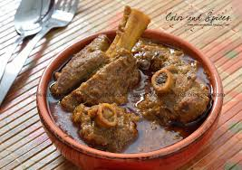
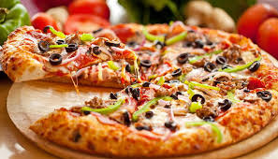
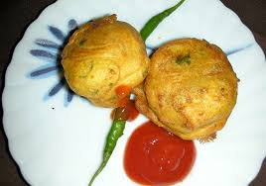
WEIGHT LOSS FAILS IF YOU AVOID THESE

Slide 5
BALANCED DIET
Food is required for sustenance, growth and energy requirements.
Food is divisible into three main categories namely carbohydrates, proteins and fats.
Traces of inorganic salts and vitamins are also necessary for the health.
Other than these food constituents water is very important for chemical interactions.

Slide 6
BALANCED DIET
Carbohydrates
Carbohydrates are polpularly called as sugars and starches.
These are composed of carbon, hydrogen and oxygen.
These are broken down to simple glucose and utilized for energy production.
In the oxidation of carbohydrates energy is produced and carbon dioxide and water is produced as byproducts.
Excess of carbohydrates can be stored in the body and utilized latter whenever necessary.
SOURCES : Rice, Jawar, wheat, starchy food, fruits etc.

Slide 7
BALANCED DIET
Proteins
Proteins are necessary for the body growth and building up protoplasm.
These are composed of carbon, hydrogen, oxygen and nitrogen.
In addition sulphur and phosphorus are also present.
It is the only nitrogenous food.
The proteins are broken down to simpler molecules of amino acids.
The main use of proteins in the body is to build up the tissues of the organisms so they are called “ Body Builders”.
Excess of proteins cannot be stored for further use but are excreted.
SOURCES : Eggs, Meat, Milk, Fish, Cerals etc.

Slide 8
BALANCED DIET
Fats
Fats contain carbon, hydrogen and oxygen but oxygen is very little.
Fats are oxidised to give energy and byproducts like carbon dioxide and water.
Fats give more energy than carbohydrates so called as energy giving food substance.
Fats are broken down to simpler molecules of fatty acids and glycerol.
Excess of fat can be stored for later use.
SOURCES : Edible Oils, Cheese, Nuts , Butter etc.

Slide 9
FOOD COMPANIES DON’T TELL EVERYTHING
ZERO
CHOLESTEROL
BUTTER

Slide 10
BALANCED DIET
Water
Water is an elixir of life.
It helps in the chemical interactions.
Two-third part of body weight is water.
It is a good solvent for many materials.
Excess of water from the body is excreted.

Slide 11
BALANCED DIET
Inorganic salts
Chlorides, carbonates and sulphates of many elements like sodium, calcium, potassium , magnessium, iodine, iron etc. are required for the proper functioning of many tissues and glands.
These are obtained in traces alongwith the food taken.

Slide 12
BALANCED DIET : vitamin
Vitamin | Source | Disease by dificiency | Symptoms of disease | Daily requirement
Vitamin A or Antixerophthalmic | Cod liver oil, carrot, milk, butter etc. | Xerophthalmia | Dry skin, night blindness | 600 IU (1 IU = 0.30 mg)
Vitamin B Complex B1 or Thyamin | Yeast, whole grains, outer barn of rice | Beri-beri | Nervous breakdown –paralysis, loss of apetite, stunted growth | Child- 0.5 to 1.5 mg Adult – 1.5 to 2 mg
Vitamin B2 or Riboflavin | Yeast, eggs, green vegetables etc. | Cheilosis , Glossitis | Patches on the skin , lips are bright red, tongue is enlarged, tender and magenta in colour | Child – 0.9 to 2.0 mg Adult – 2.0 to 3.0 mg

Slide 13
BALANCED DIET : vitamin
Vitamin | Source | Disease by dificiency | Symptoms of disease | Daily requirement
Vitamin C or ascorbic acid | Citrus fruits, germinating seeds, strawberry, apples, raw cabbages | Scurvy | Haemorrhage in the gums and in the joints | Child- 30 mg Adult – 75-150 mg
Vitamin D or Antirachitic | Fish, meat, eggs etc. | Rickets | Malformations of bones , Pigeon chest etc. | Child- 0.015 to 0.02 mg Adult – 0.025 mg
Vitamin E or Antisterility | Seeds and leafy vegetables | Sterility in rats | Reproduction is affected | 10-20 mg
Vitamin K or Antihaemorrhagic | Leafy vegetables like cabbage | Haemorrhage | Blood does not clot easily | 2 mg

Slide 14
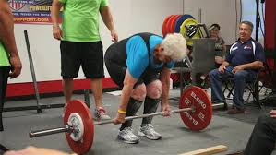
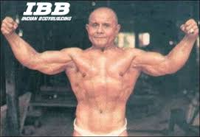
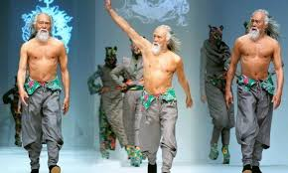
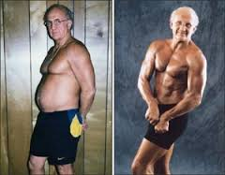
Exercise - Age is just a number

Slide 15
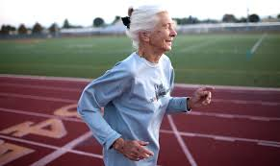
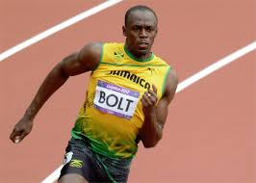
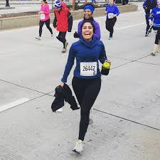
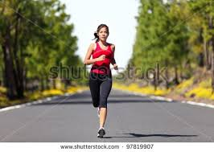
What is fitness ?

Slide 16
What to expect in your 60s and onwards
1. Save your skin
2. Bone up for Good Health
3. Motivate your metabolism
4. Keep your heart strong
5. Preserve your senses
6. Improve your sex life
7. Ramp up your immunity
8. Take fewer ‘ Night time trips’
9. Be happy
10. Stay Sharp

Slide 17
What to expect in your 60s and onwards
1. Save your skin
Skin becomes drier
Protect the skin by proper treatment- A radio- frequency emitting devices or LASER treatment
In woman, in menopause –related skin issues treat with harmone replacement therapy.

Slide 18
What to expect in your 60s and onwards
2. Bone Up for Good Health
Aging and inactivity can lead to achy joints.
It is due to the wearing down of cartildge and loss of lubricating joint fluid and weaker muscles.
Weight bearing activities stimulate the bones to grow stronger and denser which can protect against bone fractures and osteoporosis.
Ask your doctor for vitamin D and calcium supplements.

Slide 19
What to expect in your 60s and onwards
3. Motivate your Metabolism
Meatbolism typically slows upto 5 % per decade.
In your 60s stomach secrete less hydrochloric acid which decreases the availability of vitamin B12.
Ask your doctor whether you need a B12 supplement.
Stomach empties more slowly .
The slowing of digested material through the large intestine can trigger constipation.
Adding fibre to your diet may help to protect against colon polyp.
Older adults get dehydrated easily so it is important to drink even when you are not thirsty.

Slide 20
What to expect in your 60s and onwards
4. Keep your heart strong
An older heart can pump about the same volume of blood with each beat as a younger one can.
The incidence of heart diseases rises with age.
By taking cardiopulmonary exercises e.g. swimming, running, cycling and walking you can keep your heart strong.

Slide 21
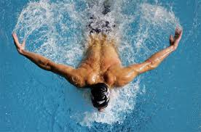
CARDIOPULMONARY EXERCISES

Slide 22
What to expect in your 60s and onwards
5. Preserve Your Senses
Lifestyle plays a major role in helping to maintain your senses as you age.
So stay away from loud noises.
Eat a well balanced diet which can help ward off some age related eye dis-orders.
If you notice that your senses of smell or taste diminish significantally then visit a doctor immediately.
By age 70, smell and taste have likely declined, reducing the ability to enjoy suitable flavours.
Taste buds decrease in number and sensitivity and nerve ending in the nose may not work as well.

Slide 23
What to expect in your 60s and onwards
6. Improve your Sex Life
Sex related hormones – estrogen and progesterone in women , testosterone in men decline.
Vaginal dryness may become more noticeable.
Rates of erectile dysfunction (ED) increase with age.
Sexual satisfaction only gets better with age, How?
The counter lubricants ,creams and tablets are effective in vaginal dryness.
Not smoking and eating a diet rich in anti-oxidants can help in erectile disfunction in men.

Slide 24
What to expect in your 60s and onwards
7. Ramp up your immunity
After 60s the immune systems becomes less aggressive, so you are more susceptible to getting sick.
Chronic inflammatioin which is linked to heart disease, diabetes and arthritis, makes it even harder for the body to mount an effectice immune response.
So it is important to shed excess pounds , eat a good diet and exercise.

Slide 25
What to expect in your 60s and onwards
8. Take Fewer “ Nighttime Trips”
More than half of men in their seventies will have prostate issues.
Visit a urologist if you suspect you might have a problem.

Slide 26
What to expect in your 60s and onwards
9. Be happy
You might stay away from stressful situations.
Just make sure all your social interactions stay strong.

Slide 27
What to expect in your 60s and onwards
10. Stay Sharp
The growth of new brain cells, called neurogenesis continues well into your 60s.
The capacity to learn new things stays strong.
In your 60s mild forgetfullness happens because the transmission of nerve impulses between cells slows down.
You can improve your brain health by getting regular mental stimulation, social interaction and physical activity.

Slide 28
THE BEST PIILS IN THE WORLD
NUTRITION
EXERCISE
YOGA

Slide 29
YOGA
ASNAS
PRANAYAM
MEDITATION

Slide 30
FAT LOSS MACHINES
HOW MUCH IT BURNS
DOES IT HELP

Slide 31
CRUNCHES
FOR ABDOMINAL
FAT
LOSS

Slide 32
THANK YOU

