Slide 1
B- Oxidation Bsc.II ZOOLOGY DEPARTMENT Miss Punam Patil.

Slide 2
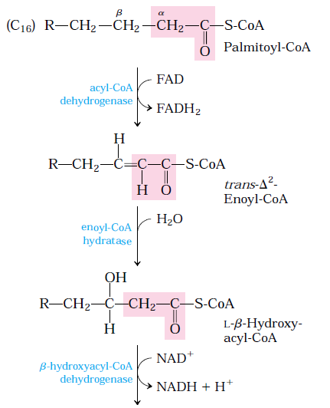
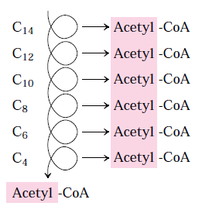
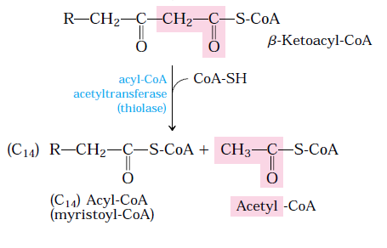
β Oxidation of saturated even number fatty acids

Slide 3
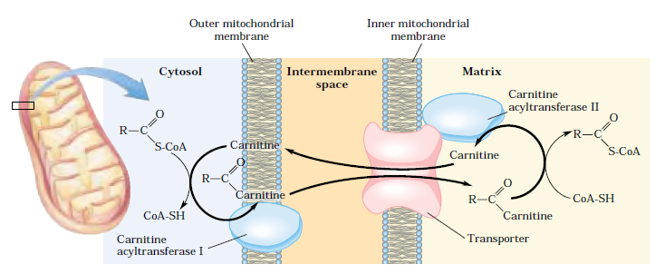
Fatty acid entry into mitochondrion via the acyl carnitine/carnitine transporter

Slide 4
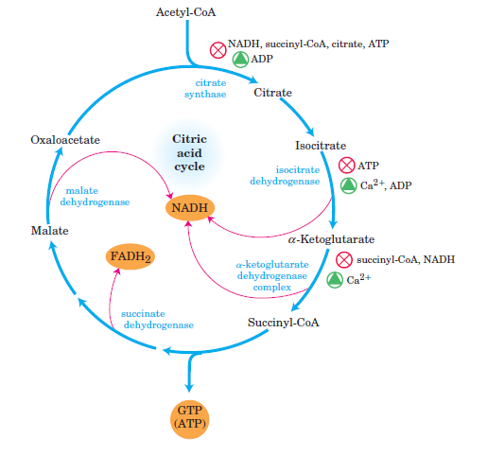
One acetyl CoA through TCA cycle gives 3NADH, 1FADH2 and 1 GTP

Slide 5
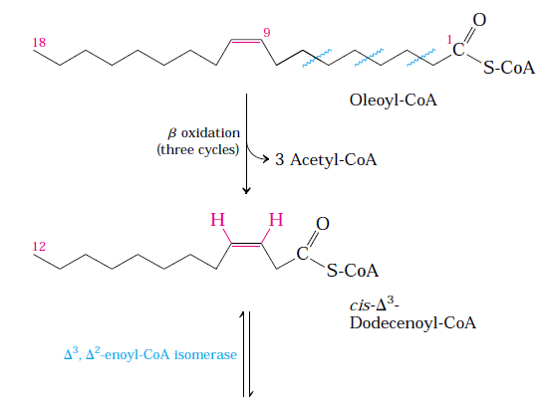
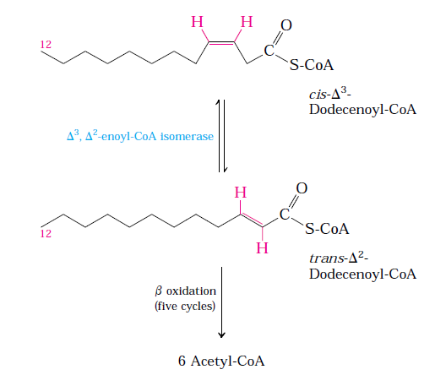
Oxidation of monounsaturated fatty acid

Slide 6
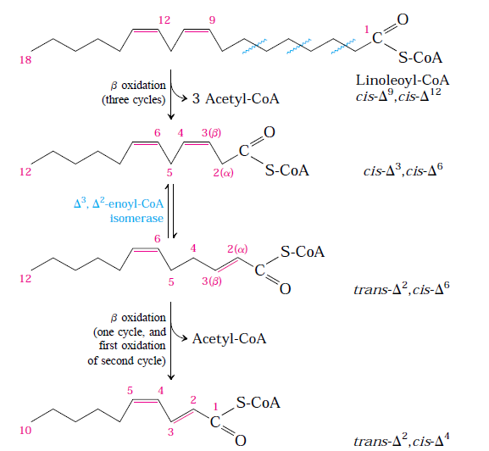
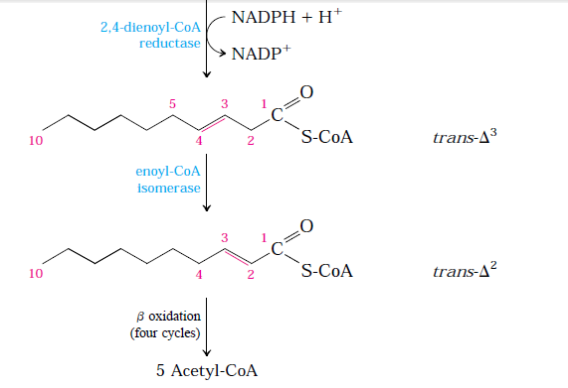
Oxidation of polyunsaturated fatty acid

Slide 9
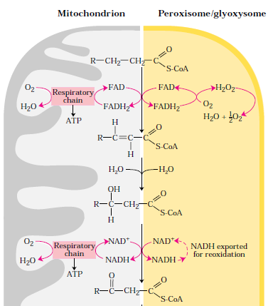
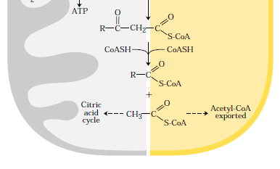
Difference between mitochondrial and peroxisomal β oxidation

