Slide 1
Biodiversity conservation
What is it?
“Richness in variety and variability of species of all living organisms in a given region (habitat).”
-Walter G. Rosen1985
“The totality of genes, species and ecosystems in a regions” - IUCN, 1992
(IUCN-International Union for Conservation of Nature and Natural Sources)

Slide 2
Three Levels of Biodiversity
Genetic diversity
Species diversity
Ecosystem diversity
Genetic Diversity It is nothing but genetic variation within species, both among geographically separated populations and among individuals within single population.

Slide 3
Species diversity
It include full range of species on earth including microbes, protozoans, and multicellular organisms like fungi, plants, animals.
Ecosystem Diversity
It include all different ecosystems exists on earth like Terrestrial ecosystem (forest, grassland, desert etc.) and Aquatic ecosystem (river, ponds, lakes, oceans etc.)
It is a base of all diversity on Earth because it provide shelter to all organisms and all communities.

Slide 4
Key Stone Species
Within the biotic communities the most crucial species is described as key stone species.
Protection of key stone species is the priority in biodiversity conservation.
This is because if key stone species is lost from habitat many other species may lost from the area.
Ex. If bats are lost from the habitat then pollination of some plants get affected like Mahogany.
Similarly population of insects increases rapidly.
Bats are seed dispersal agents thus protection of bats is essential.

Slide 5
Among the others top predators are key stone species
Predators always control herbivorous animals Ex. The areas where population of gray wolf has been drastically reduced because of hunting then the deer population increases rapidly.
Over grazing by deers leads to elimination of many endemic plants and insects who depend on these plants as their food.

Slide 6
World Wide No. Of Species
Insects
Plants
Other Animals
Fungi
Protists
Algae
Bacteria
Viruses
751000
248000
281000
69000
30000
26000
4800
1000

Slide 7
Causes for Extinction Of Biodiversity
Habitat Destruction
Explosion of human population
Increased human activities- Deforestation, Agriculture, Industries, Roads, Dams etc.
Hunting and poaching of wildlife.
Mining, commercial fishing, cattle ranching

Slide 8
Habitat Fragmentation
Habitat fragmentation is a process where large continuous area of habitat is reduced and divided in to two or more fragments.
Fragmentation is due to road construction, fields, towns, canals, power line, mining etc.
Fragmentation reduces the forging area of animals.
It also affect the microclimate – Light, temperature, wind of that habitat.

Slide 9
Habitat Degradation And Pollution
Physical degradation of forest habitat by uncontrolled ground fires kill the trees , rich perennial wild plant community and insect fauna of the forest .
Boating and Diving in coral reef areas degrade the fragile species.
The most noticible form of habitat degradation is the environmental pollution caused by pesticides, industrial chemicals and wastes, emissions from factories and automobiles, sediment deposits from eroded hill sides.

Slide 10
Introduction of Exotic Species
The exotic species are nothing but the plant and animal species which are imported from other countries.
The exotic species may kill or eat the native (endemic) species to the point of extinction.
Some times these exotic species may alter the habitat that many natives are no longer able to persist.
The effect of exotic species is maximum on islands.

Slide 11
Diseases
Human activities may increase the incidence of disease in wild species eg. Anthrax disease of cattle is transferred to bison and wild animals are more prone to infectious diseases thus infections are often fatal.

Slide 12
Shifting or Jhum cultivation
It is most common method of cultivation in North East India where people cut the forest and then burn it.
This barren land is then cultivated for few years and they shift for another area for cultivation thus it is called as shifting cultivation.
This cutting and burning kills many wild plants and animals of that area.

Slide 13
Over Exploitation
Over exploitation is excess use of natural resources like over fishing.
Overexploitation threatens one third of the endangered vertebrates in the world as well as other species.
Growing rural poverty ,increasingly efficient methods of harvesting and the globalization of the economy combine to exploit species to the point of extinction.

Slide 14
Biodiversity conservation
To conserve rare and threatened species it is necessary to protect their natural habitats and species measures are taken to present their unplanned exploitation and illegal trade.
The two known methods of conservation namely in-situ (conservation in its natural habitat)and ex-situ (conservation outside the natural area)have their own merits and demerits.

Slide 15
1.In-situ conservation
This is the conservation of genetic resources through their maintenance within natural or even human made ecosystem in which they occur. This system of protected areas includes different categories such as ,
Biosphere reserves
National parks
Wildlife sanctuaries
World heritage sites/sacred groves/national monuments /cultural landscapes

Slide 16
2.Ex-situ conservation
This is the conservation outside their habitats, which includes
Botanical Gardens/Herbal Gardens
Seed (Germplasm)Banks
Pollen Banks/Semen bank/Ovum Bank
Biotechnology use (tissue culture, Genetic engineering etc)

Slide 17
List of different species
Bacteria 850
Fungi 23,000
Algae 2,500
Bryophytes 2,564
Pteridophytes 1,022
Gymnosperms 64
Angiosperms 15,000/17,500
Total 45,000/47,500

Slide 18
Endangered Flora and Fauna of India
Indian endangered flora-
In india ,nearly 450 plant species have been identified ,threatened or rare
A list of some such species in different parts of the country is given below

Slide 19
1.Himalayas and Eastern India
1.Abies delavayi (pinaceae)
2.Acanthephippium sylhetense (orchidaceae)
3.Balanophora dioica (balanophoraceae)
4.Camelia caduca (theaceae)
5.Dipteris wallichii (dipteridaceae)
etc

Slide 20
2. Rajasthan and Gujarat
1.Commiphora wightii
2.Helichrysum cutchicum
3.Hyphaene dichotoma
4.Meconopsis betonicifolia
3. Gangetic plain
1.Aldrovanda vesiculosa

Slide 21
4.Peninsular India
1.Anemia tomentosa
2.Apama barberi
3.Bentinkia condapanna
4.Cycas beddomei
4.Frerea indica
5.Hoya wightii
6.Santalum album

Slide 22
5.Andaman and Nicobar Island
1.Ailanthus kurzii
2.Canarium manni
3.Dipterocarpus kerrii
4.Myristica anadamanica
5.Uvaria nicobaricap

Slide 23
Indian endangerd Fauna
Some of the animal species listed below have been identified as endangerd ones.
Mammals
Primates
About 12 out of 19 are endangerd .the chief species are hoolock gibbon (the only ape in India) liontailed macaque, stumptailed macaque, pigtailed macaque, nilgiri langur, the capped , golden and phyres leaf monkey.

Slide 24
Pholodota
The Chinese pangolin and the indian pangolin.
Carnivora
About 28 out of 36 are endangerd. These includes mainly indian wolf, jackal, red fox, indian fox, wild dog, himalayan brown bear, sloth bear, red panda, ermine, malbar civate, tiger civet , jungle cat , marbled cat etc

Slide 25
Perissodactyla
Great indian one horned rhinocerous, smaller one horned and the asiatic two horned rhinocerous, indian wild ass, tibetan wild ass.
Artiodactyla
Andaman wild pig, kashmir stag or hangul, swamp deer and barasingha, brown antlered deer,chowsingha, gour or indian bison , wild yak, wild buffalo, tahrs etc

Slide 26
Lagomorpha
Assam rabbit
Rodentia
Eleven species off flying squirrels and two of marmots
cetacea
Gangetic dolphin, baleen whales, and other whales and marine dolphins.

Slide 27
Birds
These includes
Geese
Swans
Pink heued duck
White winged wood duck
Gray teal whooper swan
Mute swan
Indian black crested baza
Blythbaza
Black eagle ,
Many hawks,
Eagles and falcons,
Game birds
Indian skimmer
Nicobar pigeon,
Several frog moths
Rufus necked hornbill
White throated grate pied hornbill ,
Indian pied hornbill
Malabar pied hornbill.

Slide 28
Reptiles
Several turtle
Tortois
Trunk turtle
Green sea turtle
Hawkbill or tortois shell turtle
Estuarine crocodile the marsh crocodile
Gharial
Monitor lizards
Indian python
Indian egg eating snake

Slide 29
Amphibia
The viviparous toad
Indian salamander
Insecta
Some dragonflies
Butterflies
Moths
Beetles
Tillyards dragonfly,
55 forms of Moths and Butterflies are known in India of which 14 are rare.

Slide 30
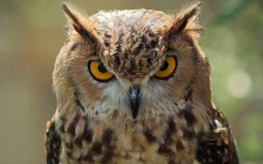
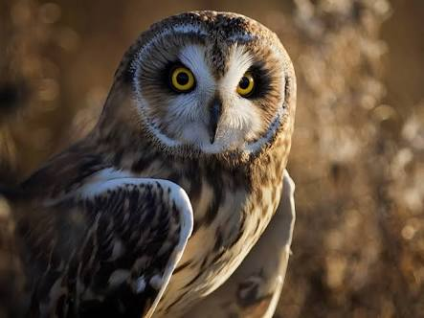
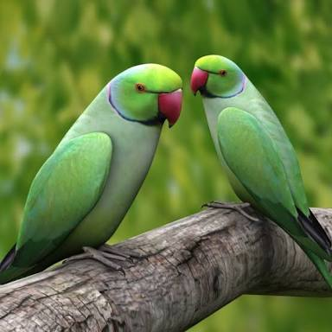
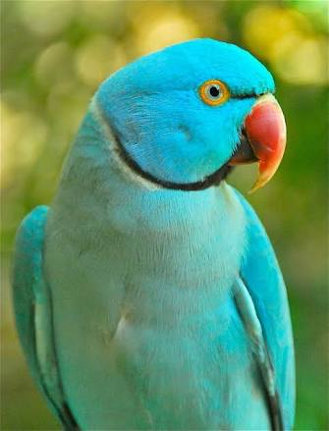

Slide 31
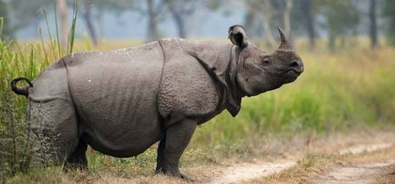
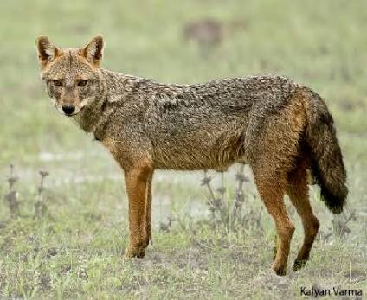
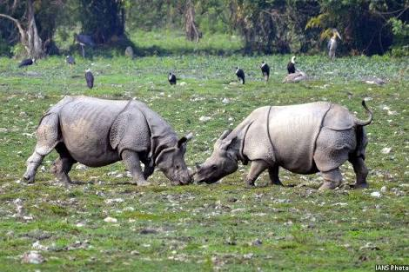
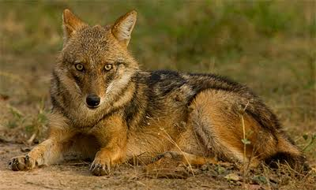

Slide 32
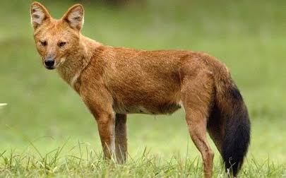
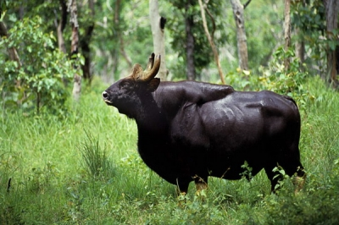
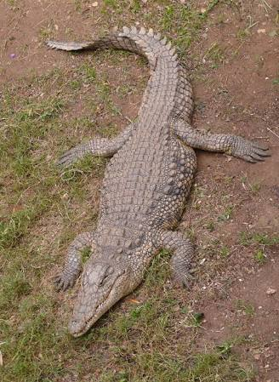
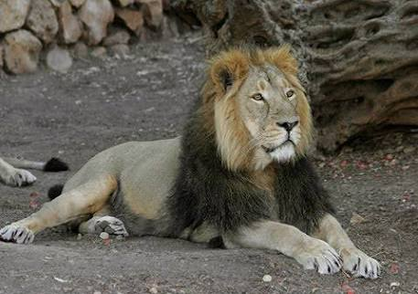

Slide 33
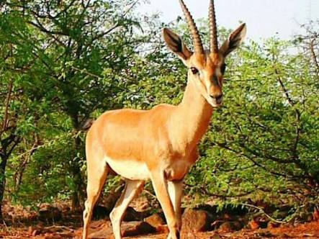
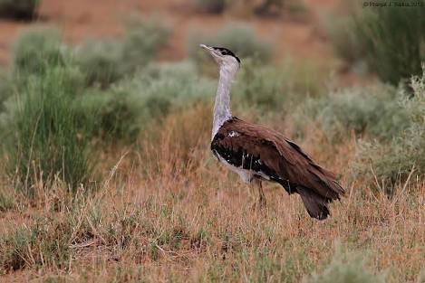
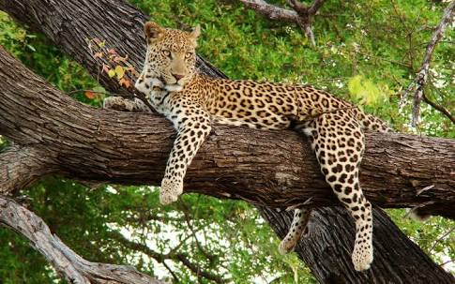
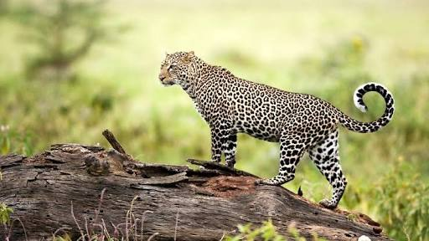

Slide 34
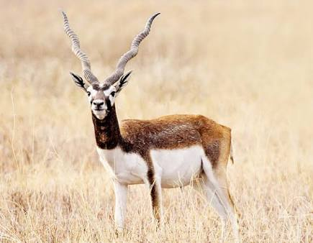
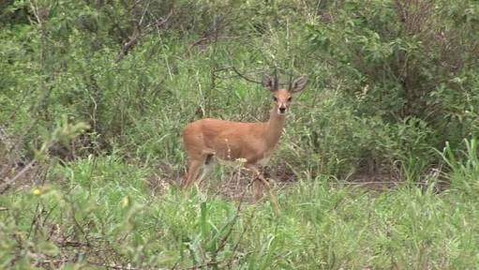
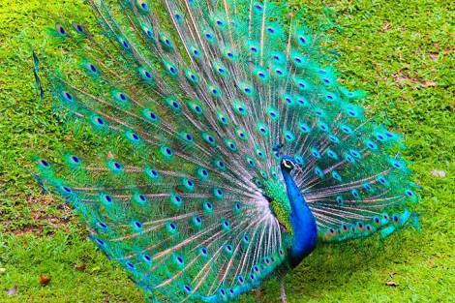
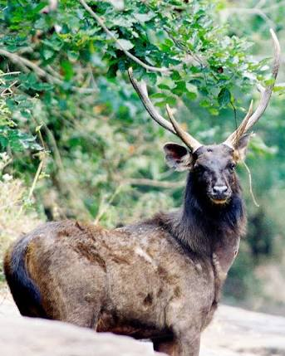

Slide 35
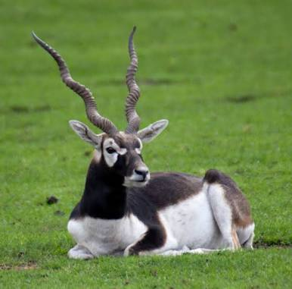
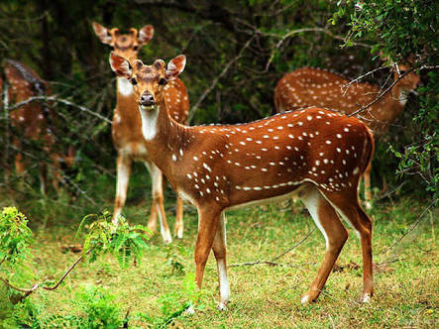
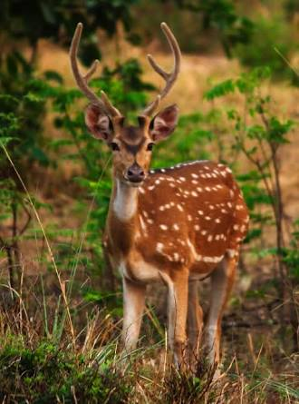
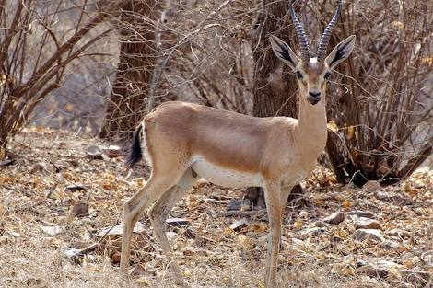

Slide 36
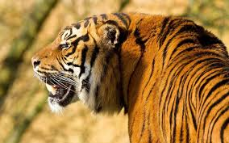
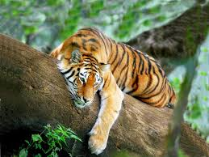
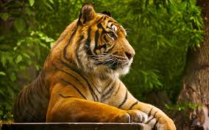
THANK YOU

