Slide 1
Workshop on revised Syllabus of B.Sc.I DSC-15b Cell biology and Evolutionary biology
Dr. Pratiksha S.Bhandare
Department of Zoology,
P.D.V. P. Mahavidyalaya Tasgaon, Sangli.

Slide 2
Cell structure Cell theory and diversity in cell size and shape
Cell Theory
Observations of T.S.Schwann
Observations of M.J. Schleiden
Studies of Virchow and others
Postulates of cell theory
Diversity in Cell size and shape
Smallest and largest cell. Longest cell
Various shapes of cells

Slide 3
Structure of nucleus Nucleus with reference to Nuclear membrane, Nucleoplasm, Chromatin and nucleolus.
Introduction: Importance, Discoverer, Various Shapes etc.
Nuclear Envelope
Structure: Outer membrane, Inner membrane, Perinuclear space, Lamins.
NPC (Structure, Transport through NPC).
Functions of Nuclear envelope
Nucleoplasm
Major Components
Chromosome Territories
Functions

Slide 4
Structure of nucleus
Chromatin
Srtucture
Euchromatin
Heterichromatin
Constitutive
Facultative
Nucleolus
Structure : 3regions
Functions: rRNA synthesis, rRNA processing, Ribosome assembly
Functions of Nucleus

Slide 5
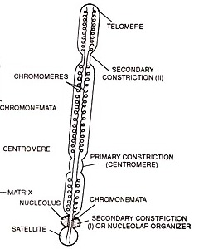
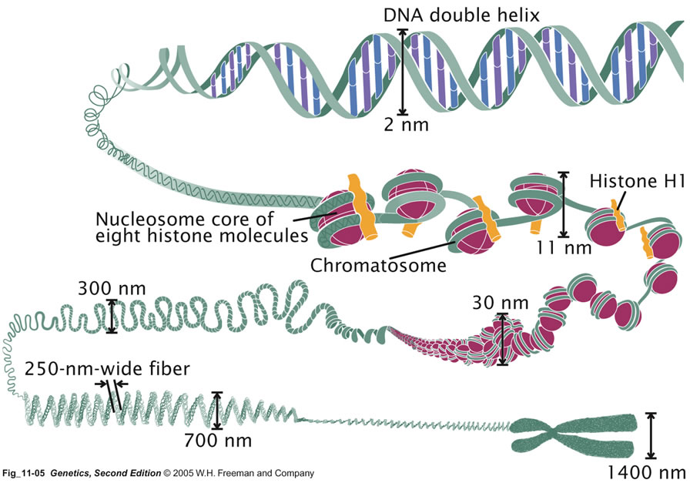
Structure of Chromosome With reference to Morphology and organization (Nucleosome), Polytene Chromosomes

Slide 6
Structure of Chromosome
Packaging of DNA
Nucleosome
Beads on string
Zic Zac arrangement
Solenoid
Chromatin Fibres
Chromonema and Chromomeres
Stages of DNA packaging with respect to cell cycle.
Structure of Metaphasic chromosome
Chromatids
Centromere and kinetochore
Telomeres
Secondary constriction
Satellite
Types of chromosomes based on position of centromere

Slide 7
Polytene chromosome
Introduction
Endomitosis
Somatic Pairing
Structure
Importance

Slide 8
Plasma Membrane
Fluid Mosaic model:
Postulates
Lipids of plasma membrane
Proteins of plasma membrane
Functions
Barrier
Cell division
Cell fusion
Conjugation
Endocytosis
Exocytosis
Transport
Passive transport
Facilitated transport
Active transport
Receptors
Antigen specificity
Impulse transmission

Slide 9
mitochondria
Structure
Functions
Shape
Size
Distribution
Outer membrane
Inner membrane
Outer chamber
Inner chamber: matrix
Power house
Synthesis of acetyl Co A from Pyruvate
β oxidation
Kreb’s cycle
Electron transfer and Oxidative phosphorylation
ATP transport
Synthesis of Urea
Synthesis of some Amino acids
Role in apoptosis
ROS formation
Study of maternal lineage
Biomarkers of cancer

Slide 10
Endoplasmic reticulum
Structure
Functions
Components
Cisternae
Tubules
Vesicles
Types
Rough ER
Smooth ER
Chemical composition
Lipids
Proteins of RER
Proteins of SER
Mechanical support
Functions of RER
Post translational modifications
Protein folding
N-glycosylation
Protein sorting
Functions of SER
Lipid biosynthesis
Lipid transport
Detoxification and bio-activation
Glycogenolysis and gluconeogenesis
Ca⁺⁺ sequestering

Slide 11
Golgi Complex
Structure
Functions
Discoverer
Three structurel components
Cisternae
Structure
Polarization
GERL region
Tubules and Vesicles
Tubles
Four types of vesicles
Transitional
Secretary
Retrival
Clathrin coated
Large vacuoles
Secretion
Continuous
Discontinuous
Protein sorting
Lysosome formation
Role in Fertilization
O-Glycosylation
Sphingomyelin synthesis
Polysaccharide synthesis
Membrane recycling
Role in cell plate formation.

Slide 12
lysosomes
Structure
Functions
Dimentions
Lysosomal membrane
Proton pump
Protection of the membrane
Hydrolytic enzymes
Polymorphism
Primary lysosomes
Heterophagosome
Autophagosome
Residual body
Intracellular digestion
Autophagy and cellular turn over
Role in fertilization
Apoptosis
Extracellular digestion
Role in body defence
Cleaning the cell debris
Secretion of hormones in thyroid

Slide 13
History Of life: Major events in the history of life
Structure of Cosmos
Primitive Earth
Prebiotic synthesis
Primitive atmosphere
Primitive biomolecules
Energy source
Absence of Oxygen
Primitive sea
Evolution of Progenote: Precellular evolution
RNA world
Ribonucleoprotein (RNP) World
Origin of Plasma membrane
DNA world
Progenotes
Prokaryotes ,Urkaryotes, Single celled eukaryotes
Heterotrophs , Autotrophs
Multicellularity

Slide 14
Introduction to evolutionary theories
Lamarkism: Inheritance of acquired characters
About Lamark
Lamark’s Theory of evolution
Examples
Critics and demerits
Significance
Darwinism: Theory of Natural selection
About Darwin and his observations
Theory
Critics and demerits
Neo-Darwinism
What is Neo-Darwinism?
Maturation into Modern Synthesis
Five basic processes: Mutations, Variations, Heredity, Natural Selection, Isolation

Slide 15
Direct evidences of evolution; Fossils
Definition
Importance of fossils
Process of formation of fossils
Nature of fossils
Unaltered fossils
Altered Fossils
Types of Fossils
Entire organism
Original hard part of Invertebrate
Skeletons preserved
Altered hard part
Traces of organisms
Dating
Imperfection of fossil record
Problems in excavation
Problems of fossilisation
Natural destructions

Slide 16
Extinctions
Mass Extinctions
End Ordovician: 444million yrs ago
Late Devinian: 375 million yrs ago
End Permian: 251 million yrs ago
End Triassic: 200 million yrs ago
End cretaceous : 66 million yrs ago
Causes
K-T extinction: cretaceous-tertiary extinction
Introduction
Pattern
Evidence
Causes
Role of extinction in evolution

Slide 17
Thank you!

