Slide 1

B.Sc. III ZOOLOGY
Applied Zoology
GOAT FARMING
By
Dr. Pratiksha Bhandare

Slide 2
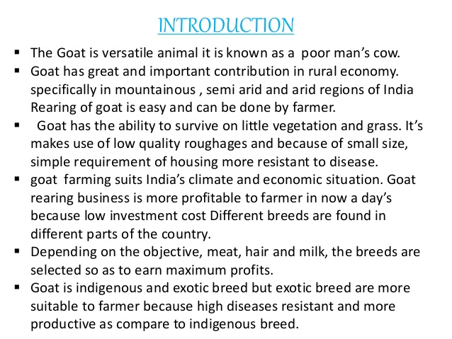

Slide 3
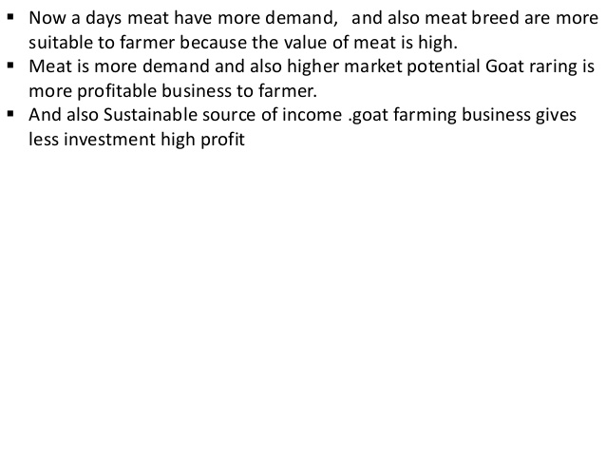

Slide 4
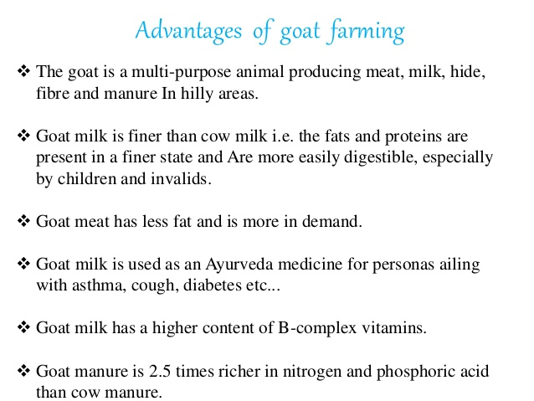

Slide 5
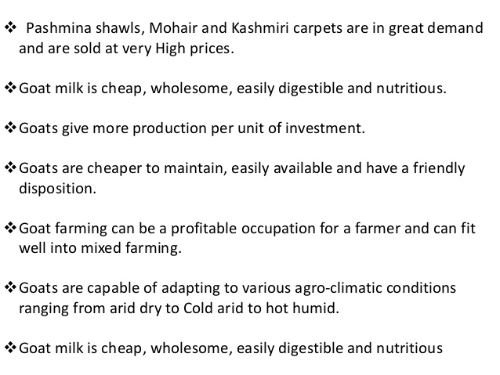

Slide 6
Goat Breeds
More than 300 goat breed available all over the world
Dairy goat breed
Milk Goat breed
Skin productive goat breed
In India 20 breeds of goats are available and some of them are as follow.
Capra hircus is scientific name of goat and it is endemic to India
Goat breeds area broadly divided into two classes,
Endemic and Exotic in origin

Slide 7
Goat Breeds
Indian Goat breeds (Endemic or Desi )
Jamunapari
Jamunapari breeds are found mainly in the state of Uttar Pradesh.
Its coat colour is white with tan or black markings at neck and ears
They are beard in both sexes; have tuft of long hairs in the buttocks.
It is largest and most elegant of the long-legged goats of India.
It has pronounced Roman nose having a tuft of hair which results in parrot mouth appearance.
Their horns are short and flat and horizontally twisting backward.
An adult male ranges from 90 to 100 cms in height, whereas a female goat ranges from 70 to 80 cms in height
.

Slide 8
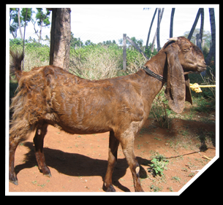
It is, tall and leggy with convex face line and large folded pendulous ears.
Generally found in white colors.
Their ears are large and drooped downwards.
An adult female weighs between 45kgs to 60kgs, whereas an adult male ranges between 65kgs to 80kgs.
Average birth weight is up to 4 kg.
Average age at first kidding is 20-25 months.
They have large udder and big teats and average yield is 280 kg / 274 days.
Have the ability to yield 2 to 2.5kgs of milk per day.
The fat content of the milk ranges between 3 to 3.5%.
Jamunapari

Slide 9
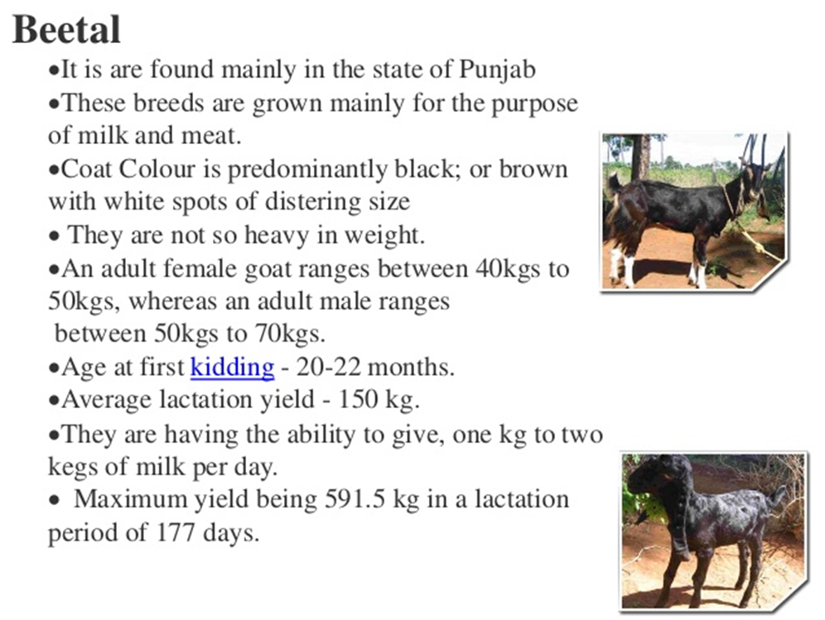

Slide 10
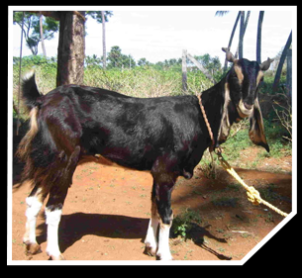
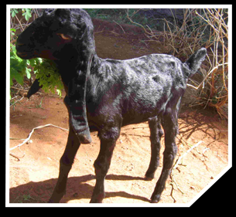
Beetal

Slide 11
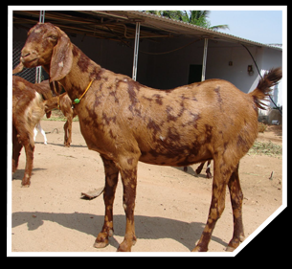
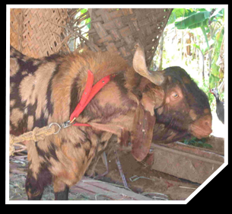
Ajmeri or Sirohi
Coat colour is brown, white, and admixture of colours in typical patches; hair coarse and short.
Compact and medium sized body.
Tail twisted and carries coarse pointed hair.
Horns are small and pointed, curved upward and backward.
Average body weight of buck is 50 and doe is 23 kg.
Average birth weight is 2.0 kg.
Kidding is once a year, twins are common.
Average age at first kidding is 19 months.
Average lactation yield - 71 kg.
Average lactation length - 175 days.

Slide 12
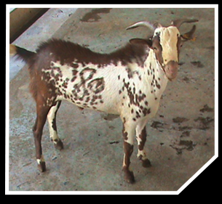
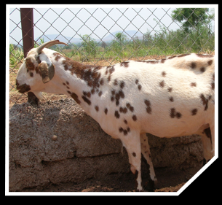
Barbari
This is short haired and erect-horned goat popular in urban areas of Delhi, Uttar Pradesh, Gurgaon, Karnal, Panipat and Rohtak in Haryana state.
Barbari breeds are grown mainly for milk and meat purpose.
The color of this breed is white with light brown patches.
An adult female goat weighs between 25kgs to 35kgs, whereas an adult male goat ranges between 35kgs to 45kgs.
They are having the ability to give one kg to 1.5kgs of milk per day.
This breed have better reproductive capabilities.
They will give, 2 to 3 kids in parturition.
They are usually stall-fed and are reported to yield 0.90-1.25 kg of milk(fat content 5%) a day in a lactation period of 108 days
They are prolific breeder and kid twice in 12-15 months.

Slide 13
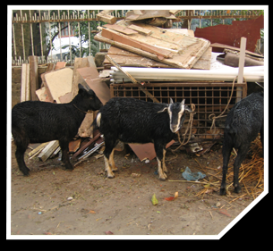
Black Bengal
Coat colour is predominantly black, brown/grey and white with soft, glossy and short hairs.
Dwarf in body size, legs short, straight back; both sexes are bearded.
Average live weight of buck is 15 kg and doe is 12 kg.
Most prolific among the Indian breeds.
Multiple births are common - two, three or four kids are born at a time.
Kidding is twice a year. Average litter size is 2.1.
Average age at first kidding is 9-10 months.
Average lactation yield is 53 kg. Lactation length is 90 to 120 days.
Its skin is in great demand for high quality shoe-making.

Slide 14
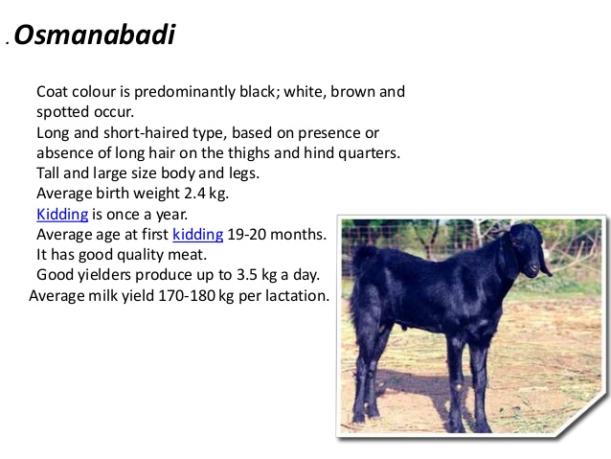

Slide 15
Sangmaneri
It is mainly found in pune , Ahmednagar and Nashik district .
It is midium sized goat which is famous for milk production.
Body colour is variable but generally white Ear lobes , slightly elongated.
body wt. About 30 to 40 Kg.
Milk Production up to 3kg/day.

Slide 16
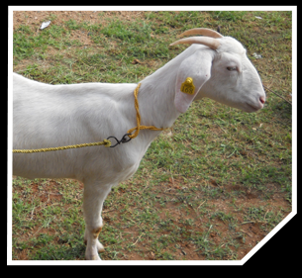
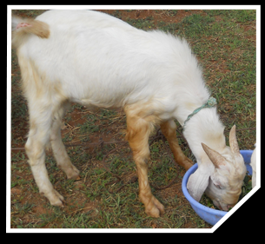
Tellicherry
Tellicherry breed is also called as malabari breed.
It is found mostly in the state of Kerala.
It is grown mostly for the purpose of meat.
Generally seen in white, purple and black colors.
An adult female ranges in weight from 30 to 40kgs, whereas an adult male ranges between 40 to 50kgs.
They can yield one kg to two kgs of milk per day.
These types of breeds have better reproductive capabilities.
They can give two to three kids in a parturition.

Slide 17
Burti
It is native of Barbera (Africa) but since many years it is domesticated in UP, Mathura , Agra considered as endemic breed
Body is white black dots.
Ear lobes are small, legss strong.
These are good milkers.
Females can produce upto 2kgmilk/day.

Slide 18
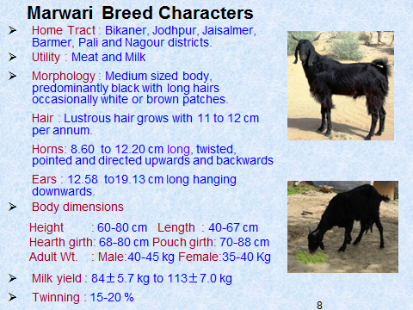

Slide 19
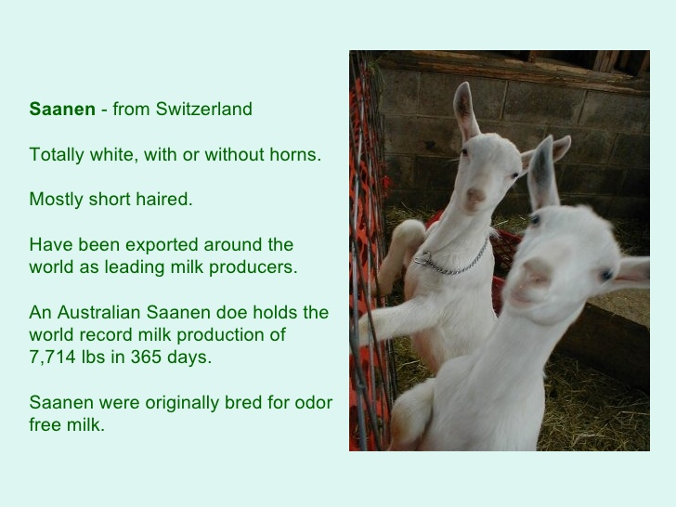
Exotic Breeds

Slide 21
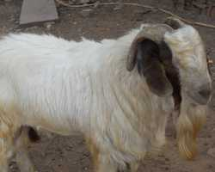
African Bore
Native of south Africa it is world famous breed for meat production .
Body colour brown head and neck remaining white,highly muscular body.
Rapid growth rate average 90 to 100 gm/day.
Female mature sexually at the age of just 6 o 7 month.
Female can produce ypungones upto 15 years.
Percentage of twin kids is upto 55%
Good resistance power, highly adaptive, beneficial breed.
Body wt. upto 100 Kg in male. 60 Kg in female.
This breed is used to improve lacal breeds.

Slide 22
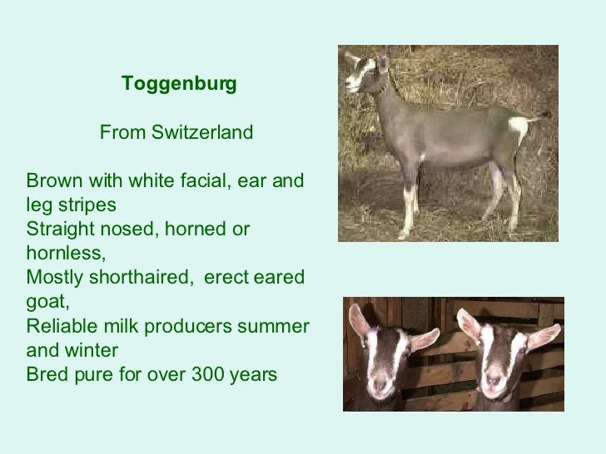

Slide 23
HOUSING For GOATS
1.Made to develop an economic.
2.Comfortable,Dry
3.Protect from adverse weather
4.Protection from rain,Humidity
5.Predator s accidents and parasitic infestation.
6.Minimum labour requirement

Slide 24
GOAT HOUSE
•60ftx20ft.with 6f t heigh tatsideand8-10ft incentreisidealfor60-80goats
•Generalflock60–80adult breeding females(nannies)are housed in thisshed
FLOOR SPACE REQUIREMENT
Adultgoats:12-16sqft/goat.
LactatingandPregnant:20sqft/goat.
Bucks:20sqft/goat.
Kids:7daysto3months:5–5sqft/kid
3–5months:8sqft/kid
6monthsto1year:10sqft/kid

Slide 25
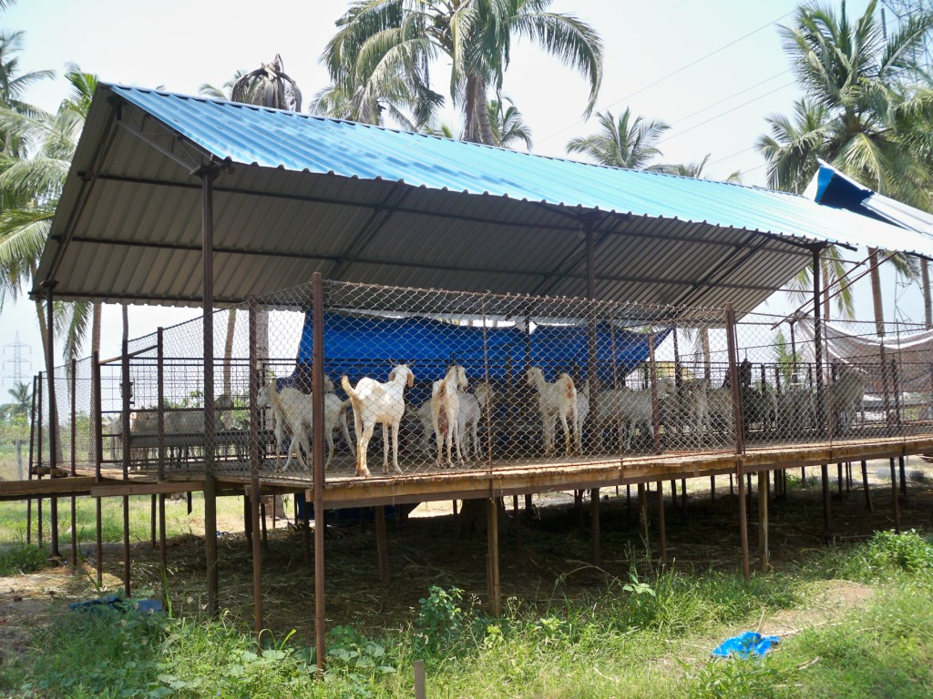
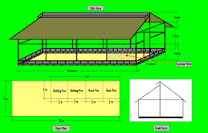
General Layout of housing

Slide 26
Several designs for housing but basically “A” shaped housing is most beneficial.
Length of house should be in South –North direction while width in East- west it help in entry of sulight in house.
Adequatespace should be provided to every goat, kid, buck. Eg.
Kids upto 6 month – 2 sq.m.? Kid
Hight of roof must be 10to 12 feet in centre and 7 to 8feet at sides. Protection side walls of 4 to 5 feet height and width should not be more than 12 M.
Open space /yard must be there outside for house for exercise of goats and kids.
Compartments/ Quarters-
Housing should be provided with diff. quarters for adult, kids, bucks, pregnant does.
Pregnant does must be kept apart from others.
Kids need more space for playing so that separate provision for them.
Each campartment must be provided with waterer, feeder or hay container
For cleaning formaline, lime or BHC power should be used.
Flooring of house must be made from corse sand, brick pieces, and from cement conerete.

Slide 27
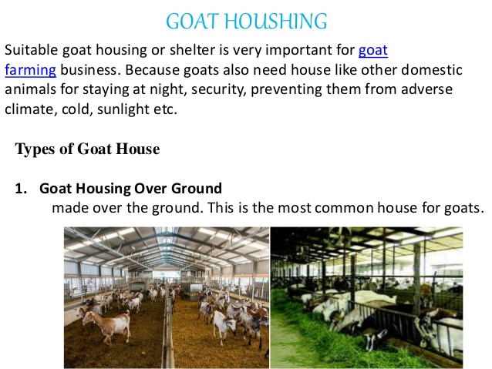

Slide 28
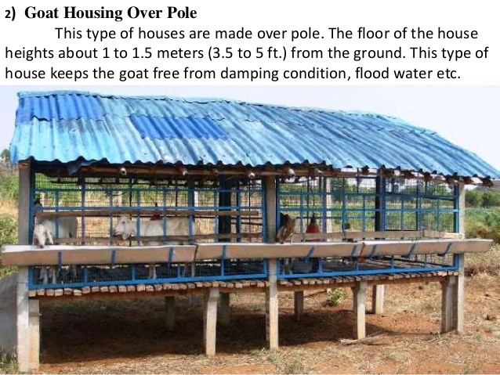

Slide 29
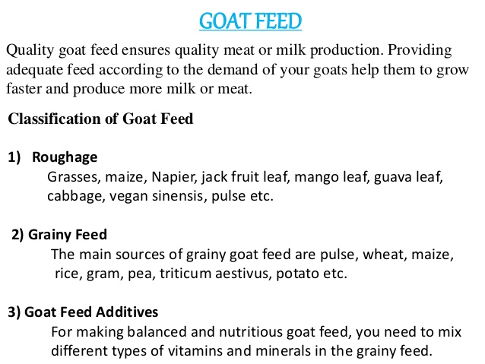

Slide 30
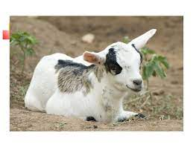
Economic Importance

Slide 31
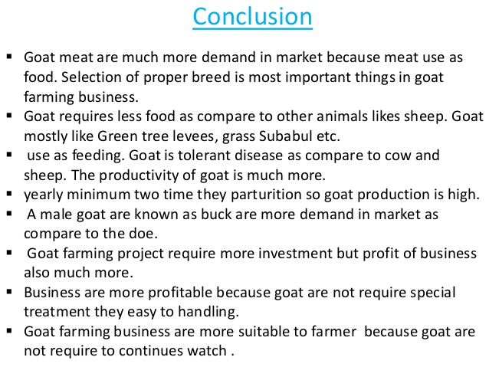

Slide 32
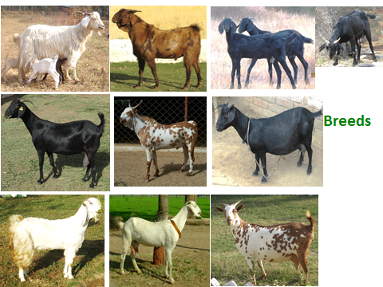

Slide 33
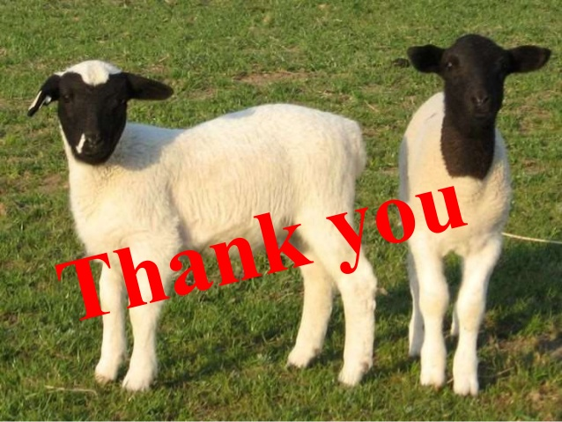

Slide 34
