Slide 1
Department of Zoology Miss Kusarkar S.P. Bsc.III

Slide 2
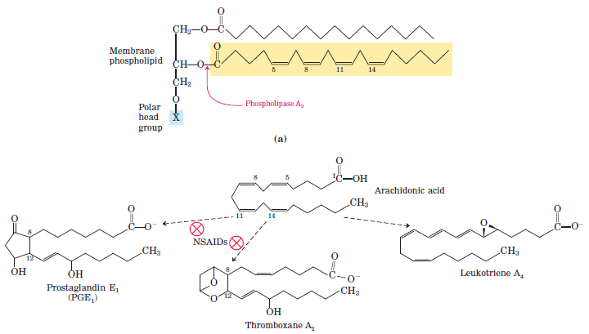

Slide 3
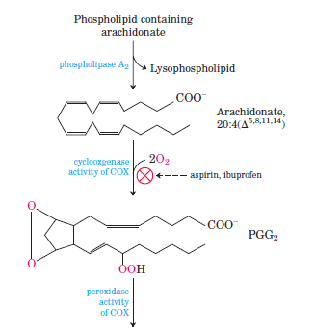
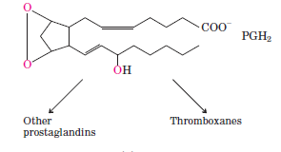
Cyclic pathway of prostaglandin synthesis

Slide 4
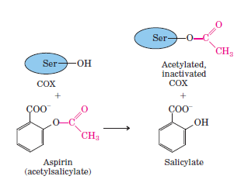
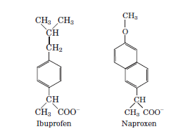

Slide 5
