Slide 1
STUDY OF CANCER
BY
Dr. P. B. TELI
(M. Sc., Ph. D.)
Assistant Professor
Department of Zoology
P. D. V. P. College, Tasgaon
Dist- Sangli, Maharashtra.

Slide 2
In multicellular organisms, growth and replacement of dead cells takes place as a result of normal process called cell division. Sometimes the cell division becomes irregular, rapid and uncontrolled. Thus result into the formation of mass of cells called tumour, which leads to cancer. Therefore cancer is defined as “The cancer is defined as uncontrolled, fast, abnormal growth or multiplication of cells resulting in mass of cells called tumour”.
The word cancer is derived from Greek word karkinos means crab, presently cancer is considered as a fatal disease one of the leading causes of death.
Proto-oncogene (Inactive): A normal gene which, when altered by mutation, becomes an oncogene (Active) that can contribute to cancer.

Slide 3
Types of Tumours: 1. Benign or Non-malignant tumour 2. Cancerous or Malignant tumour
Differentiate Between Benign and Cancerous Tumour
Benign /Non-malignant Tumour | Cancerous/Malignant Tumour
It does not spread to the one organ to the other | It spreads to one organs to the other i.e. Metastasis
It enclosed by connective tissue sheath | It is not enclosed by sheath
It is not contact with neighboring tissues | It is in contact with neighboring tissue
Growth rate is slow | Growth rate is high
It is mass of differentiated cells | It is mass of undifferentiated cells
e.g. Moles & uterine fibroids | e.g. Leukemia

Slide 4
Types of Cancer
Carcinomas: it is a cancer of epithelium of ectodermal or endodermal origin. e,g. Brain cancer, Skin cancer, breast cancer, lungs cancer etc. (85%)
Sarcomas: it is a cancer of mesodermal origin. e.g. Bone cancer, Muscle cancer, cervical cancer, cartilage cancer etc.
Lymphomas: excess production of lymphocytes by the spleen and lymph nodes.
Leukemias: Excess production of all the types of W.B.Cs. e.g. Blood Cancer.
Adenocarcinoma: Cancer of mucus-secreting glands e.g. Lung cancer

Slide 5
Causes of Cancer or Causative Agents
The cancer causing agents are called Carcinogens. These are
Addiction:
Tobacco chewing: It includes Cured tobacco chewing,
Star Gutka, RMD Gutka (Tobacco + Crushed arecanut + Catechu + slaked lime + paraffin), Vimal Pan Masala, Mawa (Crushed arecanut+Catechu+slaked lime + 120/360 type of tobacco)
Carcinogenic agents: Tobacco-Specific Nitrosamines (TSNAs), Formaldehyde, Acetaldehyde, Arsenic, Benzopyrene, Nickel and Cadmium.
It causes Mouth cancer, Throat, cheek, gums, lips or Tongue, pancreas and oesophagus cancer.

Slide 6
Smoking: contains Carbon monoxide (CO), Hydrogen cyanide (HCN), Nitrogen oxide gases and Formaldehyde, acrolein, benzene, N-nitrosoamines.
Smoking causes: Lung, oesophagus, larynx, mouth, throut, kidney, bladder, liver, pancreas, stomach, cervix, colon and rectum etc.
Alcoholism
Intake of alcohol content Beverages.
They are of 2 – types namely
1. Carbonated alcohol - Beer
2. Non-carbonated alcohol – Wine, Rum, Whisky, Gin,
Vodka & Brandy

Slide 7
A. Carbonated alcohol :
BEER: (Mild – 4% ABV and Strong 6 - 8% ABV)
Raw Materials: Malted Barley, Corn, Rice, Wheat. Alcohol Content: 4 – 5% ABV
Benefits: preventing diseases of heart includes coronary heart disease, atherosclerosis-hardening of the arteries, heart failure, heart attack, stroke and chest pain and circulatory system.
B. Non-carbonated alcohol:
WINE: are of Two types
Red Wine (Sweet) : Grapes (Vitis vinifera), blueberries, raspberries, apples e.g. SULA, Fortwine
White Wine: Cherries, Rice.
Alcohol Content: 13 – 16% ABV (Alcohol By Volume)

Slide 8
Benefits of Wine intake: it reduces risk of heart disease, stroke, diabetes etc. increase life span & improve mental health.
Rum: Sugar cane juice, molasses (40% ABV). Rum is blood thinner, Rum increase good cholesterol (HDL)
Whisky: Wheat and Barley (40% ABV)
Vodka : Grains like Sorghum, Corn, rye or Wheat
Gin: Juniper, Coriander, Citrus peel, Cinnamon, almond
Brandy: It produced by distillation of wine (35-60% ABV)
Benefits of Brandy: it contains anti-oxidants compounds which eliminate the effect of free radicals. It also prevents wrinkles on the skin, poor vision and acts as anti-ageing

Slide 9
Note: Excess intake of alcohol produces Cancers e.g. Mouth Cancer, Phyaryngeal (upper throat) cancer, Oesophageal (food pipe) cancer, laryngeal (voice box) cancer, breast cancer, bowel cancer and liver cancer
Moderate Drink: is defines as one drink a day for women of all ages and two drinks a day for men upto age of 65 and younger.
Radiation: the radiations such as X-ray, UV- rays, Nuclear disaster, etc
Viruses: like HBV - Liver Cancer, HPV - Cervix cancer, HIV- Kaposi’s sarcoma
Chemicals: Benzene, pesticides, cadmium, chromium, asbestos, polycyclic hydrocarbons etc.
Diet: fatty diet, synthetic foods, beef, smoked fish or some food colour.
Genetic factor: Mutation, DNA, hereditary factors e.g. Retinoblastoma eye cancer.

Slide 10
Symptoms or Warning sign
A lump or hard area in the breast.
Change in bowel or bladder habit.
A change in size and colour of wart or mole
A persistent cough or hoarseness, Indigestion, difficulty in swallowing.
Blood flow from any body opening, unusual or excess bleeding during menstrual cycle
Test for Cancer Diagnosis:
PAP test-Cervix cancer
BSE, Mammography, radiography,

Slide 11
Control Measures
Avoiding excessive radiation.
Avoiding alcoholism, tobacco chewing, smoking and drug addiction.
Protection of industrial workers from carcinogenic chemicals and radioactive substances.
Avoid use of synthetic colours in food.
Personal hygiene reduces chances of cancer of cervix in women.
Cancer education is essential to motivate people for early diagnosis and proper treatment.

Slide 12
Cure or Treatment
Surgery
Radiation therapy
Chemotherapy or drug treatment
Combined therapy
Uses of antibiotics,Vincristine & Vinblastine
Note:
Rate of cancer in India: Kerla (Kochi), Mizoram, Haryana, Delhi, Karnataka and Goa.
India : 106.6/1 lakh people
Kerla:135.3/1lakh people (Sept. 18, 2018, Times of India Report)

Slide 13
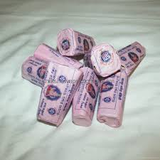
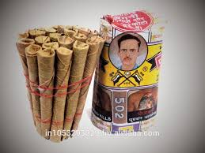
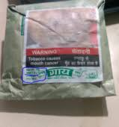
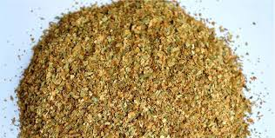
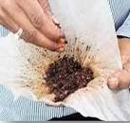
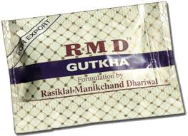
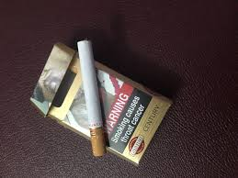
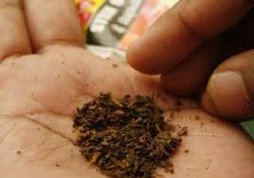

Slide 14
Goa State
Breast cancer is the commonest cancer and shows highest incidence with a frequency of 27% followed by cancer of cervix (15.2%)
Causes: Western lifestyle, dietary habits - Smoked fish, Red meet, beef and fatty diet, late marriage etc.
Research paper: IJISET Vol.4, Issue.1, Jan. 2017. Authors- T. M. Desphande, A. K. Pandey and S. K. Shyama, Dept. of Zoology, Goa University, Goa.
In India Common cancer is Oral Cancer.

Slide 15
“You beat cancer by how you live, why you live and in the manner in which you live”
“Since I had cancer I’ve realized that every day is a bonus.” – Geoffrey Boycott
THANK
YOU

