Slide 1
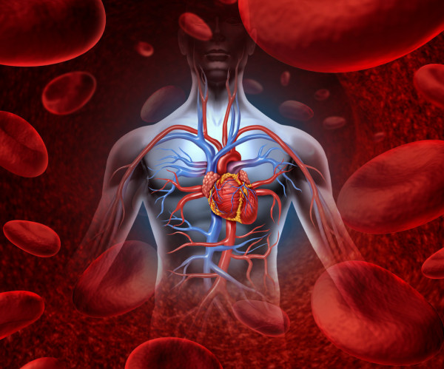
THE HUMAN HEART
Kusarkar S.P.
Department of Zoology.
P.D.V.P College, Tasgaon

Slide 2
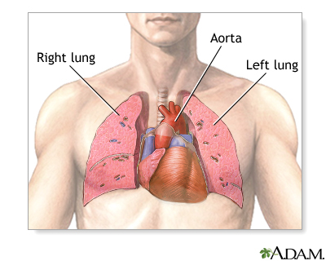
LOCATION OF HEART
Heart is situated in thoracic cavity between two lungs.

Slide 3
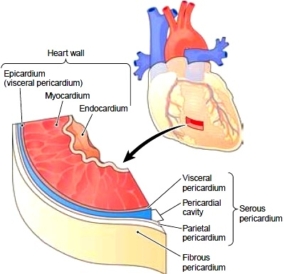
HEART WALL
Heart wall consist of three layer
Epicardium - Outer layer
Myocardium - Middle layer
Epicardium - Inner layer

Slide 4
EXTERNAL STRUCTURE OF HEART
The human heart is four chambered.
Two superior chamber is called atria.
Two inferior chamber is called ventricle.
The atria seperated bt ventricles by transverse groove called Coronary sulcus or atrioventricular groove.
Two ventricle externally seperated from each other by two grooves the anterior and posterior inter-ventricular sulci.

Slide 5
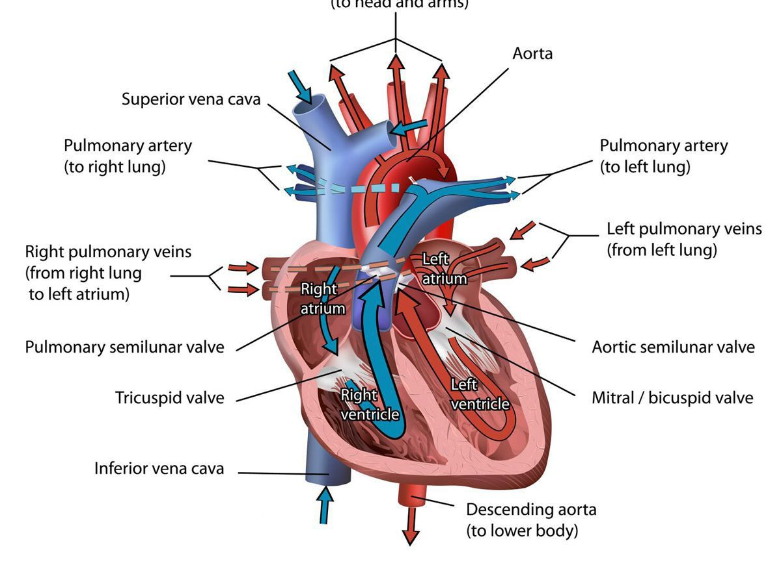
STRUCTURE OF HEART

Slide 6
INTERNAL STRUCTURE OF HEART
Atria- Receiving chamber. Superior vena cava , inferior vene cava and Coronary sinus opens into the right atrium.
Opening of superior vena cava guarded by Eustachian valve and opening of coronary sinus guarded by Thebesian valve.
Both atria opens onto respective side of ventricles by Tricuspid valve and Bicuspid valve.
All valves helps in prevention of backflow of blood

Slide 7
Ventricles
These are Inferior pumping chamber of heart
Wall of left ventricle is more muscular and 3 times thick than right ventricle
The right ventricle opens into the pulmonary aorta and left ventricle opens into the aorta.
The opening is guarded by three semilunar valves.

Slide 8
PUMPING ACTION OF HEART
Pumping action of heart include contraction and relaxation.
Contraction of heart muscle is called systole.
Relaxation of heart muscle is called diastole.
Single systole followed by diastole makes one heart beat
Heart rate is 72 beats per minute.
In one beat heart pump 70 ml blood is called stroke volume.
In one minute heart pump 5040 ml blood is called cardiac output.

Slide 9
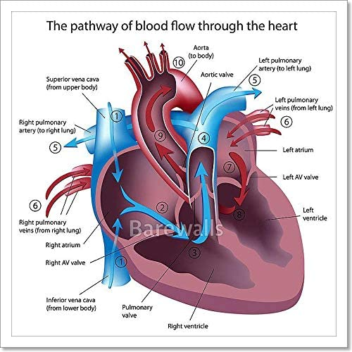

Slide 10
CONDUCTING SYSTEM OF HEART
SA Node-Present at right atrium. It act as pace maker of heart.
It has power of generating a new wave of contraction and posses contraction.
AV node – Present at right atrial wall
Act as pace setter.
Bundle of His – AV node send impulse to bundle of His.
Purkinje fibres- Bundle of his send impulse to purkinje fibres.

Slide 11
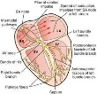

Slide 13
CARDIAC CYCLE
A single heart beat is called cardiac cycle which complete in 0.8 second.
Atrial systole- Represent atrial contrction.completed in 0.1 second.
Ventricular systole- Represent ventricular contraction. Completed in 0.3 seconds.
Joint Diastole- Represent relaxation of both atria and ventricals. Completed in 0.4 seconds.

Slide 14
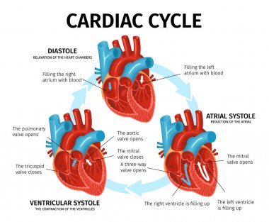

Slide 15
ECG
Graphical representation of electrical v ariations detected at surface of body during their propagation through the wall of heart is called Electrocardiogram.
Three different waves are recognized
P-wave- Small upward wave represet atrial depolarization.
QRS complex- Downward deflection represent ventricular depolarization.
T-Wave- Small, wide and upward wave represent ventricular repolarization.

Slide 16
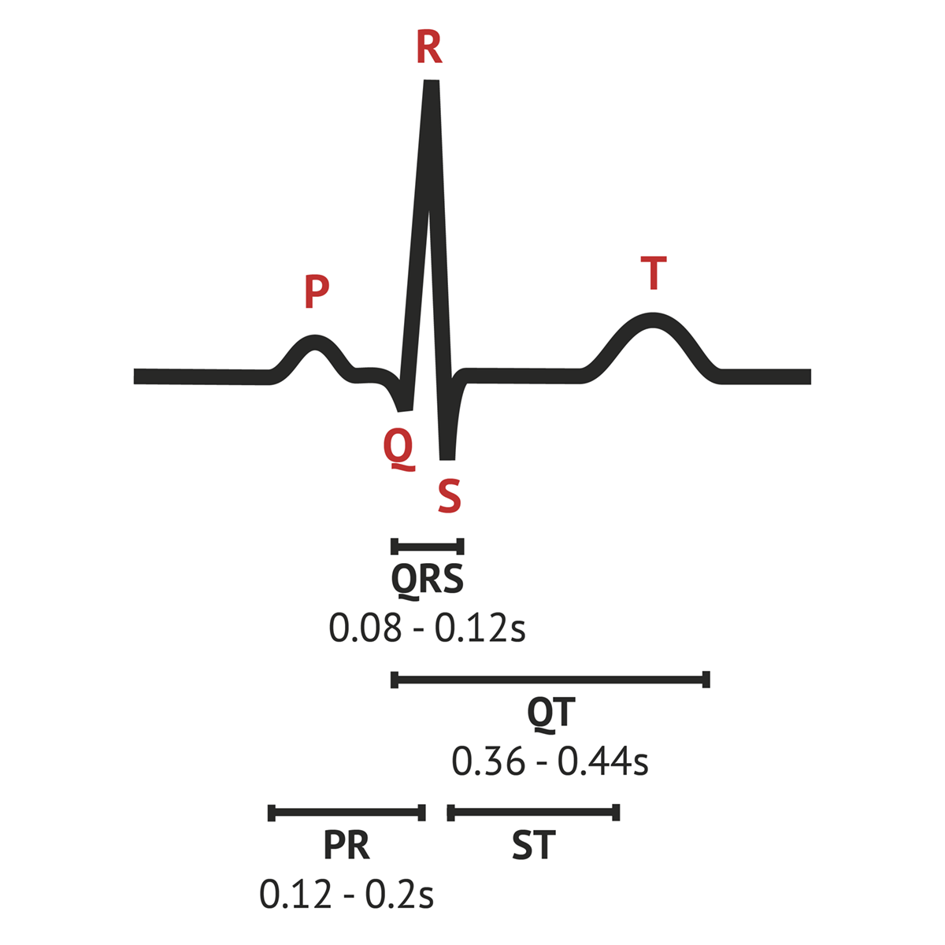
Graphical representation of ECG

Slide 17
THANK YOU

