Slide 1
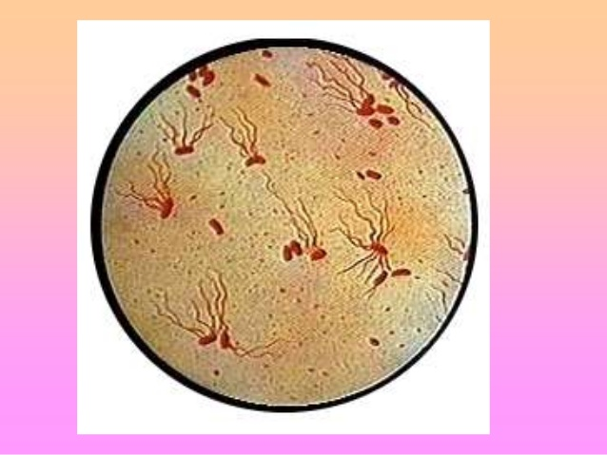
ZOOLOGY
PAPER VIII
APPLIED ZOOLOGY I
Unit 2- Epidemiology of diseases:
Transmission , Prevention and Control of TYPHOID
By
Dr. Pratiksha Bhandare.

Slide 3
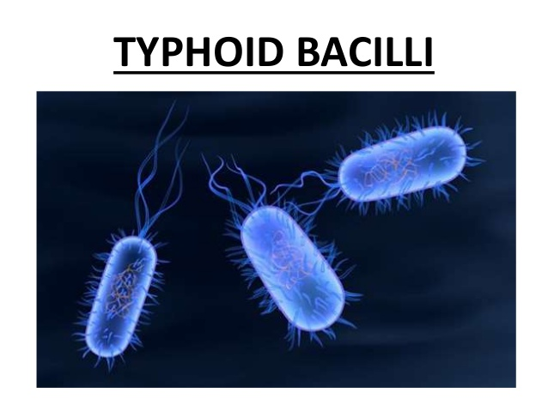

Slide 8
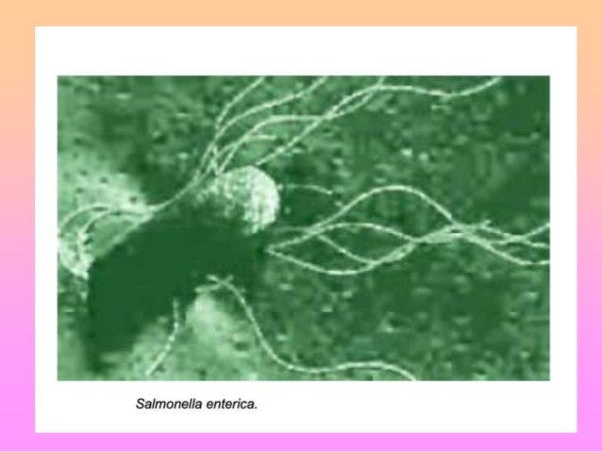

Slide 16
Pathophysiology

