Slide 1
Dr. Ajay Ambhore
M.Sc. B.Ed. NET Ph.D.
Dr. Ajay Ambhore
M.Sc. B.Ed. NET Ph.D.
Assistant Professor, Dept. of Chemistry
Padmabhushan Dr. Vasantraodada Patil Mahavidyalaya, Tasgaon

Slide 2
Introduction
To measure the concentration of Na and K in a solution, Bowing Barnes, David Richardson, John Berry and Robert Hood in 1980 develop an instrument named Flame photometry.
The principle of flame photometry is based on the measurement of emitted light intensity.
One of the branch of atomic absorption spectroscopy and also called Flame Emission Spectroscopy.
Measurement of wavelength and intensity of emitted radiation.
Used to determine the concentration of certain metal ion like Na, K, Ca, Li, Ce, etc.

Slide 3
Introduction
Elements when subjected to flame produce a light of
particular colour and of particular wavelength.
Flame: source of energy for excitation
Emitted light: Measurement of
Wavelength: Qualitative analysis
Intensity: Quantitative analysis

Slide 4
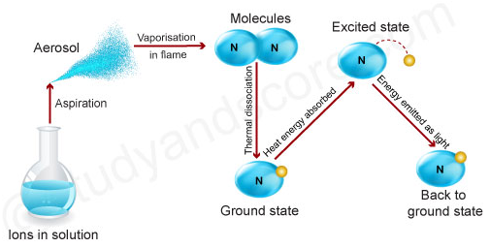
Principle
Liquid sample
Aspirated into flame
Formation of
liquid droplets
vaporization of droplets
to gaseous state
Dissociation of gaseous molecules
Into neutral atoms / radicals
(Atomization)
Measurement of
Emitted radiation
Excitation and
deexcitation

Slide 5
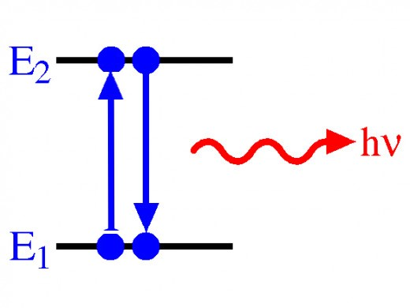
Principle
Principle of flame photometry is summarized in three steps
Vaporization: sample (solid/liquid) converted into gaseous state
Atomization: gaseous state sample converted into neutral atom
Excitation: atom excited to high energy level
∆ E = E₂ – E₁ = hv
Where, h = plank constant
v = frequency of emitted light
As we know, v$=\frac{c}{λ}$
i.e. E₂ – E₁ $=\frac{c}{λ}$
or λ = $=\frac{h X c}{\text{E}\text{2}\text{ – }\text{E}\text{1}}$

Slide 6
Chemical interference in flame photometry
The free atoms or the radical formed in atomization may combine to form new
atoms which decrease the population of neutral atoms and hence decrease the
intensity of emitted radiation.
Hence, Maxweel-Boltazmann equation is introduced for relative population of groun
State (N₀) and excited state (N_{e}) at given temperature.
$\frac{\text{N}\text{e}}{\text{N}\text{0}}= \frac{\text{g}\text{e}}{\text{g}\text{0}}e$ ^{-∆E/kT}
$\frac{\text{N}\text{e}}{\text{N}\text{0}}=A X e$ ^{-∆E/kT}
Where, N₀ = number of atom in ground state
N_{e} = number of atom in excited state
A= $\frac{\text{g}\text{e}}{\text{g}\text{0}}$ = ratio of statistical weight for ground and
excited state. It is constant for given elements.
K = Boltazmann factor and T = absolute temperature

Slide 7
Flame temperature with various fuels
Fuel | Oxidant | Temperature in ˚C
Natural gas | Air | 1700 – 1900
Propane | Air | 2200
Hydrogen | Air | 2000 – 2050
Acetylene | Air | 2400
Hydrogen | Oxygen | 2550 – 2700
Acetylene | Nitrous oxide | 2600 – 2800
Acetylene | Oxygen | 3050 - 3130

Slide 8
Temperature of flame controlled by following factors
Type of fuel and oxidant
Fuel to oxidant ratio
Type of burner used
Type of sample used for sample preparation

Slide 9
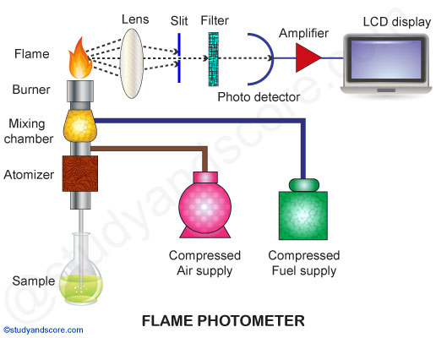
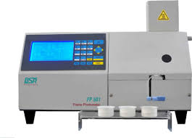
Instrumentation

Slide 10
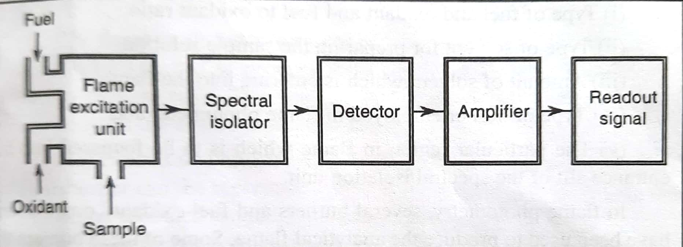
Instrumentation
Block Diagram

Slide 11
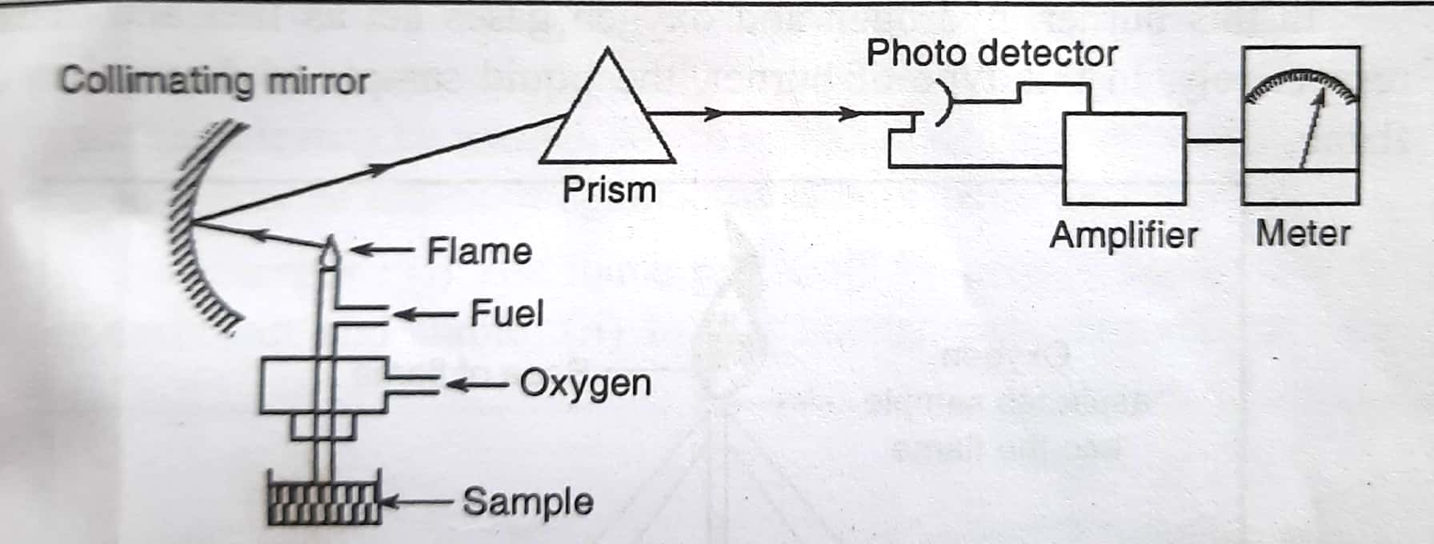
Instrumentation
Schematic Diagram

Slide 12
Instrumentation
Burners:
It have the ability to evaporate the liquid droplets from sample
solution to form solid residue.
It should decompose the solid residue to form atoms.
It must have the capability to excite the formed atom and cause
them to emit radiant energy.
Occurrence of the above mentioned process is depends
upon flame temperature .

Slide 13
Instrumentation
Burners:
Flame temperature is controlled by
Type of fuel & fuel and oxidant ratio .
Type of solvent used to prepare the sample solution.
Amount of solvent entering in the flame.
Type of burner used.
Specific region of the flame which focus on entrance slit.

Slide 14
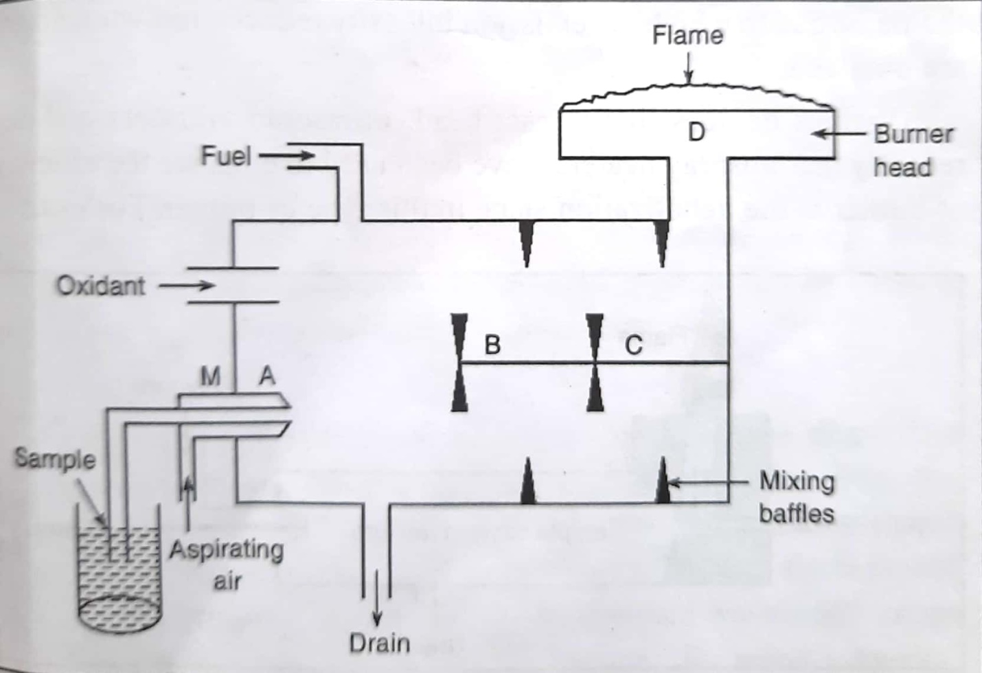
Instrumentation
Burners:
Premix or Laminar-flow burner
Premix: Fuel, oxidant & sample thoroughly mix before reaching
the flame.
Laminar-flow: Gas moves in non-turbulent fission.

Slide 15
Premix or Laminar-flow burner
Advantages:
Noiseless, non-turbulent and stable flame.
Easy decomposition of sample result to efficient atomization.
Handel sample upto several percentages without clogging.
Disadvantages:
When sample contain two solvent ; more volatile solvent will
evaporate first leaving the less volatile solvent caring
undissociated atom of sample .

Slide 16
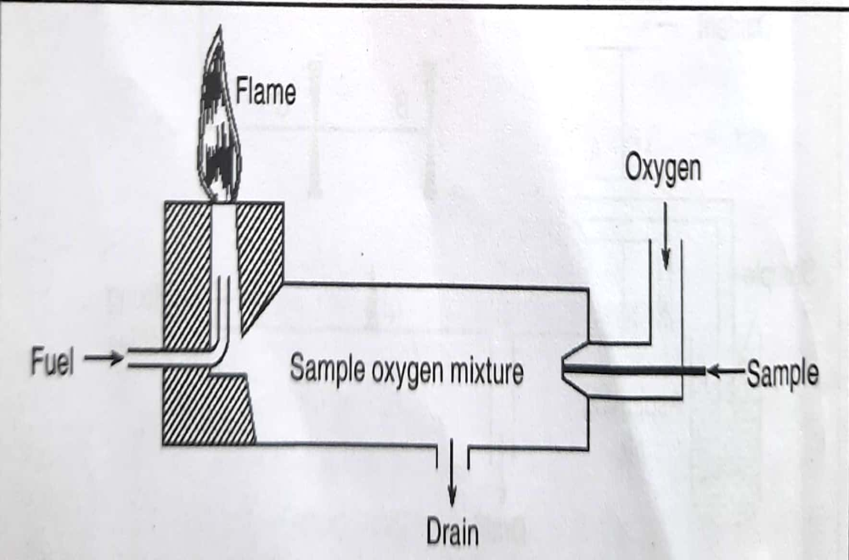
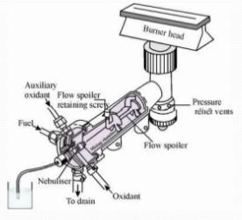
Instrumentation
Burners:
Lundergarph burner
Advantages:
Physically quit to operate.

Slide 17
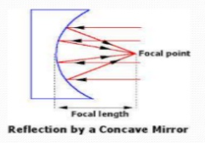
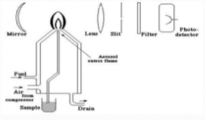
Instrumentation
Mirrors:
To maximize amount of radiation reaches to monochromator.
Concave & front faced (non supported).
Located in such a way that hottest & steadiest part of flame
reflected on to the entrance slit.

Slide 18
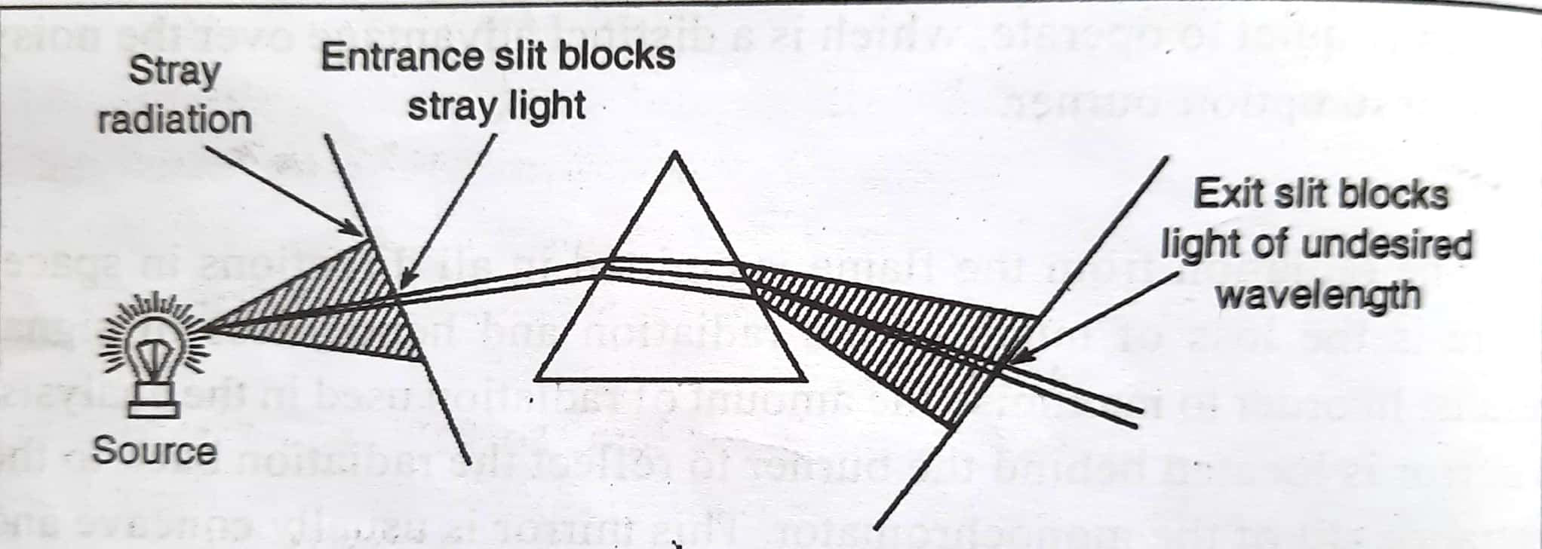
Instrumentation
Slits:
To cut most of the radiations coming from the surrounding and
allow only radiation from the flame.

Slide 19
Instrumentation
Monochromator:

Slide 20
Instrumentation
Monochromator:

Slide 21
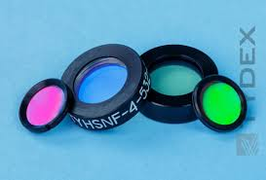
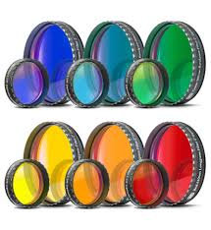
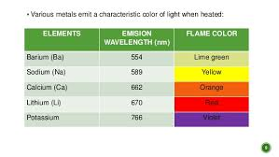
Instrumentation
Filters:

Slide 22
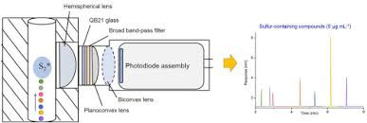
Instrumentation
Detectors:

Slide 23
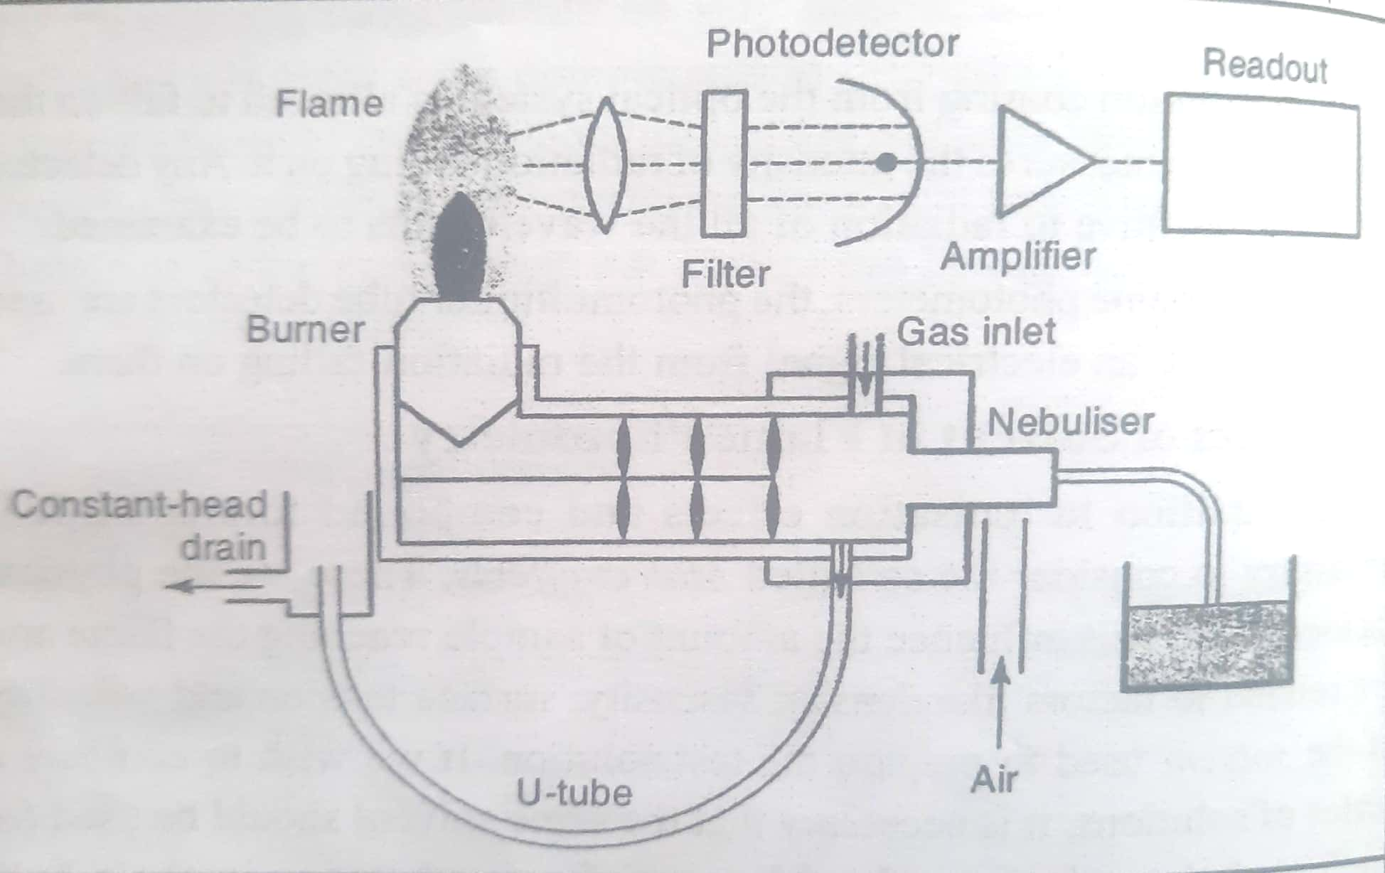
Instrumentation
Simple flame photometer

Slide 24
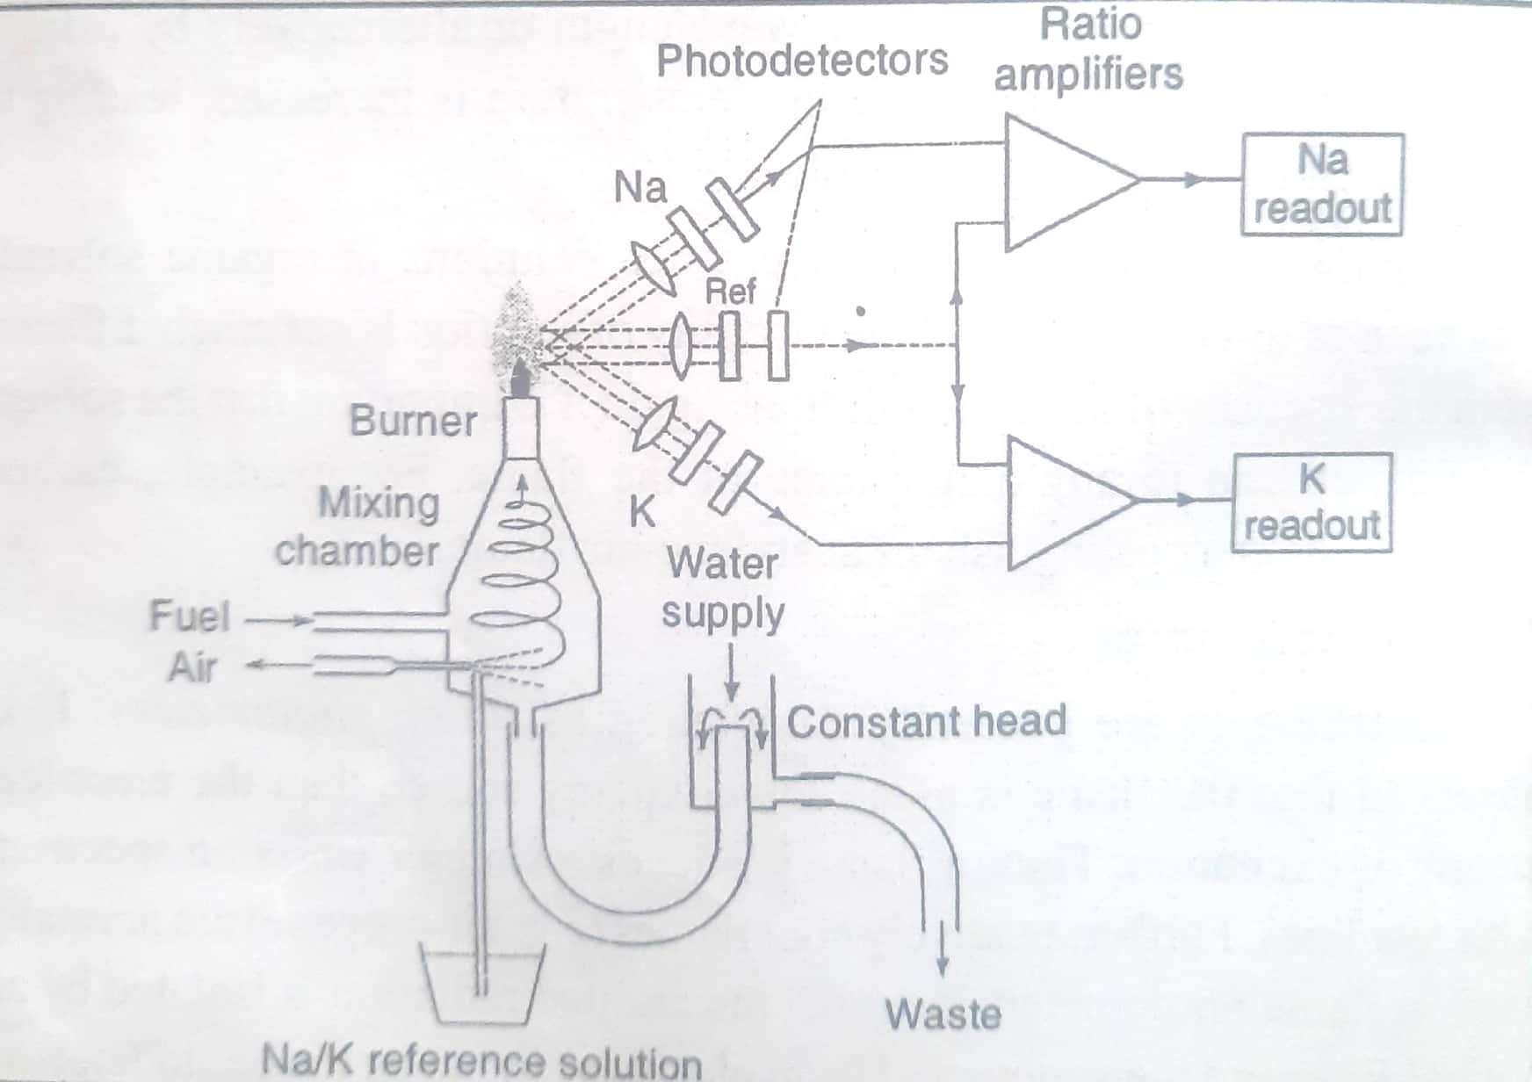
Instrumentation
Double-beam flame photometer

Slide 25
Procedure for Analysis
Qualitative Analysis:
Find out by wavelength of emitted radiation.
Detection of radiation of characteristic wavelength indicate the presence of that specific metal.
Elements from I & II group of periodic table like Na, K, Li, Mg, Ca, Ba, etc are
analyzed by this technique.
Simple, fast & reliable method.
Drawbacks: 1. Method less reliable than Atomic Absorption Spectroscopy.
2. Method does not provide any information about Structure.
3. Method not useful for the non-radiating elements like C, H, X, ..

Slide 26
Procedure for Analysis
Quantitative Analysis:
Quantitative determination by intensity of emitted radiations.
Rapid quantitative analysis.
Most useful application.
Number of elements beside group I & II are determined.

Slide 27
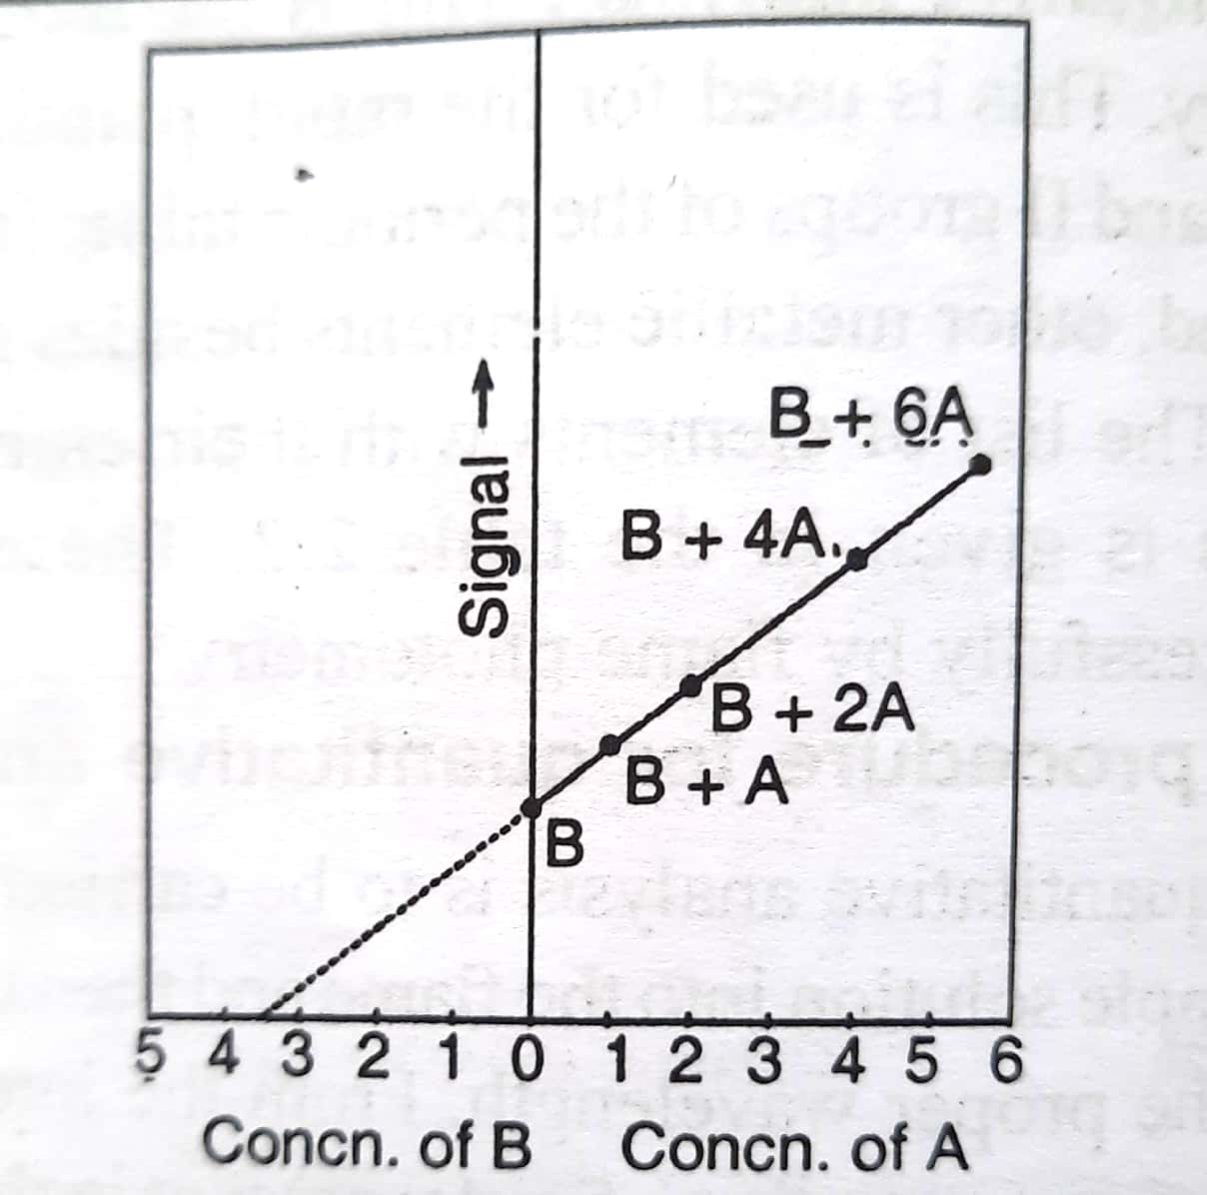
Experimental Procedure for Quantitative Analysis
Standard addition method:

Slide 28
Experimental Procedure for Quantitative Analysis
Standard addition method:
Useful for determination of very low concentration of elements.
Compensates for unexpected interfering material.
Useful to estimate that elements that are rarely analyzed.

Slide 29
Experimental Procedure for Quantitative Analysis
Internal standard method:
Preparation of std. solution containing known amount of
internal std. element (usually Li).
Record the intensity of the std. solution by aspirating them in flame.
Aspirate the sample of unknown concentration into the flame and record
signal intensity.
Calculate the ratio the two intensities and plotted against the concentration of
element to be determine by keeping concentration of internal std. element
constant.
Calculate the concentration of the element present in the sample from the
calibration curve.
Internal std. elements characteristics:
Amount should be very small.
Its emission lines reacts to interference to the element emission line.

Slide 30
Effect of Solvent
Physical factors of the solvent influence the amount of sample
reaching the flame.
Ex. Density, viscosity, surface tension and viscosity
(Matrix Effect)
Molecular absorption interference:
Ex.: High conc. of NaCl absorb radiation with wavelength
213.9 nm near to the wavelength of Zn resonance.
This can be resolve by choosing different resonance wavelength
or by using different flame.
In flame photometry, Solution made by organic solvent may be
used directly, provided the viscosity of solution is not much
differ from the viscosity of aqueous solution.
Solvent should not lead to any disturbance of the flame.
Ex. CCl₄ may extinguish an acetylene-air flame.

Slide 31
Interference in Flame Photometry
(A) Spectral Interference:
Overlap the frequencies with the lines emitted by other elements.
Ex. Observe the frequency emitted by a cathode lamp which overlap to the
emitted lines of the element.
Interfernces due to the molecule/ molecular fragments presents in flame gas.
Resonance Source | Wavelength (λ)nm | Analyte | Wavelength (λ)nm
Al | 308.2 | V | 308.2
Cu | 324.75 | Eu | 324.75
Fe | 271.9 | Pt | 271.9
Hg | 253.7 | Co | 253.7
Ga | 403.3 | Mn | 403.3

Slide 32
Interference in Flame Photometry
(B) Chemical Interference:
(i) Stable compound formation:
Incomplete dissociation of substance in the flame.
Formation of refractory compounds in the flame
Overcome:
Increasing flame temperature.
Extraction of interfering element.
Use of releasing agents.
(ii) Ionization:
Ground state gaseous atoms ionizes in to the flame which reduce the intensity
of emitted radiation.
Overcome:
Operating lowest possible temperature.
Use of ionization suppressant.

Slide 33
Factors Influencing Intensity of emitted radiation
1. Viscosity:
Increasing viscosity reduce influence of atomization.
Reducing population of atom, reduce the intensity of emitted radiations.
2. Presence of acids:
Presence of any acids make disturbance in the dissociation of sample.
Decrease intensity of emitted radiations
3. Presence of other metals:
Presence of other metals cause changes in the intensity of emitted radiation.
Use of filter.

Slide 34
THANK YOU

