Slide 1
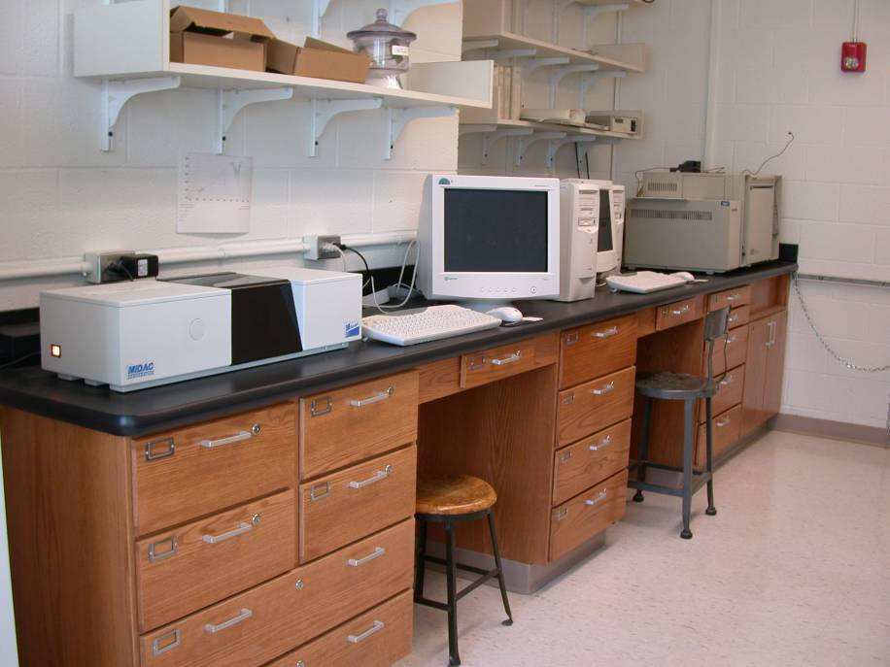
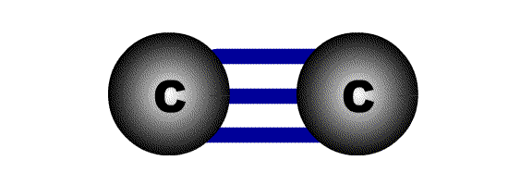
Dr. Ajay N Ambhore
(MSc PhD Bed NET)
Infrared Spectroscopy
MSc I Year

Slide 2
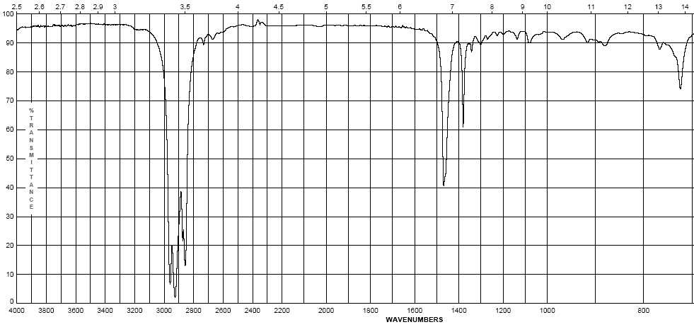
Infrared Spectroscopy
II. Infrared Group Analysis
A. General
    The four primary regions of the IR spectrum
Bonds to H
Triple bonds
Double bonds
Single Bonds
O-H N-H C-H | C≡C C≡N | C=O C=N C=C | Fingerprint Region C-C C-N C-O
4000 cm⁻¹
2700 cm⁻¹
2000 cm⁻¹
1600 cm⁻¹
600 cm⁻¹

Slide 3
The C-H stretching region
BASE VALUE = 3000 cm⁻¹
C-H sp stretch ~ 3300 cm⁻¹
UNSATURATED
C-H sp² stretch > 3000 cm⁻¹
3000 divides
C-H sp³ stretch < 3000 cm⁻¹
SATURATED

Slide 4
Infrared Spectroscopy
Octane
  Alkanes – combination of C-C and C-H bonds
    C-C stretches and bends 1360-1470 cm⁻¹
    CH₂-CH₂ bond 1450-1470 cm⁻¹
    CH₂-CH₃ bond 1360-1390 cm⁻¹
    sp³ C-H between 2800-3000 cm⁻¹
(w – s)
(m)

Slide 5
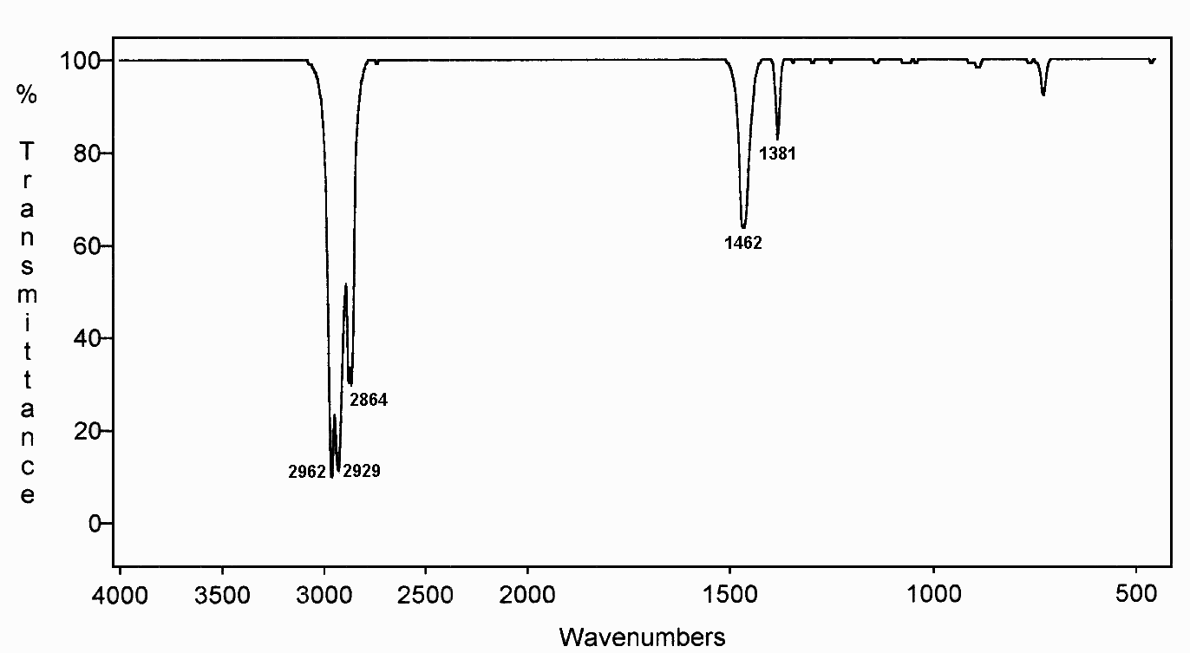
Hexane
ALKANE
CH bending vibrations
discussed shortly
CH
stretching
vibrations
includes
CH₃ sym and asym
CH₂ sym and asym

Slide 6
THE C-H BENDING REGION
CH₂ bending ~ 1465 cm⁻¹
CH₃ bending (asym) appears near
the CH₂ value ~ 1460 cm⁻¹
CH₃ bending (sym) ~ 1375 cm⁻¹

Slide 7
METHYLENE AND METHYL BENDING VIBRATIONS
CH₂
CH₃
C-H Bending, look near
1465 and 1375 cm⁻¹
asym
sym
1465
1460
1375
these two peaks
frequently overlap
and are not resolved

Slide 8
METHYLENE GROUP BENDING VIBRATIONS
Scissoring
Wagging
~1465 cm⁻¹
~1250 cm⁻¹
~720 cm⁻¹
~1250 cm⁻¹
Rocking
Twisting
in-plane
out-of-plane
Bending
Vibrations

Slide 9
METHYLENE AND METHYL BENDING VIBRATIONS
ADDITIONAL DETAILS FOR SYM CH₃
The sym methyl peak
splits when you have
more than one CH₃
attached to a carbon.
CH₂
CH₃
asym
sym
one peak
1465
1460
1375
geminal dimethyl
1380
1370
two peaks
(isopropyl)
t-butyl
1390
1370
two peaks

Slide 10
Hexane
ALKANE
CH₂
rocking
CH₃
bend
CH₂
bend
CH
stretch

Slide 11
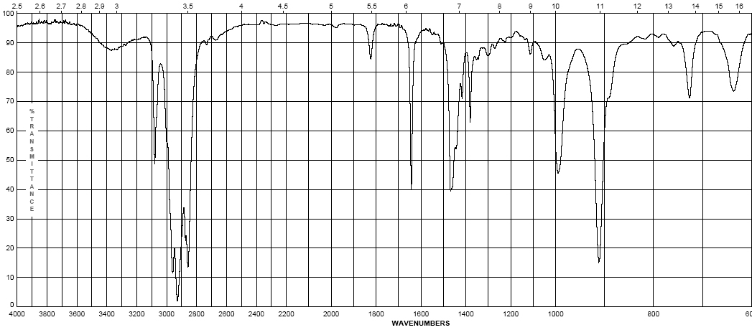
Infrared Spectroscopy
1-Octene
  Alkenes – addition of the C=C and vinyl C-H bonds
    C=C stretch at 1620-1680 cm⁻¹ weaker as substitution increases
    vinyl C-H stretch occurs at 3000-3100 cm⁻¹
    The difference between alkane, alkene or alkyne C-H is important! If the band is slightly above 3000 it is vinyl sp² C-H or alkynyl sp C-H if it is below it is alkyl sp³ C-H
(w – m)
(w – m)

Slide 12
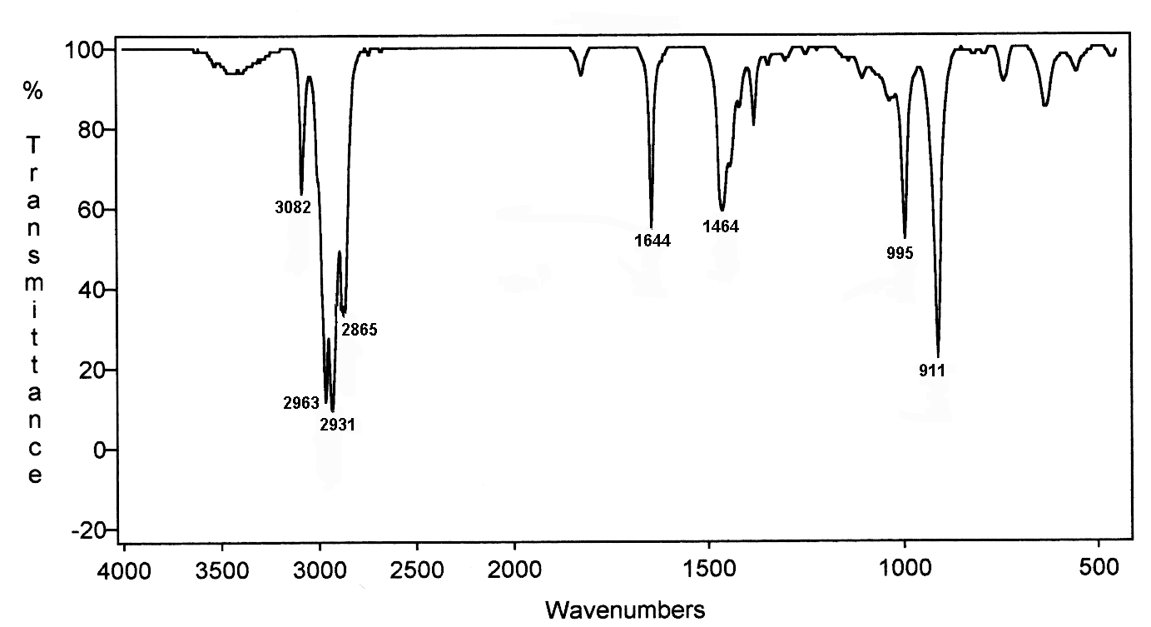
1-Hexene
ALKENE
=CH
C=C
CH₂
CH₃
bend
CH
CH

Slide 13
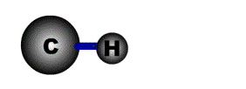
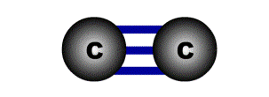
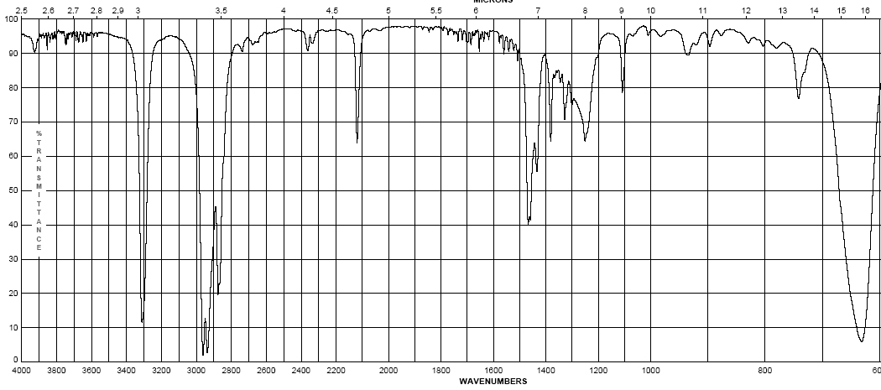
Infrared Spectroscopy
1-Octyne
  Alkynes – addition of the C=C and vinyl C-H bonds
    C≡C stretch 2100-2260 cm⁻¹; strength depends on asymmetry of bond, strongest for terminal alkynes, weakest for symmetrical internal alkynes
    C-H for terminal alkynes occurs at 3200-3300 cm⁻¹
    Internal alkynes ( R-C≡C-R ) would not have this band!
(w-m)
(m – s)

Slide 14
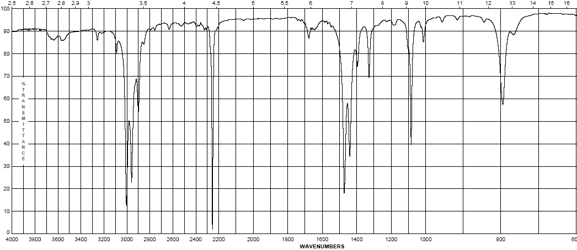
Infrared Spectroscopy
propionitrile
  Nitriles (the cyano- or –C≡N group)
    Principle group is the carbon nitrogen triple bond at 2100-2280 cm⁻¹
    This peak is usually much more intense than that of the alkyne due to the electronegativity difference between carbon and nitrogen
(s)

Slide 15
The triple bond stretching region
=
C N 2250 cm⁻¹
C C 2150 cm⁻¹
=
=
=
The cyano group often gives a strong, sharp peak
due to its large dipole moment.
The carbon-carbon triple bond gives a sharp peak,
but it is often weak due to a lack of a dipole. This is
especially true if it is at the center of a symmetric
molecule.

Slide 16
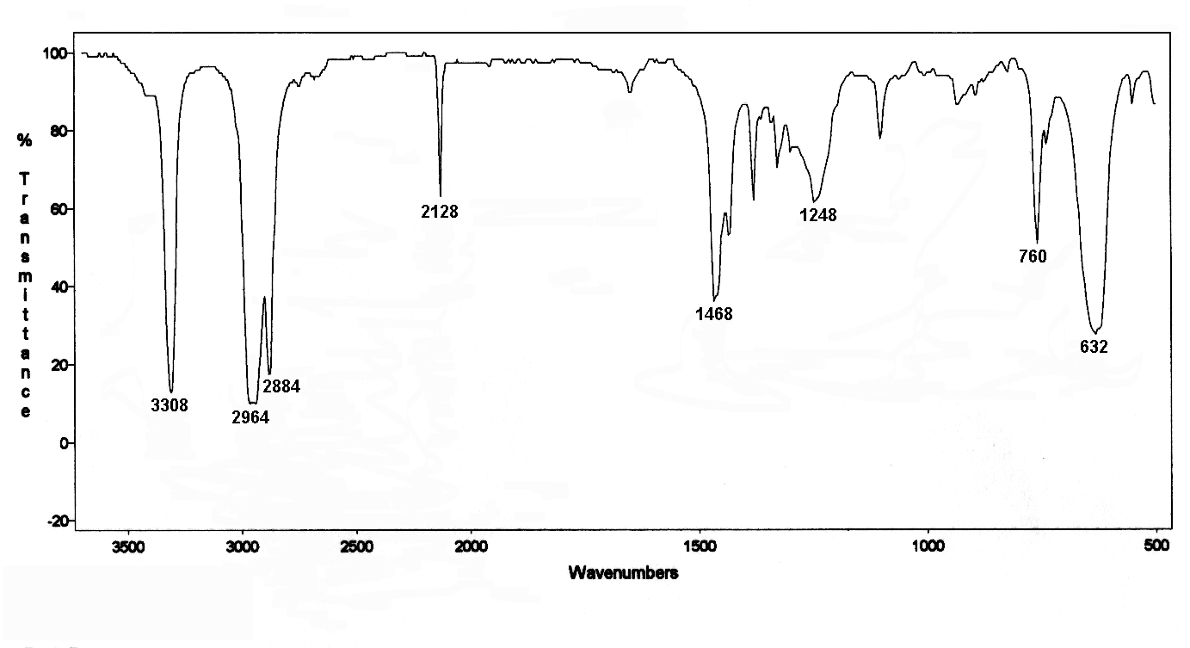
1-Hexyne
ALKYNE
BASE = 2150
=
C=C
CH₂, CH₃
=
C-H
=C-H

Slide 17
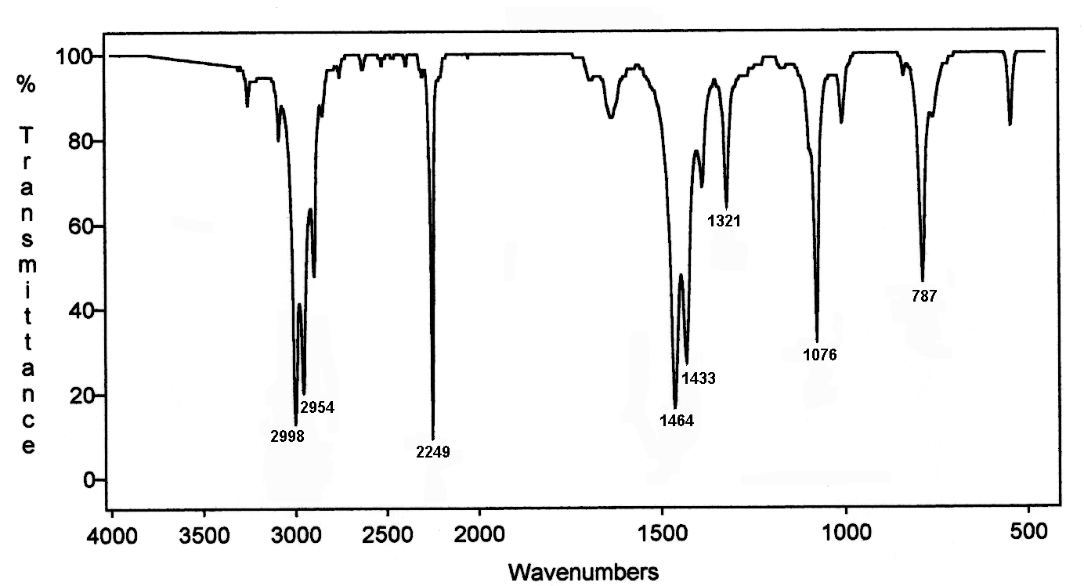
Propanenitrile
NITRILE
BASE = 2250
=
C=N

Slide 18
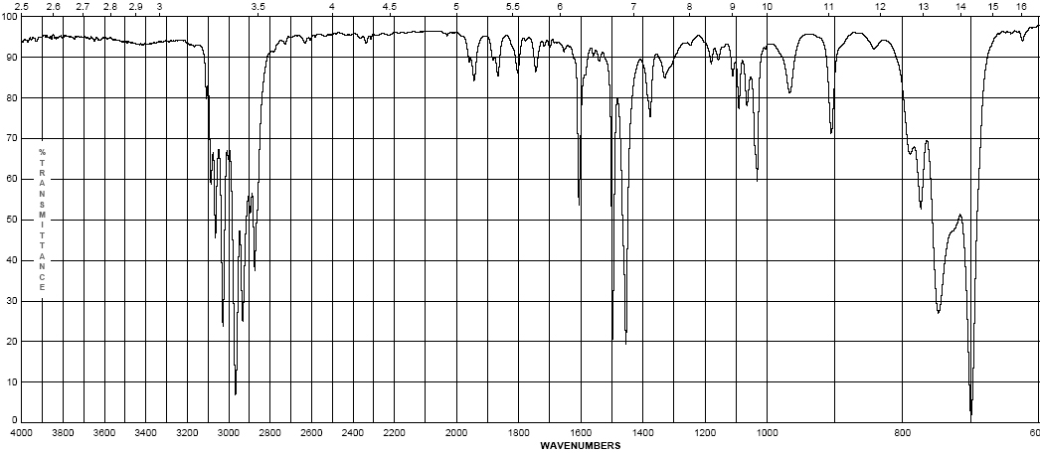
Infrared Spectroscopy
Ethyl benzene
  Aromatics
    Due to the delocalization of e⁻ in the ring, C-C bond order is 1.5, the stretching frequency for these bonds is slightly lower in energy than normal C=C
    These show up as a pair of sharp bands, 1500 & 1600 cm⁻¹, (lower frequency band is stronger)
    C-H bonds off the ring show up similar to vinyl C-H at 3000-3100 cm⁻¹
(w – m)
(w – m)

Slide 19
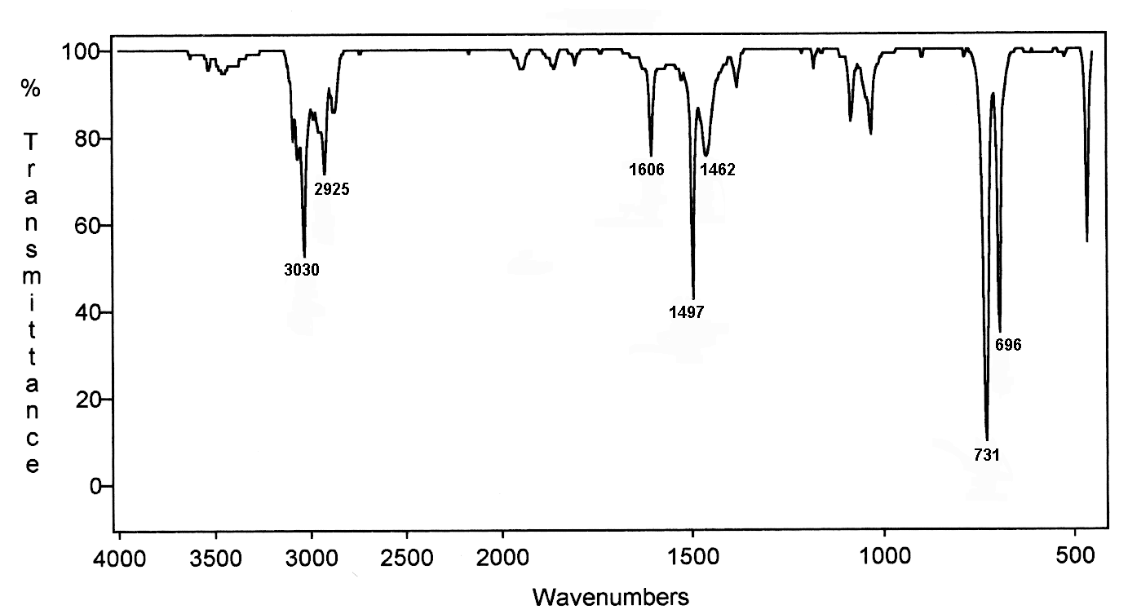
Toluene
AROMATIC
Ar-H
CH₃
C=C
benzene
Ar-H

Slide 20
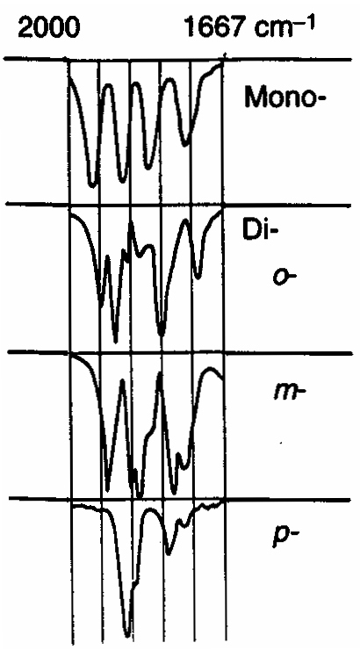
Infrared Spectroscopy
  Aromatics
    If the region between 1667-2000 cm⁻¹ (w) is free of interference (C=O stretching frequency is in this region) a weak grouping of peaks is observed for aromatic systems
    Analysis of this region, called the overtone of bending region, can lead to a determination of the substitution pattern on the aromatic ring
Monosubstituted
730-770
690-710
1,2 disubstituted (ortho or o-)
735-770
1,2 disubstituted (meta or m-)
860-900
750-810
680-725
1,4 disubstituted (para or p-)
800-860

Slide 21
O-H STRETCH

Slide 22
Typical Infrared Absorption
Regions
O-H
WAVELENGTH (μm)
2.5
4
5
5.5
6.1
6.5
15.4
O-H
C-H
C N
C=O
C=N
C-Cl
Very
few
bands
C-O
N-H
C C
C=C
C-N
X=C=Y
C-C
*
(C,O,N,S)
N=O N=O
4000
2500
2000
1800
1650
1550
650
FREQUENCY (cm⁻¹)

Slide 23
The O-H stretching region
O-H 3600 cm⁻¹ (alcohol, free)
O-H 3300 cm⁻¹ (alcohols & acids, H-bonding)
broadens
shifts
FREE
H-BONDED
3600
3300

Slide 24
HYDROGEN-BONDED HYDROXYL
Many kinds of OH
bonds of different
lengths and strengths
This leads to a broad
absorption.
“Neat” solution.
Longer bonds are weaker and lead to
lower frequency.
Hydrogen bonding occurs in concentrated solutions
( for instance, undiluted alcohol ).

Slide 25
“FREE” HYDROXYL
The “free” hydroxyl vibrates without interference from any other molecule.
Distinct bond has a well-defined length and strength.
Solvent molecules surround but do not
hydrogen bond.
Occurs in dilute solutions of alcohol in an “inert” solvent like CCl₄.

Slide 26
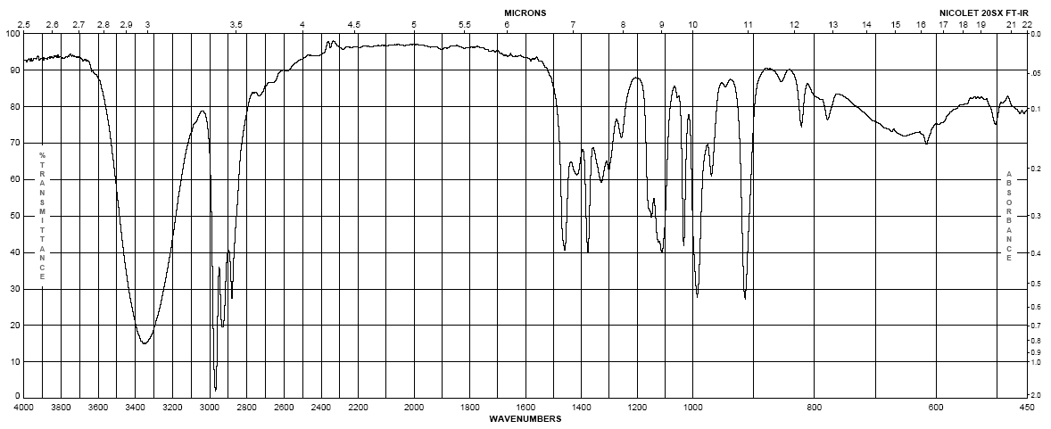
Infrared Spectroscopy
1-butanol
Alcohols
  Strong, broad O-H stretch from 3200-3400 cm⁻¹
  Like ethers, C-O stretch from 1050-1260 cm⁻¹
  Band position changes depending on the alcohols substitution: 1° 1075-1000; 2° 1075-1150; 3° 1100-1200; phenol 1180-1260
  The shape is due to the presence of hydrogen bonding
(m– s)
br
(s)

Slide 27
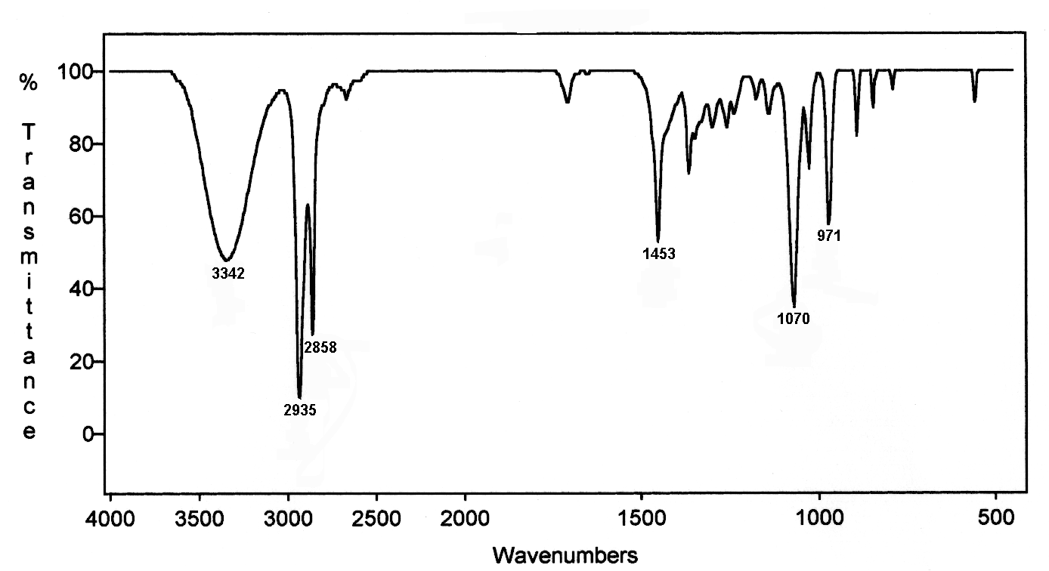
Cyclohexanol
ALCOHOL
neat solution
,
O-H
H-bond
CH₂
C-O
C-H

Slide 28
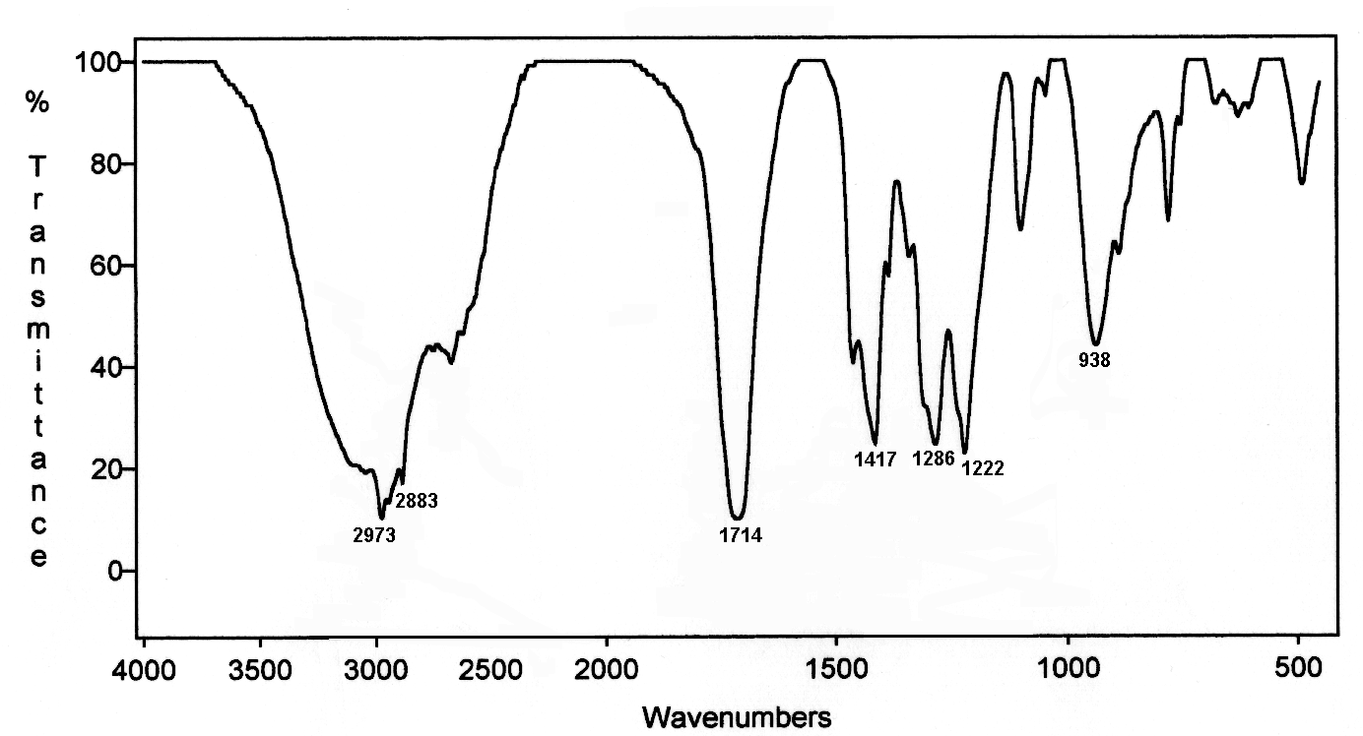
Butanoic Acid
CARBOXYLIC ACID
neat solution
O-H
H-bond
C-O
CH₂
C-H
C=O

Slide 29
CARBOXYLIC ACID DIMER
Strong hydrogen bonding in the dimer weakens the OH
bond and leads to a broad peak at lower frequency.

Slide 30
C=O STRETCHING

Slide 31
Typical Infrared Absorption
Regions
C=O
WAVELENGTH (μm)
2.5
4
5
5.5
6.1
6.5
15.4
O-H
C-H
C N
C=O
C=N
C-Cl
Very
few
bands
C-O
N-H
C C
C=C
C-N
X=C=Y
C-C
*
(C,O,N,S)
N=O N=O
4000
2500
2000
1800
1650
1550
650
FREQUENCY (cm⁻¹)

Slide 32
THE CARBONYL STRETCHING REGION
This region stretches from about 1800 to 1650 cm⁻¹ - RIGHT IN THE MIDDLE OF THE SPECTRUM
The base value is 1715 cm⁻¹ (ketone)
The bands are very strong !!! due to the large C=O dipole moment.
C=O is often one of the strongest peaks in the spectrum

Slide 33
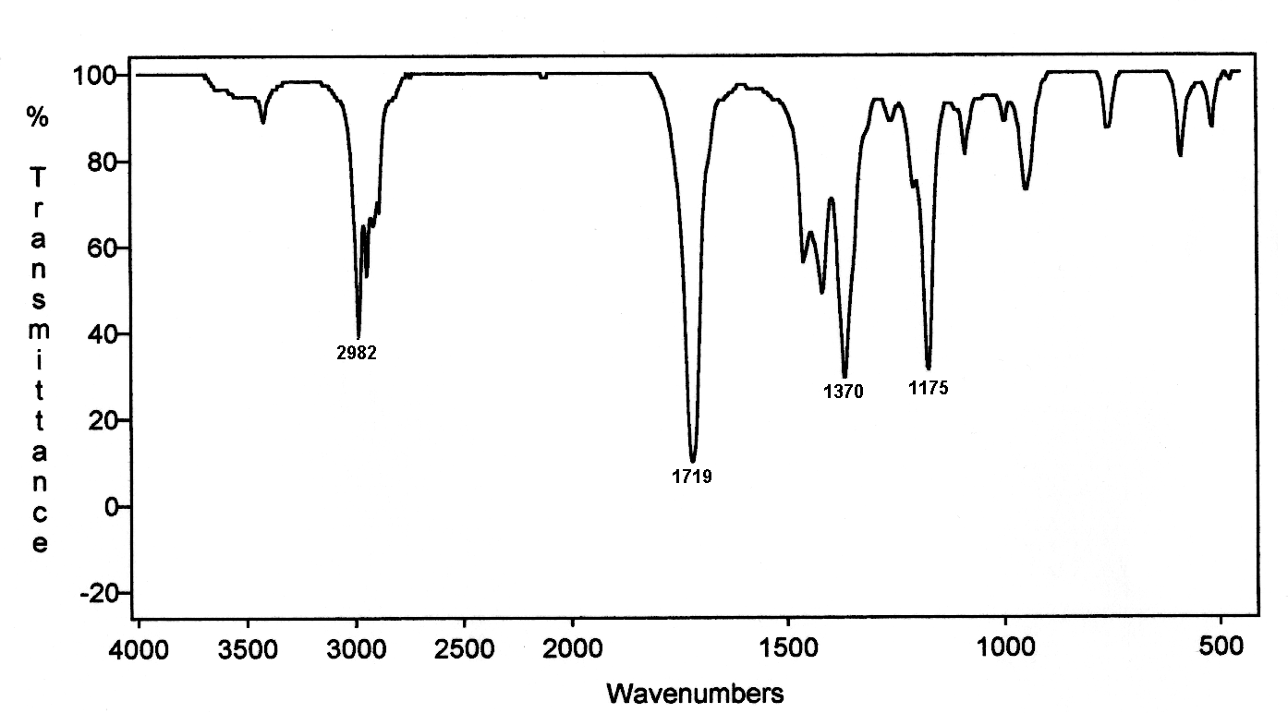
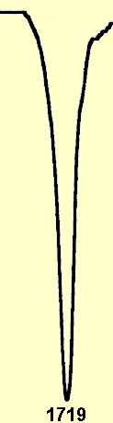
KETONE
2-Butanone
BASE = 1715
1715
overtone
2x C=O
C-H
CH bend
C=O
C=O

Slide 34
C=O IS SENSITIVE TO ITS ENVIRONMENT
EACH DIFFERENT KIND OF C=O COMES AT A DIFFERENT FREQUENCY
acid
chloride
carboxylic
acid
ester
aldehyde
ketone
amide
1800
1735
1725
1715
1710
1690
anhydride
BASE
VALUE
1810 and 1760
THESE VALUES ARE
WORTH LEARNING
all are +/- 10 cm⁻¹
( two peaks )

Slide 35
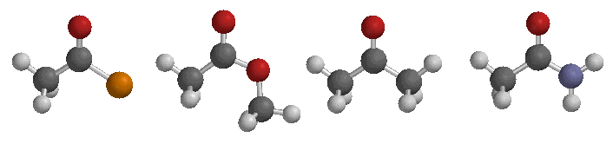
C=O BOND LENGTHS IN CARBONYL COMPOUNDS
shorter
longer
1.225 A
1.231 A
1.235 A
1.248 A
acid
chloride
ester
ketone
amide
1780 cm⁻¹
1735 cm⁻¹
1715 cm⁻¹
1680 cm⁻¹

Slide 36
SUMMARY
Ketones are at lower frequency than Aldehydes because of
the second electron-donating alkyl group.
Acid chlorides are at higher frequency than ketones because
of the electron-withdrawing halide.
Esters are at higher frequencies than ketones due to the electron-withdrawing oxygen atom. This is more important than resonance with the electron pair on the oxygen.
Amides are at lower frequencies than ketones due to resonance involving the unshared pair on nitrogen. The electron-withdrawing effect of nitrogen is less important than the resonance.
Note the electronegativity difference, O versus N, weights the
two factors (resonance/ e-withdrawal) differently in esters
than in amides.
Acids are at lower frequency than ketones due to H-bonding.

Slide 37
2-Butanone
KETONE
overtone of strong C=O peak
1719 x 2 = 3438
BASE = 1715
overtone
C-H
CH bend
C=O
3438

Slide 38
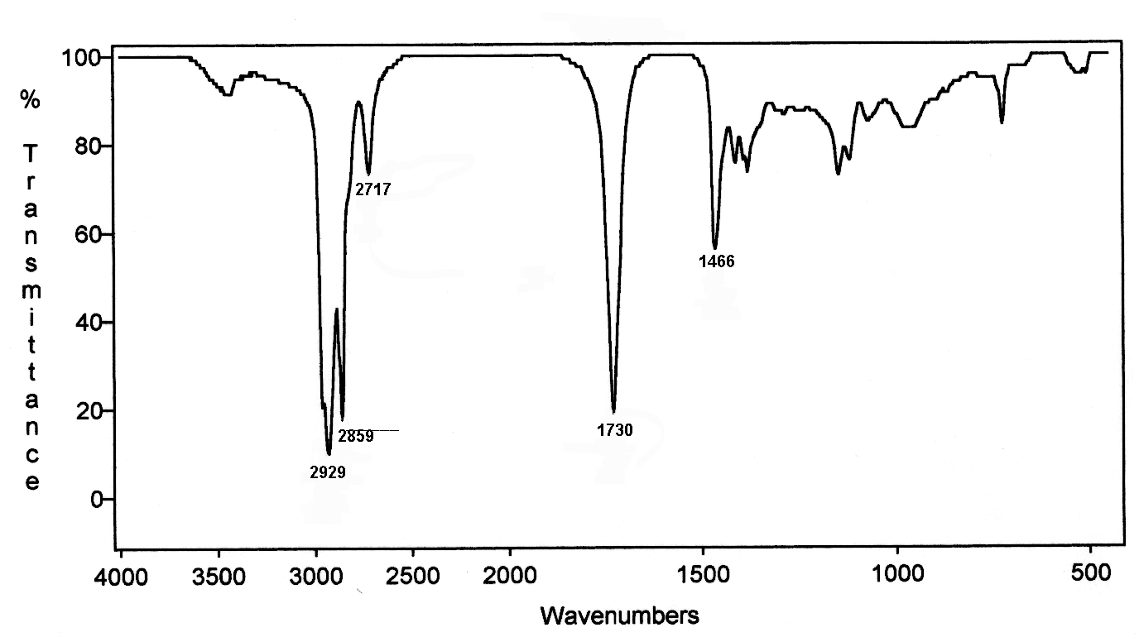
Nonanal
ALDEHYDE
BASE = 1725
CHO
CH bend
C=O
3460

Slide 39
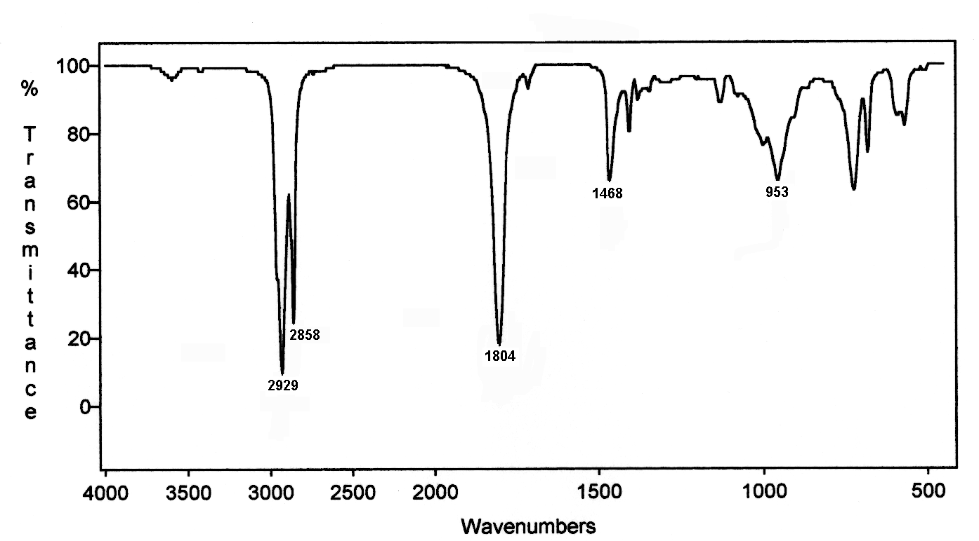
Dodecanoyl Chloride
ACID CHLORIDE
BASE = 1800
CH bend
C=O
C-H
3608

Slide 40
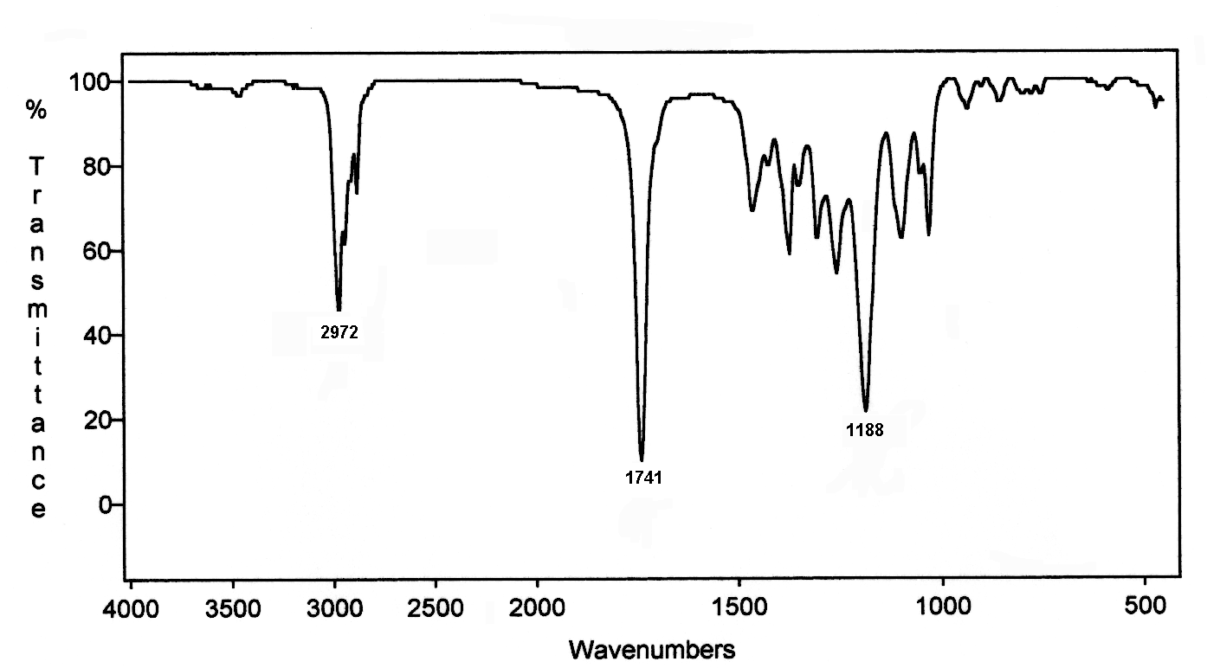
Ethyl Butanoate
ESTER
BASE = 1735
C-O
C-H
C=O
3482

Slide 41
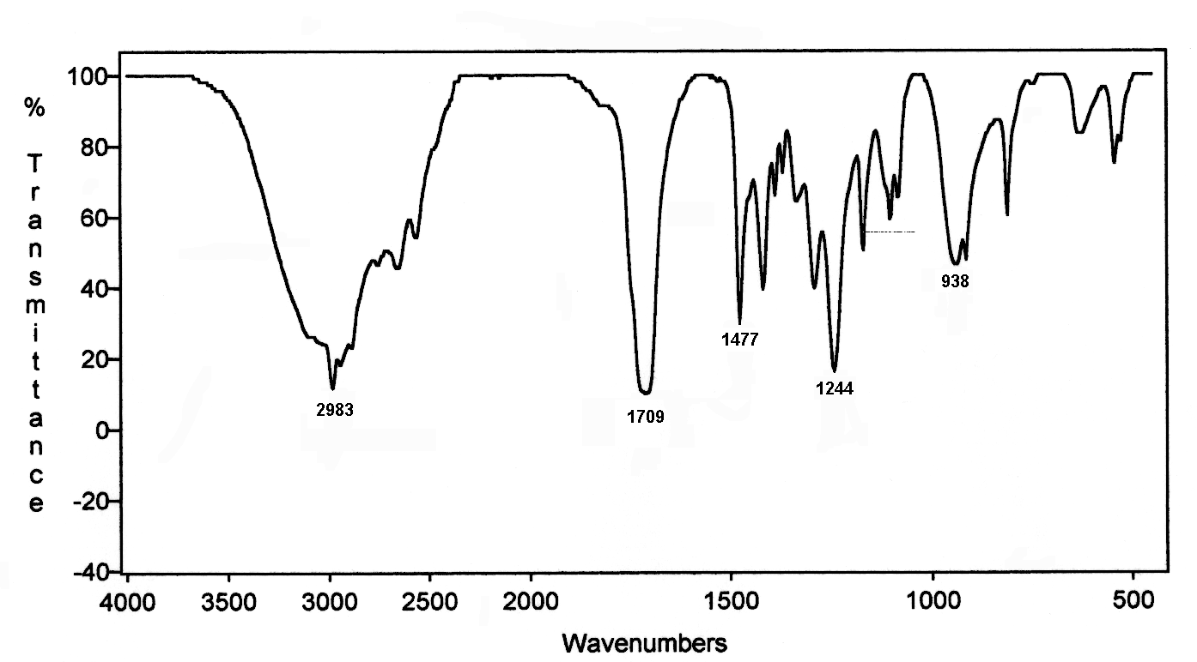
2-Methylpropanoic Acid
CARBOXYLIC ACID
BASE = 1710
O-H
C-O
C-H
C=O

Slide 42
CARBOXYLIC ACID DIMER
RECALL
lowers
frequency
of C=O
and also
of O-H
Strong hydrogen-bonding in the dimer weakens the O-H and
C=O bonds and leads to broad peaks at lower frequencies.

Slide 43
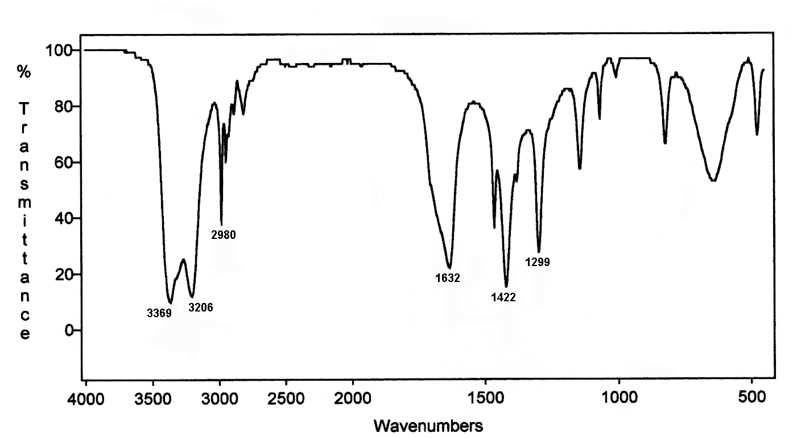
AMIDE
two peaks
sym / asym
Propanamide
BASE = 1690
C-H
C=O
NH₂
CH bend

Slide 44
N-H STRETCH

Slide 45
Typical Infrared Absorption Regions
N-H
WAVELENGTH (μm)
2.5
4
5
5.5
6.1
6.5
15.4
O-H
C-H
C N
C=O
C=N
C-Cl
Very
few
bands
C-O
N-H
C C
C=C
C-N
X=C=Y
C-C
*
(C,O,N,S)
N=O N=O
4000
2500
2000
1800
1650
1550
650
FREQUENCY (cm⁻¹)

Slide 46
The N-H stretching region
N-H 3300 - 3400 cm⁻¹
Primary amines give two peaks
Secondary amines give one peak
Tertiary amines give no peak
symmetric
asymmetric

Slide 47
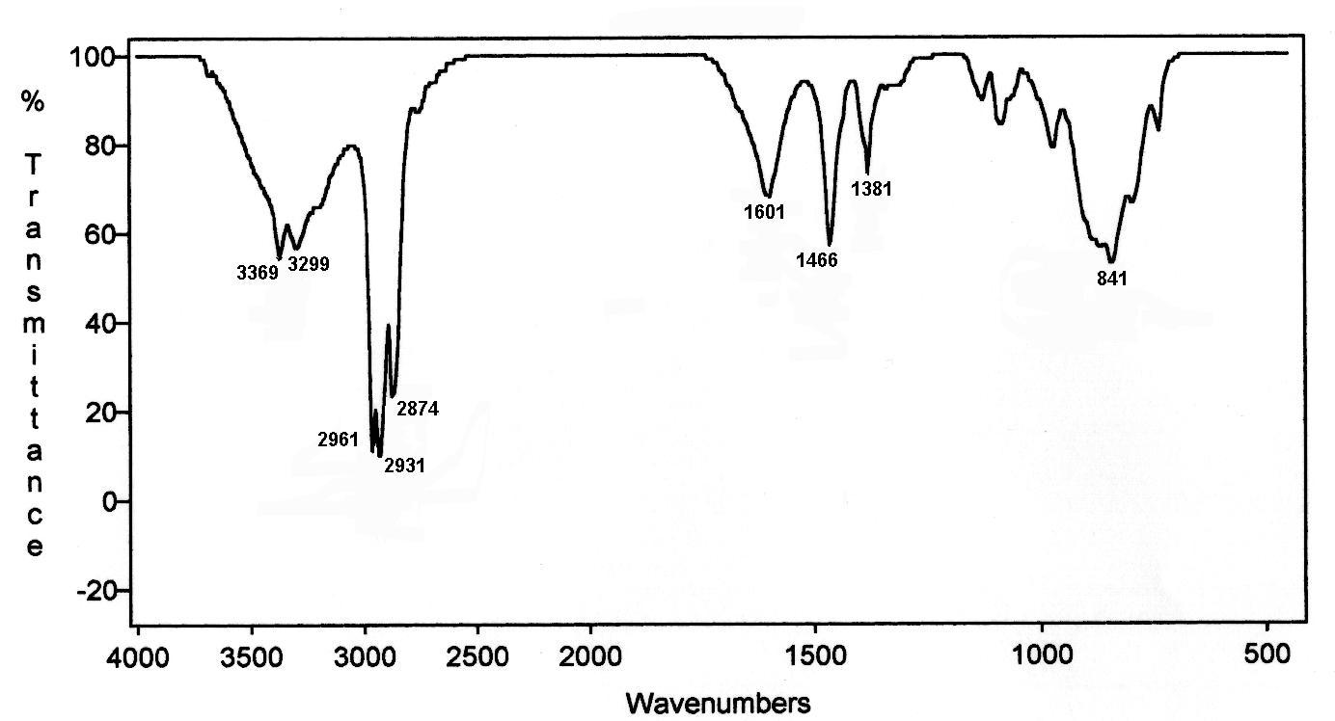
PRIMARY AMINE
aliphatic
1-Butanamine
NH₂
scissor
CH₃
CH₂
NH₂

Slide 48
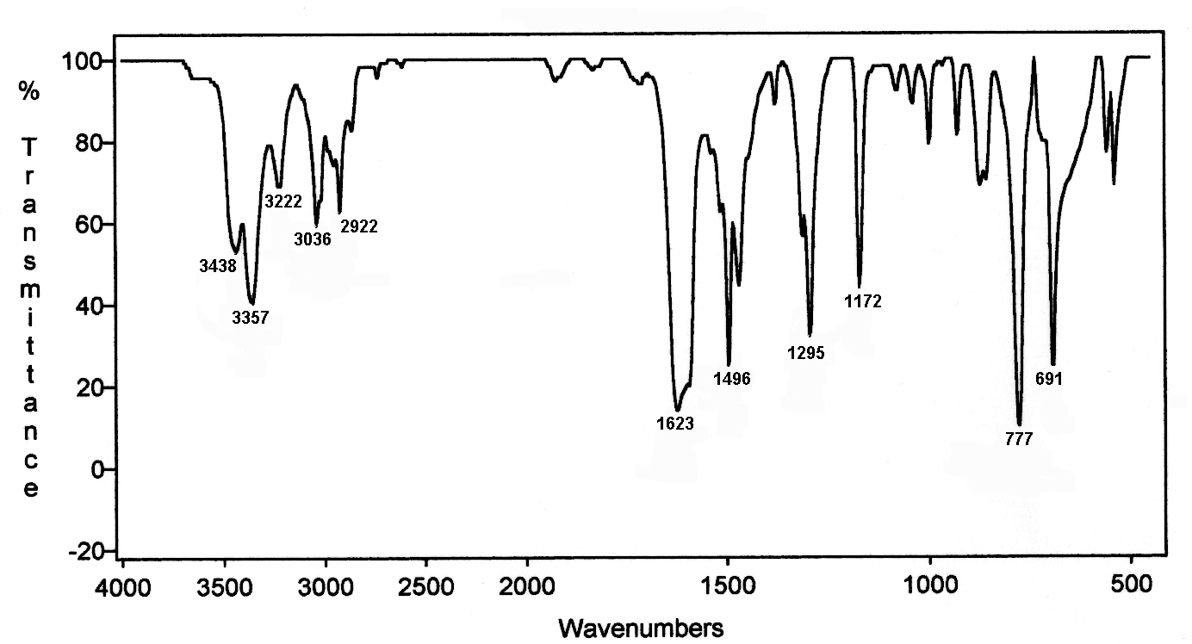
PRIMARY AMINE
aromatic
3-Methylbenzenamine
-CH₃
Ar-H
NH₂
benzene
Ar-H

Slide 49
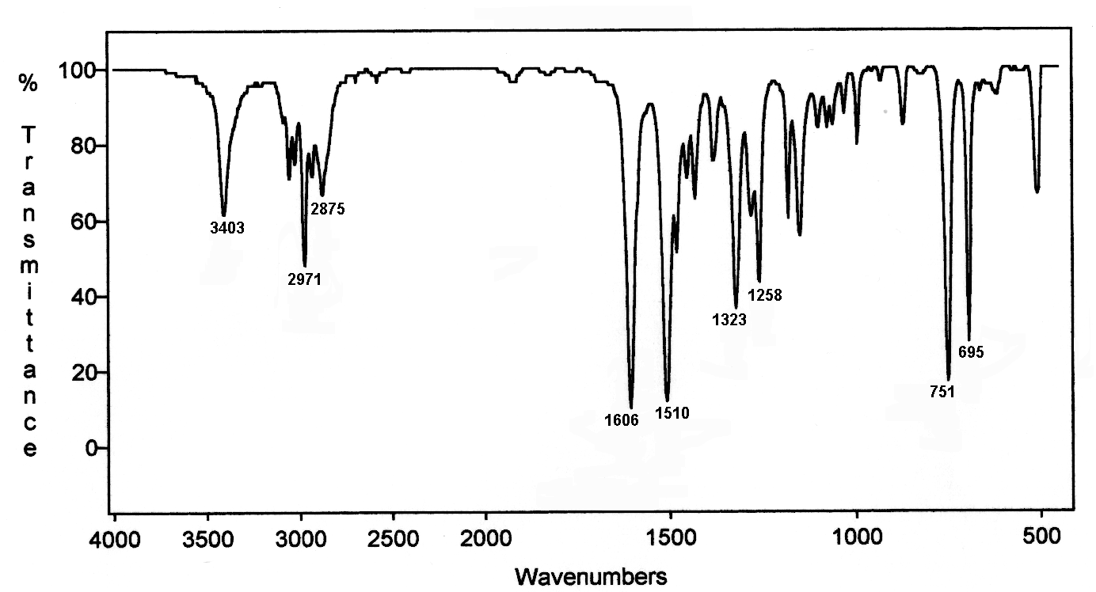
SECONDARY AMINE
N -Ethylbenzenamine
NH
CH₃
Ar-H
benzene

Slide 50
C-O STRETCHING

Slide 51
Typical Infrared Absorption
Regions
WAVELENGTH (μm)
C-O
2.5
4
5
5.5
6.1
6.5
15.4
O-H
C-H
C N
C=O
C=N
C-Cl
Very
few
bands
C-O
N-H
C C
C=C
C-N
X=C=Y
C-C
*
(C,O,N,S)
N=O N=O
4000
2500
2000
1800
1650
1550
650
FREQUENCY (cm⁻¹)

Slide 52
The C-O stretching region
The C-O band appears in the range of 1300 to 1000 cm⁻¹
Look for one or more strong bands appearing in this range!
Ethers, alcohols, esters and carboxylic acids have C-O bands

Slide 53
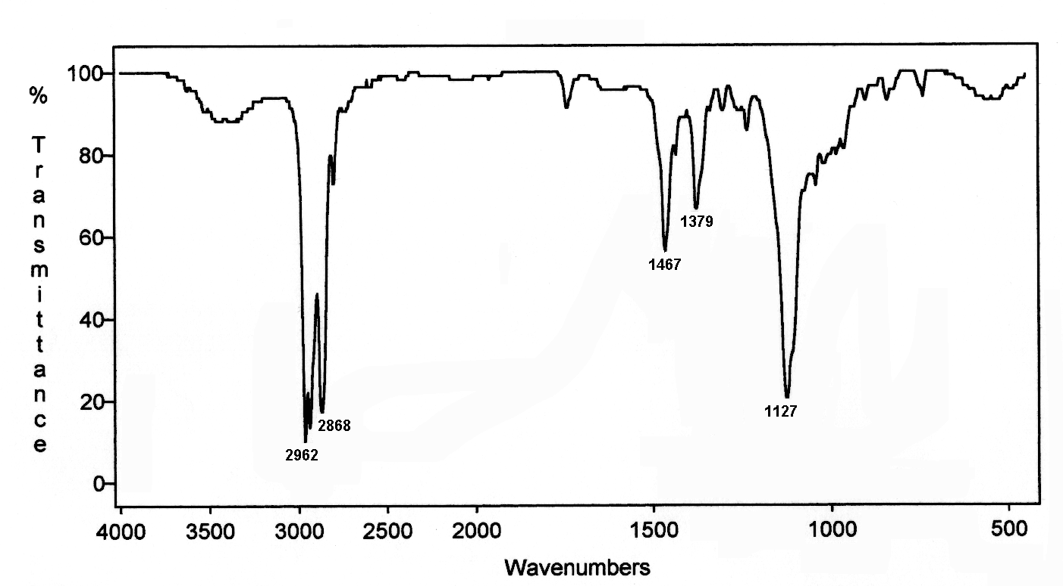
ETHER
Dibutyl Ether
BASE = 1100
CH₂
CH₃
C-H
bending
C-O

Slide 54
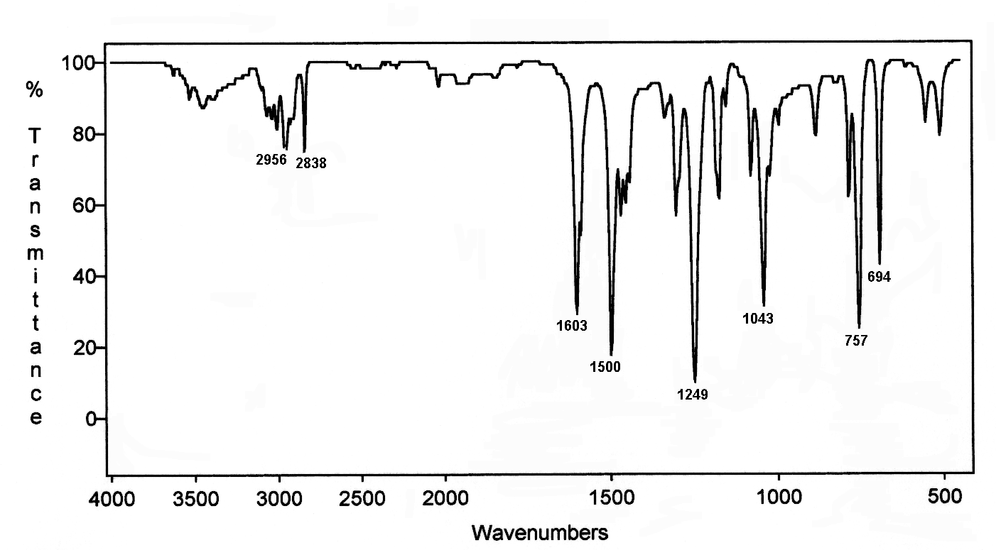
AROMATIC ETHER
BASE = 1100
Anisole
C-H
aromatic
benzene
oops
C-O

Slide 55
ALCOHOL
BASE = 3600
BASE = 1100
Cyclohexanol
CH₂
bend
OH
C-O
C-H

Slide 56

CARBOXYLIC ACID
2-Methylpropanoic Acid
OH
C-O
CH
C=O

Slide 57

ESTER
Ethyl Butanoate
CH
C-O
C=O

Slide 58
AROMATIC ETHER
BASE = 1100
Anisole
C-H
aromatic
benzene
oops
C-O

Slide 59
N=O STRETCHING

Slide 60
Typical Infrared Absorption
Regions
N-O
WAVELENGTH (μm)
2.5
4
5
5.5
6.1
6.5
15.4
O-H
C-H
C N
C=O
C=N
C-Cl
Very
few
bands
C-O
N-H
C C
C=C
C-N
X=C=Y
C-C
*
(C,O,N,S)
N=O N=O
4000
2500
2000
1800
1650
1550
650
FREQUENCY (cm⁻¹)

Slide 61
The N=O stretching region
N=O stretching -- 1550 and 1350 cm⁻¹ asymmetric and symmetric stretchings
Often the 1550 cm⁻¹ peak is stronger than the other one

Slide 62
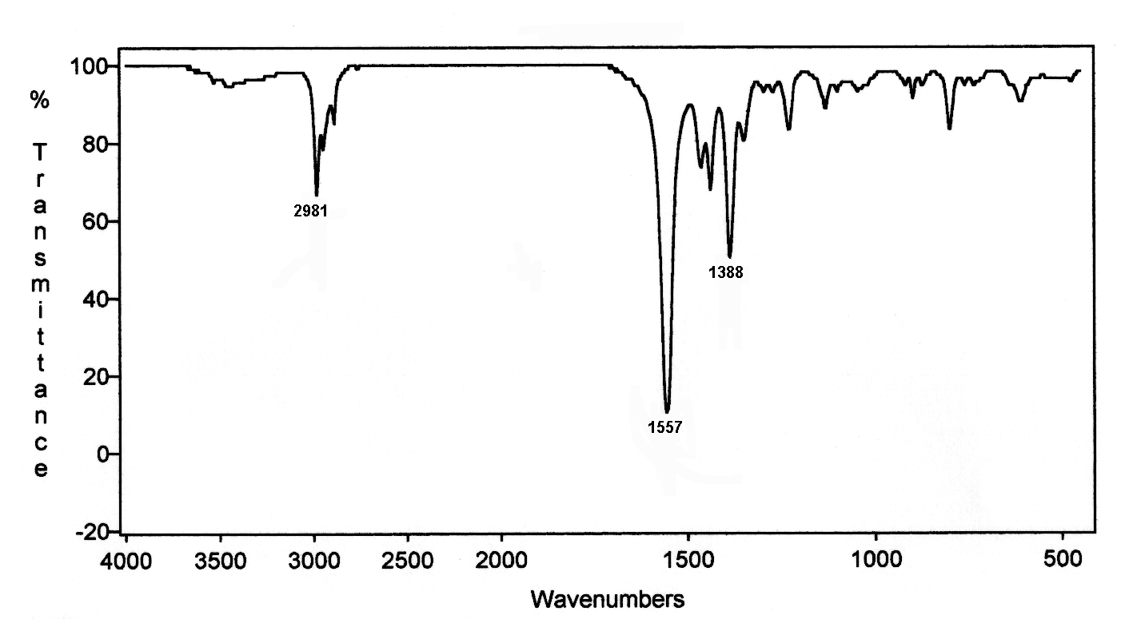
NITROALKANE
2-Nitropropane
C-H
N=O
gem-dimethyl
N=O

Slide 63
Typical Infrared Absorption
Regions
C-Cl
WAVELENGTH (μm)
2.5
4
5
5.5
6.1
6.5
15.4
O-H
C-H
C N
C=O
C=N
C-Cl
Very
few
bands
C-O
N-H
C C
C=C
C-N
X=C=Y
C-C
*
(C,O,N,S)
N=O N=O
4000
2500
2000
1800
1650
1550
650
FREQUENCY (cm⁻¹)

Slide 64
The C-X stretching region
C-Cl 785 to 540 cm⁻¹,
often hard to find amongst the fingerprint bands!!
C-Br and C-I
appear outside the useful range of infrared spectroscopy.
C-F bonds can be found easily, but are not that common.

Slide 65
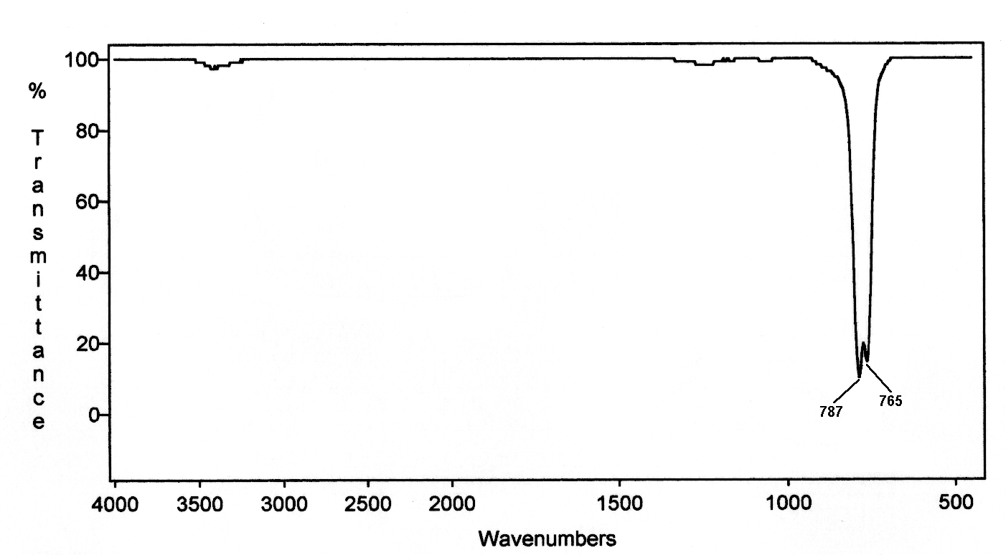
Often used as a solvent for IR spectra.
When it is used, spectra show C-Cl absorptions.
Carbon Tetrachloride
C-Cl

Slide 66
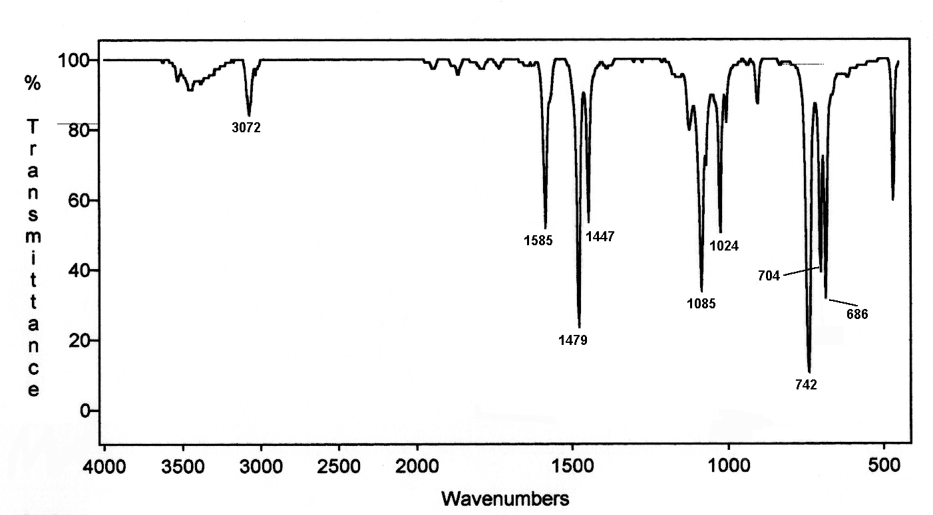
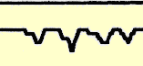
Chlorobenzene
benzene ring
combination
bands
oops
benzene
C=C
C-Cl

Slide 67
Typical Infrared Absorption
Regions
C-Cl
WAVELENGTH (μm)
2.5
4
5
5.5
6.1
6.5
15.4
O-H
C-H
C N
C=O
C=N
C-Cl
Very
few
bands
C-O
N-H
C C
C=C
C-N
X=C=Y
C-C
*
(C,O,N,S)
N=O N=O
4000
2500
2000
1800
1650
1550
650
FREQUENCY (cm⁻¹)

Slide 68
The C-X stretching region
C-Cl 785 to 540 cm⁻¹,
often hard to find amongst the fingerprint bands!!
C-Br and C-I
appear outside the useful range of infrared spectroscopy.
C-F bonds can be found easily, but are not that common.

Slide 69
Often used as a solvent for IR spectra.
When it is used, spectra show C-Cl absorptions.
Carbon Tetrachloride
C-Cl

Slide 70
Chlorobenzene
benzene ring
combination
bands
oops
benzene
C=C
C-Cl

