Slide 1



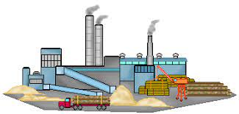
“Dissemination of Education for Knowledge, Science and Culture”
- Shikshanmaharashi Dr. Bapuji Salunkhe
Shri Swami Vivekanand Shikshan Sanstha’s Kolhapur
PADMABHUSHAN DR. VASANTRAODADA PATIL MAHAVIDYALAYA, TASGAON DIST. SANGLI
(Affiliated to Shivaji University, Kolhapur)
DEPARTMENT OF CHEMISTRY
INDUSTRIAL CHEMISTRY
Manufacture of Heavy Chemicals
Dr. Ajay Ambhore
M.Sc. B.Ed. NET Ph.D.

Slide 2
Manufacture of Heavy Chemicals
Syllabus
1 Introduction.
2 Manufacture of Ammonia: Haber Process
3 Manufacture of Sulphuric Acid: Contact Process
4 Manufacture of Nitric Acid: Ostwald's Process
5 Manufacture of Sodium Carbonate.

Slide 3
Manufacture of Heavy Chemicals
Introduction:
Chemicals which are consumed in large commercial scales are called
as Heavy Chemicals
Ex.:
Organic heavy Chemicals: Benzene, phenol, ethylene, vinyl chloride, etc
Inorganic heavy chemicals: Ammonia, sulphuric acid, nitric acid,
hydrochloric acid, etc

Slide 4
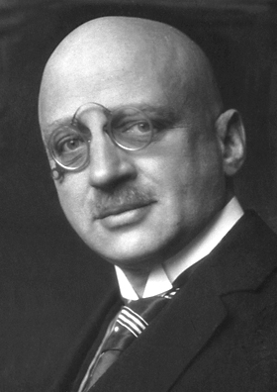
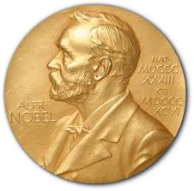
Manufacture of Ammonia
HABER PROCESS
Haber–Bosch is an industrial process for manufacture of ammonia
In this process nitrogen from the air combines with hydrogen (derived from natural gas methane) to form ammonia
This method was developed by German physical chemist Fritz Haber in 1909
He got Nobel prize in 1918
This method makes manufacture of ammonia economically feasible
Fritz Haber

Slide 5
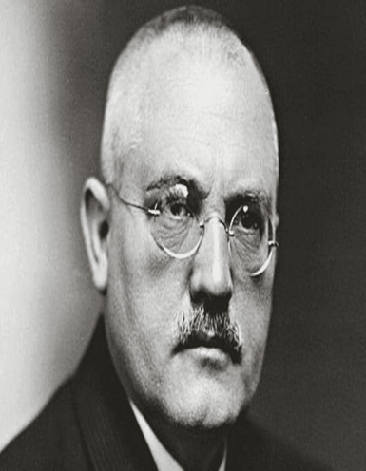
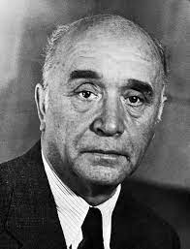
Manufacture of Ammonia
HABER PROCESS
This method was translated in large scale process using catalyst and high Pressure by Carl Bosch with Friedrich Bergius and got Nobel prize in 1931
Carl Bosch
Friedrich Bergius

Slide 6
Manufacture of Ammonia
HABER PROCESS
Catalytic combination of nitrogen with hydrogen at high pressure
catalyst
Physico-chemical Principles
1 volume
3 volume
2 volume
This is a reversible reaction
Forward reaction is exothermic
Volume decreases in forward reaction
Apply Le-Chatelier’s principles and optimum condition for maximum
yield of ammonia

Slide 7
Manufacture of Ammonia
HABER PROCESS
1. Effect of Temperature:
Forward reaction is exothermic hence decrease in temperature
increase the yield of ammonia
Decreasing temperature, decrease the rate of reaction
Use of catalyst to increase the rate of reaction
Optimum temperature for this reaction is 500-550˚C

Slide 8
Manufacture of Ammonia
HABER PROCESS
2. Catalyst:
Use of catalyst to achieve formation of ammonia at low temperature
Finally divided iron is used as a catalyst
With catalyst, promoter is also used to increase the rate of reaction
Molybdenum is used as promoter

Slide 9
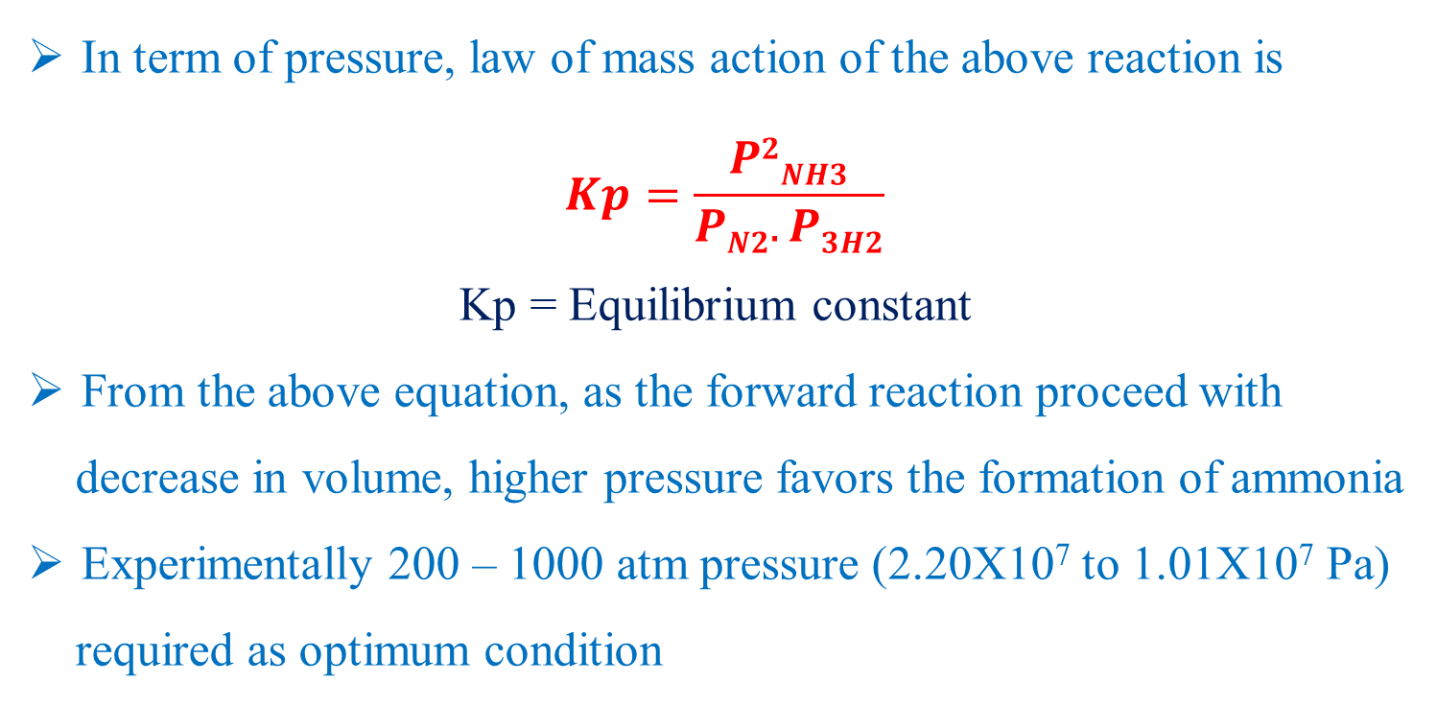
Manufacture of Ammonia
HABER PROCESS
3. Effect of Pressure:
In term of pressure, law of mass action of the above reaction is
$$Kp=\frac{P2NH3}{PN2.P3H2}$$
Kp = Equilibrium constant
From the above equation, as the forward reaction proceed with
decrease in volume, higher pressure favors the formation of ammonia
Experimentally 200 – 1000 atm pressure (2.20X10⁷ to 1.01X10⁷ Pa)
required as optimum condition

Slide 10
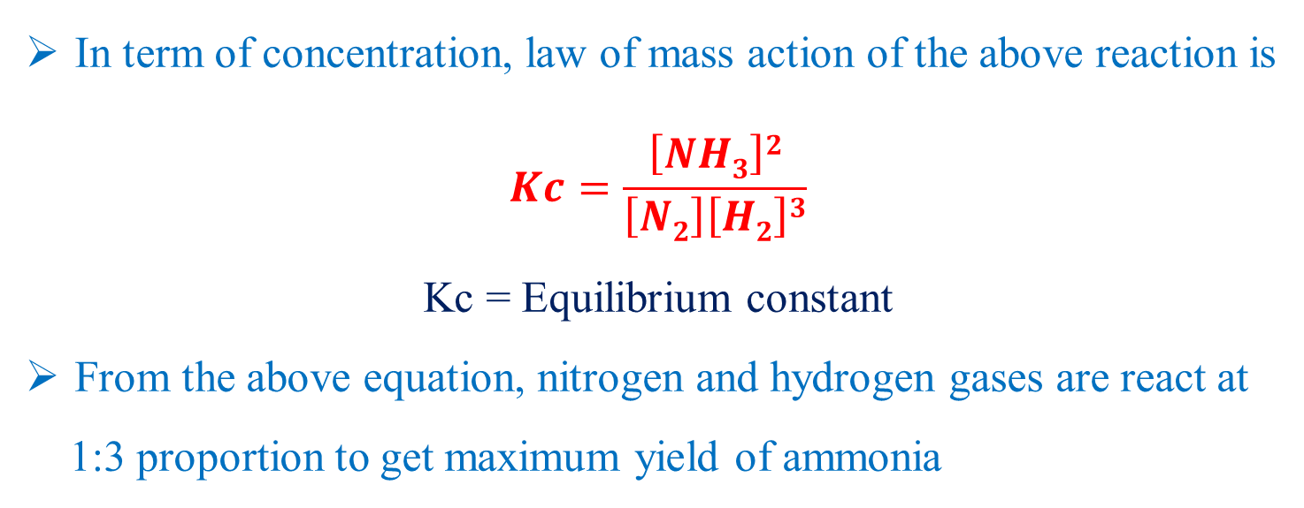
Manufacture of Ammonia
HABER PROCESS
4. Effect of Concentration:
In term of concentration, law of mass action of the above reaction is
$$Kc=\frac{\left[NH3\right]2}{\left[N2\right]\left[H2\right]3}$$
Kc = Equilibrium constant
From the above equation, nitrogen and hydrogen gases are react at
1:3 proportion to get maximum yield of ammonia

Slide 11
Manufacture of Ammonia
HABER PROCESS
5. Rate of flow (Time of contact):
Maximum yield of product is depends upon time of contact of
reacting gases with catalyst
Hence, reacting gases recirculate over the catalyst repetadely

Slide 12
Manufacture of Ammonia
HABER PROCESS
Optimum Conditions:
Temperature: 500-550˚C
Pressure: 200-250 atm pressure
Catalyst: Finely divided Fe with promoter (molybdenum)
Proportion of reacting gases, N₂ & H₂ = 1:3

Slide 13
Manufacture of Ammonia
HABER PROCESS

Slide 14
Manufacture of Ammonia
HABER PROCESS
Following operations are involved in this process
Preparation and purification of reacting gases
Reaction in the converter
Separation of ammonia from the unreacted gases

Slide 15
Manufacture of Ammonia
HABER PROCESS
1. Preparation and purification of reacting gases:
Water gas (CO + H₂) and producer gas (CO + N₂) passing over
iron oxide (Fe₂O₃) with steam at 550˚C to obtain N₂ & H₂ gases
CO from water gas & producer gas reacts with steam to form H₂ gas
CO2 is removed by dissolving it in water under pressure
Trace of CO is removed by adding NaOH in the solution
Removing of CO is essential as it affect the catalyst by forming volatile carbonyls
Formed pure gases of N₂ & H₂brought in exact proportion (1:3)
Formed gases are dried, compress at 200 atm pressure and pass to converter

Slide 16
Manufacture of Ammonia
HABER PROCESS
2. Converter:
Electrically heated catalyst is placed in converter
Initially it is heated to 500-550˚C
As reaction is exothermic, optimum temperature is maintain by controlling the flow of reacting gases
Reacting gases then pass through heat exchanger
In heat exchanger heat is exchanged to the fresh incoming gases

Slide 17
Manufacture of Ammonia
HABER PROCESS
3. Removal of ammonia (Condensation):
Gases from the converter contains 8% ammonia
These gases then cooled to -10 to -20˚C for condensation
Condensation produce liquor ammonia
Unreacted N₂ & H₂ gases are again send to converter
In converter they mix with the fresh gases and react over the catalyst
Thus the process is repeated in the converter
At each circulation 8% pure ammonia is obtain
Loss of reacting gases is nil, which is the main advantage of this process

Slide 18
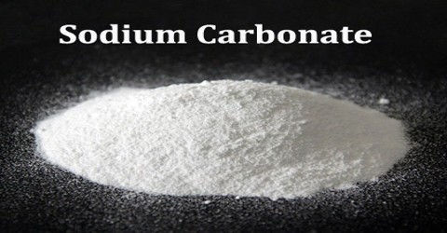
Manufacture of Sodium Carbonate
Sodium carbonate is a diazonium salt of carbonic acid with
molecular formula Na₂CO₃
It is also known as soda crystal, Soda ash, washing soda.
It is white and colorless in pure form
It is water soluble compound and form carbonic acid and
sodium hydroxide in water

Slide 19
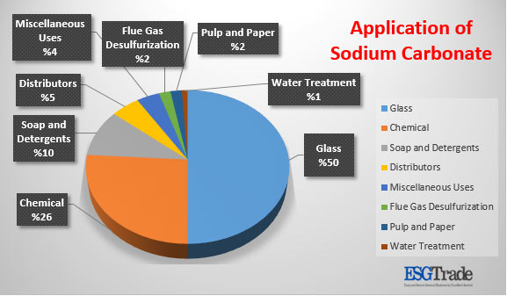
Manufacture of Sodium Carbonate

Slide 20
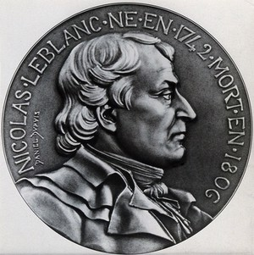
Manufacture of Sodium Carbonate
French chemist, Nicolas Leblanc made sodium carbonate, in 1791 by LeBlanc process
In this process, salt (sodium chloride) was reacted with sulfuric acid to produce sodium sulfate and hydrochloric acid.

Slide 21
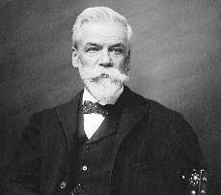
Manufacture of Sodium Carbonate
In 1864, Belgian chemist, Ernest Solvay develop first major
industrial process for the manufacture of sodium carbonate
This process is called as ammonia-soda process or Solvay process
This method superseded the Leblanc process.

Slide 22
Manufacture of Sodium Carbonate
a)
CaCO₃
CaO + CO₂
H = - 43.4 kcal
b)
C + O
CO₂
H = - 96.5 kcal
c)
CaO + H₂O
Ca(OH)₂
H = - 15.9 kcal
d)
NH₃ + H₂O
NH₄OH
H = - 8.4 kcal
e)
2NH₄OH + CO₂
(NH₄)₂CO₃ + H₂O
H = - 22.1 kcal
f)
(NH₄)₂CO₃ + CO₂ + H₂O
2NH₄HCO₃
g)
NaCl + NH₄HCO₃
NH₄Cl + NaHCO₃
2NaHCO₃
NaCO₃ + CO₂ + H₂O
H = +30.7 kcal
h)
i)
2NH₄Cl + Ca(OH)₂
2NH₃ + CaCl₂ + 2H₂O
H = +10.7 kcal

Slide 23
Manufacture of Sodium Carbonate
Overall reaction for the entire process
CaCO₃ + 2NaCl
Na₂CO₃ + CaCl₂
Role of ammonia and carbon dioxide is very important I Solvay process
2NH₃ + 2CO₂ + 2H₂O
2NH₄HCO₃
Optimum Condition:
At low temperature sodium bicarbonate precipitate out in
microcrystalline form.
NaCl = 4.9 mole/lit & NH₃= 4.5 mole/lit
Reaction temperature is high in initial point and the gradually cool
during filtration

Slide 24
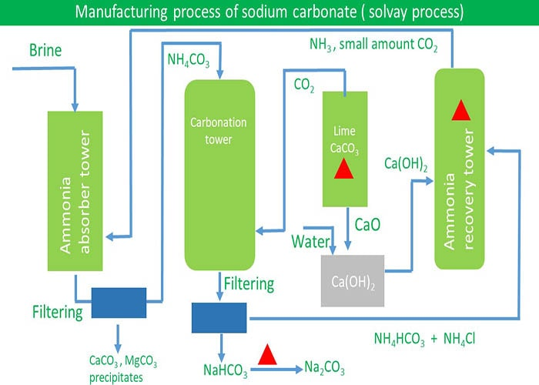
Manufacture of Sodium Carbonate

Slide 25
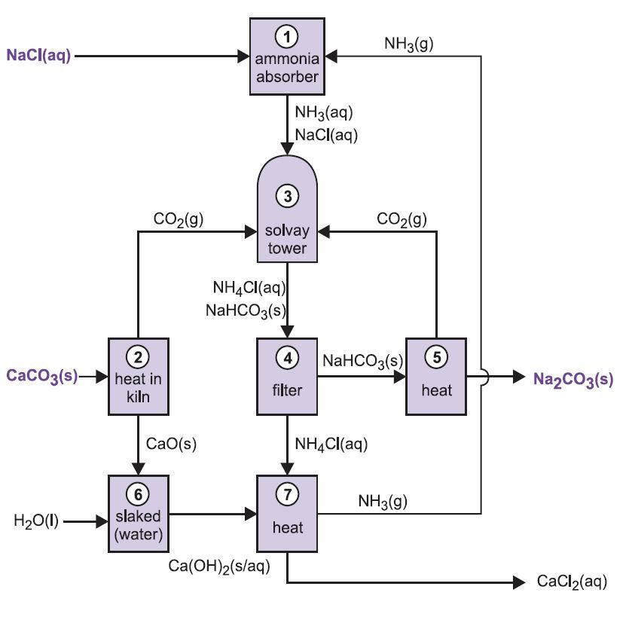
Manufacture of Sodium Carbonate

Slide 26
THANK YOU

