Slide 1


“Dissemination of Education for Knowledge, Science and Culture”
- Shikshanmaharashi Dr. Bapuji Salunkhe
Shri Swami Vivekanand Shikshan Sanstha’s Kolhapur
Padmabhushan Dr. Vasantraodada Patil Mahavidyalaya, Tasgaon Dist. Sangli
DEPARTMENT OF CHEMISTRY
Unit 2: Potentiometric Titration
Dr. Ajay Ambhore
M.Sc. B.Ed. NET Ph.D.

Slide 2
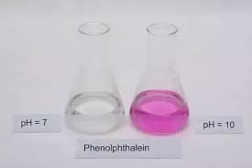
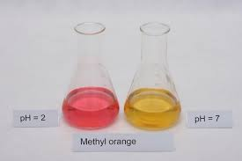
Potentiometric Titration
Titration: The process which is used to measure the
volume in volumetric analysis
In titrimetric analysis, end point is find
out by using suitable indicator
Indicator: Compounds that shows change
in color by changing pH of solution
Ex. Phenolphthalein Methyl Orange

Slide 3

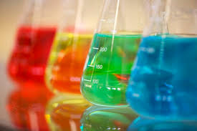
Limitations:
Unavailability of indicator
Colored solution
Very dilute solution
Forming precipitate

Slide 4
Potentiometric Titration
Potentiometric titration is a physico-chemical method which is
used to find out the end point in volumetric analysis
In potentiometric titration end point was find out by measuring
the potential of indicator electrode
Indicator electrode: Electrode, whose potential is depends upon
activity or concentration of the ions present
in the solution

Slide 5
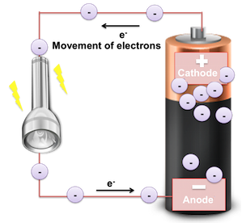
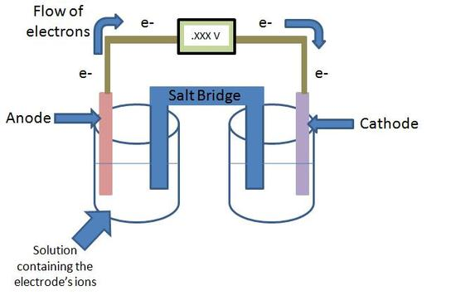
Electrode: An electrode is a solid electric conductor
that carries electric current into non-metallic solids,
or liquids, or gases, or plasmas, or vacuums
Electrode Potential: tendency of metal electrode to loose or gain
electrons when it is in contact with a solution of its own salt
Standard Electrode Potential: tendency of metal electrode to loose
or gain electrons when it is in contact with a solution of its own salt
of 1M con. at 25˚C
Electromotive force/ cell potential:
Difference between electrode potential
when the cell is under operation
Oxidation
Reduction

Slide 6

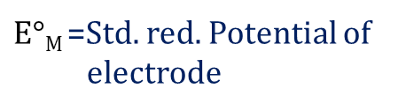
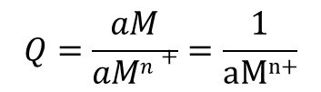
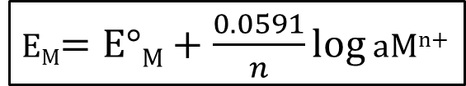
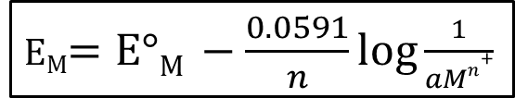
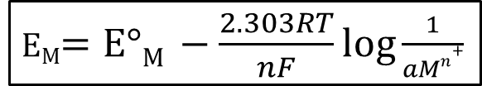
Half cell reaction of the metal ion electrode
M^{n+} + ne⁻ M
$$Q=\frac{aM}{aMn+}=\frac{1}{\text{aM}\text{n}\text{+}}$$
Q=Reaction quotient
The reaction quotient Q is a measure of the relative amounts
of products and reactants present in a reaction at a given time
According to Nernst equation potential of metal electrode is
expressed as
E_{M}$=\text{E}°\text{M} −\frac{2.303RT}{nF}log Q$
E_{M}$=\text{E}°\text{M}+\frac{0.0591}{n}log$ aM^{n+}
E_{M}$=\text{E}°\text{M} −\frac{2.303RT}{nF}log\frac{1}{aMn+}$
E_{M}= reduction potential
$\text{E}°\text{M}$=Std. red. Potential of
electrode
at 298K
n=no. electron involved
in electrode reaction
E_{M}$=\text{E}°\text{M} −\frac{0.0591}{n}log\frac{1}{aMn+}$
aM^{n+} =Activity of metal ion

Slide 7
Determination of pH
2) Potentiometric titration
Determination of pH

Slide 8


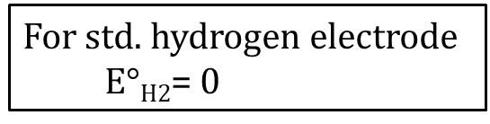

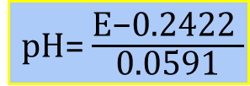


Determination of pH
Ex. Std. hydrogen electrode (SHE)
reverse electrode
H⁺+ e⁻ $\frac{1}{2}$ H₂
E _{H2} $=\text{E}°\text{H}\text{2}+\frac{2.303RT}{F}log$ C_{H+}
Pt,H₂(g,1atm)ІH⁺(C=unknown)ІІSCE
E=E_{R}-E_{L}
For std. hydrogen electrode
$\text{E}°\text{H}\text{2}$= 0
E=E_{SCE}-E _{H2}
E _{H2} $=\frac{2.303RT}{F}log$ C_{H+}
E=0.2422-(-0.0591pH)
at 298K
0.0591pH=E-0.2422
E _{H2} $=0.0591log$ C_{H+}
pH= $\frac{\text{E}\text{−0.2422 }}{\text{0.0591}}$
E _{H2} $=−0.0591pH$

Slide 9
Indicator Electrode
Electrode whose potential is depends upon the activity or
concentration of ions present in that solution is called as
indicator Electrode
Hydrogen gas electrode
Saturated calomel electrode
Quinhydrone electrode
Glass electrode

Slide 10
Quinhydrone Electrode
Potential of electrode change with change in the activity of
ions in solution
Used in potentiometric titration to determine the pH of solution
Used in galvanic cell with reference electrode like SCE
and represented as
SCE ll solution of unknown pH l Q, H2Q l Pt
Half cell reaction is represented as
solution of unknown pH l Q, H2Q l Pt
Q= Quinone H₂Q= Hydroquinone
Quinhydrone: equimolecular mixture of Quinone and Hydroquinone

Slide 11
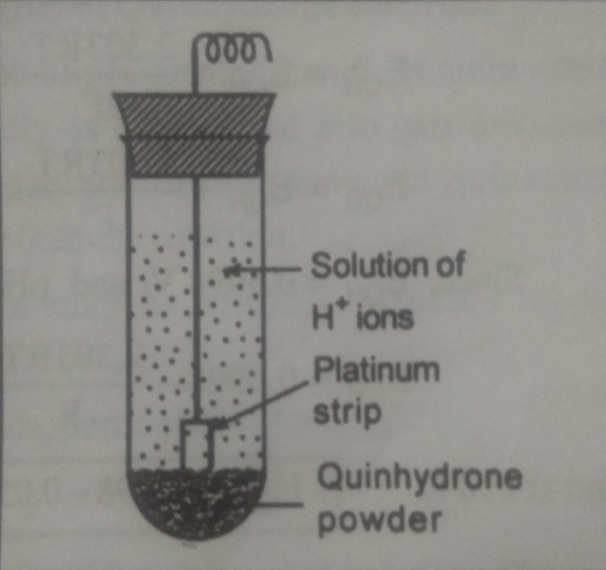
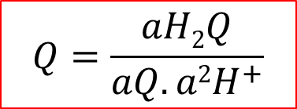
Quinhydrone Electrode
$$Q=\frac{aH2Q}{aQ.a2H^{+}}$$

Slide 12









Potential of Quinhydrone electrode (QH) according to Nernst equation
E_{QH}$=E˚QH−\frac{2.303RT}{2F}log\frac{aH2Q}{aQ.a2H^{+}}$
Since, $E˚QH$=0.6998
As … aQ = aH₂Q; hence.. $\frac{aH2Q}{aQ}$=1
E_{QH}$=\text{0.6998}+\frac{2.303RT}{F}logaH^{+}$
E_{QH}$=E˚QH−\frac{2.303RT}{2F}log\frac{1}{a2H^{+}}$
E_{QH}$=\text{0.6998}−\frac{2.303RT}{F}pH$
At 298K
E_{QH}$=E˚QH+\frac{2.303RT}{2F}loga2H^{+}$
E_{QH}$=\text{0.6998}−0.0591pH$
E_{QH}$=E˚QH+\frac{2.303RT}{F}logaH^{+}$

Slide 13
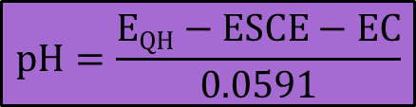
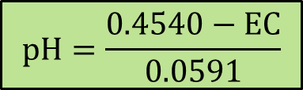
Determination of pH by Quinhydrone electrode
SCE l Solution of unknown pH l Q,H₂Q l Pt
Cell potential is measured by potentiometry
E_{C} = E_{R} – E_{L}
E_{C} = E_{QH} – E_{SCE}
E_{c}= 0.4540-0.0591pH
At 298K
$$pH=\frac{0.4540−EC}{0.0591}$$
E_{QH} = 0.6998-0.0591pH
E_{SCE} = 0.2458
$$pH=\frac{EQH−ESCE−EC}{0.0591}$$
E_{c}= 0.6998-0.0591pH- 0.2458

Slide 14
Advantages:-
Easy to construct
Equilibrium attained rapidly
Not easily poisoned
Used to the solution where SHE was not applicable
Disadvantages:-
Not applicable in solution of pH greater than 8
Electrode potential affected by high concentration salt
Not stable for long period

Slide 15
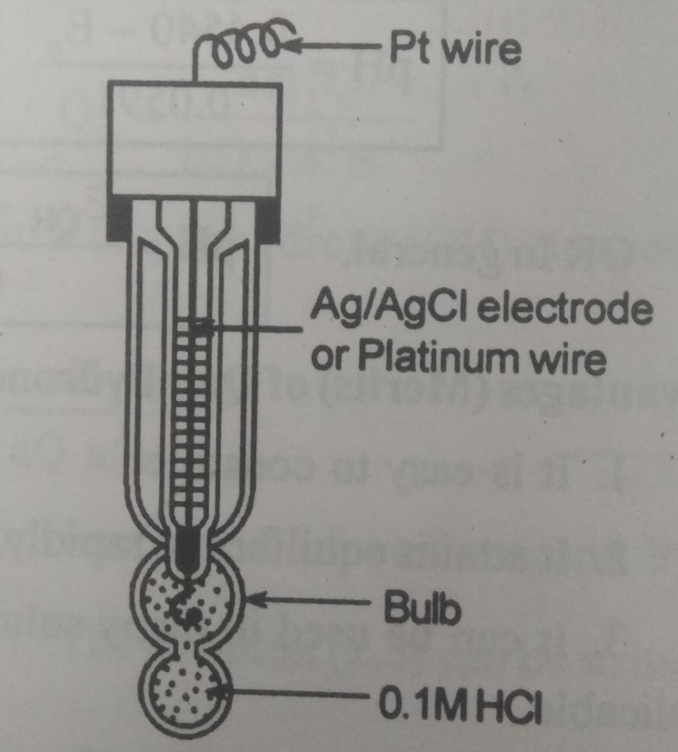
Glass Electrode
Glass:
pH sensitive
Low melting pint
High electrical conductivity
0.1 M HCl provides constant H⁺ ion conc. (constant pH)
Solution of unknown pH l Glass l 0.1M HCl l AlgCl l Ag

Slide 16
Glass Electrode
Electrode Potential:-
Electrode potential exist at the interference between glass and
a solution congaing H⁺ ion
E_{G} = E˚_{G} – 0.0591 pH
Glass work in the same manner as the given glass electrode

Slide 17
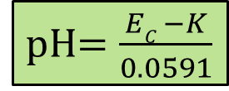
Glass Electrode
Determination of pH:-
Ag I AgCl I 0.1M HCl I glass I Solution of unknown pH I SCE
E_{C} = E_{R} - E_{L}
E_{C} = E_{SCE} - E_{G}
E_{C} = 0.2458 – (E˚_{G} – 0.0591pH)
E_{C} = 0.2458 – E˚_{G} + 0.0591pH
E_{C} = K + 0.0591pH
(K = 0.2458 - E˚_{G})
(Constant depends upon composition of glass)
pH$=\frac{EC −K}{0.0591}$

Slide 18
Glass Electrode
Advantages:-
Not affected by oxidizing or reducing agents
Used in presence of metallic ion
Simple to operate
Simple to operate
Used up to pH ranging from 0 to 9 (upto12 pH for special glass)
Disadvantages:-
Glass membrane is extremely high resistance
Costly & fragile

Slide 19
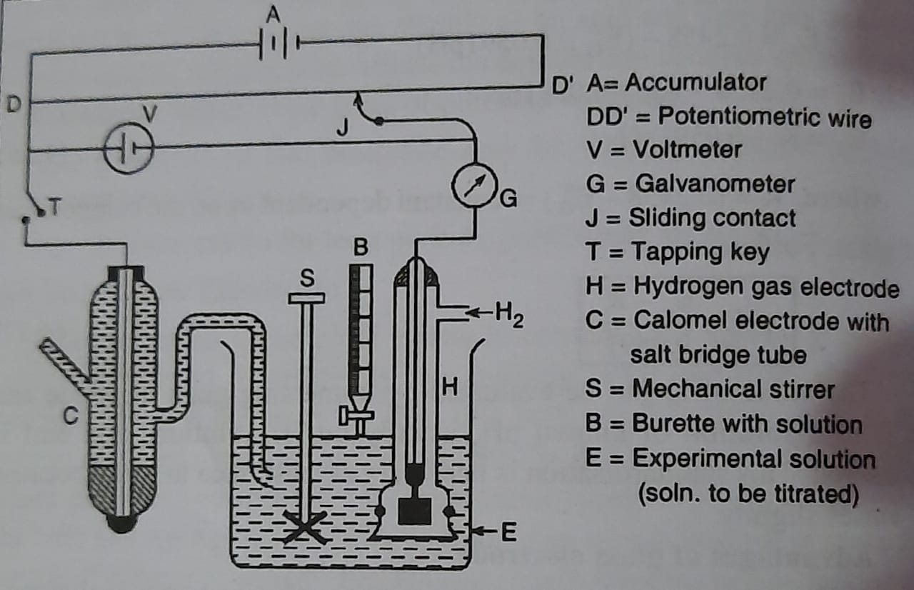
Potentiometric titration
Titration assembly

Slide 20
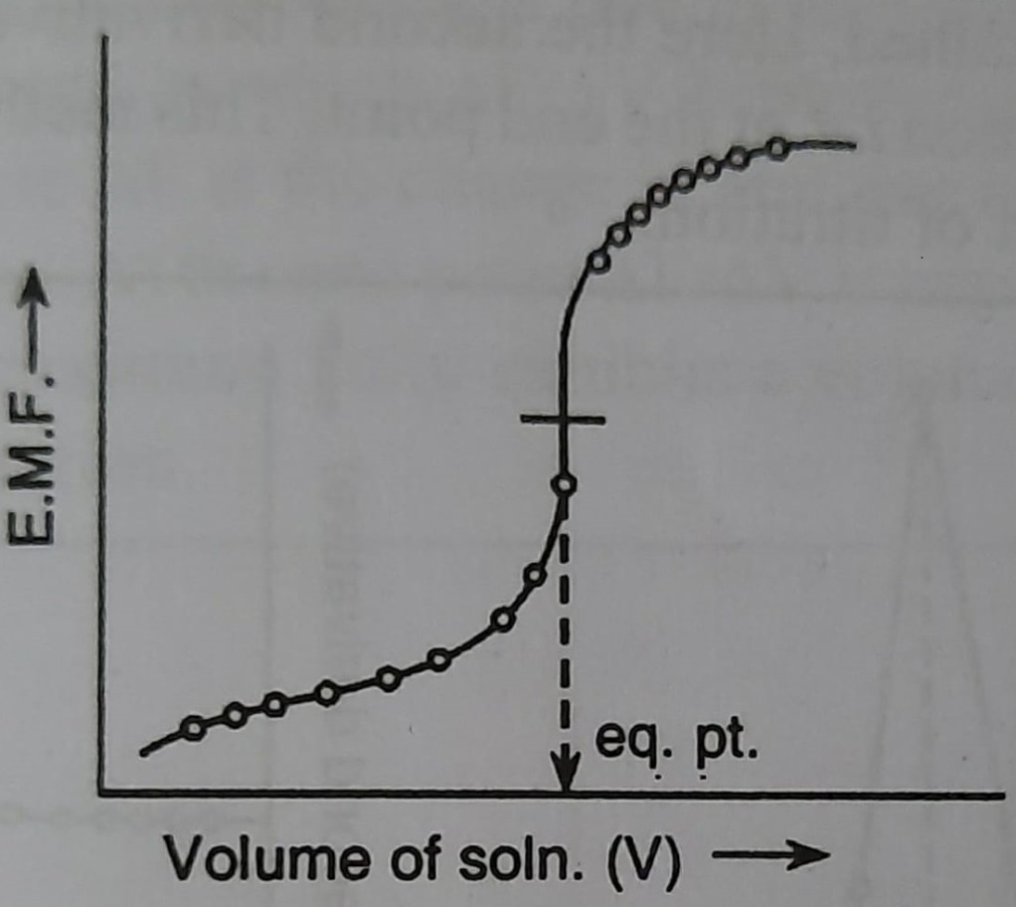
Potentiometric titration
A) Classical method for locating end points -

Slide 21
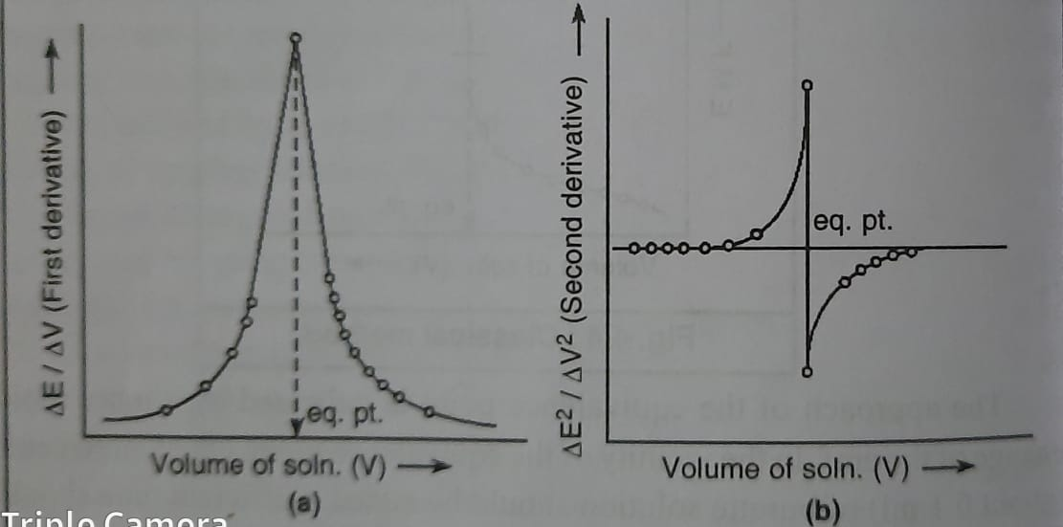
Potentiometric titration
B) Analytical (Derivative) method for locating end points:-

Slide 22
Potentiometric titration
Acid-Base Titration
(Neutralization Reaction)
Change in concentration of H⁺ ions
Indicator electrode reversible to H⁺ ions
Ex. Hydrogen electrode, Quinhydrone electrode, Glass electrode

Slide 23
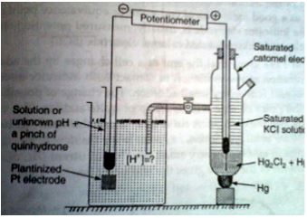
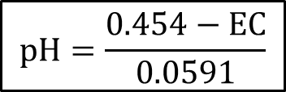
Acid-Base Titration
(Neutralization Reaction)
⁻ SCE II H⁺ ions (H2Q + Q) I Pt ⁺
$$pH=\frac{0.454−EC}{0.0591}$$

Slide 24
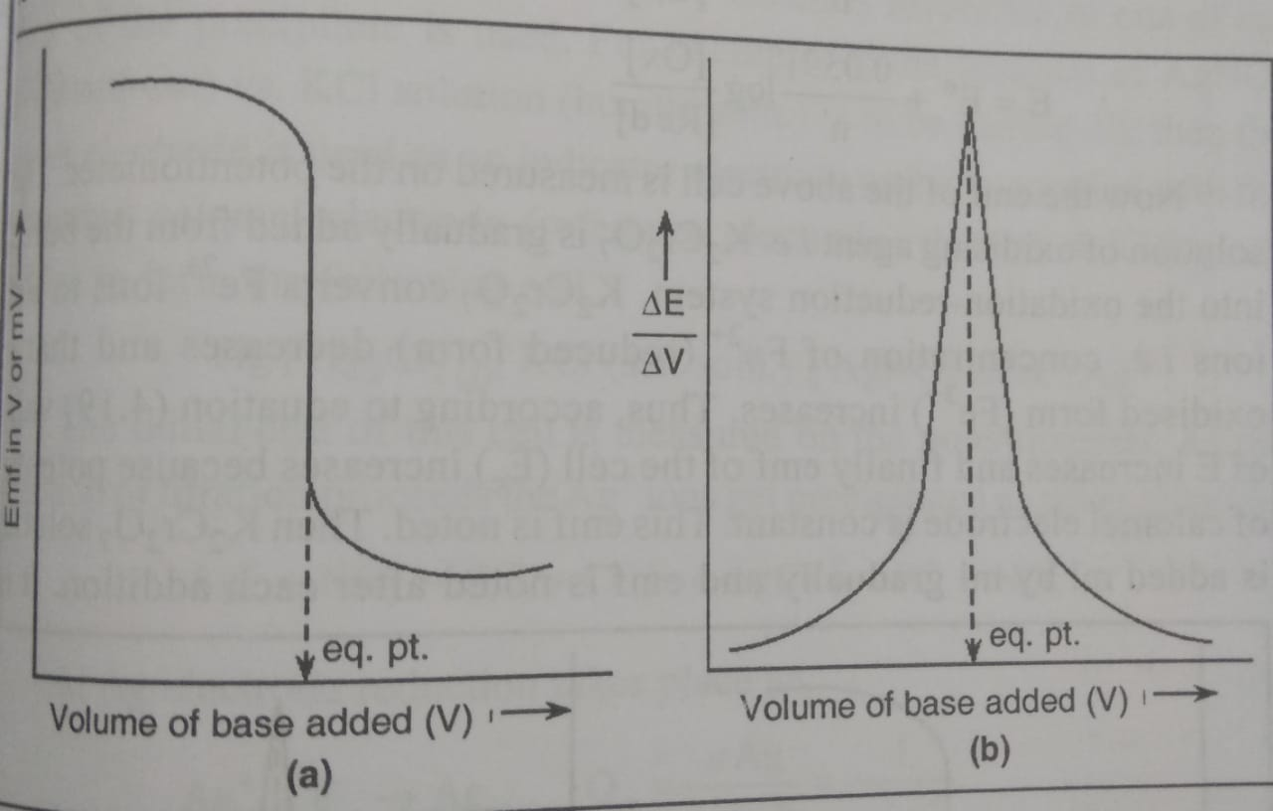
Acid-Base Titration
(Neutralization Reaction)

Slide 25
Potentiometric titration
Redox Titration
(Oxidation-Reduction Reaction)
Use of redox electrode
Ex. Titration between FeSO₄ & K₂Cr₂O₇
FeSO₄ = Reducing agent
K₂Cr₂O₇ = oxidizing agent
Fe exist as Fe⁺⁺ & Fe⁺⁺⁺
⁻SCE II Oxdn.Redn. System (Fe²⁺/Fe³⁺) I Pt⁺

Slide 26
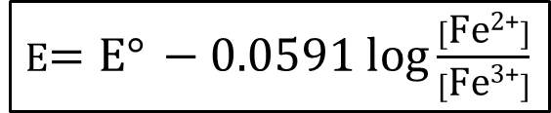
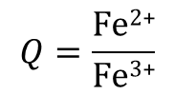
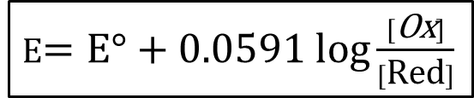
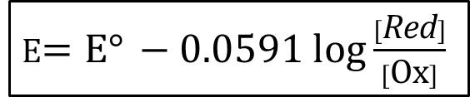
Redox Titration
(Oxidation-Reduction Reaction)
Fe³⁺ + e⁻ Fe²⁺
$$Q=\frac{\text{Fe}\text{2}\text{+}}{\text{Fe}\text{3+}}$$
Ox
Red
E$=\text{E}° −0.0591 log\frac{[\text{Fe}\text{2}\text{+}]}{[\text{Fe}\text{3+}]}$
As n = 1
E$=\text{E}° −0.0591 log\frac{[\text{R}\text{ed}]}{[\text{Ox}]}$
E$=\text{E}°+0.0591 log\frac{[\text{Ox}]}{[\text{Red}]}$

Slide 27
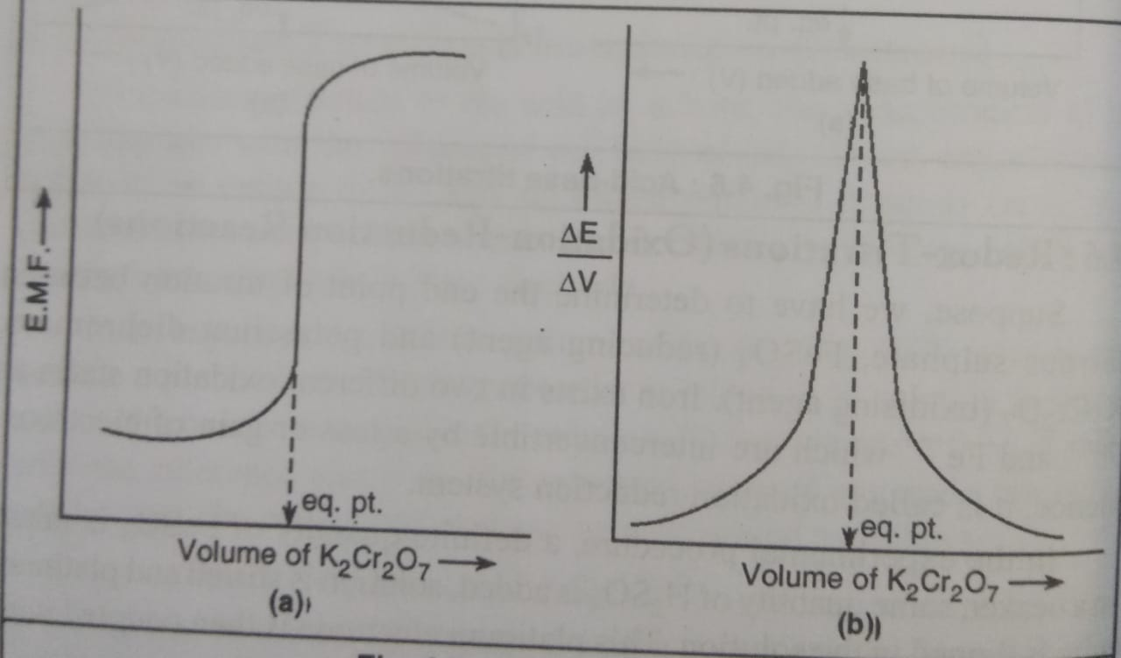
Redox Titration
(Oxidation-Reduction Reaction)

Slide 28
Potentiometric titration
Precipitation Titration
Indicator electrode reversible to one of the ion of the precipitate
Ex. Titrating AgNO3 against KCL
AgNO₃ + KCL AgCl + KNO₃
Ag⁺ + NO₃⁻ + (K⁺ + Cl⁻) AgCl + K⁺ + NO₃⁻
Silver electrode is used with SCE
Reduction is takes place at silver electrode

Slide 29
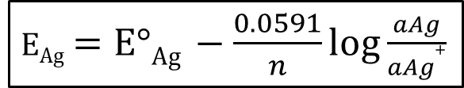
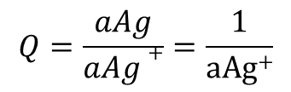

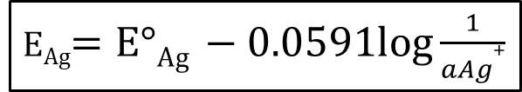
Potentiometric titration
Precipitation Titration
Ag⁺ + e⁻ Ag_{(s)}
$$Q=\frac{aAg}{aAg+}=\frac{1}{\text{a}\text{Ag}\text{+}}$$
E_{Ag}$=\text{E}°\text{Ag} −\frac{0.0591}{n}log\frac{aAg}{aAg+}$
E_{Ag}$=\text{E}°\text{Ag} −0.0591log\frac{1}{aAg+}$
E_{Ag}$=\text{E}°\text{Ag}+0.0591log aAg$⁺
E_{c} = E_{Ag} - E_{SCE}

Slide 30
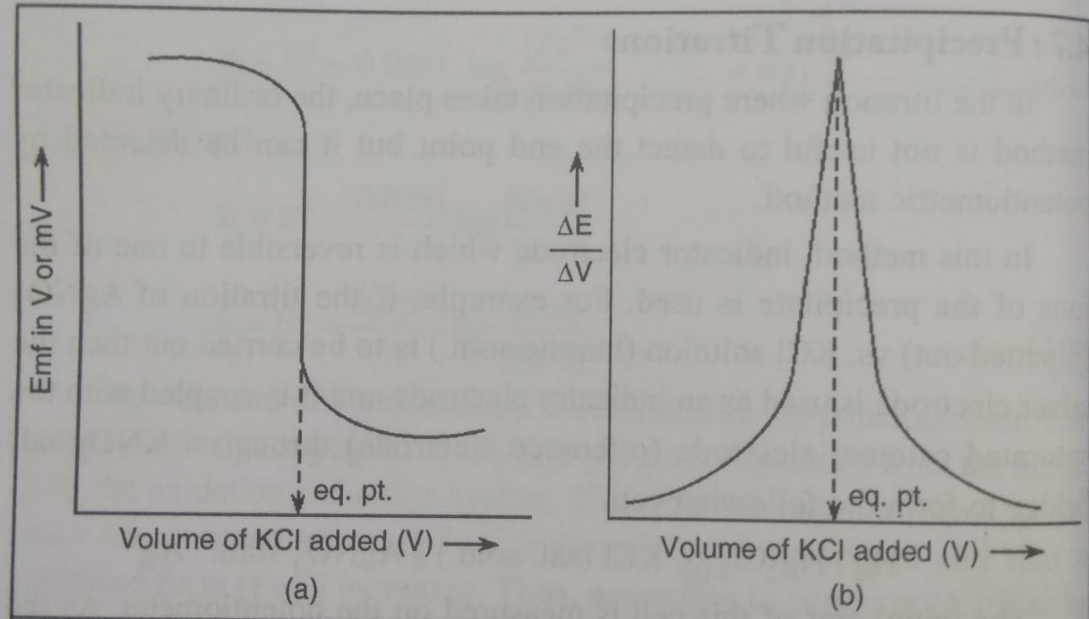
Precipitation Titration

Slide 31
Advantages of Potentiometric Titration
Used for diluted and colored solution
Used for Weak acid against weak base
Used for polybasic acids/ mixed acid
Used for titrating oxidising agents against redusing agents
Used for analyze chloride, bromide, iodide using silver electrode

Slide 32
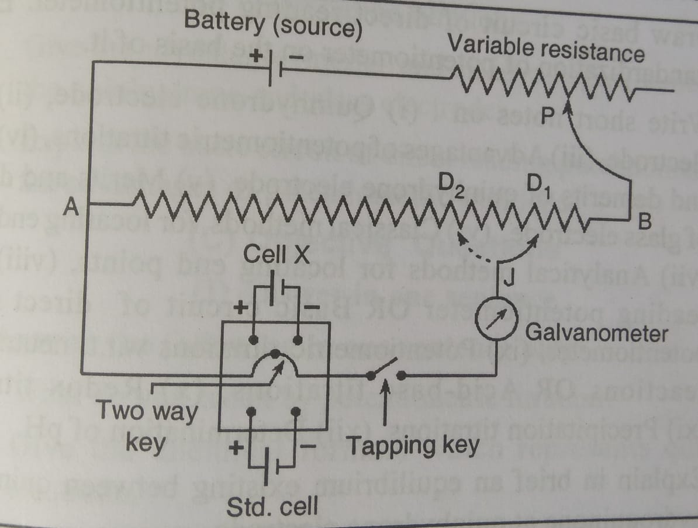
Circuit Diagram

Slide 33
Thank you

