Slide 1
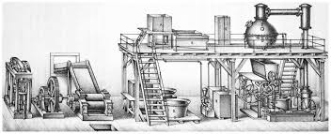
“Dissemination of Education for Knowledge, Science and Culture”
- Shikshanmaharashi Dr. Bapuji Salunkhe
Shri Swami Vivekanand Shikshan Sanstha’s Kolhapur
PADMABHUSHAN DR. VASANTRAODADA PATIL MAHAVIDYALAYA, TASGAON DIST. SANGLI
(Affiliated to Shivaji University, Kolhapur)
DEPARTMENT OF CHEMISTRY
INDUSTRIAL CHEMISTRY
Sugar Industry
Dr. Ajay Ambhore M.Sc. B.Ed. NET Ph.D.

Slide 2
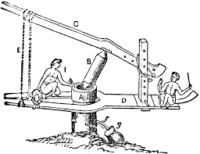
Sugar Production introduced by India in world
Cultivation of Sugar cane in Bengal region from 1500-500 BC
Extraction of juice from sugar cane from 400 BC
Sugar production in India from 350 AD
Crystallization of sugar in 17th century.
Commercial production of sugar start in 18th century.

Slide 3
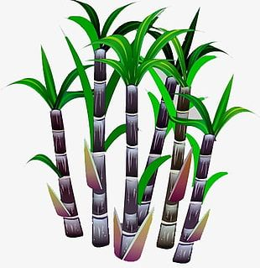
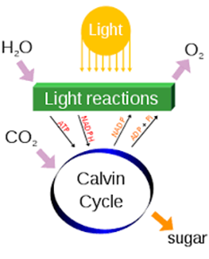
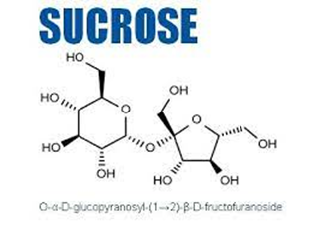
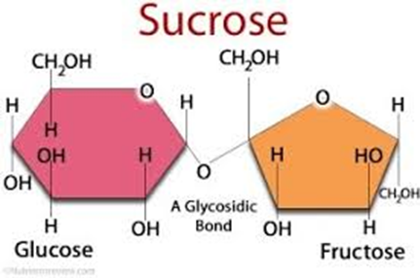
Sugar Industry

Slide 4
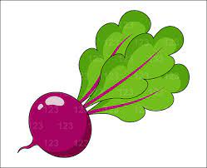
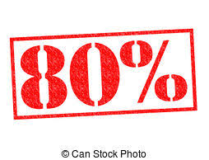
Sugar Industry
Near about 110 countries produce sugar in the world from Cane sugar or beet.
Production of sugar globally in the year 2019-20 is about 170 million metric tons.
Production of Sugar Globally

Slide 5
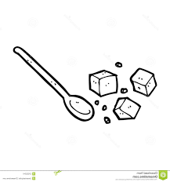
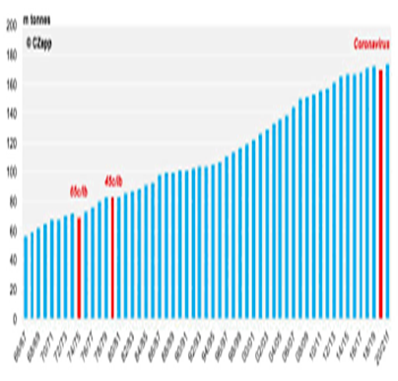
Sugar Industry
Consumption of Sugar yearly

Slide 6
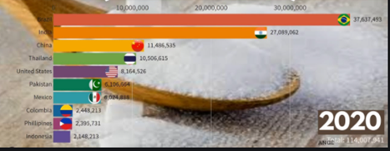
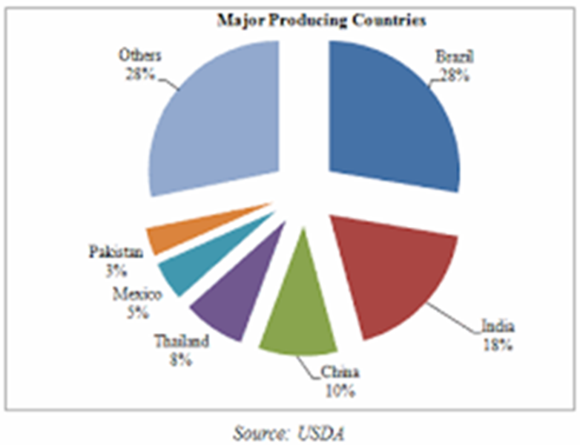
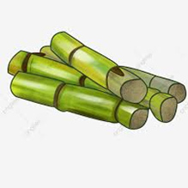
Sugar Industry
Top 10 Sugar Produced Countries

Slide 7
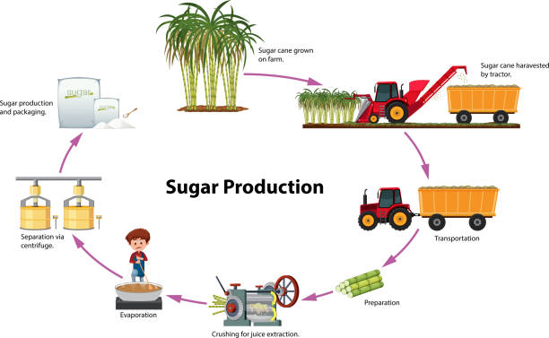
Sugar Industry

Slide 8
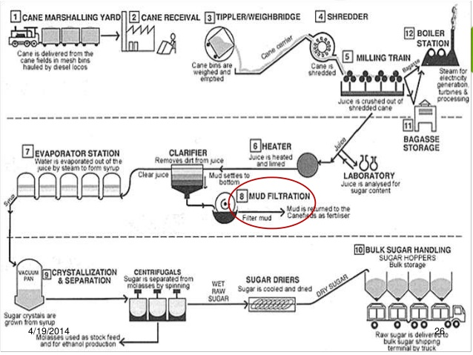
Sugar Industry
Production of Sugar
Extraction
Purification
Refining

Slide 9
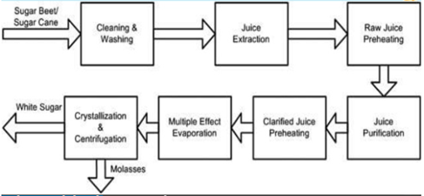
Sugar Industry

Slide 10
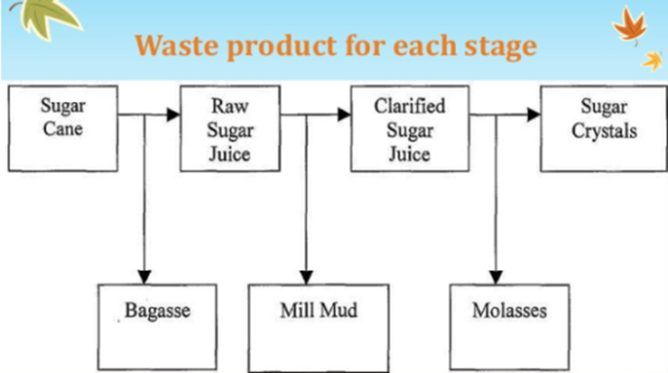
Sugar Industry

Slide 11
Sugar Industry
Manufacture of Sugar
Extraction
Clarification
Concentration
Crystallization
Centrifugation
Refining

Slide 12
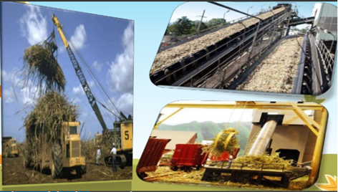
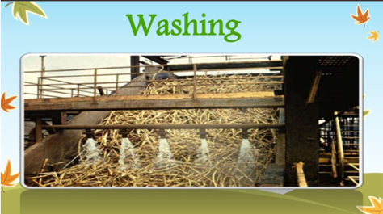
Sugar Industry
Manufacture of Sugar

Slide 13
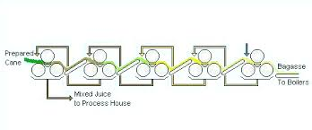
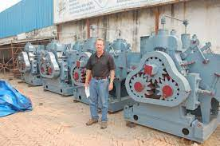
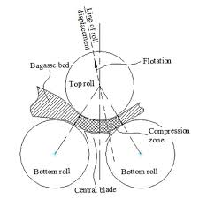
Sugar Industry
Manufacture of Sugar
Extraction of juice
Milling Train

Slide 14
Sugar Industry
Manufacture of cane Sugar
Extraction of juice

Slide 15
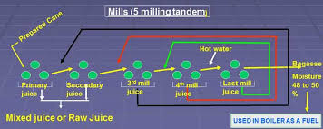
Sugar Industry
Manufacture of cane Sugar
Extraction of juice
Crusher | 1st mill | 2nd mill | 3rd mill | 4th mill | Total
70 % | 12.5 % | 7.0 % | 4.5 % | 2.0 % | 96 %

Slide 16
Sugar Industry
Clarification of juice
Removing of impurities from cane juice is called
Clarification or defecation.
Raw Juice : Acidic in nature; Greenish in colour.
Impurities
Soluble impurities |  | Insoluble impurities
Organic matters | Inorganic matters
crystalline sugar/ proteins/organic acids/pectins / etc | inorganic Salt | Clay/ fibers/ path/ etc

Slide 17
Sugar Industry
Clarification of juice
Lime defecation method:
Addition of lime (Cao)
Calculated amount: 0.5 Kg/ ton of cane
Increase pH up to 8.5
Reduce loss of sucrose by hydrolysis
Precipitate soluble acids and phosphates
Coagulation of colloidal partials like proteins/pectins/ gum etc due to increase in pH
Precipitate out clay/ fibers/ path etc
Addition of phosphoric acid and super phosphate:

Slide 18
Sugar Industry
Clarification of juice
Juice Heater
Heating for coagulation and settling of soluble proteins
Juice heater having brass tubes.
Juice heated by high pressure hot steam.
Juice and steam are travel through the tubes in opposite direction.
Juice heated up to its boiling point.

Slide 19
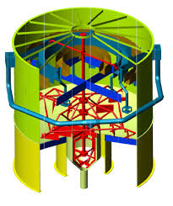
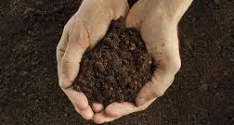
Sugar Industry
Clarifier
Clarification of juice
Clarifier: settling tank
Upper layer: Scum : fiber particles
Middle layer: clear juice
Lower level: heavy particles : mud
By product of this step : Manure

Slide 20
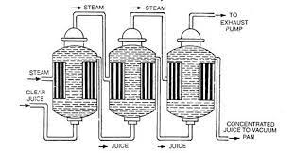
Sugar Industry
Clarification of juice
Multiple effect Evaporator
Steam chamber/
Calandria
Juice chamber
Concentration of Juice to Syrup
Use steam with reduced pressure.
Juice become more concentrate to form syrup.
Multiple effect evaporator is energy economy.
Reduce loss of sugar due to decomposition.

Slide 21
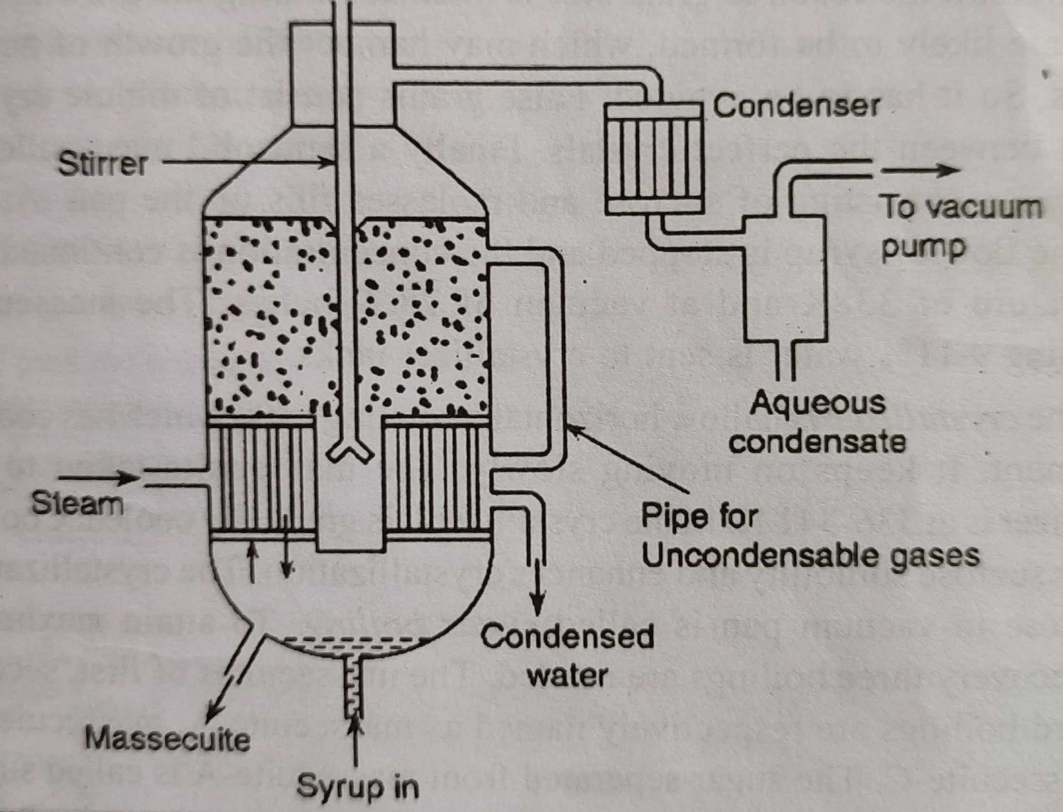
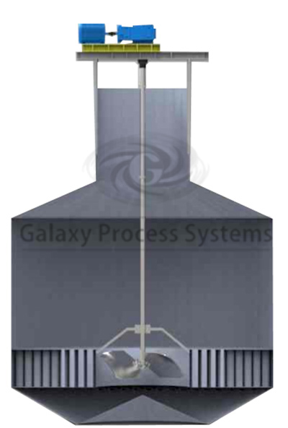
Sugar Industry
Crystallization of Sugar
Vacuum Pan
Single effect vacuum pan/ Strike pan

Slide 22
Sugar Industry
Crystallization of Sugar
Graining:
Sucrose concentration in the syrup is raise to supersaturation
Crystallization done by
Waiting method:
Supersatiration is broken by gradually cooling
Shock treatment method:
Supersaturation broken by Sudden chilling | Decreasing rate of steam Increasing vacuum Mixing large amount of cold syrup
In India external seed grains are added for crystalization
About one ton added sugar crystals recover 25 to 30 ton massecuite

Slide 23
Sugar Industry
Crystallization of Sugar
Crystal Growth:
When graining point is reached, sucrose forced out from the syrup by…
Addition and mixing of syrup in lots
Maintain the vacuum (28.5 inches)
Crystal growth till the required grain size is attain
During this process avoid formation of false grains
(False grain- minute crystals are formed in between the perfect crystals
which hamper the crystal growth)
Finally formed Massecuite
(Massecuite = Sucrose + Molasses and 10 % water)
Massecuite sent to crystallization tank

Slide 24
Sugar Industry
Crystallization of Sugar
Crystallization Tank:
Horizontally rotating tank which moves slowly and having cooling
attachment
Massecuite cool gradually at 336-341 K which reduce the solubility of
sucrose and crystallization occurs
Crystallization of sugar in vacuum pan is called Sugar Boiling
Three boiling are required for maximum recovery of sugar
Boiling 1st | Massecuite -A | Molasses - A
Boiling 2nd | Massecuite -B | Molasses - B
Boiling 3rd | Massecuite -C | Molasses - C

Slide 25
Sugar Industry
Crystallization of Sugar
Massecuite A = 80-85 % blending syrup with molasses A
Massecuite B = 70-75 % blending syrup with molasses B
Massecuite A
Sent to centrifugation for recovery of Sugar A and B
Massecuite B (to form commercial sugar)
Massecuite C = 60-55 % blending syrup with molasses C
Low purity and highly viscuss
Sent to crystallization and allow to stay for 4-5 days
Add additional sugar and sent to centrifuge to recover sugar C
and molasses C (black strap)
Sugar C is used for seeding purpose in boiling

Slide 26
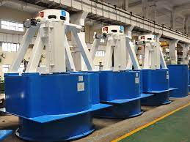
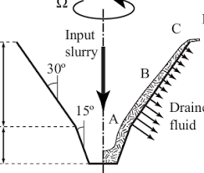
Sugar Industry
Clarification of juice
Centrifugation
Separation of sugar crystals from mother liquor by centrifugation force
Centrifugation tank:

Slide 27
Centrifugation tank:
Cylinder perforated basket (400-600 perforation per inch)
Hot massecuite rotate in the basket at the speed of 1800-2400 rpm
Due to centrifugation force massecuite drawn to the wall of cylinder
The syrup drain through perforation where as sugar crystals held within
Crystals covered with massecuite hence brown in colour which is then wash with water spray
Centrifugal basket rotate till the sugar crystals is dry which then
collect manually

Slide 28
Sugar Industry
Refining of Raw Sugar
Unit Operations
Affination
Defecation
Decolorization
Crystallization and centrifugation
drying

Slide 29
Sugar Industry
Refining of Raw Sugar
1. AFFINATION
Raw sugar are further mixed with heavy syrup (mother liquor)
of 60˚-80 ˚ brix (Brix = Density scale of sucrose solution)
Mixing in a vessel having stirrer called Mingler
Remove only the colored impurities of molasses film around the
sugar crystals
Crystals then centrifuge to separate from mother liquor and washed
with hot potable water
During washing sugar crystals melted in water at 55-60 brix
Melting of sugar is done in a melting vessel called Melter
This syrup then sent to defecation process

Slide 30
Sugar Industry
Refining of Raw Sugar
2. Defection
At this stage sugar syrup having some insoluble impurities like
clay, gum, pectins, etc
These impurities are removed by the process of liming, sulphonation
and carbonation
Lime is added up to natural pH and then heat the syrup
Impurities are precipitated out which then filtered
Addition of diatomaceous earth enhance the process of defection

Slide 31
Sugar Industry
Refining of Raw Sugar
3. Decolorization
Filtered syrup obtained from defecation process has dark brown
in colour because of impurities still remain in it
It pass through bed of bone charcoal in a char tank
The colored impurities are selectively adsorbed on charcoal to obtain
clear, pure and colorless syrup
Disadvantages:
Takes longer time
Inorganic salts are not removed
After the process charcoals are reactivated and use for next batch

Slide 32
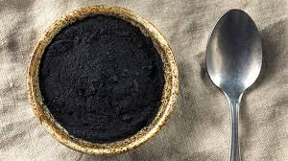
Sugar Industry
Refining of Raw Sugar
Alternative methods for purification of Sugar
i) Activated carbon process:
Addition of pulverized charcoal directly into the colored syrup for
defecation and then filter
Take short time

Slide 33
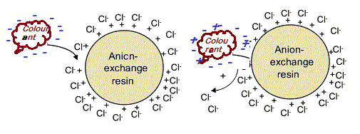
Sugar Industry
Refining of Raw Sugar
Alternative methods for purification of Sugar
ii) Ion exchange process:
Colored syrup pass through both cation and anion exchange resin
Charge impurities are retrained on ion exchange column to form
uncharged sucrose
Expensive but repetitively used process

Slide 34
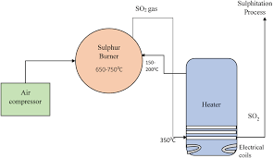
Sugar Industry
Refining of Raw Sugar
Alternative methods for purification of Sugar
iii) Sulphitation process:
Use of SO₂ gas for defection process
Double sulphitation is employed

Slide 35
Sugar Industry
Refining of Raw Sugar
Alternative methods for purification of Sugar
vi) Carbonation process:
Excesses amount of lime is used to precipitate out the impurities
Same process explained in lime defecation process

Slide 36
Sugar Industry
Refining of Raw Sugar
4. Crystallization and Centrifugation
After defecation process , sugar syrup become dilute
It is sent to a vacuum pan to concentrate it under reduced presser
The formed massecuite then sent to crystallizer
Crystallization is done by centrifugation to form sugar crystals
The mother liquor formed in this step is used for refining of raw sugar
of next batch (in affiation step)

Slide 37
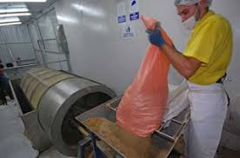
Sugar Industry
Refining of Raw Sugar
5. Drying process
The sugar crystals are formed was contain 1-2% moisture
It can dried in granulator, a horizontally rotating drum
In granulator the sugar is dried by passing hot air blown in
opposite direction

Slide 38
Manufacturing of White Sugar in India
Manufacturing of sugar in single step without producing raw sugar
Extraction of juice: Compound imbibition process
Clarification of juice: Raw juice contains……
Sucrose (10-20%), reducing sugar (0.5-2.5%), organic matters (0.5-1%),
water (78-86%), ash (0.3-0.7%) pith, fiber and some colloidal particles
Sulphination defecation process:
Addition of lime and heated to 333K (1-2 kg lime/ton cane)
Colloidal particles and soluble impurities like phosphates separate by
coagulation due to increasing pH
Suplhur dioxide (SO₂) gas bubbled out through the juice to brought
accelerate the pH 7 and sedimentation of coagulated particles
SO₂ also helps to bleach the juice

Slide 39
Manufacturing of White Sugar in India
b) Carbonation defecation process:
Addition of lime and heated to 333K (8-12 kg lime/ton cane)
Non sugar and coloring matters separate out completely because of high alkalinity
Carbon dioxide (CO₂) gas bubbled out through the juice to accelerate
the sedimentation of coagulated particles which are the filters
Resituate the CO₂ by boiling the juice to Break the bicarbonate form and to remove the remained contaminant
Cheaper method than sulphination

Slide 40
Manufacturing of White Sugar in India
3. Concentration of juice:
Triple effect evaporator used to convert juice to syrup
4. Crystallization of sugar:
Syrup converted to massecuite in crystallization or strike pan
5. Centrifugation:
Separate the sugar crystals from mother liquor

Slide 41
Sugar Industry
By-products of Sugar industry
Complete utilization of by-product:
Reduce operational coast
Provides additional employments
Reduce waste management risk

Slide 42
Sugar Industry
By-products of Sugar industry
Bagasse:
Cane residue expelled from milling house
It contain solid matter and water with some quantity of sucrose
Applications:
Energy Source
Manufacture of hard board like celotex
Manufacture of Cattle feed
Manufacture of paper for printing news paper
Manufacture of furfural from the pith

Slide 43
Sugar Industry
By-products of Sugar industry
Molasses:
Mother liquor behind after crystallization of sucrose
Also called black strap
Contains 25-40% sucrose and 5-30% reducing sugar with water, solids and other organic matters
It was mainly used for the manufacturing of ethyl alcohol

Slide 44
Manufacturing of ethyl alcohol from molasses
Ethyl alcohol is the principal type of alcohol in alcoholic beverages.
Ethyl alcohol is mostly produced by the fermentation of sugar by yeast or by petrochemical processes.
Ethyl alcohol is a chemical product primarily used for antiseptic, antidote, medical solvent, recreational, fuel (engine fuel, rocket fuel, fuel cells), household heating, feedstock, solvent, and low temperature liquid(used in laboratories with dry ice or other coolants).

Slide 45
Manufacturing of ethyl alcohol from molasses
Ethyl alcohol are manufactured mainly by three process
1. Ethylene hydration Synthesis:
Ethyl alcohol can be produced from ethylene absorption in sulphuric acid which produce ethyl sulphate that hydrolyzed to ethyl alcohol and sulphuric acid.
Ethanol for industrial stock is usually made from petro chemical by this method
The catalyst most commonly use phosphoric acid that adsorbed onto a porous support like silica or diatomaceous earth

Slide 46
Manufacturing of ethyl alcohol from molasses
2. Ethylene catalytic hydration:
Synthesis ethyl alcohol generally processes from direct ethylene hydration using sulphuric acid as catalyst
The current process involves ethylene direct hydration with catalytic amount of sulphuric acid.
The temperature is around 300˚ C to 400˚ C with pressure 1000 Psi.

Slide 47
Manufacturing of ethyl alcohol from molasses
3. Fermentation:
This process is mainly used for manufacturing of ethyl alcoho from molasses
When the yeast reduced in oxygen produce ethyl alcohol and carbon dioxide
The chemical equation can be shown as
C₆H₁₂O₆ 2 CH₃CH₂OH + 2 CO₂
C₁₂H₂₂O₁₁ + H₂O 4 CH₃CH₂OH + 4 CO₂
Yeast culturing process under favorable thermal condition at around 35˚C – 40˚ C to make an ethyl alcohol..

Slide 48
Manufacturing of ethyl alcohol from molasses
Process :
Basically the step of producing ethyl alcohol from molasses is
1. Molasses process:
Molasses processing is make optimum condition for yeast growth.
The important thing at this stage is controlling pH by adding sulphuric acid and sugar concentration by adding water (M-01).
To eliminate unwanted contaminant heat the molasses using steam to 75˚C and then cooled to 35˚ C

Slide 49
Manufacturing of ethyl alcohol from molasses
2. Yeast culturing:
Grow the cells before used in fermentation process as long as 24 hours before at around 32˚ -35˚ C and 1 atm pressure
Molasses pumped to culturing tank with capacity about 5% from reactor capacity
In this process needs an adjuvant like (NH₄)₂HPO₄
(phosphate needs), urea (carbon needs), ammonia (nitrogen needs),
air (oxygen needs), and antifoam (anticipate the foam form).

Slide 50
Manufacturing of ethyl alcohol from molasses
3. Fermentation:
Fermentation done on fermenter reactor with pH around 4.5-5, at 35˚C of temperature, and 1 atm pressure
Molasses are mixed with yeast and other adjuvant like ammonia, urea, antifom etc
Also add a buffer solution to make the pH of media still stable.

Slide 51
Manufacturing of ethyl alcohol from molasses
4. Filtering:
Separation of ethyl alcohol and the other fluid before purification
The fermented ethyl alcohol pumped to the filter
Still consist a small other fluid after filtration
Its thrown to Waste Management Unit while the filtrate pumped to separator through heat exchanger

Slide 52
Manufacturing of ethyl alcohol from molasses
5. Purification:
Filtered fluid consist of ethyl alcohol (95%) with water (5%), and small amount of aldehyde.
The top product from the separator first sent to distillation column then pass through the heat exchanger
While the bottom product pumped to Waste Management Unit.
From first distillation column get aldehyde, water, and ethyl alcohol as top product
while the bottom product as acetic acid, glycerol, and pentanol.
Ethyl alcohol will store in storage tank through cooler

Slide 53
THANK YOU

